Slide 1
xtUML and BridgePoint
Verifier
Notes:
1

Slide 2

The xtUML method - Verification
Analysis – questioning, thinking, sketching...
  Descriptive UML diagrams
    use case, sequence, ...
Executable Modeling – formalizing the analysis:
  Component Diagrams (partitioning/interfaces)
  Class Diagrams (data)
  State Machines (control)
  Activities (processing)
Verification
  Interpretive Model Execution
Code generation
  Template and Rule-Based Translation

Slide 3
Verifier Overview
Execute your models using the BridgePoint Verifier
Allows interactive debugging of the model without translation into platform specific code
Functions like a normal debugger
  Breakpoints
  Event queue for pending events
  Variable inspection
  Stepping (into/over)
Notes:
Full Featured debugger and run environment for your models.

Slide 4
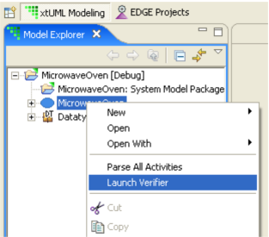
xtUML Verification Perspective
Can be launched via right-click on the model in the Model Explorer perspective
xtUML Debugging perspective will open and a Model Verifier Application configuration will appear. Select the model to launch in Verifier

Slide 5
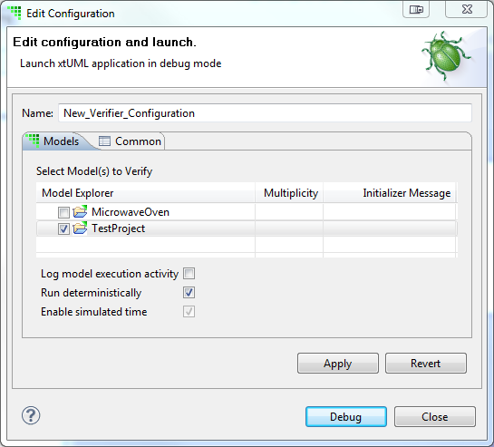
Verifier Debug Configurations
Verifier requires that at least one debug configuration be created for each model
Select a model to verify, click ‘Debug’ to start

Slide 6
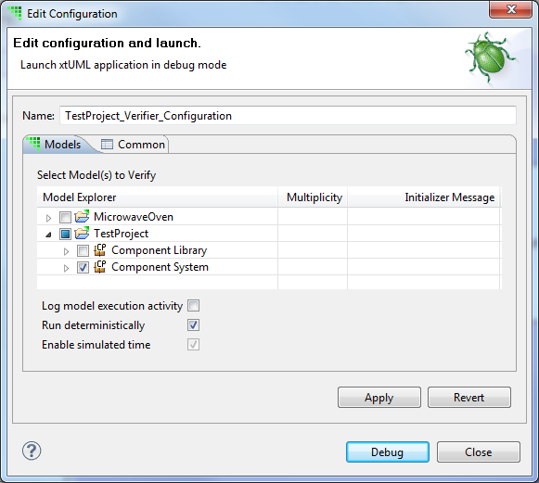
Managing Verifier Debug Configurations
Useful for selecting which components to debug in a session
At least one component must be selected to run Verifier
Notes:
A user can choose to omit a component that is not fully functional, for example.

Slide 7
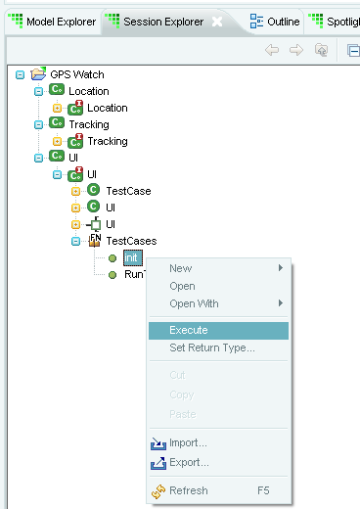
Executing Models in Verifier
Models do not run automatically, functions must be manually invoked
Functions contained in Function Packages will create instances of classes involved if state machines do not have creation transitions
Port operations and signals can also be executed via the context menu
Context menu “execute” option not available in Model Explorer window, must use Session Explorer

Slide 8
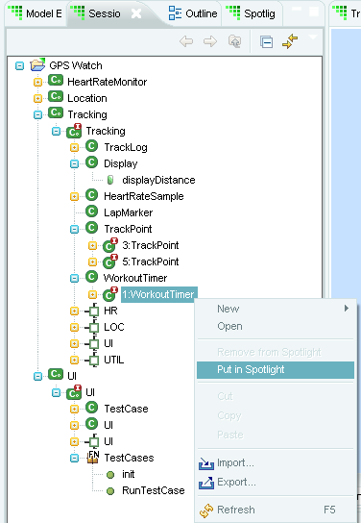
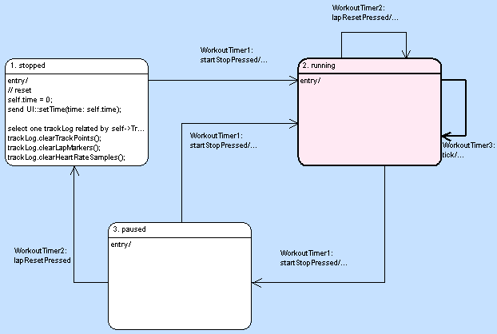
Spotlight in Verifier
Spotlight is a method of highlighting current states in state machines
Transitions that caused the state to be entered are also highlighted

Slide 9
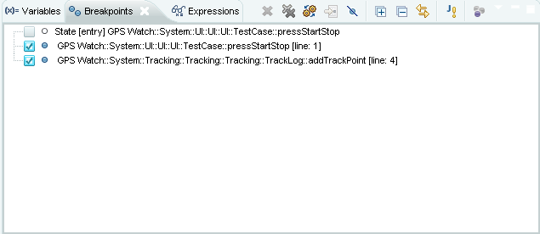
Breakpoints in Verifier
Breakpoints can be set on
  State entry and exit
  Action language statements
Properties are contextual to type of breakpoint; states or action language lines
Debug window shows that a breakpoint has been hit, and events that are queued

Slide 10
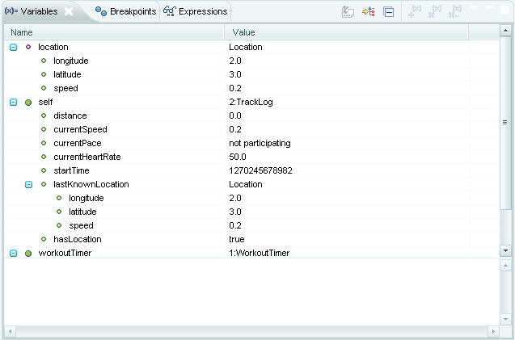
Variables window
Variables window displays:
  Transient variables
  Operations
  Parameters
  Class instances, attributes
  also displayed hierarchically
List is dynamic and
expandable

