Slide 1
xtUML and BridgePoint
Code Generation
Notes:
1

Slide 2

The xtUML method – Code Generation
Analysis – questioning, thinking, sketching...
  Descriptive UML diagrams
    use case, sequence, ...
Executable Modeling – formalizing the analysis:
  Component Diagrams (partitioning/interfaces)
  Class Diagrams (data)
  State Machines (control)
  Activities (processing)
Verification
  Interpretive Model Execution
Code generation
  Template and Rule-Based Translation

Slide 3

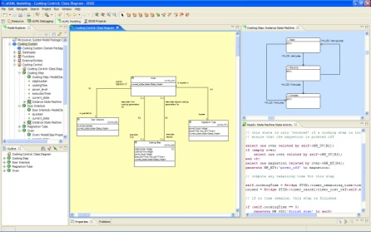
Code Generation
xtUML
Database
xtUML
Database
Translation
Rules
Translation
Rules
Model
Compiler
Model
Compiler
C Source
Code
C Source
Code
Markings
Markings
Notes:
Code generation flow, starting from model creation, through C source. The translation rules and especially the markings give users control over the result.

Slide 4
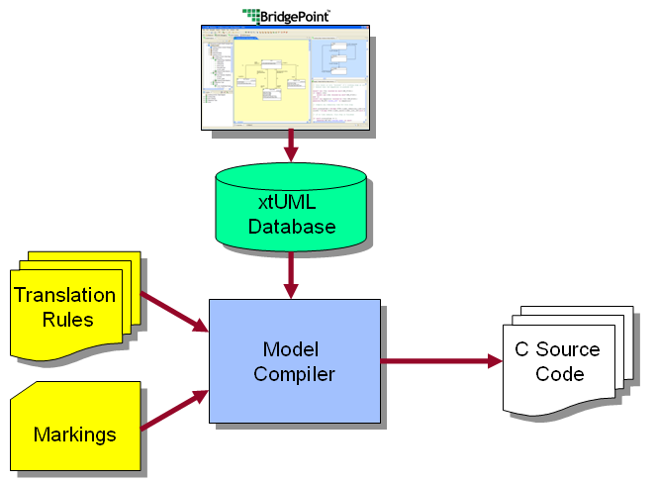
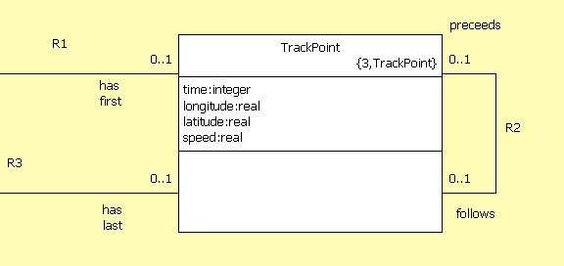
Generating Classes
Tracking:Class Diagram
Tracking_Trackpoint_class.h
struct Tracking_TrackPoint {
/* application analysis class attributes */
i_t time; /* - time */
r4_t longitude; /* - longitude */
r4_t latitude; /* - latitude */
r4_t speed; /* - speed */
/* relationship storage */
/* Note: No storage needed for TrackPoint->TrackLog[R1] */
Tracking_TrackPoint * mc_TrackPoint_R2_follows;
Tracking_TrackPoint * mc_TrackPoint_R2_preceeds;
/* Note: No storage needed for TrackPoint->TrackLog[R3] */
};
Notes:
The attributes and associations of a class map directly to data fields and pointers in the C struct.

Slide 5
Translation Rules
struct <class name>_s {
<attr1 type> <attr1 name>; /* <attr1 description> */
<attr2 type> <attr2 name>; /* <attr2 description> */
<attr3 type> <attr3 name>; /* <attr3 description> */
. . .
/* Association storage */
<ref1 class name>_s * < ref1 class name >_<assoc1 number>;
<ref2 class name>_s * < ref2 class name >_<assoc2 number>;
. . .
/* State machine current state */
StateNumber_t current_state;
};
struct Tracking_TrackPoint {
/* application analysis class attributes */
i_t time; /* - time */
r4_t longitude; /* - longitude */
r4_t latitude; /* - latitude */
r4_t speed; /* - speed */
/* relationship storage */
/* Note: No storage needed for TrackPoint->TrackLog[R1] */
Tracking_TrackPoint * mc_TrackPoint_R2_follows;
Tracking_TrackPoint * mc_TrackPoint_R2_preceeds;
/* Note: No storage needed for TrackPoint->TrackLog[R3] */
};
Notes:
Here are the rules for generation. Note that the current_state field is needed for support of class-based state machines.

Slide 6
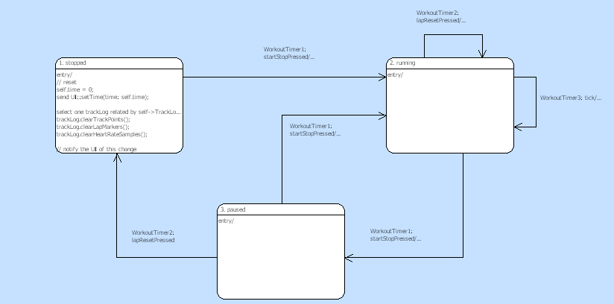
State Machine Generation
Tracking_Workout_Timer
state = instance->current_state;
next_state = Tracking_Workout_Timer_StateEventMatrix[ state ][ event_number ];
/* Update state and execute the state action */
instance->current_state = next_state;
( *Tracking_Workout_Timer_Actions[ next_state ] )( instance, eventData );
. . .
Notes:
Here we see a simple state machine, and the state logic produced by the model compiler. This code is specific to this state machine. All of the state actions and transitions are dispatched by this code.

Slide 7
Translation Rules: Event Dispatch
. . .
state = instance->current_state;
next_state = <class name>_StateEventMatrix[ state ][ event_number ];
/* Update state and execute the state action */
instance->current_state = next_state;
( *<class name>_Actions[ next_state ] )( instance, eventData );
. . .
. . .
state = instance->current_state;
next_state = Tracking_Workout_Timer_StateEventMatrix[ state ][ event_number ];
/* Update state and execute the state action */
instance->current_state = next_state;
( *Tracking_Workout_Timer_Actions[ next_state ] )( instance, eventData );
. . .
Notes:
The translation rules define the structure of the generated code. This is defined in RSL – Rule Specification Language, which defines how text substitutions are performed.

Slide 8
Generated Code structure
StateEventMatrix contains next state for each current state and input event.
Actions is an array of function pointers to the generated action code for the state itself.
One Procedure for each state machine, and they all are essentially the same – Only the class name is unique.
Next_state = <class name>_StateEventMatrix[ state ][ event_number ];
( *<class name>_Actions[ next_state ] )( instance, eventData );
Notes:
Here’s how all states can be generalized. The state event matrix indexes define the current state, and the event. This matrix is populated with constants based on the configuration of the state diagram.
The actions are dispatched in a similar manner. The state indexes the function to call – the generated OAL action code for this state.
This code is executed when the state is entered, so as a minor detail, a particular state will call the function for next_state, once this
is determined. This prevents action code for the initial state from being executed the first time through.
Example state transition matrix definion:
static const Escher_SEMcell_t Tracking_WorkoutTimer_StateEventMatrix[ 3 + 1 ][ 3 ] = {
/* row 0: uninitialized state (for creation events) */
{ EVENT_CANT_HAPPEN, EVENT_CANT_HAPPEN, EVENT_CANT_HAPPEN },
/* row 1: Tracking_WorkoutTimer_STATE_1 (stopped) */
{ Tracking_WorkoutTimer_STATE_2, EVENT_IS_IGNORED, EVENT_IS_IGNORED },
/* row 2: Tracking_WorkoutTimer_STATE_2 (running) */
{ Tracking_WorkoutTimer_STATE_3, Tracking_WorkoutTimer_STATE_2, Tracking_WorkoutTimer_STATE_2 },
/* row 3: Tracking_WorkoutTimer_STATE_3 (paused) */
{ Tracking_WorkoutTimer_STATE_2, Tracking_WorkoutTimer_STATE_1, EVENT_IS_IGNORED }
};

Slide 9
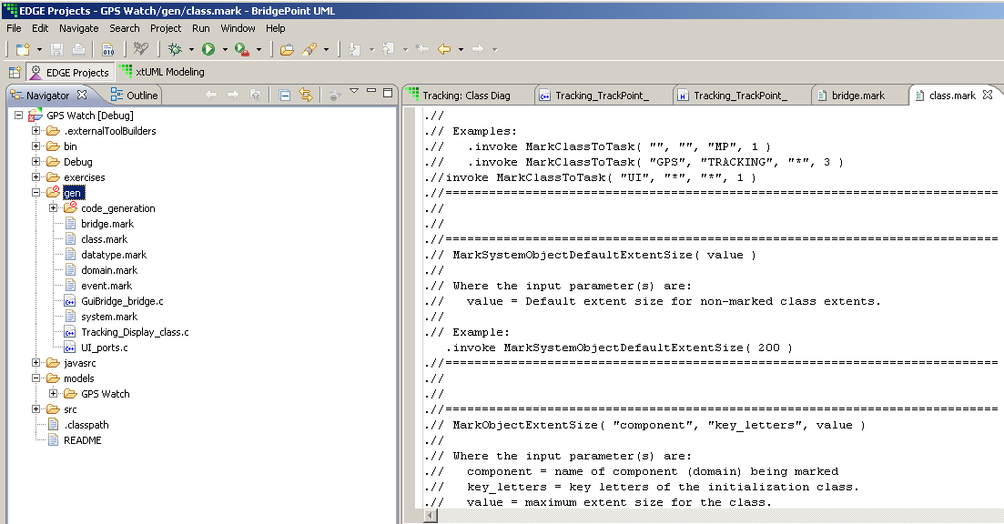
Markings
Contained in the gen folder.
.mark files control details of the code generation.
6 mark files available.
System, domain, class, event, bridge, datatype
Notes:
The marking files give additional control to the user. These files contain the various options, ready to be modified and uncommented.

Slide 10
Useful Markings
MarkActionStatementTracingOn() in domain.mark
MarkActionStatementTracingOn is used to enable the generation of trace macros into the generated code that will output run-time trace statements of the Object Action Language statements executed during the run.
MarkInitializationFunction( "comp", "fname" ) in domain.mark
Designate a function to serve as an initialization function in a domain.
TagDataTypePrecision( "domain", "dt_name", "tagged_name", "initial_value" ) in datatype.mark
To indicate the 'precision' of a user defined data type. (e.g. double)
Notes:
Some common and useful markings.

Slide 11
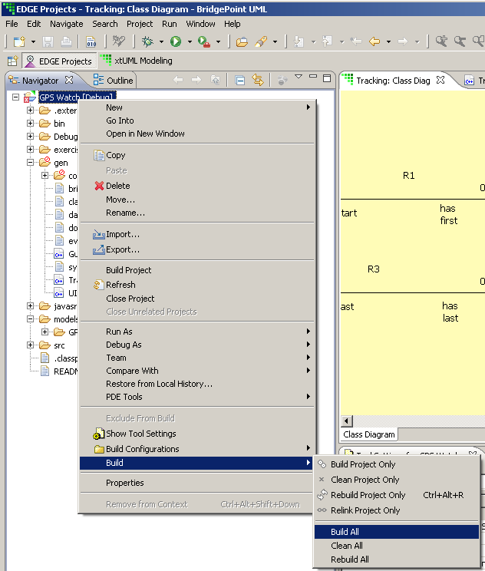
Performing Code Generation
Use the C/C++ Perspective in Eclipse and Build Project.
Batch generation:
xtumlmc_gen_erate
  -import xtUML_file
  -nopersist
  -v verbosity
  -f output_filename
Notes:
Use the gui to generate code, and also build your executable. Gen_reate is useful in scripts and makefiles to allow the user to create a fully automatic code generation flow. These are some common options, use –h to get the full syntax.

Slide 12
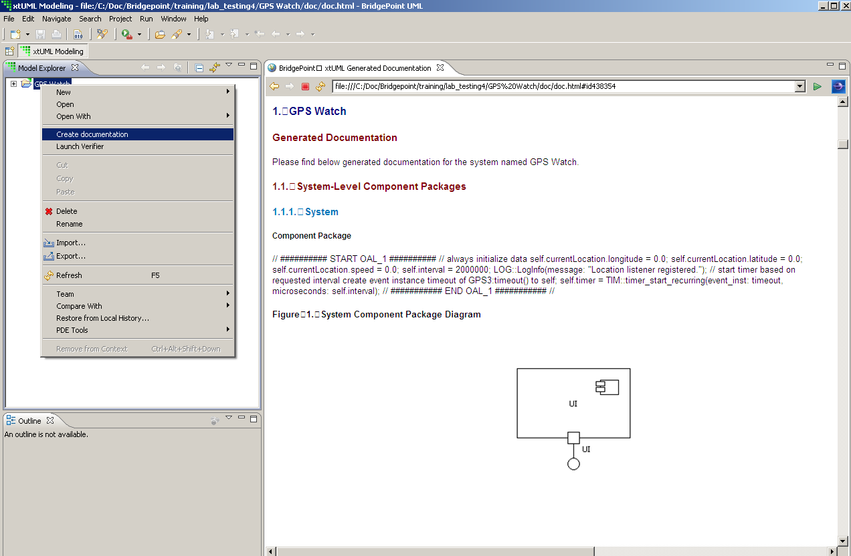
Document Generation
Generate HTML Documentation from your models.
Notes:
Documents can be generated automatically by BridgePoint.

