Slide 1
xtUML and BridgePoint
Workspace and Configuration Management
Notes:
1

Slide 2
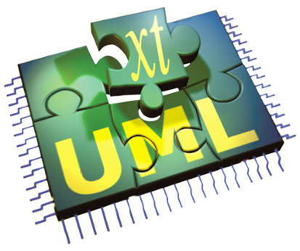
The xtUML method – Configuration Management
Analysis – questioning, thinking, sketching...
  Informal UML diagrams
    use case, sequence, ...
Modeling – formalizing the analysis:
  Component Diagrams (partitioning/interfaces)
  Class Diagrams (data)
  State Machines (control)
  Activities (processing)
Verification
  Interpretive Model Execution
Code generation
  Template and Rule-Based Translation
Relevant to all method steps

Slide 3
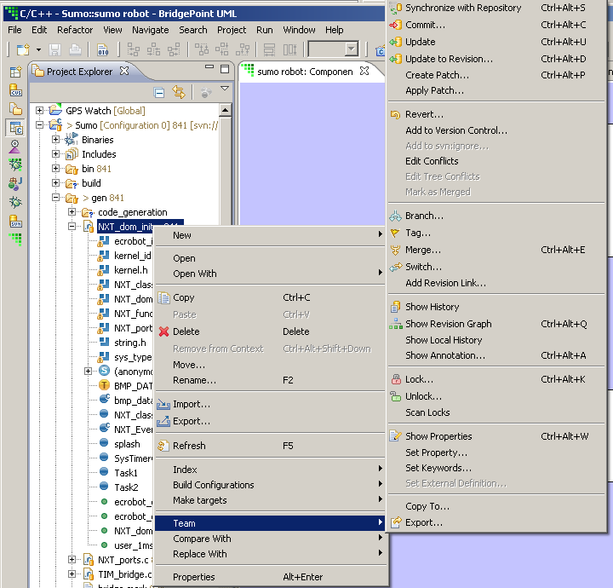
The Team Interface
Team: Eclipse’s generic Version Control interface
Team typically operates at the file level, supporting:
  Revision display and selection – directly in the Resource and Project Explorer views.
  Compare and merge – in dedicated merge editors
  Branch management – in dedicated Synchronize view

Slide 4
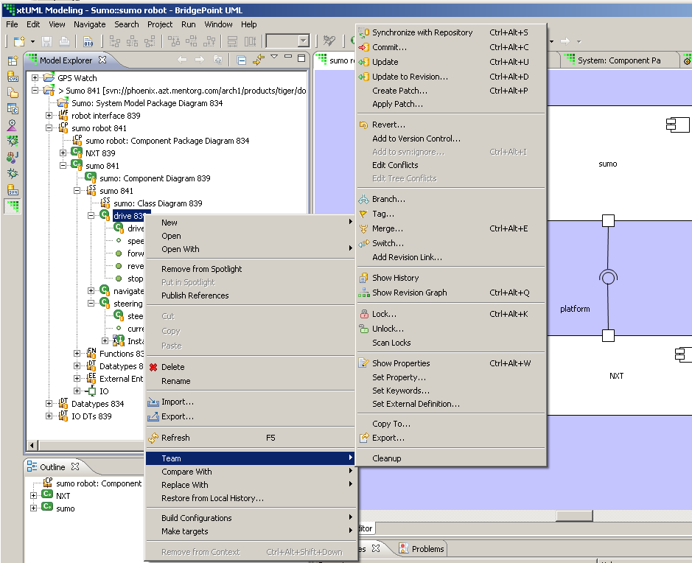
BridgePoint and Team
Bridgepoint uses the file system for model storage
Bridgepoint interfaces with Team by providing a thin layer over the file system where appropriate

Slide 5
BridgePoint and Team
BridgePoint and Team work together, operating at the model element level, supporting:
  Revision display and selection – directly in the Model Explorer view where you need it.
  Compare – in a dedicated compare editor
  Branch management – in standard Synchronize view

Slide 6
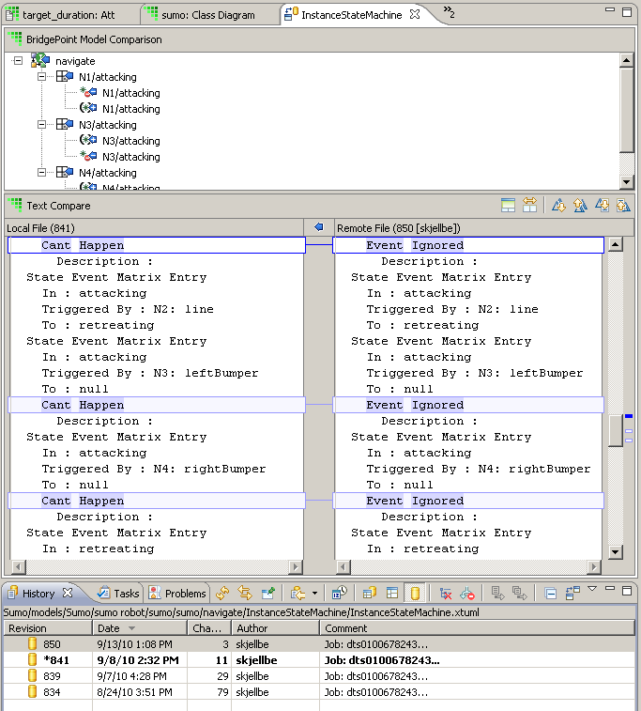
Comparing Model Revisions

Slide 7
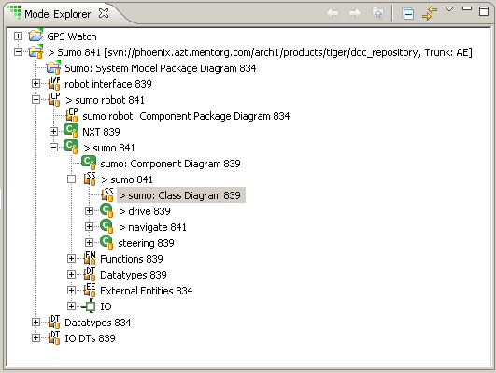
Why does the Model Explorer show an entry twice?
Allows you control over the extent of a commit
Commit here to upload changes made to the whole sumo subsystem
‘>’ highlights changed model elements
Commit here to upload changes to just the sumo subsystem diagram itself (i.e. changes to the drive and navigate classes are not up loaded)

Slide 8
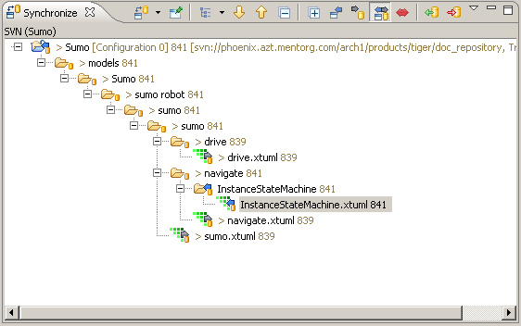
Synchronize View

Slide 9
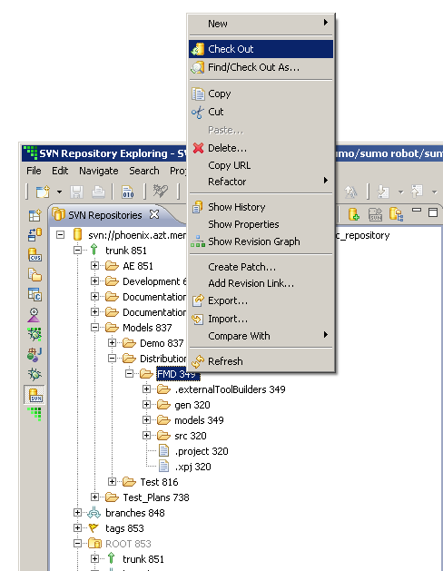
Checking out a project from Subversion

Slide 10
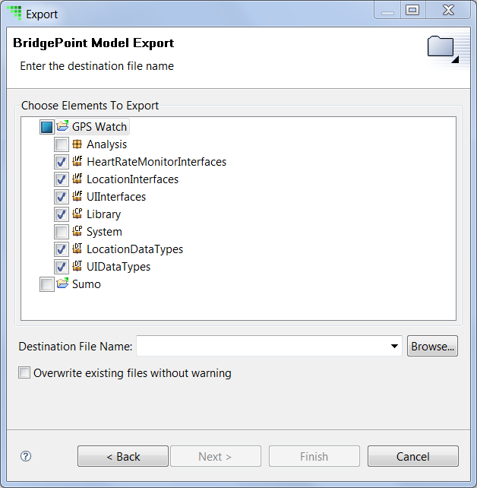
BridgePoint Model Export / Import
Exports only models – no other project artifacts
Allows portions of the model to be exported
Model are imported to existing BridgePoint projects

Slide 11
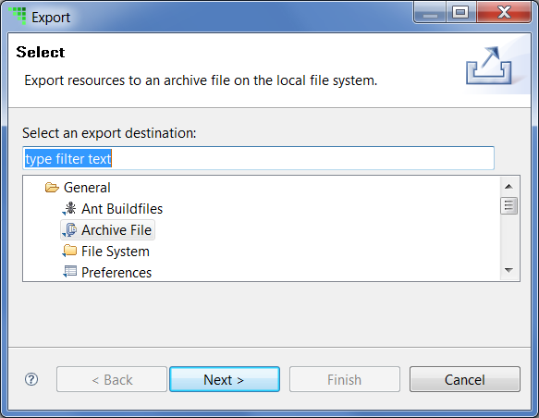
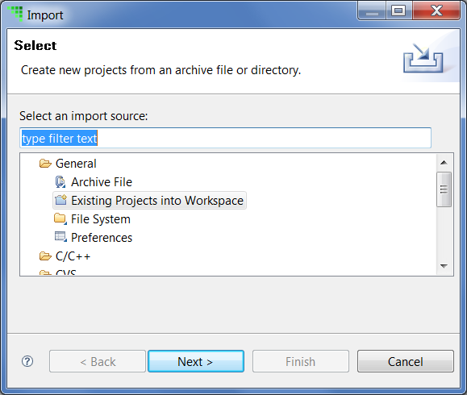
Generic Eclipse Export / Import
Exports imports entire projects with all artifacts
Non-intuitive flow:

