Slide 1
xtUML and BridgePoint
System Level Modeling
Notes:
1

Slide 2









Traditional Development Process
Customer requirements
Delivery
System
Specification
Test & Verification
Defect
Specification review
Integration & deployment
Implementation
C/C++
Java
Code review

Slide 3
Levels of Commitment
Natural language and informal diagrams
    Use case, sequence diagrams etc.
Structural models
    Interconnected components
    Interfaces
    Data types
Passive class models
    Classes
Behavioral models
    State machines
    Active ports

Slide 4

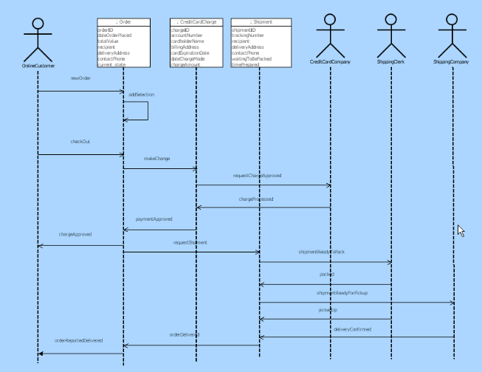
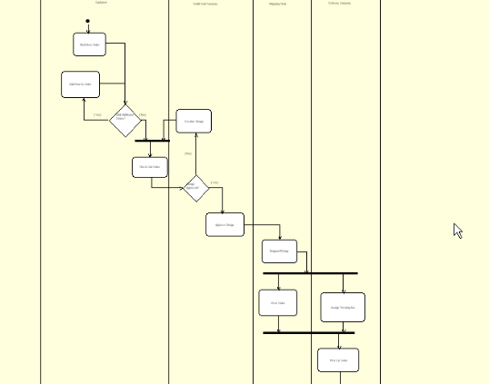
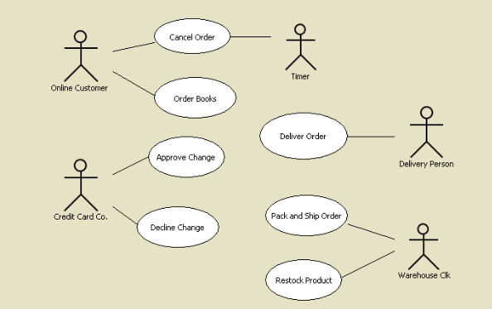
Natural Language and Informal Diagrams
Common tool environment
Well known concepts
Report generation
Sequence Diagram
Activity Diagram
Use Case Diagram

Slide 5

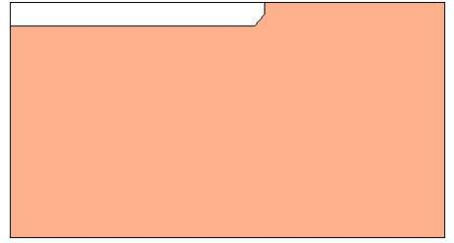
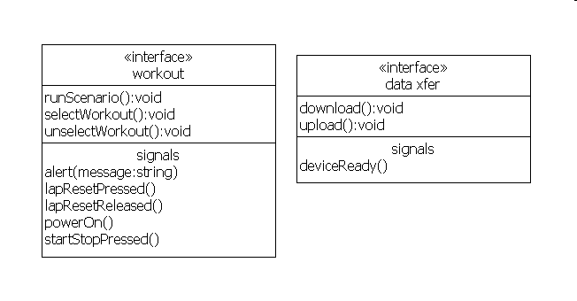
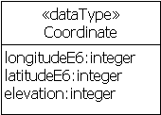
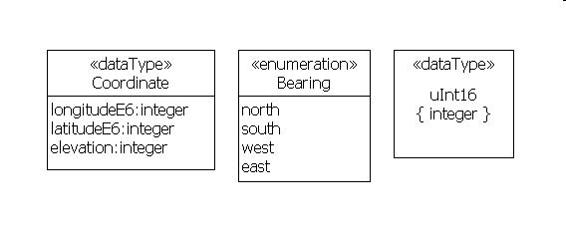
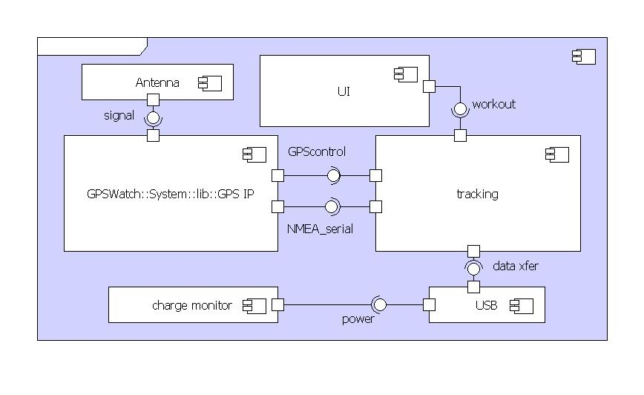
Structural Models
Interface: workout
Data type: GPS
System level interfaces declare messages that carry data
System level
data types
Component: Watch
Interfaces are provided and required by components
Data types are used in component design

Slide 6
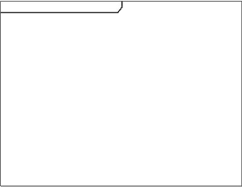
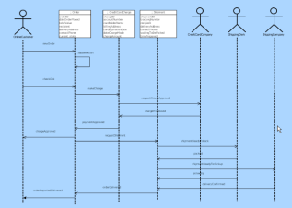



Structural Models
Work that is already being done
No inconsistencies – one source of information
Reuse of components, interfaces and data types
Model diff reveals communication changes
Allow informal models to be formalized

Slide 7
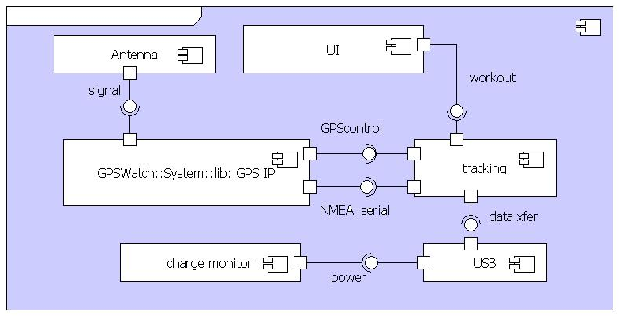

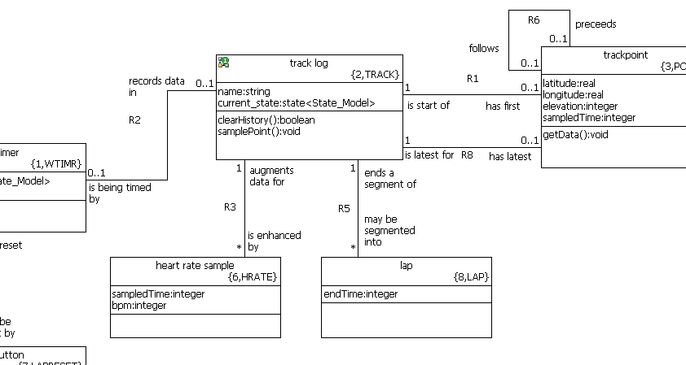
Passive Class Models
Component: Watch
Class Diagram: Tracking

Slide 8
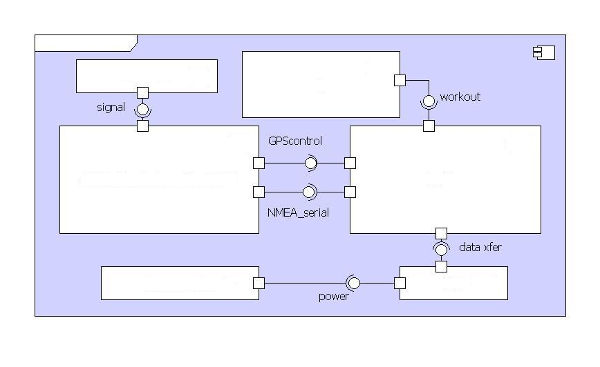
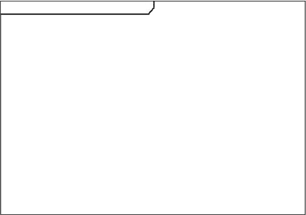

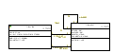

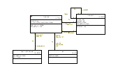

Passive Class Models
Significantly improves impact analysis
Class model reuse
Reachable with no risk and little effort

Slide 9
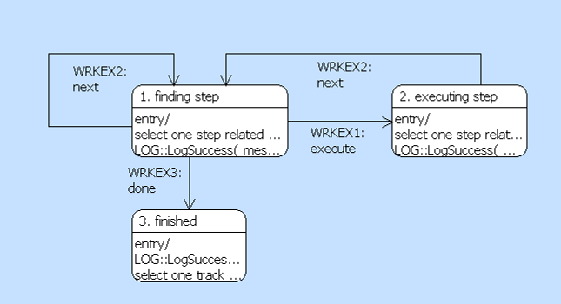

Behavioral Models
Component: Watch
Class Diagram: Tracking
State Chart: Track Log

Slide 10
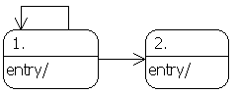
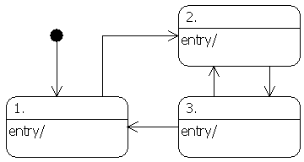
Behavioral Models
Forced to deal with the hard questions up front
Execution reveals defects early
Can be introduced in small portions
Reuse behavioral models in design phase

Slide 11
Sumo Robot Competition – Round 3

Slide 12
UML 2.0 Component Definition
A modular part of a system design that hides its implementation behind a set of external interfaces
Within a system, components satisfying the same set of interfaces may be substituted freely

Slide 13
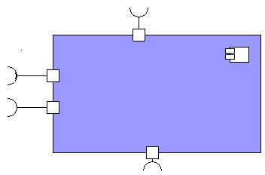
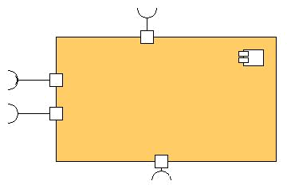
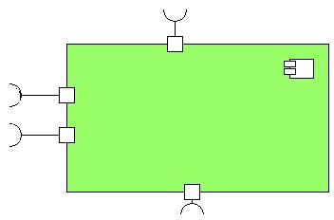
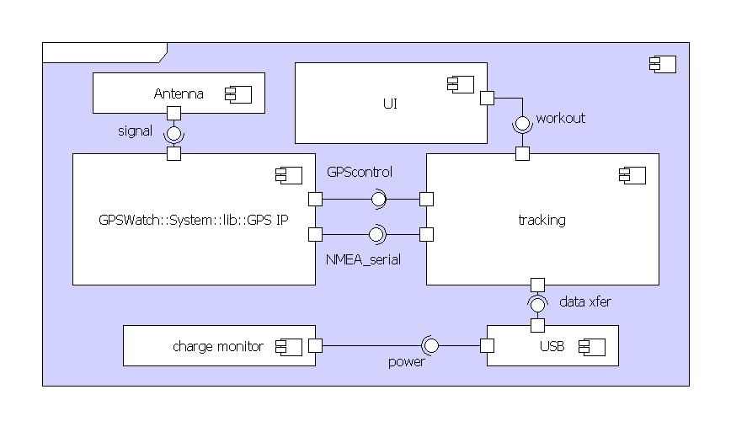
Components and Substitution
A component may be:
  Behavioral system level component
  Implementation component
  Test stub
  External code
  Others…

Slide 14
Refining the model for code generation
System spec
Implementation
Test stub

Slide 15
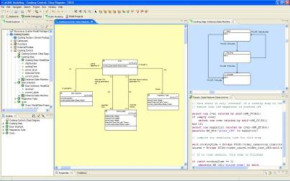
Improved Development Process
Customer requirement
Delivery
Application
Specification
Defect removal
Test & Verification
Spec. review
Integration & deployment
Implementation
C/C++
Java
Code review

Slide 16
Conclusions
Executable specs can be introduced in small increments in existing modeled or non-modeled systems
Verification takes place early when recovery is cheap
  Increase productivity and improve quality
Executable specs are unambiguous
System level models may be reused in design phase
  Minimal handover
  Bridge the gap between system and design

