Slide 1
xtUML and BridgePoint
Module 3
User Interface Concepts
Notes:
1

Slide 2
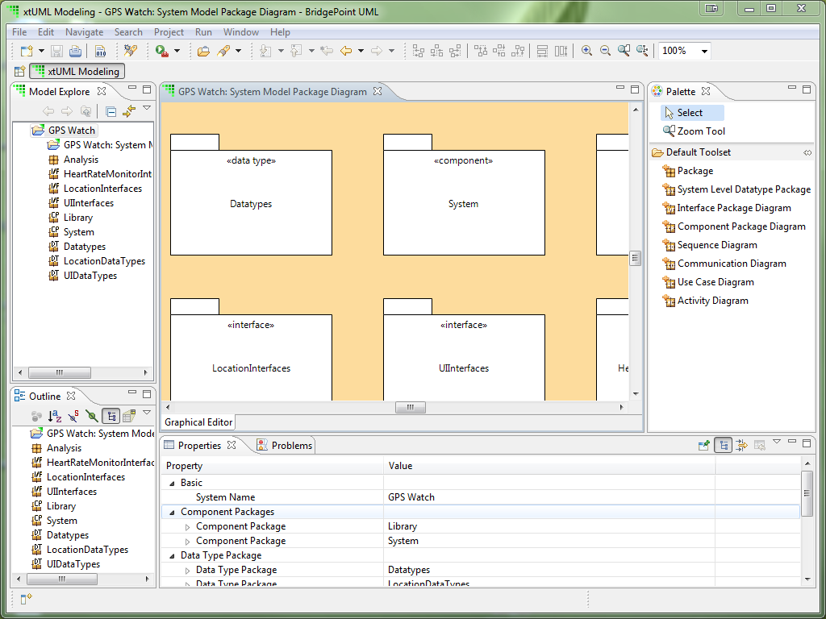
Model Structure
Structure of the model is realized in packages
Packages can contain model elements or other packages
Notes:
An xtUML model is constructed, at its top level, of packages containing different model elements. These packages define compositional boundaries and are hierarchical. The elements of one package can be accessed by an element of another—though some are global in scope and do not need to be referenced by their containing package.

Slide 3
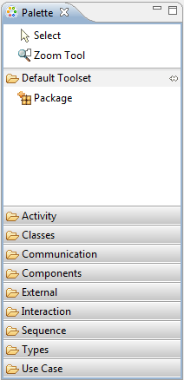
Generic Packages
Generic packages can contain any other model element.
Useful for high-level partitioning along functional divisions
Model elements are available from the palette classified by type.
Generic Package
Notes:
Generic packages can be used to partition the model within more logical boundaries as they can contain any model element. Specific packages must only contain the elements associated with them and thus cannot be used to high-level partitioning like generic packages.

Slide 4
Specialized Packages (soon to be discontinued)
Add diagrams and packages to top level of model; Components and models
Package icons look similar, have different letter abbreviations
Diagrams are intended for domain analysis only
Packages contain executable model elements
Component Package
Activity Diagram
Communication Diagram
Sequence Diagram
Use Case Diagram
Data Type Package
External Entities Package
Function Package
Subsystem Package
Notes:
Analysis Diagrams can be used at the system or component level of the design. Packages listed are used at the component/domain level of the design. This level of the design can not contain individual model elements; only packages.

Slide 5
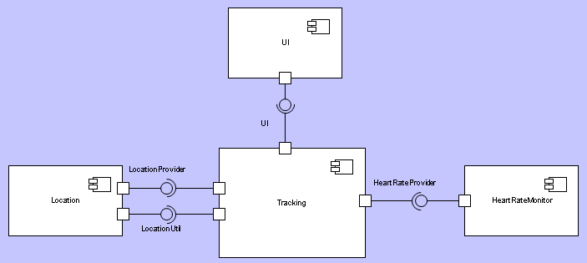
Components
Packages containing components can be subdivided with additional component diagrams if necessary
Components are connected together via Provided/Required interfaces at this level
Interfaces can also be defined in these packages
Component
Component Reference
Provided Interface
Required Interface
Notes:
The component packages contain system components, or references to system components in other component packages. Components are drawn, and then connected together via interfaces (which are, themselves, defined in interface packages). Provided and Required interfaces are connected together, and then formalized to a defined interface.

Slide 6
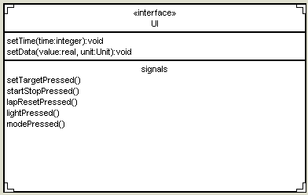
Interfaces
Interfaces must be decomposed into their Signals and Operations at this level
Can contain additional packages of interfaces for clarity and hierarchy
Interface Package
Interface
Operation
Parameter
Signal
Parameter
Notes:
Interfaces are defined in an interface package. Several interfaces can be defined in a single package, and these interfaces can then be decomposed into operations and signals, with the parameters necessary for both.

Slide 7
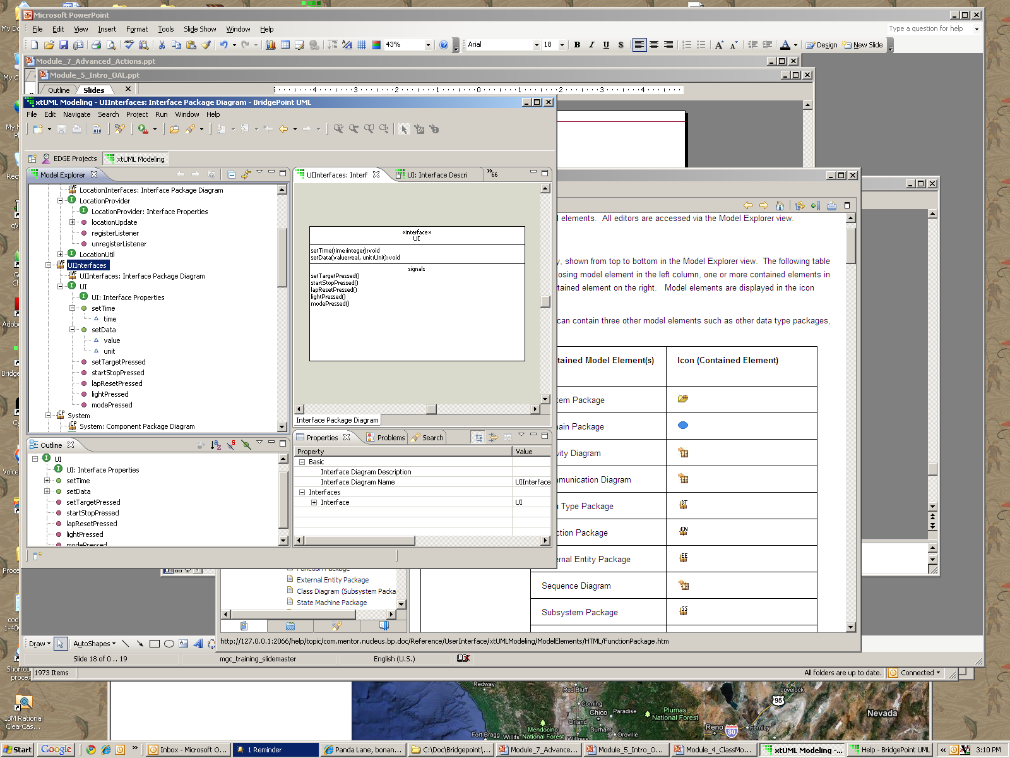
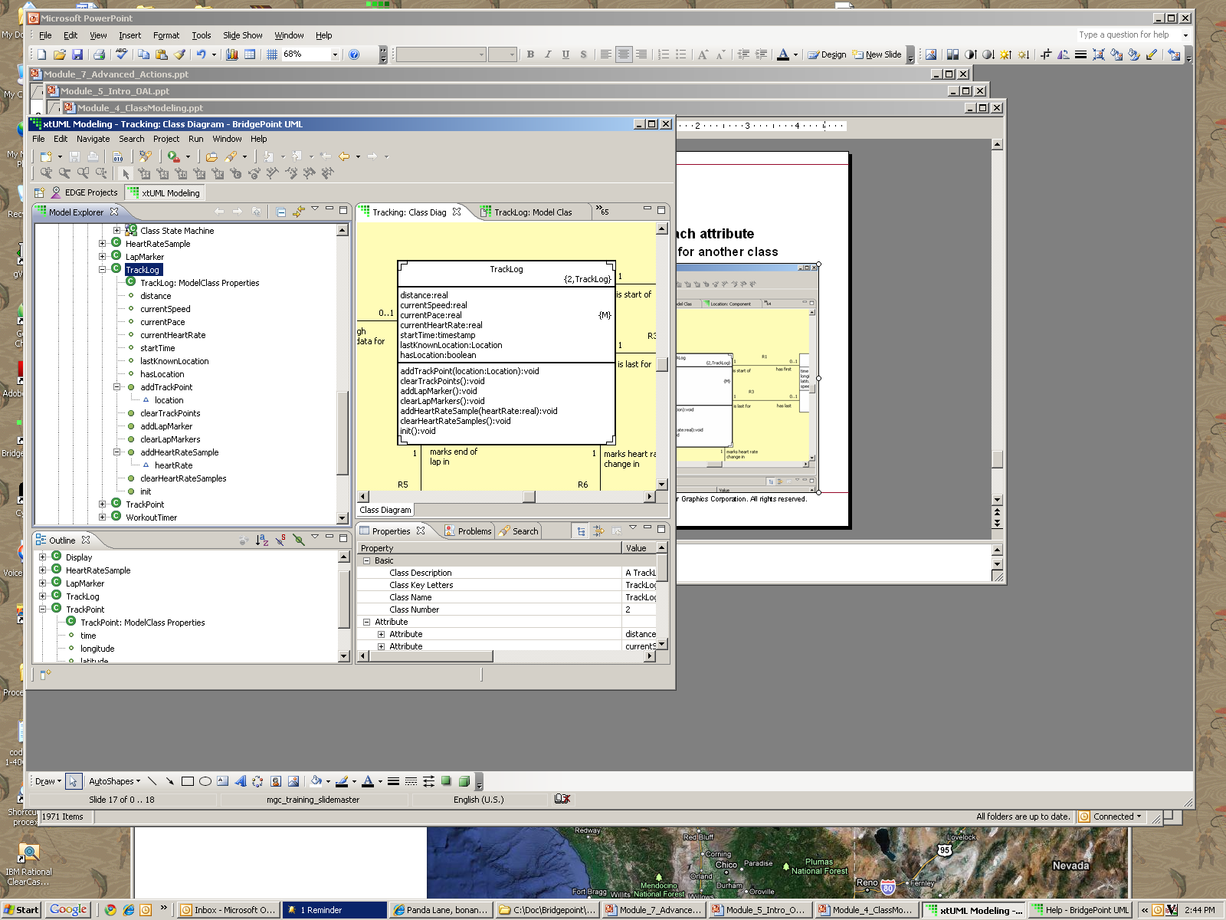
Exploring Interfaces
Use Model Explorer to analyze an Interface shows an outline view of the interface graphic
Interface
Signal
Parameter
Operation
Parameter
Notes:
Interface elements are very similar to class elements, and their similarity is reflected in the icons used.

Slide 8
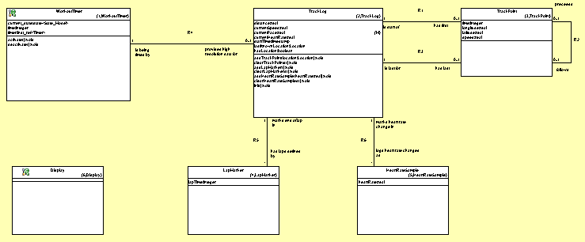
Subsystem Level
Contained within a Component or Domain package
Subsystems can be further decomposed into additional subsystem packages if needed
Class diagrams drawn and defined within a subsystem package
Class
Imported Class
Association
Associative Link
Supertype
Subtype
Notes:
Subsystem packages are where the structure of the modeled domain’s classes come together. Classes are drawn and defined with their attributes and operations, then related together using associations.

Slide 9
Exploring Classes
Use Model Explorer to analyze a class to list attributes, operations and their parameters
Class
Attribute
Operation
Parameter
Notes:
Icons identify the contents and characteristics of a class.

Slide 10
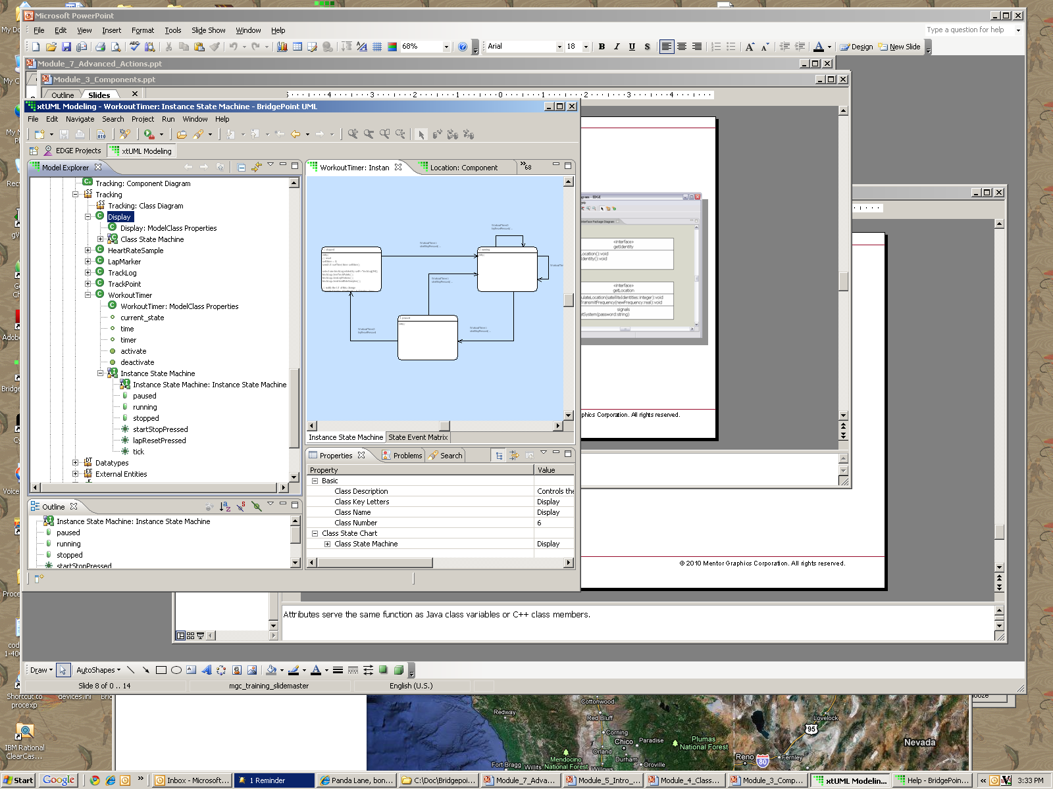
Exploring State Machines
An outline view of the state machine is visible in Model Explorer
Class
Class State Machine
State
Event
Instance State Machine
State
Event
Notes:
Two types of state machines, class and instance based. The difference is that only one class state machine will exist for all instances of a class. Instance state machines are uniquely created for each class instance. Notationally they are similar in the interface. State and events are two new objects, unique to state machines.

