Slide 1
xtUML and BridgePoint
Module 4
Analysis Modeling
Notes:
1

Slide 2
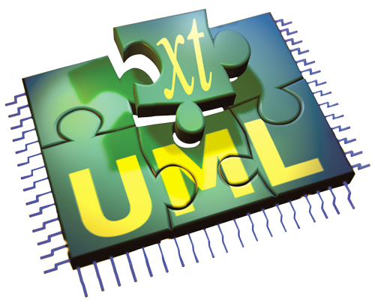

Analysis – Step 1 in the xtUML Method
Analysis – questioning, thinking, sketching...
  Descriptive UML diagrams
    use case, sequence, ...
Executable Modeling – formalizing the analysis:
  Component Diagrams (partitioning/interfaces)
  Class Diagrams (data)
  State Machines (control)
  Activities (processing)
Verification
  Interpretive Model Execution
Code generation
  Template and Rule-Based Translation
Notes:
This slide summarized the xtUML method. As we progress through the training, we will revisit this methodology slide as concepts are detailed.

Slide 3
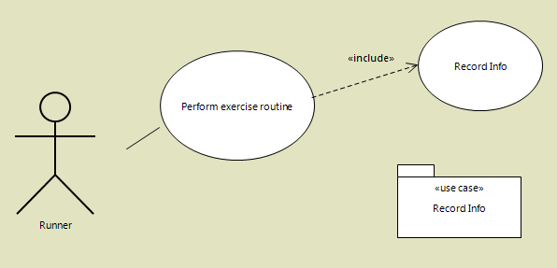
Use Cases
A use case is a description of a potential series of interactions a software module and an external agent which leads to something useful. (usage case)

Slide 4
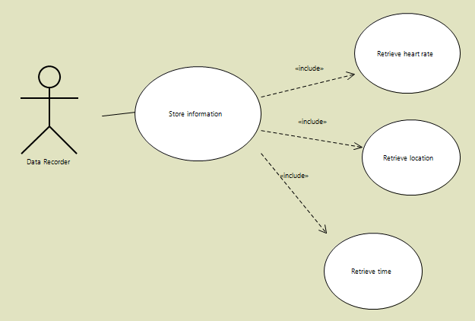
Use Case Diagramming
This use case illustrates a hierarchy of usage within a use case showing hierarchy of usage and interaction.

Slide 5
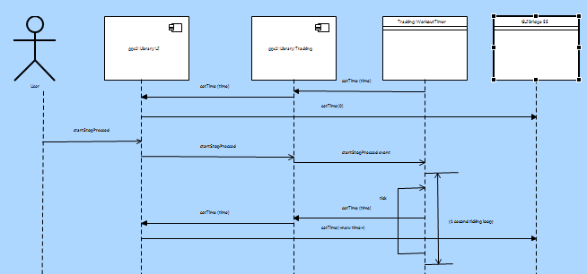
Sequence Diagrams
A sequence diagram is a type of interaction diagram that shows how processes operate with one another and in what order. Sequence is actually short for “Message Sequence”.

Slide 6
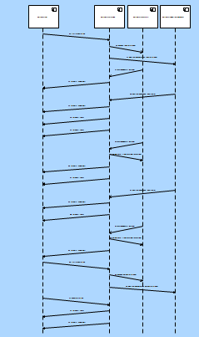
Sequence Diagrams
Sequence diagrams can show expectations or actual resulting behavior. Here is an example of a sequence chart generated from a run.

Slide 7
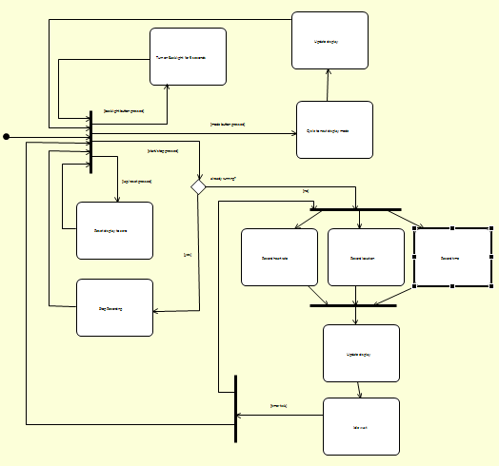
Activity Diagrams
Activity Diagrams show the flow of processing.
They can show “large” flows at a “high level”.
Or they can show the inner workings of low level state actions, transitions, operations, etc.

Slide 8
Mapping Into System Solution Model
Artifacts from analysis models supply clues to artifacts needed in the working solution.
A mapping can exist from an element or elements on an informal analysis model to the executing solution model.
This mapping is not necessarily one-to-one.
This mapping is not necessarily isomorphic.

Slide 9
Use Case Mapping
Actors → class, messages from other components
Use case → class state machine, state, cluster of states and state machines
Associations → associations on class diagram

Slide 10
Sequence Diagram Mapping
Component → component, class
Message → message, event, instance
Instance → instance, message, component
Ordering → state machine or thread of control sequence

Slide 11
Activity Diagram Mapping
Partition → class or component
Action → state action, transition action, operation, function, etc.
Action → single line of OAL
Fork/join → concurrency in state actions or messages
Events/signals → events/signals
Decision → if statement, multiple transitions
Initial node → creation state
Final node → final state

