Slide 1
xtUML and BridgePoint
Module 5
Components and Interfaces
Notes:
1

Slide 2
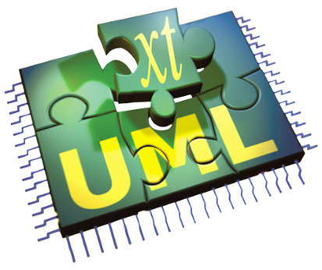
The xtUML method - Building Component Diagrams
Analysis – questioning, thinking, sketching...
  Descriptive UML diagrams
    use case, sequence, ...
Executable Modeling – formalizing the analysis:
  Component Diagrams (partitioning/interfaces)
  Class Diagrams (data)
  State Machines (control)
  Activities (processing)
Verification
  Interpretive Model Execution
Code generation
  Template and Rule-Based Translation
Notes:
Components are the ’highest level’ view of the domain that a subject-matter-expert has of the system.
The boundaries of a component can be placed wherever needed, according to the analysis.
Different users may partition systems in different manners while still modeling the entire functionality of the system.

Slide 3
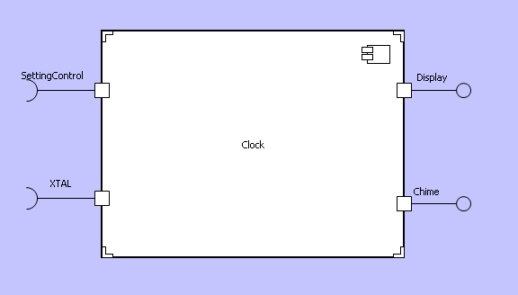
UML 2.0 Component Definition
A modular part of a system design that hides its implementation behind a set of external interfaces
Within a system, components satisfying the same set of interfaces may be substituted freely
Notes:
Components are similar to “black boxes” in system design. Their function is not visible from outside, and they must have a well defined set of interfaces at the boundary to facilitate cooperation with other components. There is no way of ‘seeing inside’ the component to access its individual model elements, all communication must be handled through those defined interfaces.
Being a “black box”, components that have the same interfaces at the boundary can be substituted for each other. This is called the “interface signature”.

Slide 4
Component Packages
Packages are a diagrammatic way to group modeling elements together and manage their hierarchy.
Components are defined in packages.
Packages can be nested.
Component packages may contain other component packages and/or interface packages.
Interfaces also are organized in packages.
This allows a level of organizational association between components and their interfaces.
Notes:
Components define structure and encapsulation, they formalize interfaces “into” the component. Interconnection between components are defined in the component package.

Slide 5
Interfaces
An interface is a declaration of a collection of synchronous and asynchronous messages
Managed separately from components
Components implement Interfaces
The separation also allows more than one component to implement (require or provide) any particular interface.
Interfaces can be resolved from a different hierarchical path in the project and reused.
Implementation can be specified at the individual component port and is unique for each component.
Notes:
Interfaces are the formal communications mechanism for components. Separating interfaces from components allows reuse and consistent implimentation.

Slide 6
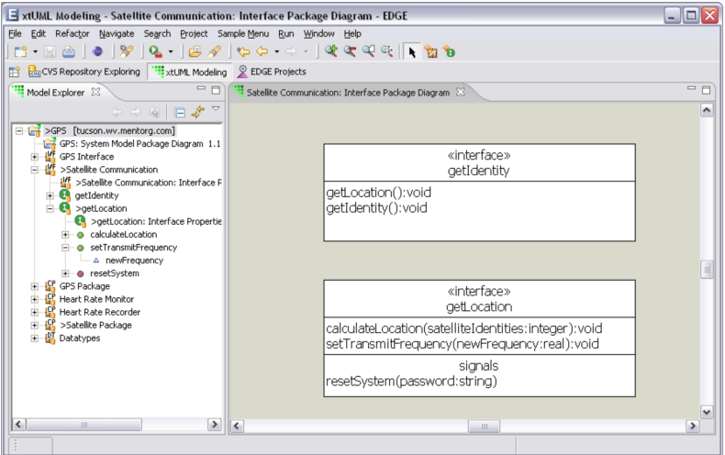
Interface Editor
Three sections in graphic
  Name
  Operations
    Synchronous message
    Operation completes before further execution
    Can carry return values
  Signals
    Asynchronous message
    Execution resumes immediately after signal sent
    No return value

Slide 7
Provided vs. Required Interfaces
Provided Interface
  “The Ball”
  Allows a component to provide services
  to other components
Required Interface
  “The Cup”
  Allows a component to demand services from another component
Ports provide a name.
  Necessary if an interface is multiply used.
Provided
Required

Slide 8
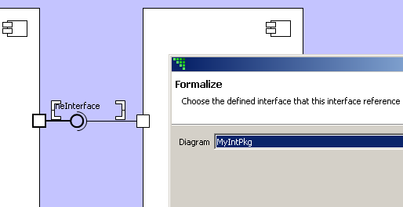
Formal Interfaces
When an interface is added it is not named or formalized.
Name interface for clarity
Formalize to interfaces declared in interface packages.
Interfaces must be
formalized to pass
messages.

Slide 9
Termination of Interface Messages
Signal (async message) between two connected components:
  Class based state machine (mapped event), or
  Receiving port
Signal sent from single component
  Sending port
Operation (sync message) between two connected components:
  Receiving port
Operation invoked from single component:
  Sending port

Slide 10
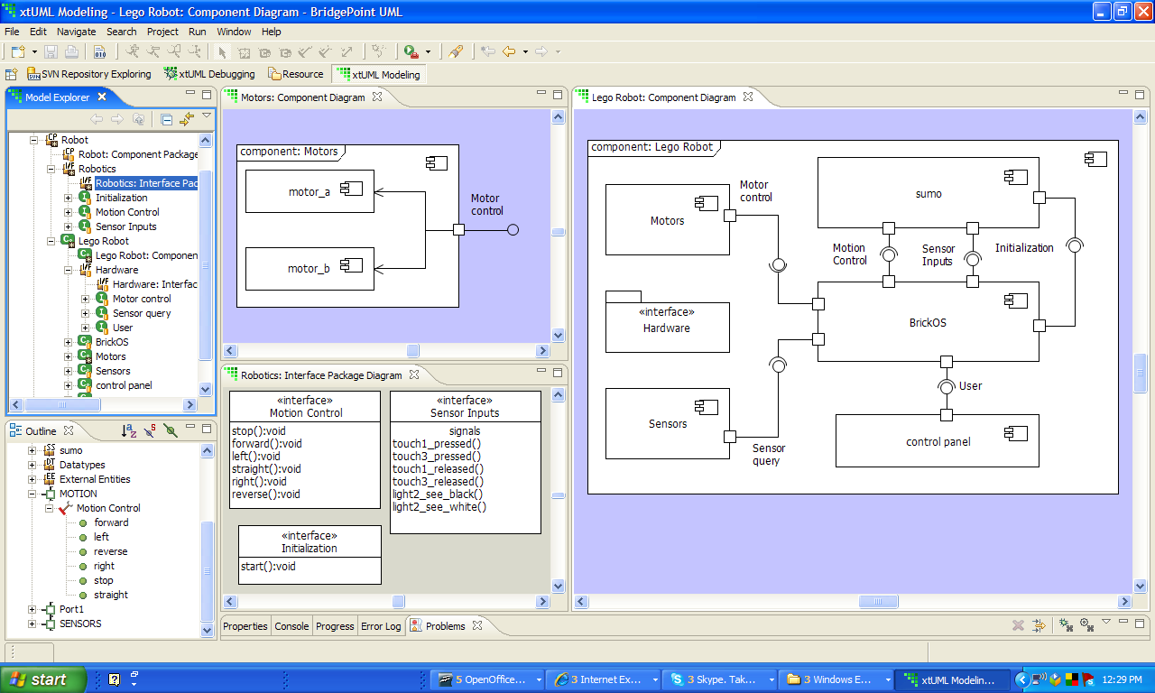
Component Views
Provided Interface
Non xtUML -Modeled
Components
Models
wired
graphically
Interfaces
on
Ports
Interface
Definition

Slide 11
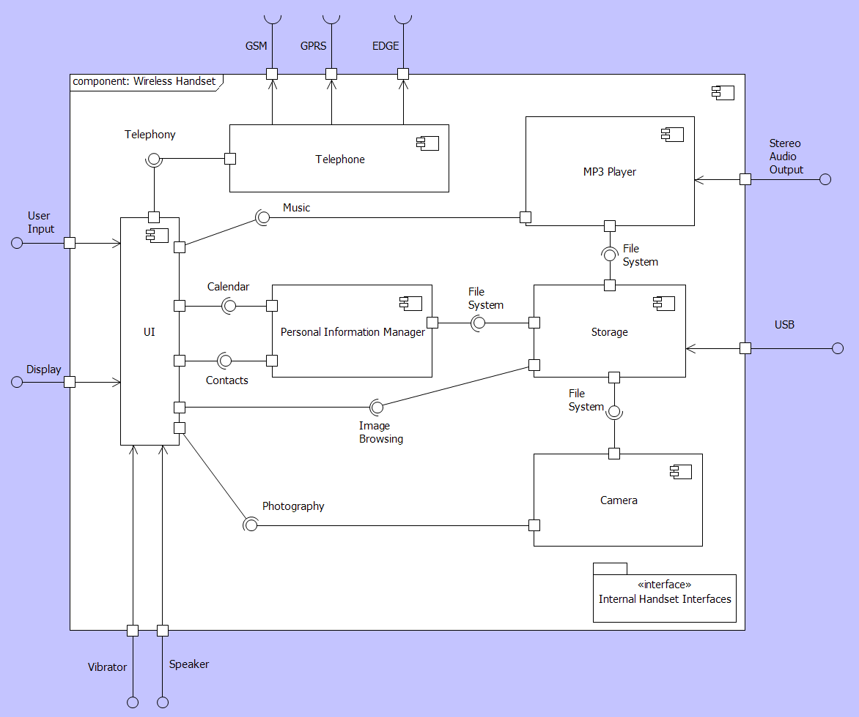
Nesting Components
Internal interfaces
Delegation
  Provided and required interfaces to Parent Component
Leaf components:
  xtUML models
    Class,
    State Machine
    Actions
  Legacy code
Notes:
Interfaces can be connected between components nested inside a top-level component, or can be assigned to the top level component.
Delegation satisfies the interface requirements by promoting a nested component’s interface to the top-level component’s boundary. Each non-leaf component can only contain other components and the interfaces between those components. No class diagrams, datatypes, or other xtUML model elements.
Leaf components can have classes, state machines, xtUML models…

Slide 12
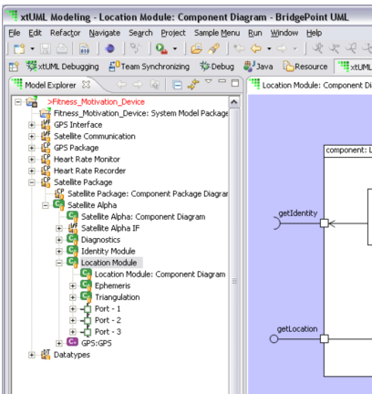
Component References (vs. Definitions)
Placeholder for a component.
Allows for multiple implementations to be swapped conveniently.
Multiple configurations with different components in Verifier.
Purple Glyph

Slide 13
Lab 1: Exercises 2, 3
Continue embellishing the model with components and interfaces to capture communication boundaries.
Notes:
Allow approximately 30 minutes for this lab.

