Slide 1
xtUML and BridgePoint
Action Language Part 2
Notes:
1

Slide 2
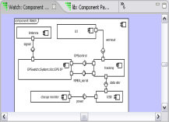
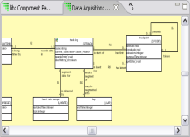
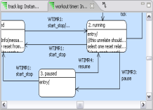
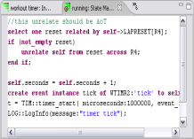
The xtUML method – Specifying Activities
Analysis – questioning, thinking, sketching...
  Descriptive UML diagrams
    use case, sequence, ...
Executable Modeling – formalizing the analysis:
  Component Diagrams (partitioning/interfaces)
  Class Diagrams (data)
  State Machines (control)
  Activities (processing)
Verification
  Interpretive Model Execution
Code generation
  Template and Rule-Based Translation

Slide 3
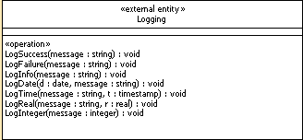
External Entities
EE’s are used for accessing functions external to the model
  ‘C’ routines in legacy code for translation
  Java methods for use in model verification
Common logging and timing functions included by default in xtUML projects in LOG:: and TIM:: packages
Notes:
Access to external routines. LOG is another package included automatically.

Slide 4
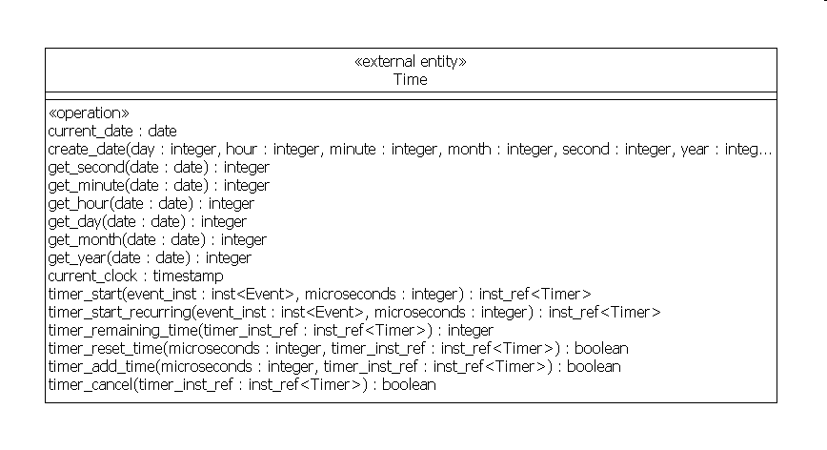
Time Package
Date and Time Access
now = TIM::current_date();
year = TIM::get_year(date:now);
month = TIM::get_month(date:now);
day = TIM::get_day(date:now);
hour = TIM::get_hour(date:now);
minute = TIM::get_minute(date:now);
second = TIM::get_second(date:now);
Timers
st = row.sampling_time;
create event instance move_on of SP1:finished_sampling() to self;
mo_timer = TIM::timer_start(microseconds:st, event_inst:move_on);
create event instance evt of WorkoutTimer3:tick() to self;
self.timer = TIM::timer_start_recurring(event_inst: evt, microseconds: 1000000);
Notes:
Access to external routines. TIME is another package included automatically.

Slide 5
Logging Package
Send test messages to the console.
now = TIM::current_date();
LOG::LogDate(d:now,message:”Current Date:”);
LOG::LogInfo(message:“Hello World!!”);
Notes:
Examples

Slide 6
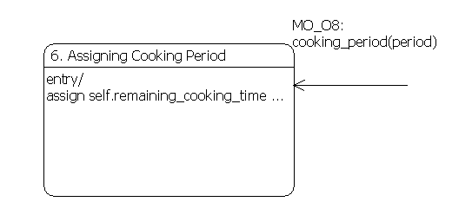
Events
generate MO_O8:cooking_period(period: 60) to oven;
Event name
Event parameters
Destination
// Receiving Event – rcvd_evt is a keyword.
assign self.remaining_cooking_time = rcvd_evt.period;
Notes:
Event instances are only used when passing events to a timer. The “create event instance” syntax is used only when creating an event to pass to a timer. Otherwise use the “generate” syntax only.

Slide 7
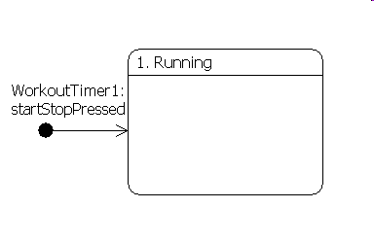
Creation events
Events can be used to create an instance of a class
  Must generate an event assigned to a Creation Transition
  This new instance has no handle name to be addressed by
// asynchronous instance creation
generate WorkoutTimer1() to WorkoutTimer creator;
Class keyletters
Notes:
Generating an event that causes a creation transition - causes an instance to be created.
No way to address the instance created since there is no handle.

Slide 8
Event Pre-creation
An event may be created without sending it by using the create event statement.
Create object instance class_inst of WorkoutTimer;
Create event instance event_inst of WorkoutTimer1:startStopPressed to class_inst ;
Event Label
Sending a Pre-Created Event.
generate event_inst ;

Slide 9
Delayed event
create event instance event of MO_O8(period: 60) to oven;
handle = TIM::timer_start(event_inst: event, microseconds: 1000000);
Notes:
TIM external entity included in every project.
“timer_start()” is used to send event with delay.
“timer_start_recurring()” does the same for recurring events.
Functions return handle for timer, use the handle to cancel the timer. Canceling timers is not recommended, however.

Slide 10
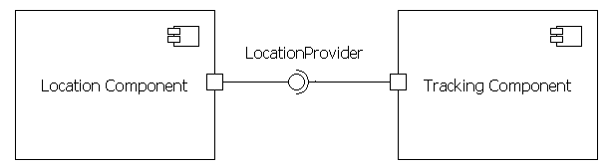
Interface messages
// asynchronous interface message – Interface signal
send LocationProvider::registerListener(interval: 1000);
Interface or port name
Signal name
Signal parameters
// synchronous interface message – Interface operation
send dist = LocationProvider::distance(from: loc1, to: loc2);
Local variable
Operation name
Notes:
Must use I/F messages to communicate across interfaces because there is no visibility into a component. Can’t select instances in another component.
Local variables must be used in synchronous messages (operations). The local variable acts as an intermediary between the components via the operation.

Slide 11
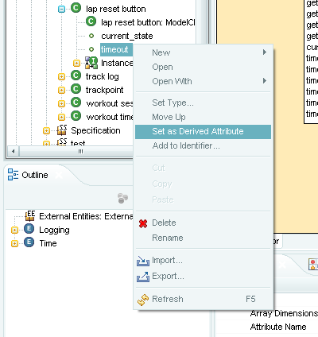
Mathematically Derived Attributes
Attributes can be computed using the full range of Action Language statements
No return statement needed
Read-only in all other places

