Slide 1
xtUML and BridgePoint
State Modeling
Notes:
1

Slide 2
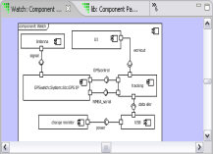
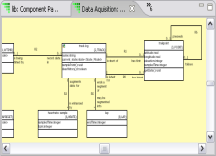
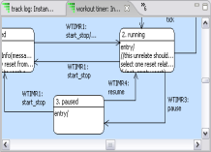
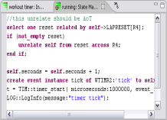
The xtUML method - Building State Machines
Analysis – questioning, thinking, sketching...
  Descriptive UML diagrams
    use case, sequence, ...
Executable Modeling – formalizing the analysis:
  Component Diagrams (partitioning/interfaces)
  Class Diagrams (data)
  State Machines (control)
  Activities (processing)
Verification
  Interpretive Model Execution
Code generation
  Template and Rule-Based Translation

Slide 3
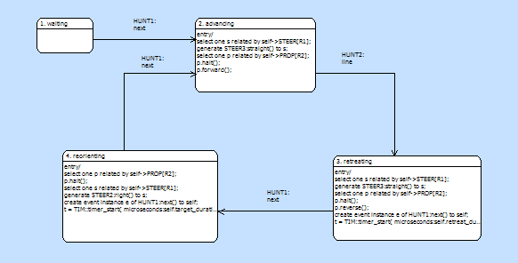
State Machines = control flow
Some classes have dynamic behavior; they progress through stages during their lifetime.
The collection of stages and the order of progression constitutes the lifecycle, represented as a state machine.
Notes:
State machines handle the sequencing of the system over time.

Slide 4
State Machines
Each existing instance of a class is in exactly one state of its lifecycle at any instant.
Transitions between states are driven by received signals, called events.
Events arise from incidents in the real world appearing as signals on component interfaces.
Internally, state machines may generate new events to propagate change to other state machines.
Internally generated events may be delayed by timers.

Slide 5
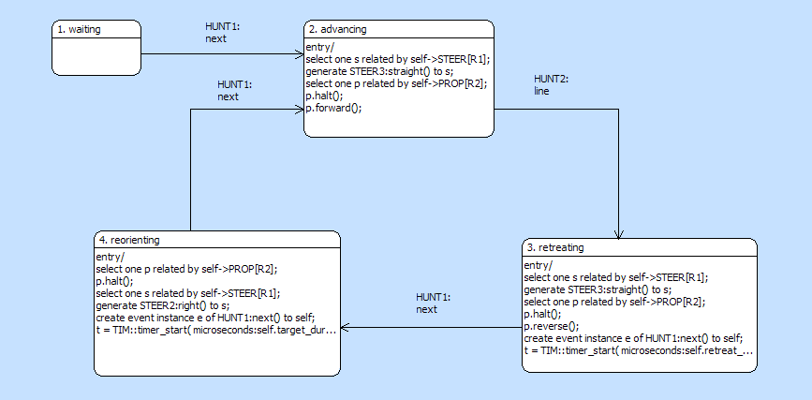
State Machine Diagram Elements
State
Assigned Event
Transition
Activity
Notes:
Activities are executed when in states or transitions.
Each state machine is an instance of the containing class and runs concurrently and independently of other state machines.
The SM remains in a state until an event is received, and only if that state expects a certain transaction to occur on that received event.
Each transitioning event advances only one state per event fire.

Slide 6
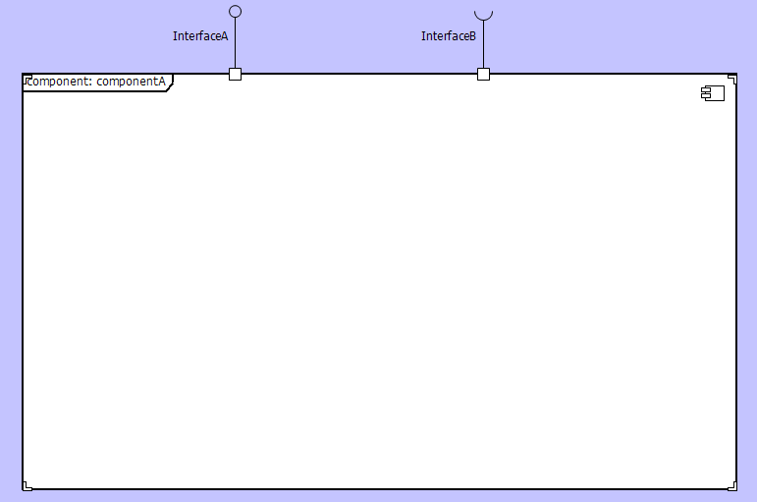
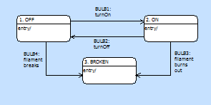
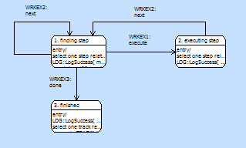

Event Sources
Timer
Notes:
Events can be delayed via timers.
States can send events to themselves.
Events are always addressed to a specific target; not globally broadcast.

Slide 7
Timers
A timer allows a pre-created event to be delivered at some future time
The event is placed in the event queue when the timer expires
One shot or recurring
Delayed events define minimum delay
Notes:
Events are always created as if they were to be sent immediately. They are then given to the timer for delivery.
Timers are not exact. Consider the relative accuracy of the target when designing timers.

Slide 8
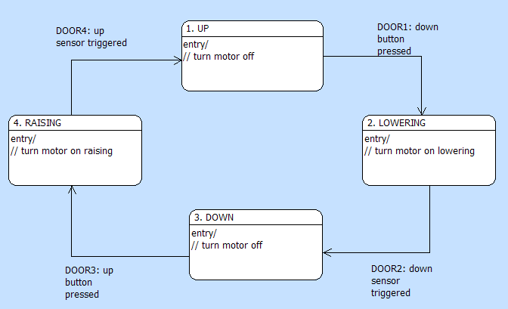
Checking for Completeness
An automatic garage door: Two Buttons and Position Sensors
Notes:
Typical state machine diagram allows for easy understanding and can be a quick check to see if there are any missing states.

Slide 9
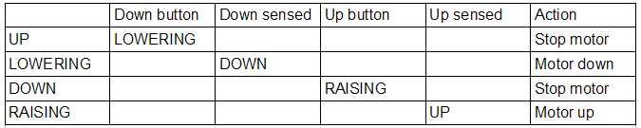
Filling the State Event Matrix
Events
Entry Action
States
What do the empty cells mean?
Notes:
There are two views available for each state machine: the graphical editor, and the state event matrix.
The State Event Matrix is more useful than the diagram view to discover if the SM is complete.

Slide 10
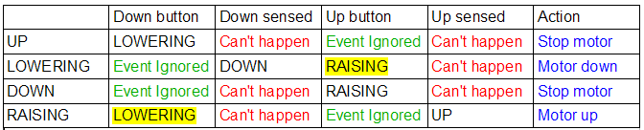
Filling the State Event Matrix (cont)
Notes:
“Can’t happen” is used when there is no expectation of reasonable recovery from a certain state when a certain event occurs—an error occurs when executing this pair.
State-Event pairs that do not cause a transition automatically default to a “Can’t happen”. “Event ignored” will not allow a transition, but will not generate an error during execution.

Slide 11
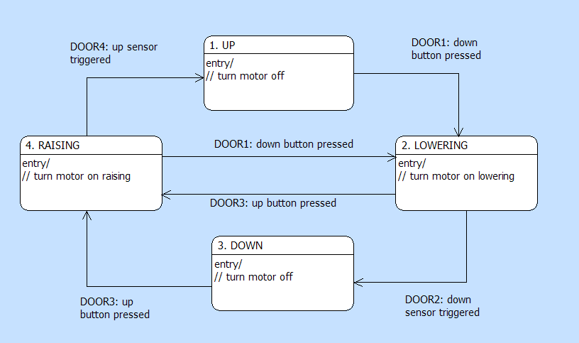
Completed Diagram

Slide 12
Initial and Final States
When an instance of a class is synchronously created, it is placed in its initial state
  It has not 'transitioned' into that state – so the 'entry' state action is not executed
  An event assigned to a 'reflexive' transition can trigger execution of the action
  The initial state is the lowest numbered state
A state machine may have one or more states with no outgoing transitions
  Obviously, when such a state is entered, the lifecycle can never proceed further
  The state can be marked as 'final'; after completing the state action, the instance will delete itself.

Slide 13
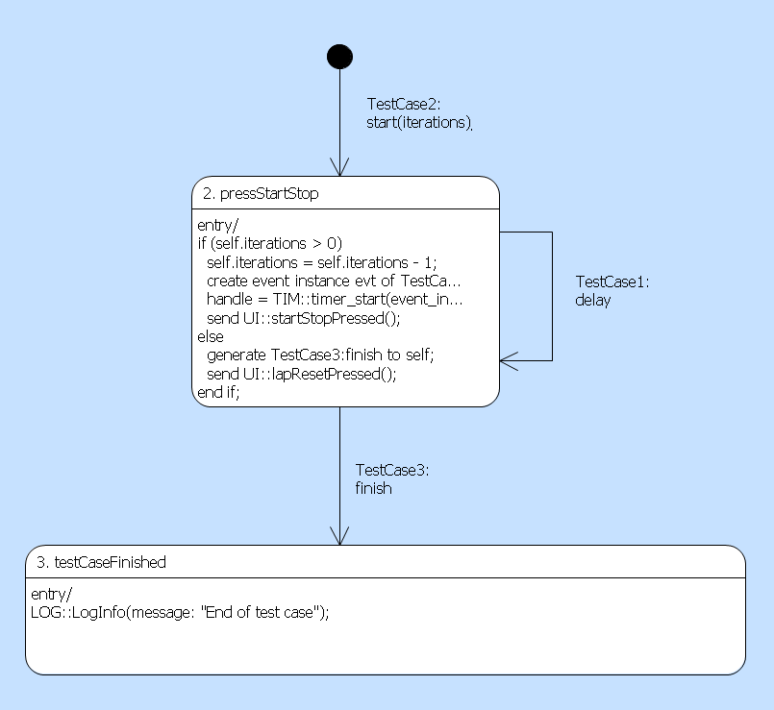
Creation Transition
It is possible to create instances asynchronously.
New instance is created by the architecture and the event is enqueued to it
Target state entry action is executed and event data is available to it.
generate TestCase:start(iterations:5) to TestCase class;
This state is ‘final’

Slide 14
Common State Machine Patterns
One shot
  Manage an action that takes time to complete
  No record of action is required (Born and Die)
  Record of action is required (Born and Quiescent)
Cyclic
  Reusable resource such as equipment, link etc.
  Usually returns to an ‘Idle’ state
Managing Contention for resources
  Can be modeled using a singleton class or as a Class State Machine
  Class State Machine can co-exist with an Instance State Machine if required

Slide 15
Constructing State Machines
Draw and name the states you know.
Write a comment: what does this state mean?
Draw the transitions you know, into or out of each state.
Do incomplete transitions suggest missing states?
Define and name the known events.
Assign an event to each transition; any missing events?
Do events need to carry event data?
Check for completeness; add discovered states/transitions.

Slide 16
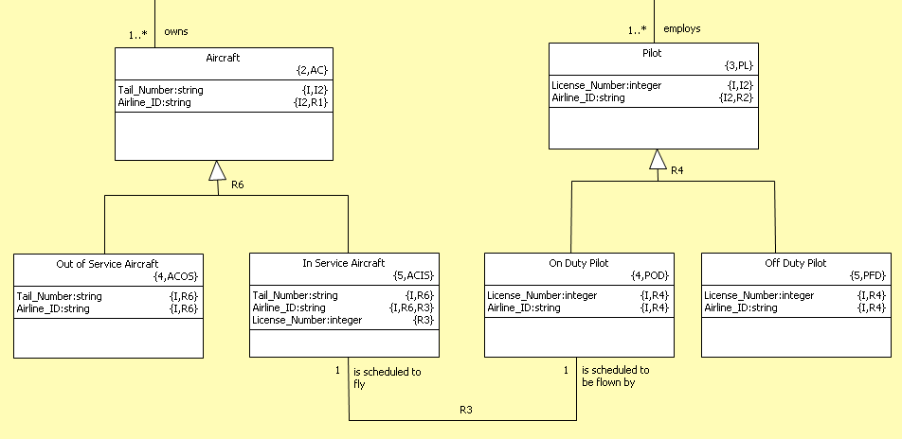
Remember this?

Slide 17
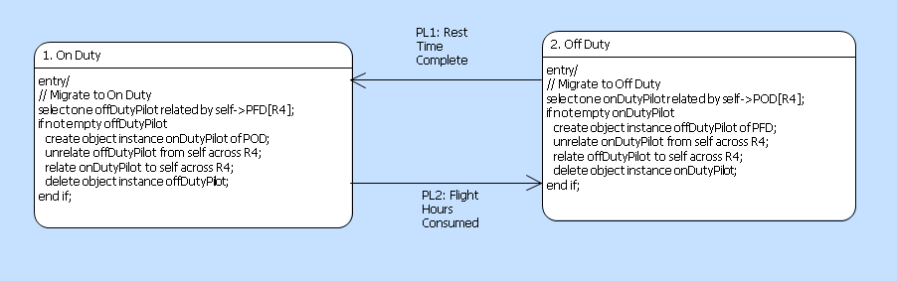
Where Data and State Modeling meet
This is the state model for Pilot (PL).
Note the creation of a new subtype to reflect the change of state
(and the destruction of the old subtype).
This technique is known as ‘Type Migration’.

Slide 18
Descriptions for Everything
State Machines
  Describe the scenarios the state machine is required to support
  Before beginning to identify states and events
States
  Describe the state in which the instance is found
  Before beginning to identify transitions
Events
  Describe the real world occurrence that the events abstract
  Before beginning to assign to transitions
You know it makes sense

