Slide 1
Network 0.1 Case Study
How to Model an Embedded Network Domain
Leon Starr
Model Integration, LLC.
Notes:
ABSTRACT #2
How to Model an Embedded Network Domain (Case Study #2)
Presenter: Leon Starr (1 hour)
Most published case studies demonstrate xtUML modeling principles on physical application domains such as elevators, microwave ovens, airports and so forth. But on a real project, the bulk of the analysis and modeling effort is directed toward an intermediate layer of abstract services where specifications, policies, and just plain weird stuff predominates. In practice, the requisite abstractions run the gamut from uselessly generic to rigidly unreusable and project specific. This case study explores the right balance and the analysis techniques required to yield a pragmatic yet powerfully reusable solution. Bridging and the use of specifications to maximize reconfigurability will be examined. And on top of all that, a network layer that can be reconfigured to handle different protocols will be demonstrated.

Slide 2
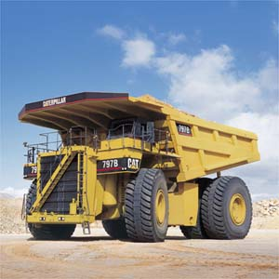
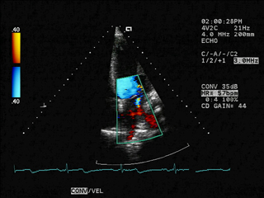
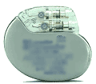

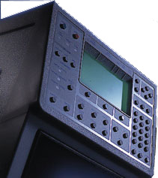

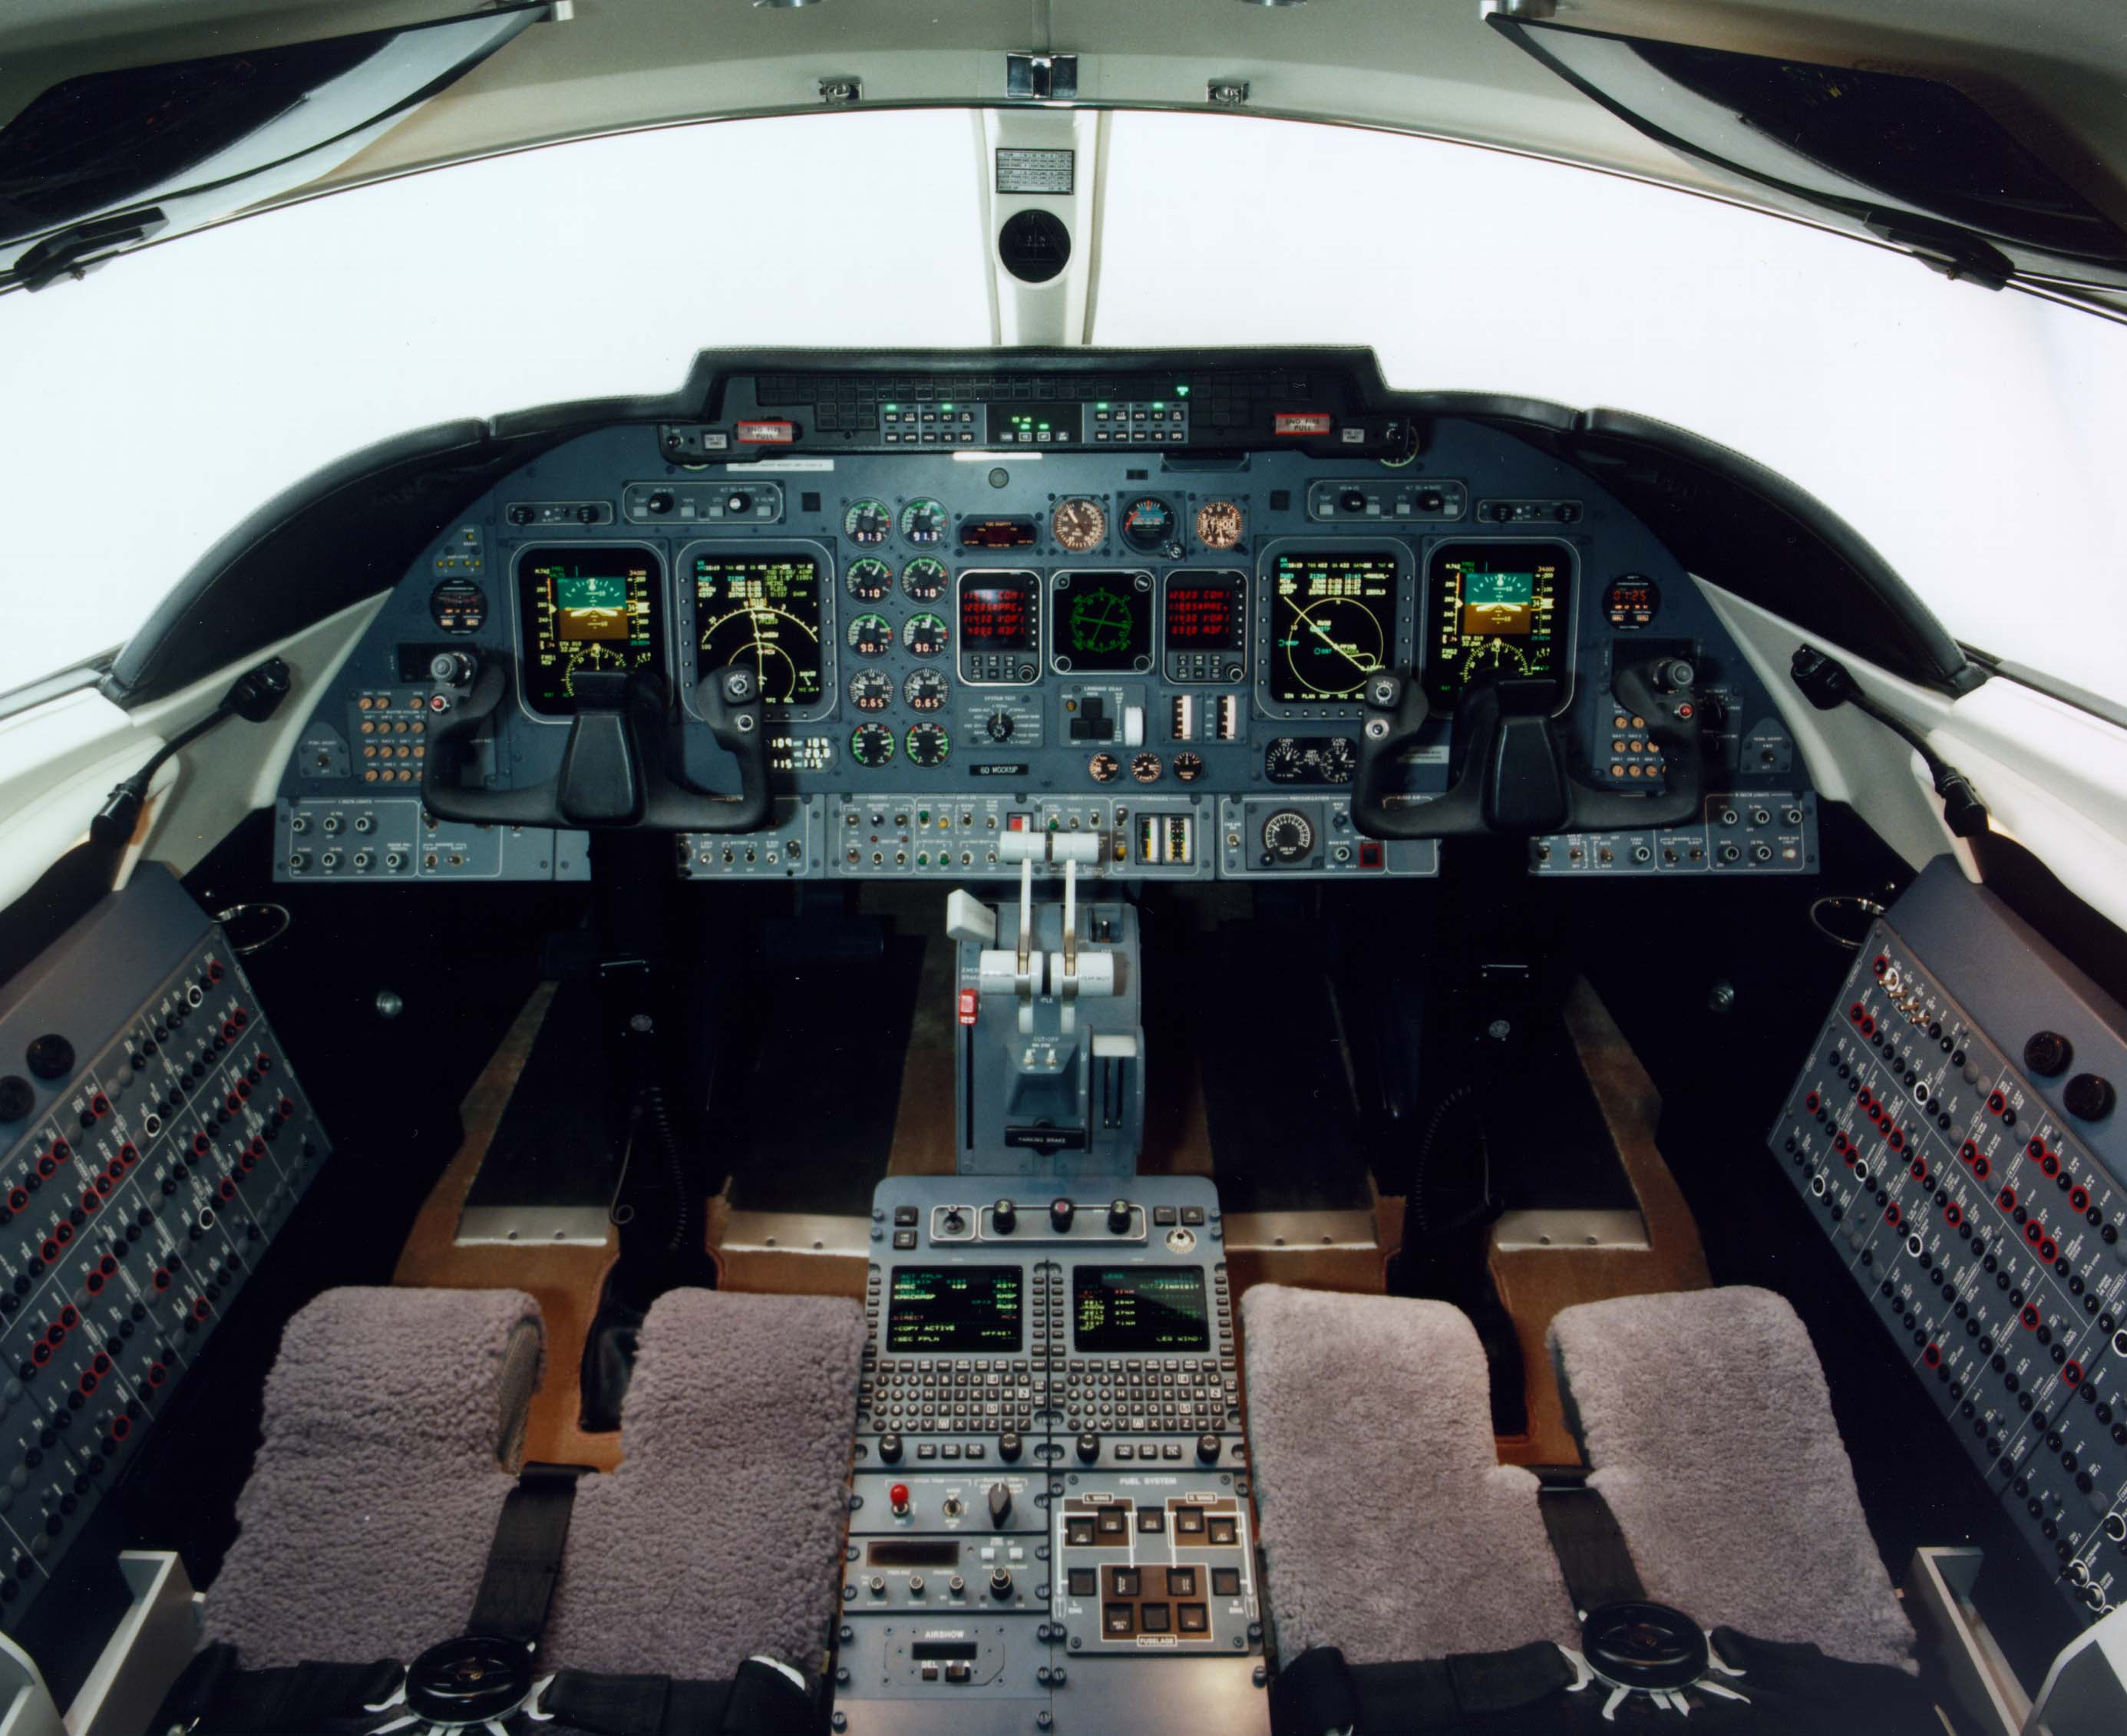
The same problem over and over
Vehicles
Medical
Avionics
Measurement

Slide 3
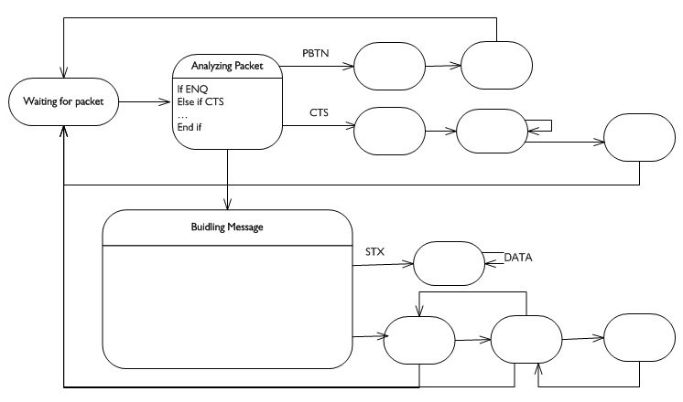
Protocol State Charts

Slide 4

Problems with explicit protocol models
Easy and intuitive to build
Easy to explain to net experts
Lots of model content
cut and paste, drag and draw
Works for only one protocol
Changes require recompilation and testing
Generates lots of code
Requires endless testing
Not object oriented

Slide 5
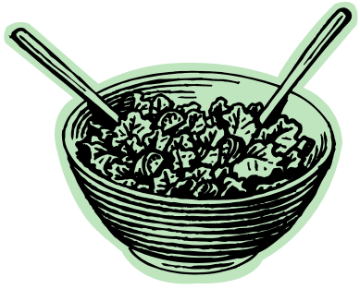
Protocol proliferation
Industry Standard Protocols
Proprietary Protocols
CAN
TCP/IP
<company acronym>_LINK
J1939
ARINC 739-A
App-hardware specific
DICOM
Mixed domain
Organic
Tunneling / Transition / Legacy

Slide 6
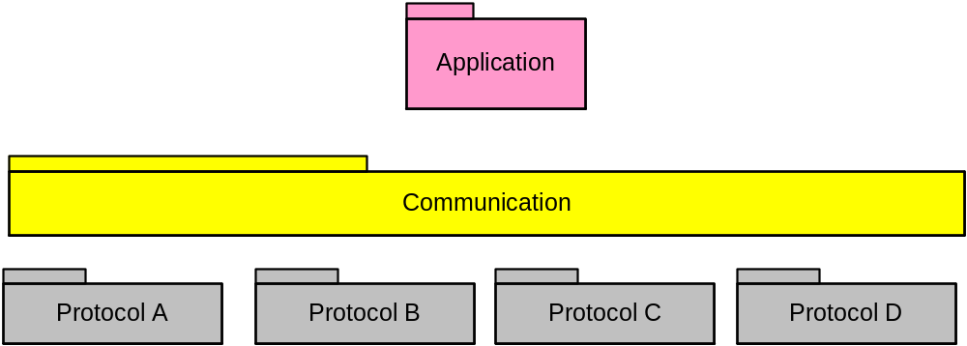
How to simplify?

Slide 7
Step 1 – Study

Slide 8
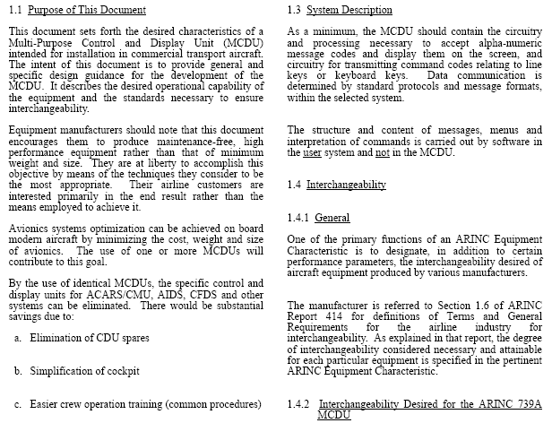
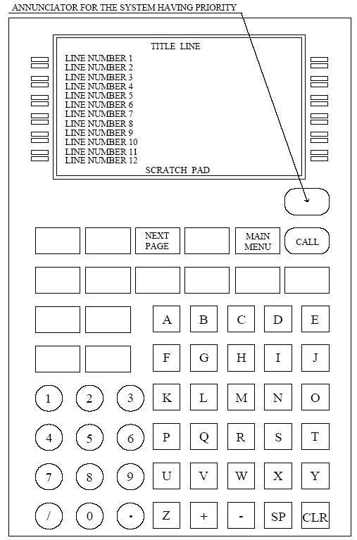
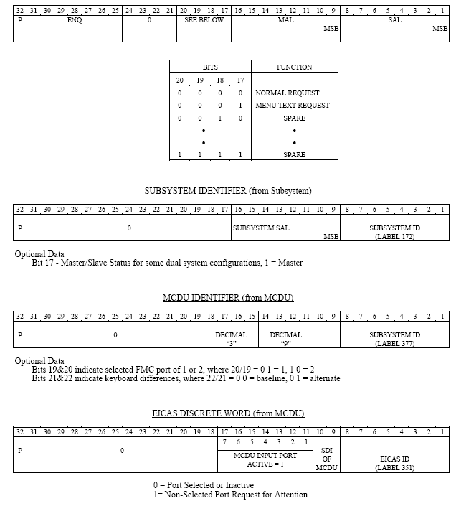
Read the spec
ARINC 739A-1

Slide 9
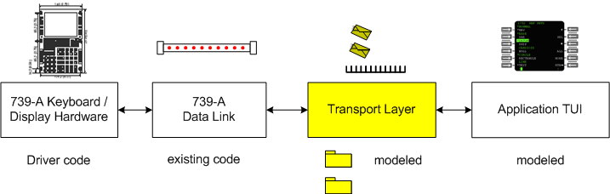
Network <-> Model Translator

Slide 10
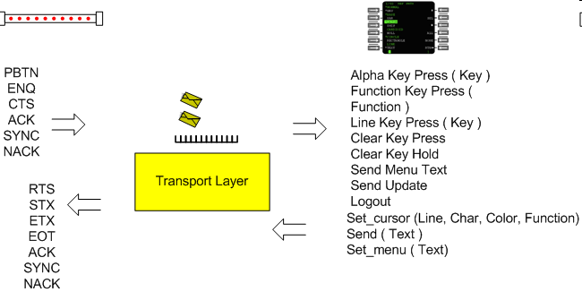
Transport interactions

Slide 11
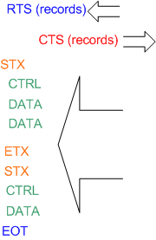
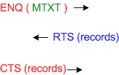
Finite set of normal interactions
Pattern 1: Send data to display on the CRT
Pattern 2: Initiate communication

Slide 12
Step 2: Domain chart

Slide 13
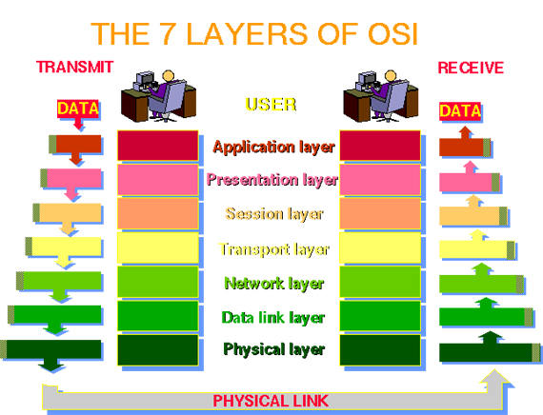
Network layers (or domains?)

Slide 14
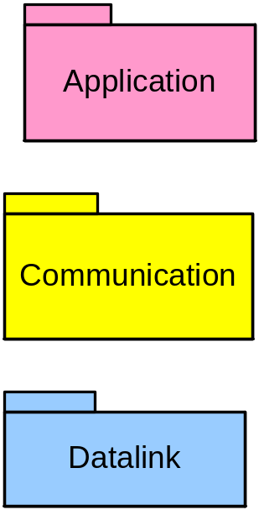
Will this work?

Slide 15
Step 3 – Model something

Slide 16
The abstraction goal
No protocol specific command or field names in any model element (class, attribute, relationship, state, action language)

Slide 17
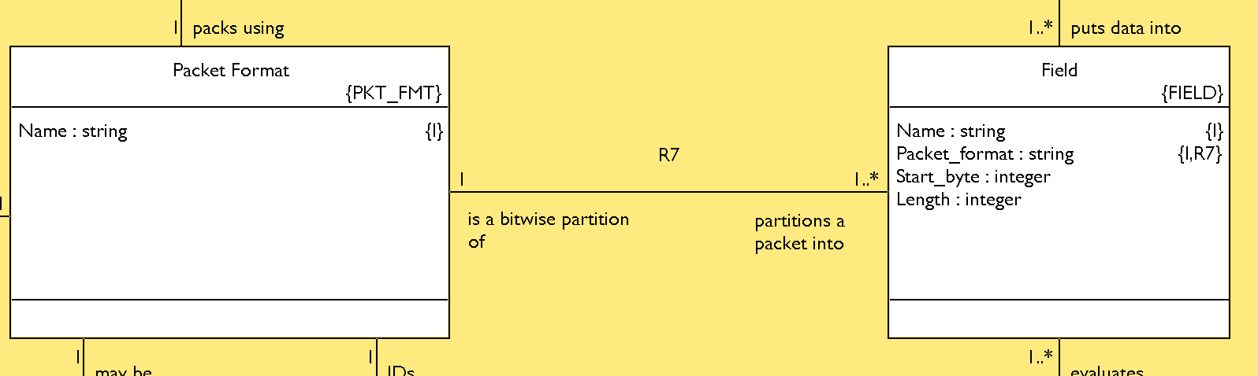
Abstracting packet structure

Slide 18
Modeling sequence
Model receive path by itself
Model send path by itself
Realize that send path is pretty complicated
  (variable size messages, recovery, restart, synch)
Model 3 – Split out Communication and Packet domains

Slide 19
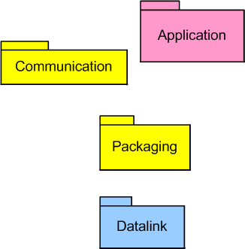
Improved domain chart
Communication handles multi-word message structure, connections, channels, etc.
Packaging packs data into and extracts data from individual packets.

Slide 20
Modeling sequence
Unite send and receive paths by generalizing common elements
Model the communication domain
Bridge it all together, compile, etc.

Slide 21
Packet Identification

Slide 22
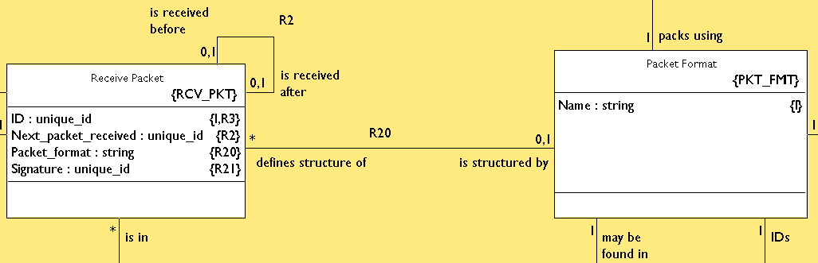
Packets arrive
Data Link services:
::DL_Packet Arrived (Packet_ID)
Field_value = DL::Extract (Packet_ID, Position)

Slide 23
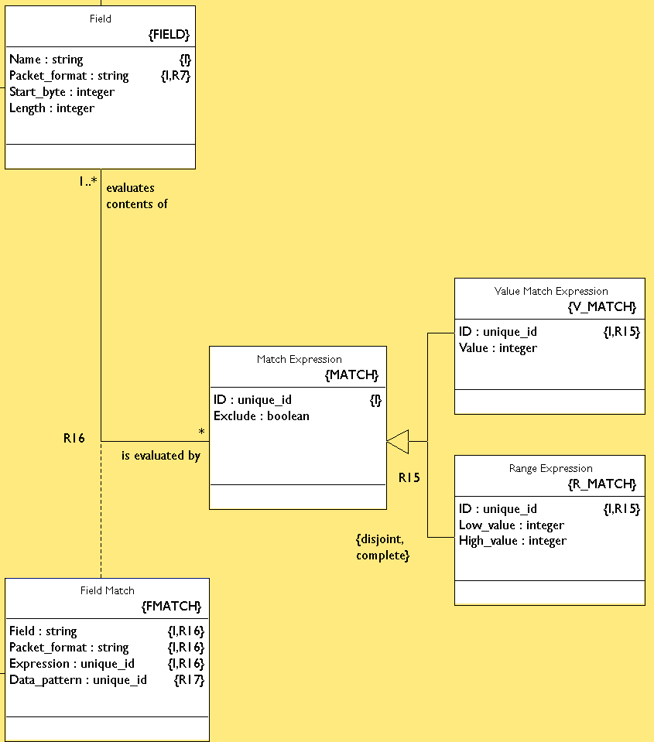
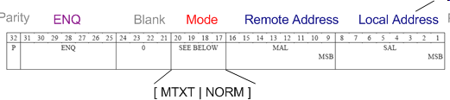
Identification

Slide 24
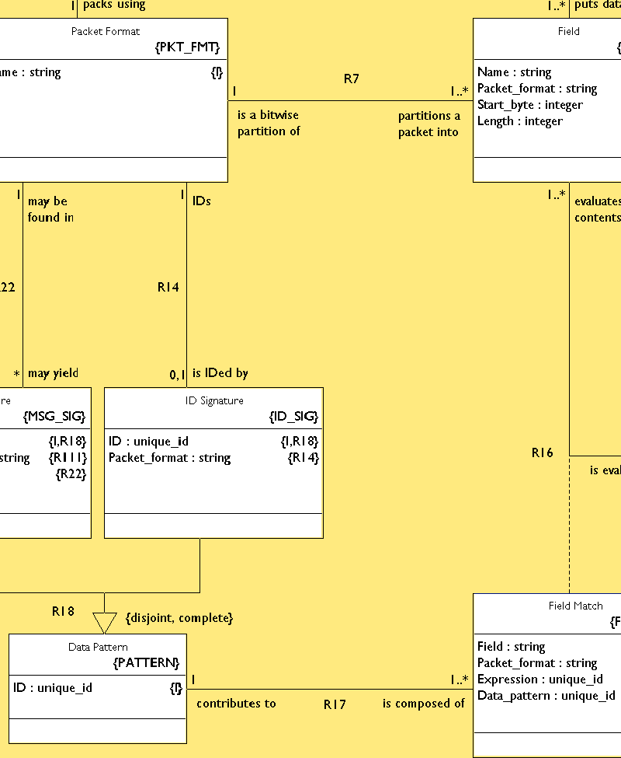
Identification

Slide 25
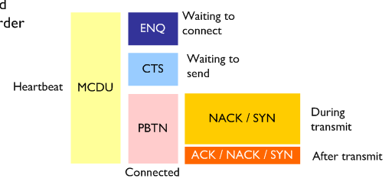
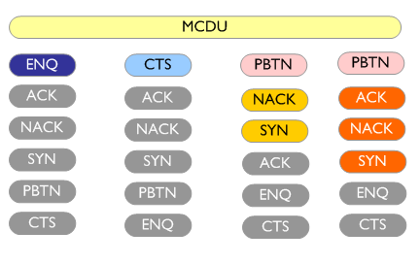
Optimized IDing

Slide 26
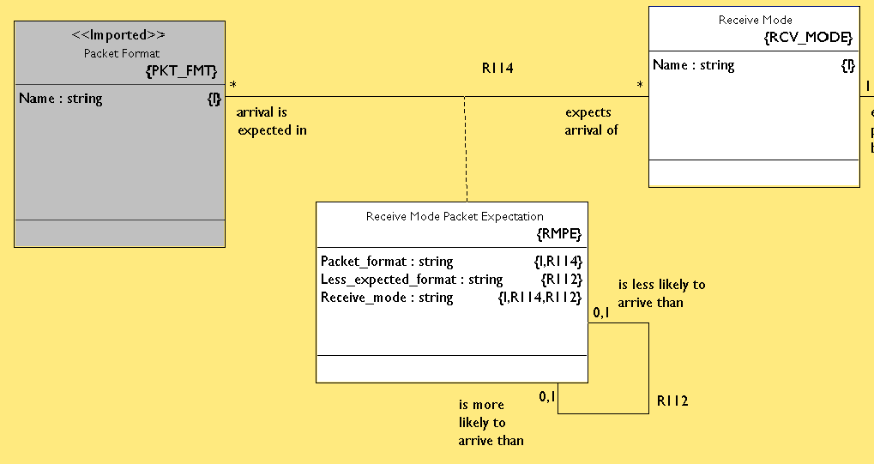
ID model

Slide 27
Packet Extraction

Slide 28
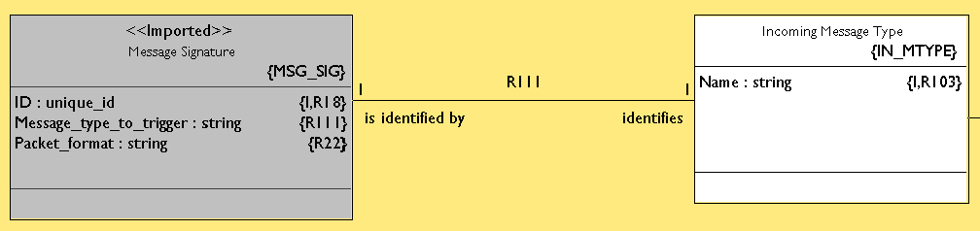
Build the message

Slide 29
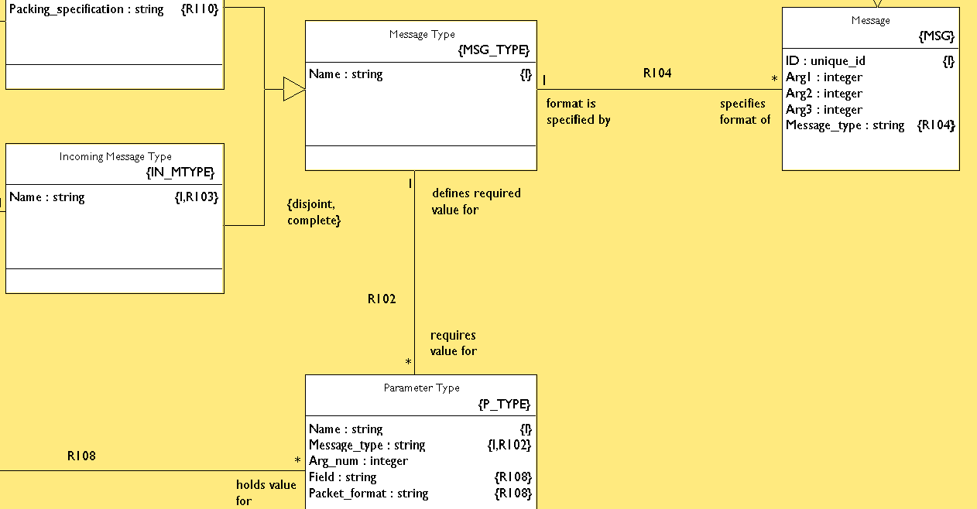
Extraction

Slide 30
Bridge Summary

Slide 31
Bridge to Data Link
From Data Link
Packet Arrived (Packet_ID)
To Data Link
Pack data (Value, Packet_ID, Position)
Data_item = Get data (Packet_ID, Position)
Send (Packet_ID)
Release (Packet_ID)

Slide 32
Bridge to Communication
From Communication
Send Message (Name, Arg1, Arg2, Arg3)
To Communication
Received Message (Name, Arg1, Arg2, Arg3)

Slide 33
Communication Side
To
Resend
Data Received
Channel Opened (Size)
Disconnected
Message (Name, Arg1, Arg2, Arg3)
Open / Close Channel
Channel Opened
Data
From
Connect

Slide 34
Sending

Slide 35
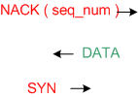
Variable length messages
High level coordination is needed when all goes well…
… AND when it doesn’t.

Slide 36
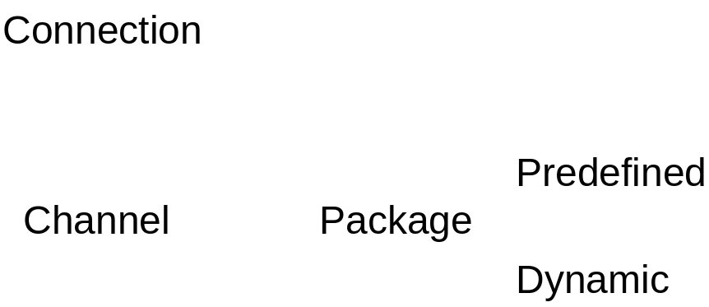
Communication level concepts
Requests and establishes itself.
Opens and closes itself.
Knows how to send all of its components, resending as necessary.

Slide 37
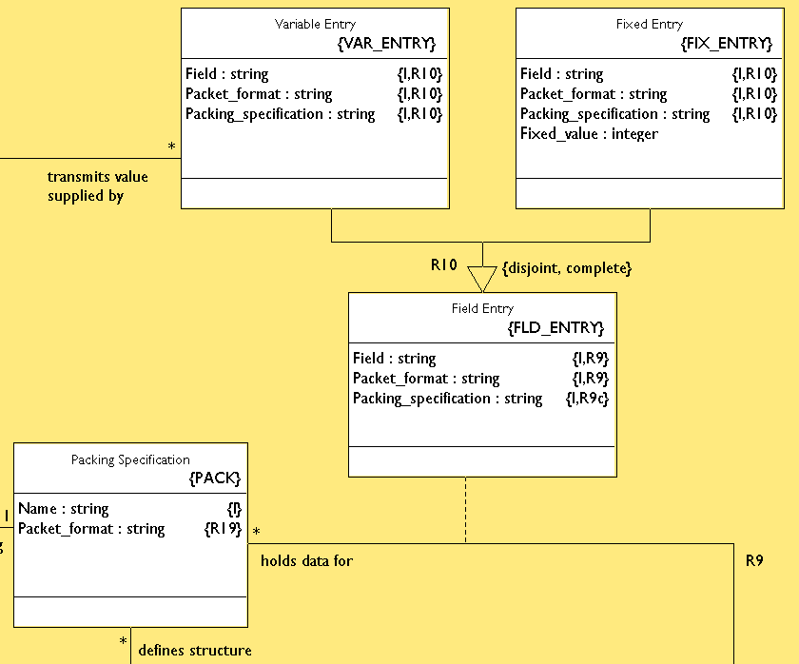
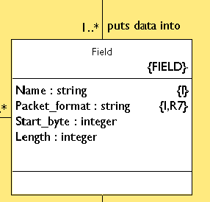
How to fill out a packet

Slide 38
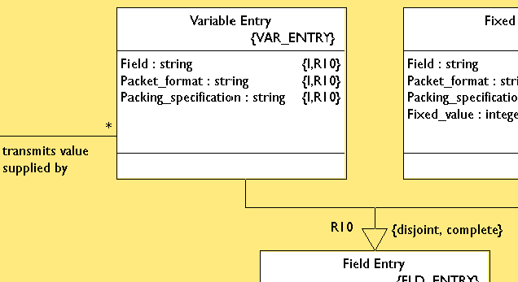
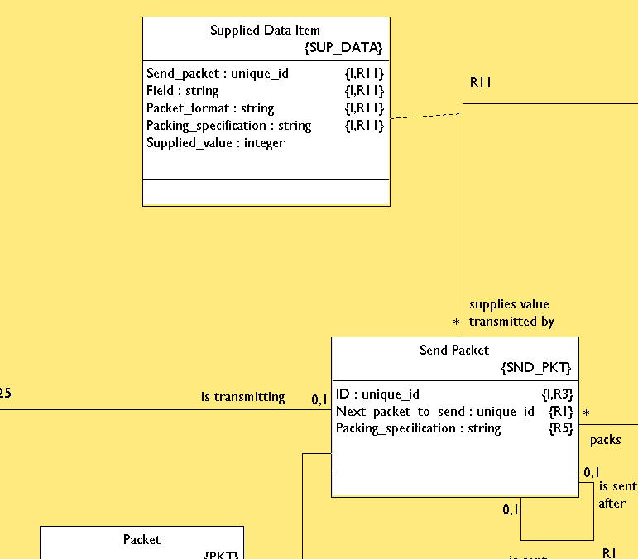
Supplying the data

Slide 39
Next steps

Slide 40
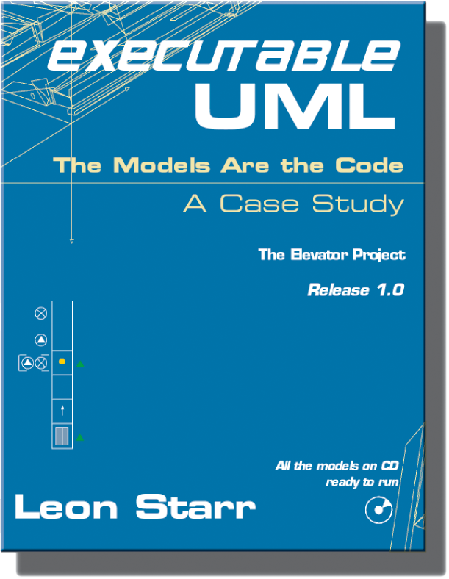
What’s next?
Finish the model
Write up a case study and publish
You want it earlier…?
$$
no problem.
Embedded
Network
1.0

Slide 41

M O D E L I N T E G R A T I O N L L C
xtUML Resources
Leon Starr
Model Integration, LLC
http://www.modelint.com
leon_starr@modelint.com

