Slide 1
Rotating fx and fy runs into TT and RR
FWANT · LOVE-WAVE (TT) EXTENSION
What source-side and receiver-side rotation mean, and why we need both
Notes:
Goal of the talk: agree on what is rotated where, before the kernel code is patched. Rayleigh (ZZ) and Love (TT) projects stay separate; this is only about the TT simulations.

Slide 2
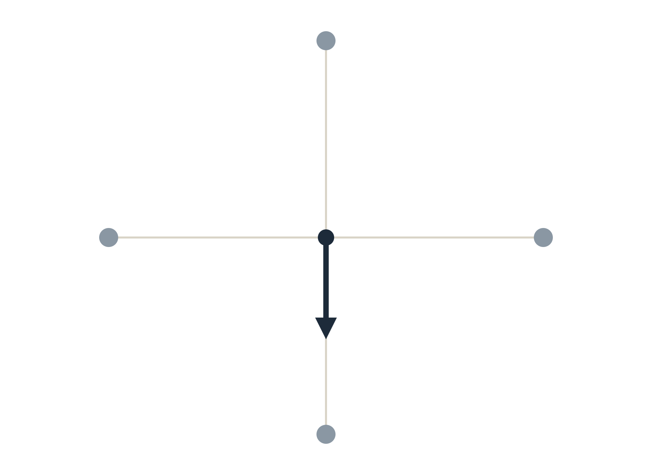
One horizontal force cannot give Love waves at every azimuth
1 · THE PROBLEM
A horizontal force excites Rayleigh with its component along the path and Love with its component across the path.
North: Love 0
Rayleigh −1
A single force toward south therefore flips the sign of Love between east and west receivers, and gives zero Love to the north and south.
One run cannot give TT for every azimuth. Two orthogonal runs, fx and fy, can: any horizontal force is a mix of them.
virtual source
West
Love −1
Rayleigh 0
East
Love +1
Rayleigh 0
force fx (south)
South: Love 0
Rayleigh +1
Notes:
The polarity reversal seen in the fy run is exactly this: Love amplitude goes like sin(alpha) for an fx force, so receivers on the other side of the source get the opposite sign, and receivers along the force axis get nothing.

Slide 3
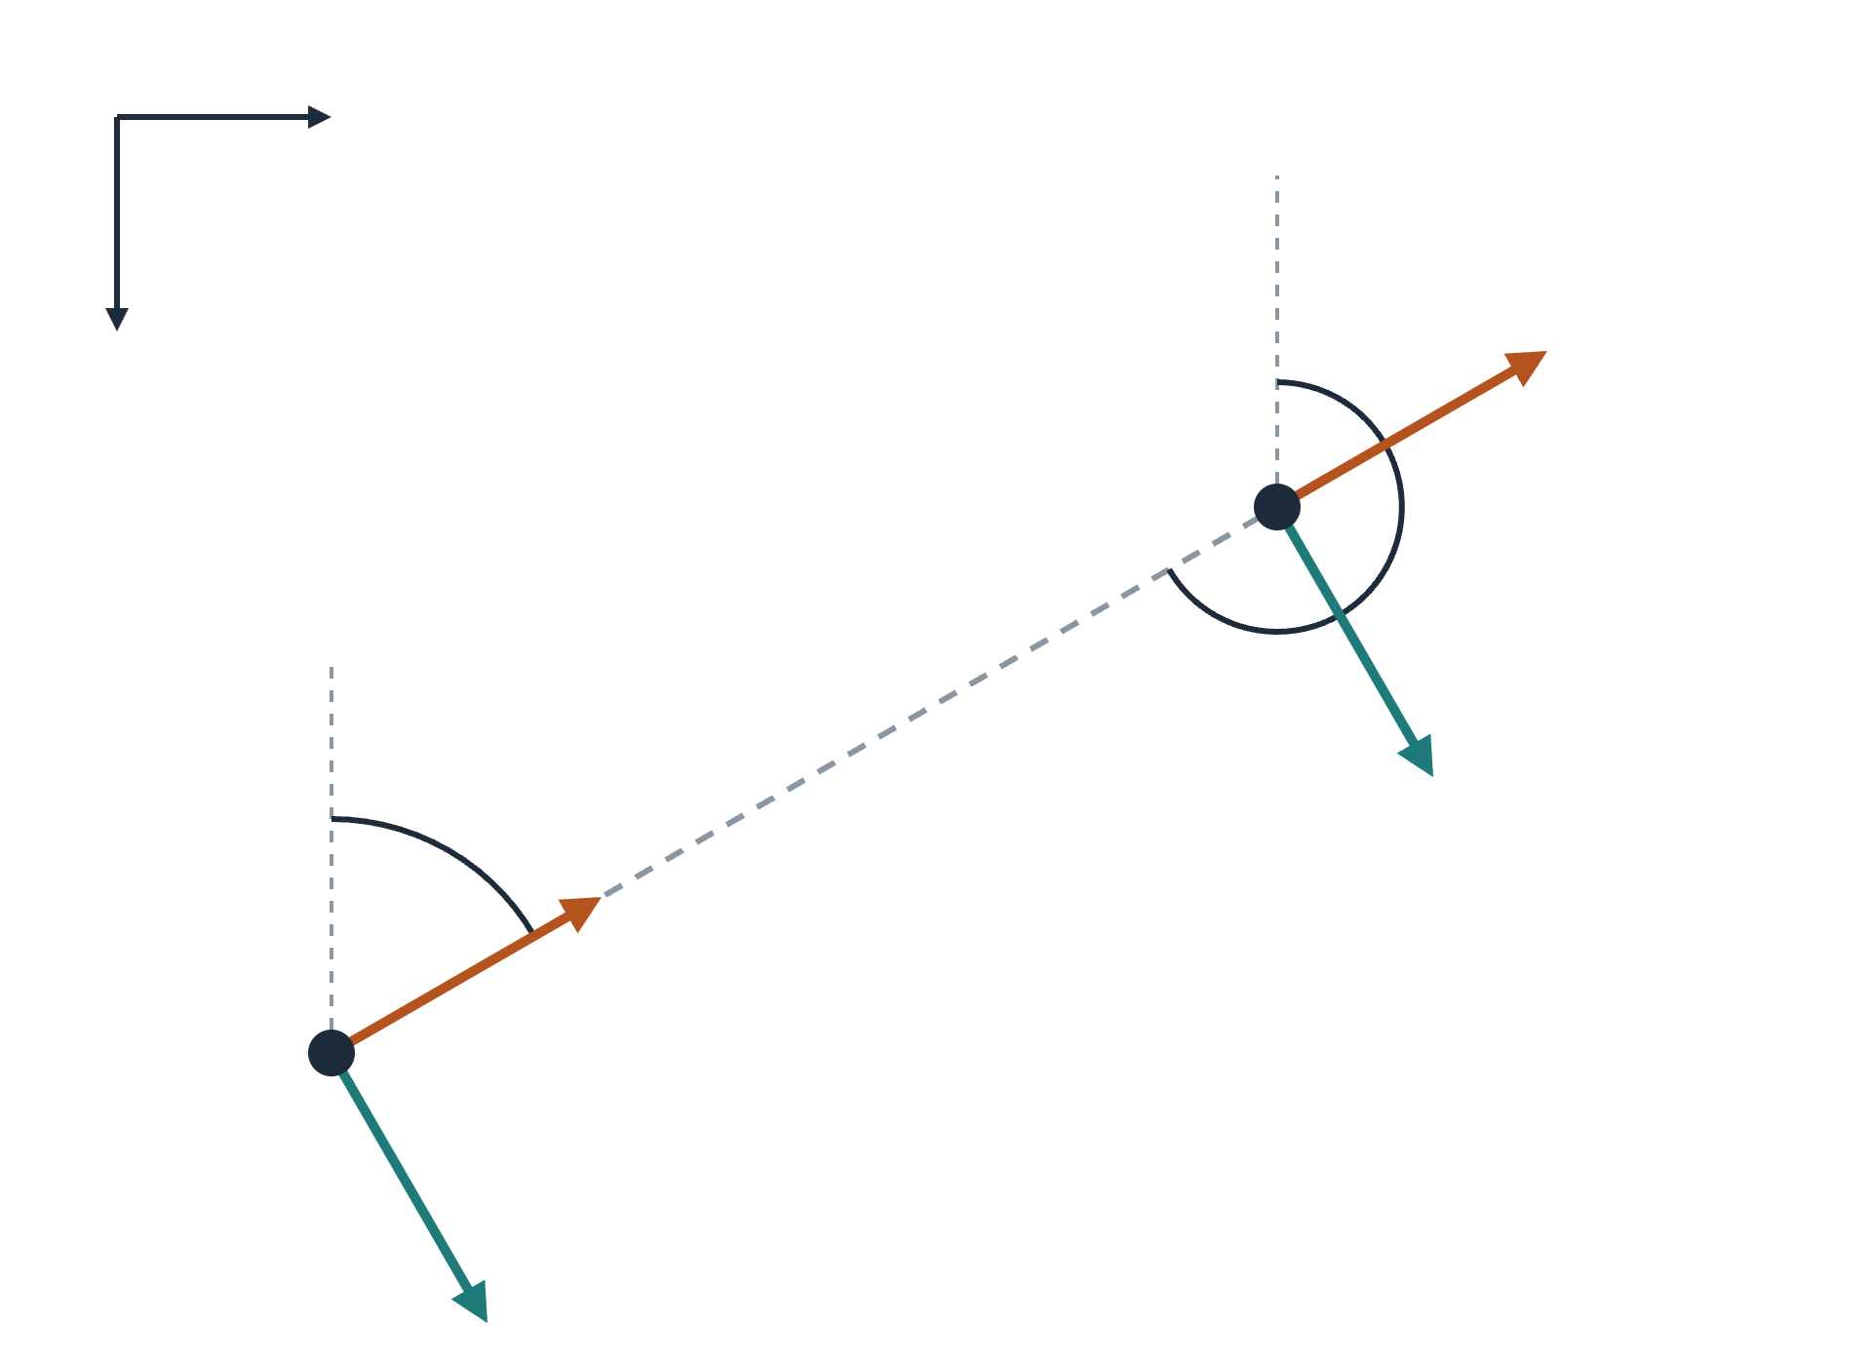
Two azimuths, two pairs of unit vectors
2 · GEOMETRY
Code frame: x = south (colatitude), y = east, z = up.
y (east)
α: azimuth source → receiver. β: azimuth receiver → source. Both clockwise from north.
β
x (south)
R at receiver
T is the propagation direction turned 90° clockwise; R points along propagation.
receiver
T src = ( sin α, cos α)
R src = (−cos α, sin α)
T rcv = (−sin β, −cos β)
R rcv = ( cos β, −sin β)
α
R at source
T at receiver
components in (x, y)
source
T at source
Notes:
On a flat plane beta = alpha + 180 and the source and receiver arrows coincide. On the sphere they differ by the convergence of meridians, so we keep both pairs. T uses the same handedness at both ends, which matches obspy rotate_ne_rt.

Slide 4
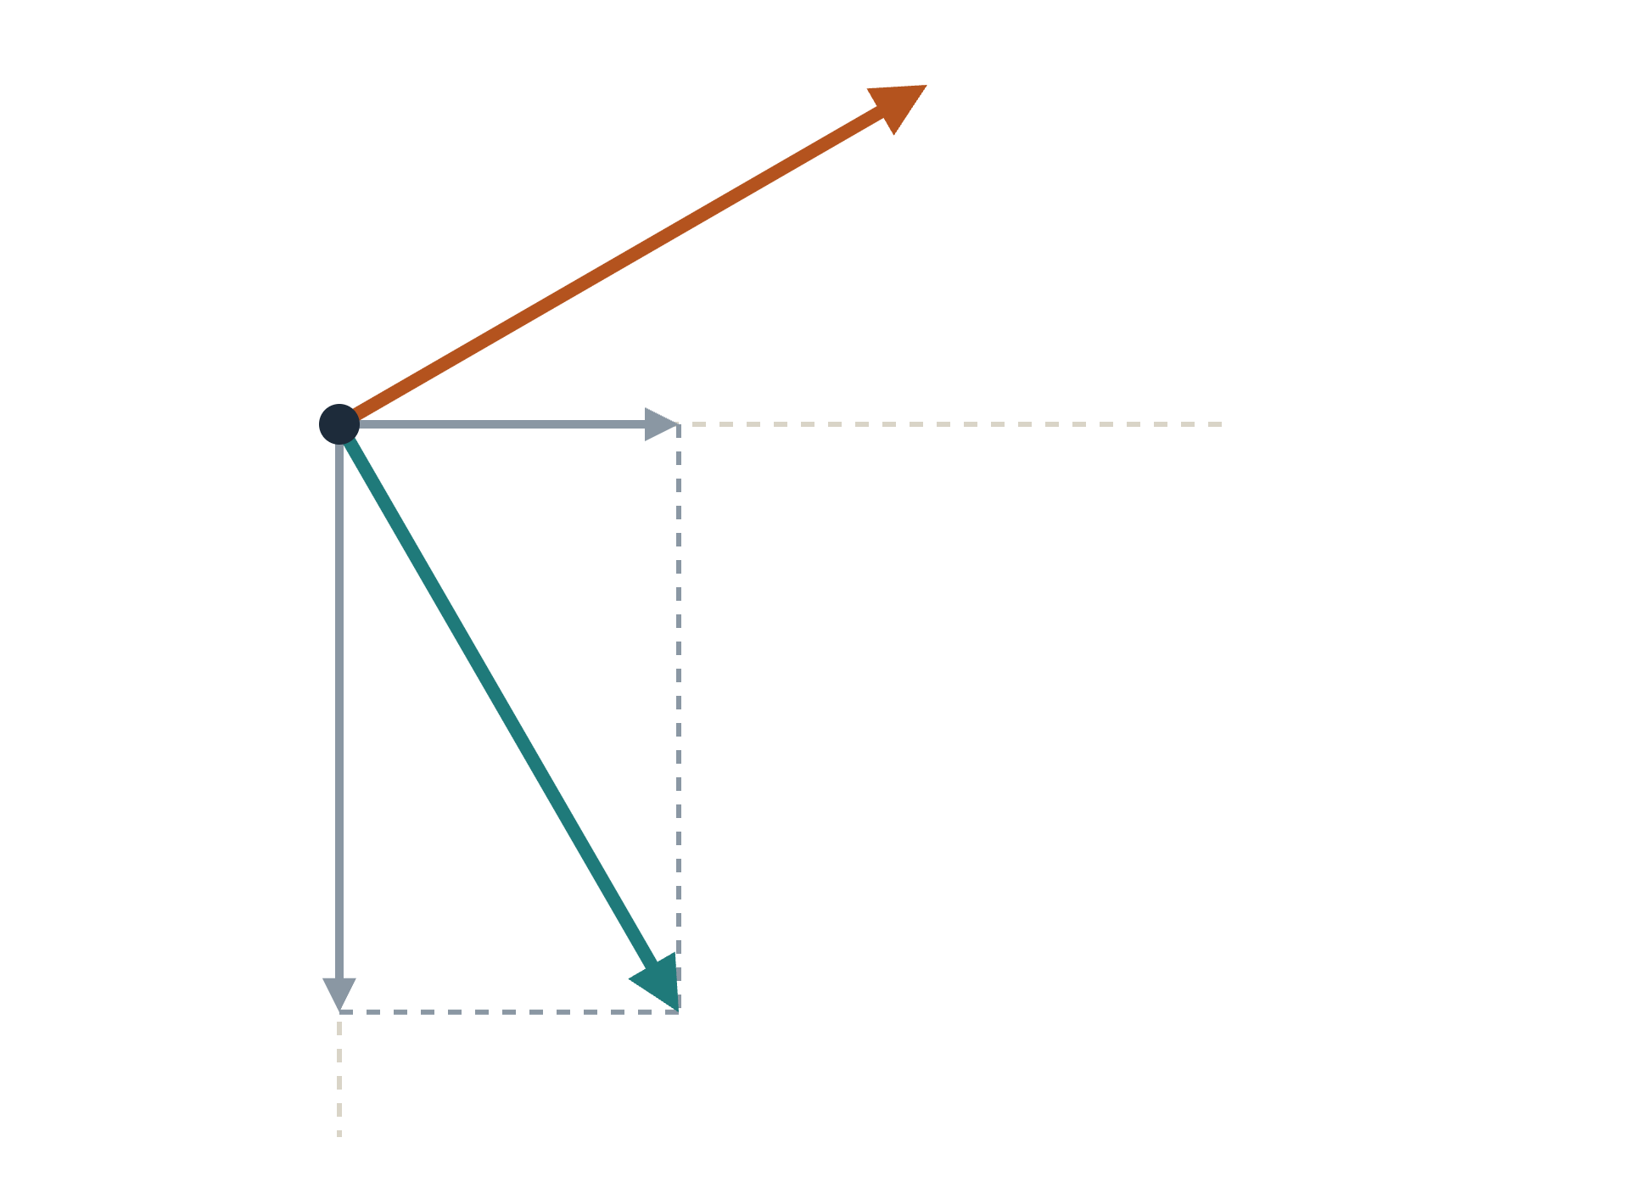
Source-side rotation: build a force along T from fx and fy
3 · SOURCE SIDE
The wavefield is linear in the force: u = Fx · u(fx) + Fy · u(fy).
force along R
A force along T has (Fx, Fy) = (sin α, cos α), so u(T) = sin α · u(fx) + cos α · u(fy)
cos α · fy
A force along R has (−cos α, sin α), so u(R) = −cos α · u(fx) + sin α · u(fy)
fy axis (east)
No new simulation: this is a weighted sum of the two stored wavefields, with a different α for every receiver.
sin α · fx
force along T
fx axis (south)
Notes:
Source-side rotation answers the question: what would the receiver record if the virtual source had pushed across the path to this particular receiver? The weights depend on alpha, so each receiver gets its own mix of the two runs.

Slide 5
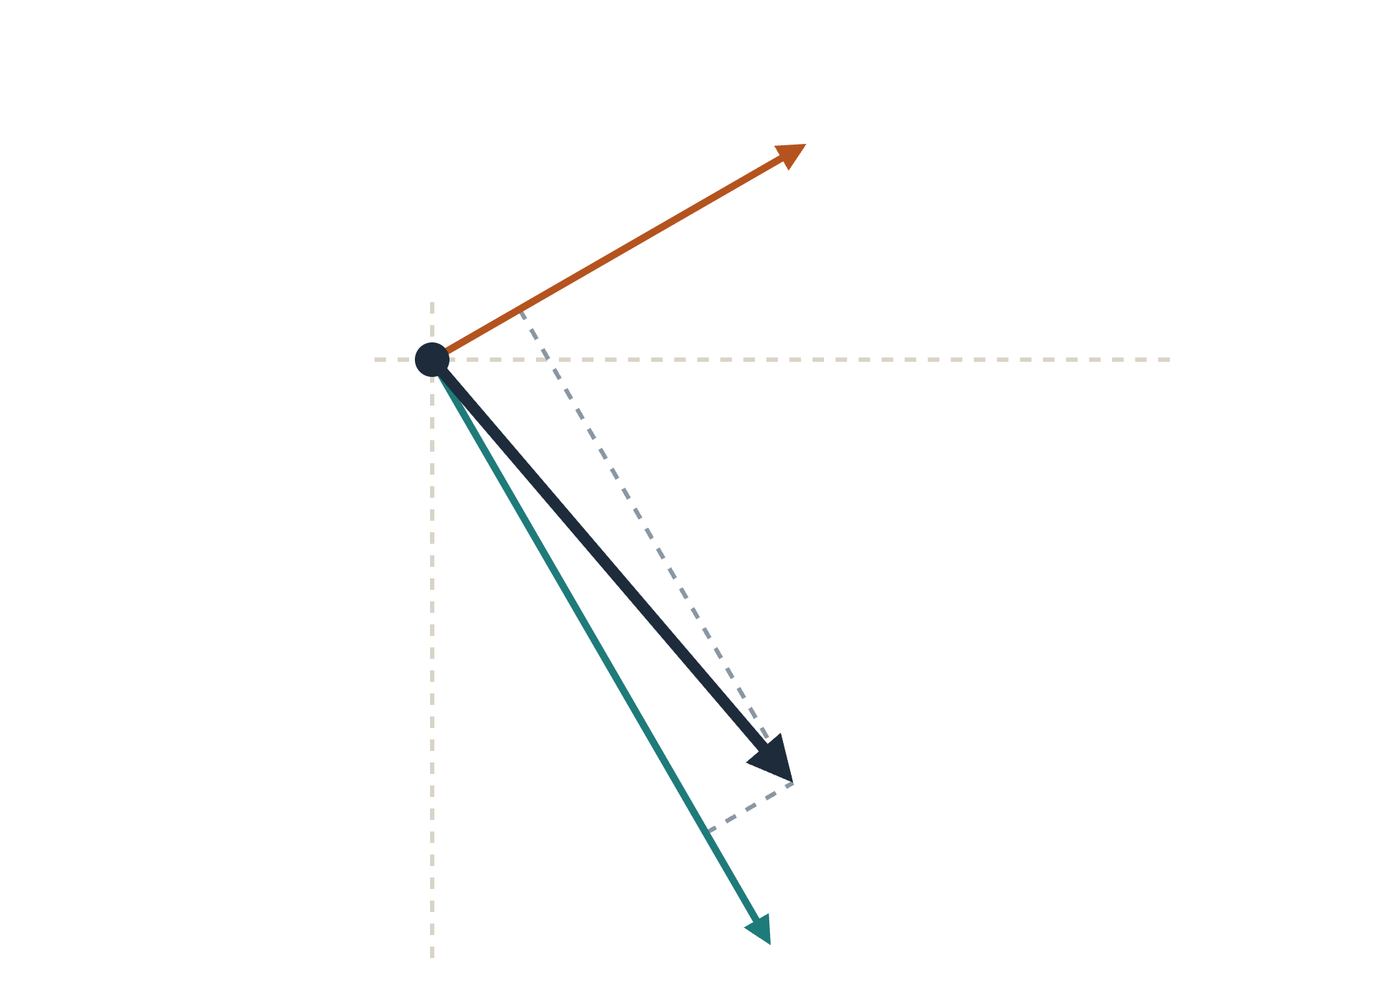
Receiver-side rotation: project the response onto T and R
4 · RECEIVER SIDE
After the source-side step we still hold a vector at each receiver: its x (south) and y (east) components, plus z.
R at receiver
Project it with the unit vectors at the receiver: TT = T · u, and the unwanted part RT = R · u.
RT = R · u (leakage)
This is the same as rotating N/E records into R/T with the back azimuth β.
y (east)
The kernel code repeats this step with rot_mat (columns T, R, Z) from the conf file.
TT = T · u
response u (x, y)
x (south)
T at receiver
Notes:
Receiver-side rotation is the familiar one. It uses beta, the back azimuth, because T and R are defined by the local propagation direction at the receiver. If the source force really is transverse, the R and Z parts are small leakage, which we use as a check.

Slide 6
Putting it together: TT, RR and the leakage checks
5 · BOTH ROTATIONS TOGETHER
Output | Source force | Receiver | Expected
TT | along T | T | Love signal
RR | along R | R | Rayleigh, horizontal signal
RT | along T | R | ≈ 0, leakage
TR | along R | T | ≈ 0, leakage
ZT | along T | Z | ≈ 0, leakage
ts = [sind(a) cosd(a)];
tr = [-sind(b) -cosd(b)];
uxT = ts(1)*Fx.Vx + ts(2)*Fy.Vx;
uyT = ts(1)*Fx.Vy + ts(2)*Fy.Vy;
TT = tr(1)*uxT + tr(2)*uyT;
From rotate_fx_fy.m; a = α and b = β in degrees.
In one line: TT = Σ t(receiver)ᵢ · Gᵢⱼ · t(source)ⱼ, the Green’s tensor sandwiched between the two T vectors. RR is the same with R.
Notes:
The same pair of vectors gives every combination. Only TT and RR carry signal. RT, TR and ZT are not used further; they are our test that the geometry is right.

Slide 7
The frames are right: leakage is tiny and the azimuths agree
6 · CHECKS ON THE RIO GRANDE DATA
≤ 5e-3
0.0°
No flip
Leakage
Azimuth check
Polarity
Peak ratio of RT, TR and ZT to TT: 1e-5 to 5e-3 across stations 2–80, 0.05–0.1 Hz.
Median error of the azimuth recovered from Z, since Uz(fy) / Uz(fx) = −tan α; maximum about 0.5°.
Raw single-force records reverse sign across the source; after weighting by sin α and cos α they do not.
Still to verify
Sign of the synthetic TT against the real TT EGFs (cross-correlation convention), before measuring phase delays on all pairs.
Notes:
Leakage and azimuth tests used the fx and fy runs from the Rio Grande project. The remaining open item is the sign convention between the EGF TT and the synthetic TT; a few stations with high SNR are enough to settle it.

Slide 8
Where each rotation happens in the workflow
7 · IN THE WORKFLOW
1
Simulate
Nothing rotated yet: two raw single-force wavefields per virtual source.
seis3d_wave in fx/ and fy/
2
Synthetic TT
Both sides: writes TT and RR, plus the response to a T force as x, y, z.
snap2sac_sphere_fxfy.m
3
Delays and conf
kern_synthetic4kernel_fxfy.m
kern_measure2kernelconf_fxfy.sh
Delays measured on TT. The conf keeps rot_mat (receiver) and (sin α, cos α) (source).
4
Kernels
Receiver: rot_mat applied before the convolution. Source: sin α · fx + cos α · fy event strains.
SI_ker_sta_fxyz.F90
Notes:
Use SI_ker_sta_fxyz.F90 for TT (it also runs fz-only ZZ lines). The original SI_ker_sta.F90 would ignore the source weights and silently use only one event run, so the kernels would be wrong for most azimuths. Both runs must use the same force amplitude, because the program mixes the raw event SGTs with weights sin α and cos α.

