Slide 1




HEALTHCARE APPOINTMENT SYSTEM WITH E-PAYMENT & SMS/EMAIL VERIFICATION

Slide 2

Chapter 1
Introduction

Slide 3
SIGNIFICANCE OF THE STUDY
Technology Application. In healthcare settings, the sched-IT system demonstrates how technology may successfully address typical scheduling and resource management issues.
Individuals. This system is intended to appoint as soon as possible, simplify healthcare scheduleing and enhance efficiency for better flow of the system. Community. It benefits the locals who don’t have any access to devices such as mobile phones, laptop and etc. Cause the admin will provide assistance so that the locals will book an appointment.
Future Researchers. The result of this project will enhance the understanding of healthcare management systems, that also allows the future researchers to use this as a reference or improve if any problems in the future will occur.

Slide 4
OBJECTIVES OF THE PROJECT
To appoint consultations for the healthcare in the Montalban, that automates scheduling process and provide real-time updates and notifications for both parties.

Slide 5
OBJECTIVES OF THE PROJECT
2. Provide a application for healthcare scheduling history, payment, and verification through email.

Slide 6
OBJECTIVES OF THE PROJECT
Provide a tool for locals and people who don’t have any access to devices, to schedule an appointment and also to measure their blood pressure and pulse rate when they give our admins a consent or approval that they are willing.

Slide 7
SCOPE
The healthcare appointment system is designed to simplified scheduling and rescheduling appointments for hospitals, clinics and other health facilities. This will cater this three main parts of user roles. The patients / clients / users can view their appointment through our website and our mobile application. Additionally our admins are to approved the schedule of every clients.

Slide 8
DELIMITATION
Our delimitation focuses on the integration of a blood pressure detection device into the healthcare appointment system. This decision establishes a clear boundary for the system's functionality, prioritizing the incorporation of a reliable and user-friendly device for blood pressure monitoring.

Slide 9
Chapter 2
Review of Related Literature, Studies, and Systems

Slide 10
SYNTHESIS OF THE REVIEW
As technology continues to advance, it significantly transforms our daily lives, particularly in the context of healthcare. In response to the growing need for efficiency, a fast and reliable method to manage health-related matters is essential. According to Sheily and Ranzel (2020), their study focuses on enhancing hospital outpatient services through the implementation of a web-based appointment system. The primary goals of this system are to reduce patient waiting times, facilitate early scheduling, and improve overall service delivery. The system's features enable patients to easily schedule, reschedule, or cancel appointments online, eliminating the need for manual scheduling. This not only streamlines the process for patients but also offers medical staff a more efficient workflow. This research is particularly valuable as it highlights how technology in the Philippines is adapting swiftly, despite existing challenges.

Slide 11
SYNTHESIS OF THE REVIEW
The study "Development of a Web-Based Appointment and Scheduling System for Medical Consultations" addresses the difficulties in managing healthcare appointments by developing an effective digital system. The system was created to improve the entire experience for both patients and healthcare providers, cut down on patient wait times, and expedite the appointment process. It makes use of web-based technology, which makes it simple for patients to make, change, or cancel appointments and allows medical personnel to better monitor and manage schedules.

Slide 12
SYNTHESIS OF THE REVIEW
Given the ongoing problems of overcrowded clinics, scarce resources, and disjointed appointment procedures, the adoption of such a system is extremely pertinent in the Philippine healthcare sector. In order to guarantee better time management, reduce patient stress, and increase operational efficiency, the study highlights the significance of having a dependable appointment scheduling system. It also emphasizes how a well-organized system can free up medical personnel from administrative duties so they can concentrate more on patient care and less on logistical issues. In order to guarantee prompt and well-organized access to medical services, healthcare appointments are essential. Efficient scheduling guarantees that patients receive the appropriate attention from medical experts, minimizes waiting periods, and avoids overbooking. Furthermore, by offering a smooth healthcare experience, it promotes patient pleasure and trust.

Slide 13
Chapter 3
Research Methodology

Slide 14
RESEARCH DESIGN
The developers of this study used a descriptive-survey research design. One kind of descriptive research that uses quantitative data to produce accurate and pertinent information is descriptive survey research. To gather and examine trustworthy responses, the developers employed survey questionnaires. Questions that are pertinent to the developed system are included in the descriptive survey design. The survey questionnaire was then distributed to the respondents in an effort to get truthful answers.

Slide 15
SETTING OF THE STUDY
The study's setting, where the developers created the system, will be in Barangay San Isidro, Montalban, Rizal.

Slide 16
RESPONDENTS OF THE STUDY
The respondents of this study is the IT Experts.

Slide 17
Data Collection Method
The main method of data collection for this study is through survey questionnaires that include closed-ended questions using Google Forms, which will be distributed to the patients of JL Dialmed Dialysis Center San Isidro - Montalban who hav.e used the Healthcare Appointment System.

Slide 18
Data Collection Analysis
The developer investigates how a healthcare appointment system may improve the quality of service delivery and streamline efficiency using quantitative research. Information technology experts provide data to the developer.

Slide 19
Chapter 4
Results and Discussion

Slide 20
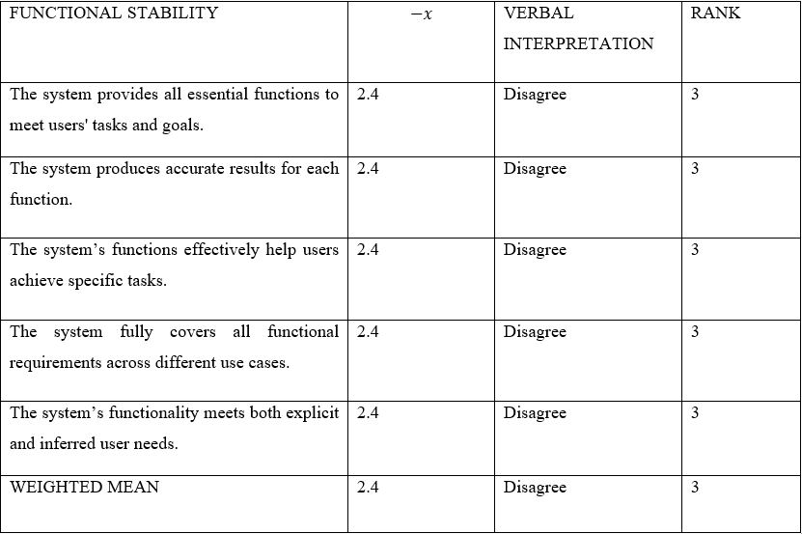
Factor 1. Level of Validation of the Healthcare Appointment System with E-Payment Transaction And SMS / Email with Respect to Functional Suitability

Slide 21
ANALYSIS AND INTERPRETATION
Table 1 illustrates the weighted mean and verbal interpretation of the functional suitability of the system, as assessed by validators. The table evaluates three statements regarding the system’s capability to meet user needs effectively. The first statement, "The system provides all essential functions to meet user tasks and goals," had a mean score of 2.4 with a verbal interpretation of Disagree, ranking it 3rd.
The second statement, "The system produces accurate results for each function," received a mean score of 2.4, which is verbally translated as Disagree, and ranked 3rd as well.
The third statement, "The system functions effectively help users achieve specific tasks," received a 2.4, which was verbally translated as strongly agreeing, and was ranked 3rd.
The fourth statement, “The system fully covers all functional requirements across different use cases,” received a mean score of 2.4, which was also verbally translated as Disagree, thus ranking third as well.

Slide 22
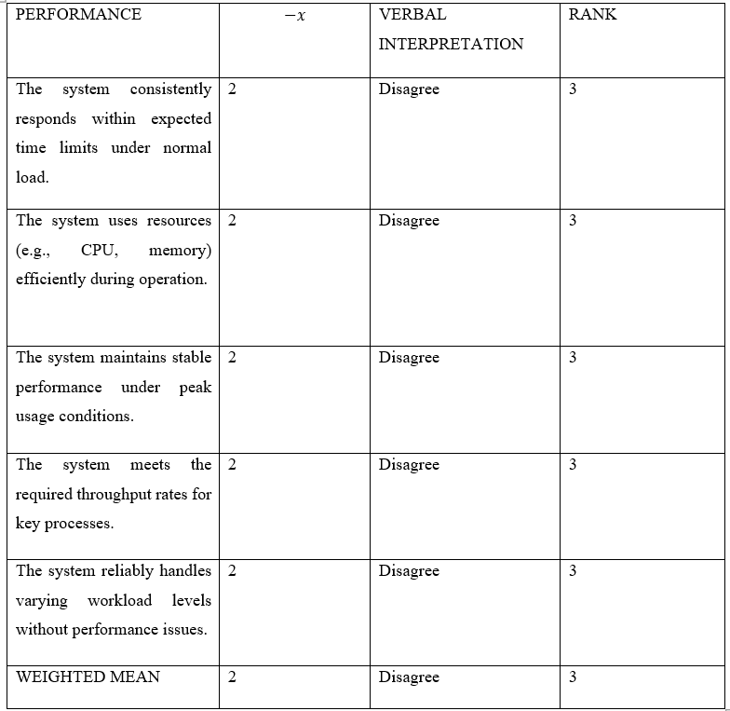
Factor 2 Level of Validation of the Healthcare Appointment System with E-Payment Transaction And SMS / Email with Respect to Performance Efficiency

Slide 23
ANALYSIS AND INTERPRETATION
Table 2 presents the weighted mean and verbal interpretation of the system's compatibility features, as assessed by the validators. The table includes five essential statements regarding the system's integration and cooperation with other software and systems.
The first statement, " The system consistently responds within expected time limits under normal load.," received a mean score of 2 and a verbal interpretation of "Disagree," placing it third among the claims. The second statement, " The system uses resources (e.g., CPU, memory) efficiently during operation," also earned a mean score of 2, regarded as "Disagree," and was ranked third. The third statement, " The system maintains stable performance under peak usage conditions," received a mean score of 2 and was verbally evaluated as "Disagree," also ranking third. The fourth statement, " The system meets the required throughput rates for key processes.," received a mean score of 2 and was verbally evaluated as "Disagree," also ranking third. The fifth statement, "The system reliably handles varying workload levels without performance issues," received a mean score of 2 and was verbally evaluated as "Disagree," also ranking third. Overall, the system achieved a weighted mean of 2, interpreted as "Disagree."

Slide 24
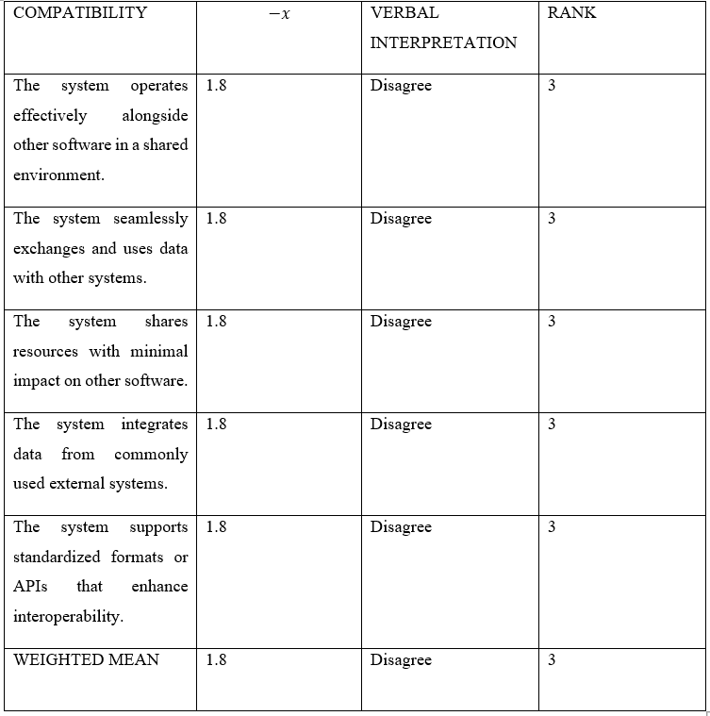
Factor 3 Level of Validation of the Healthcare Appointment System with E-Payment Transaction And SMS / Email with Respect to Compatibility

Slide 25
ANALYSIS AND INTERPRETATION
Table 3 shows the weighted mean and verbal interpretation of the interaction capability of the system, as assessed by validators. The table includes three statements regarding the system's interaction features.
The first statement, " The system operates effectively alongside other software in a shared environment," has a mean score of 1.8 and is verbally evaluated as Disagree, placing it third among the assertions. The second statement, " The system seamlessly exchanges and uses data with other systems," receives a mean score of 1.8, which is translated as "Disagree," and third second. The third statement, " The system shares resources with minimal impact on other software," has a mean score of 1.8, with a verbal interpretation of Disagree, and ranks 3rd. The fourth statement, "The system integrates data from commonly used external systems," has a mean score of 1.8, also with a verbal interpretation of Disagree, and ranks third. The fifth statement, "The system supports standardized formats or APIs that enhance interoperability," also has a mean score of 1.8, also with a verbal interpretation of Disagree, and ranks third. The overall weighted mean of 1.8 is considered low, indicating that validators Disagree that the system excels in interaction capability.

Slide 26
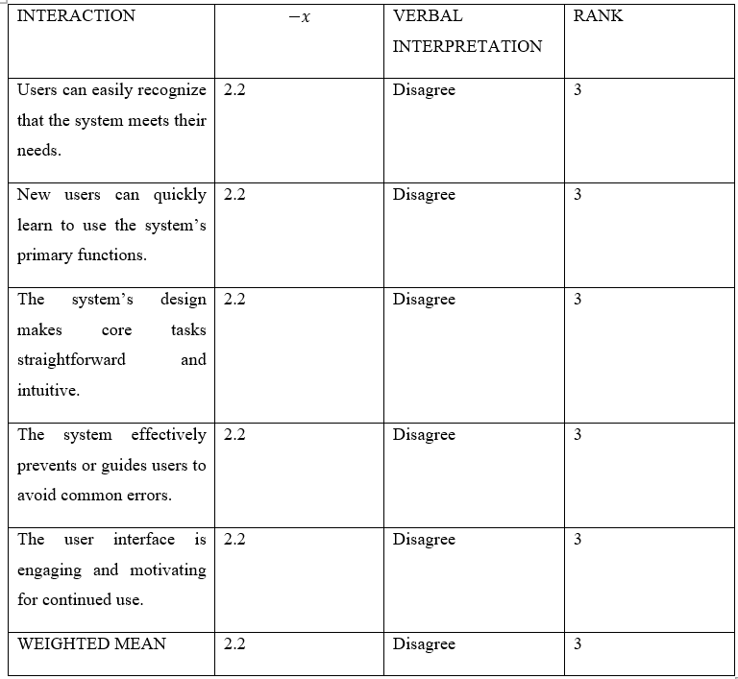
Factor 4 Level of Validation of the Healthcare Appointment System with E-Payment Transaction And SMS / Email with Respect to Interaction Capability

Slide 27
ANALYSIS AND INTERPRETATION
Table 4 shows the weighted mean and verbal interaction capability of the reliability of the system, as assessed by validators. The table includes five statements concerning the reliability features of the system.
With a mean score of 2.2 and a verbal interpretation of Disagree, the first statement, Users can easily recognize that the system meets their needs," comes in third place. With a mean score of 2.2, which is orally interpreted as Disagree, the second statement, "New users can quickly learn to use the system’s primary functions," comes in third. With a mean score of 2.2 and a verbal interpretation of Disagree. The third statement, "The system’s design makes core tasks straightforward and intuitive," ranks third as well. The fourth statement, " The system effectively prevents or guides users to avoid common errors," with a mean score of 2.2 and a verbal interpretation of Disagree. The fifth statement, " The user interface is engaging and motivating for continued use," with a mean score of 2.2 and a verbal interpretation of Disagree.

Slide 28
Chapter 5
Conclusion and Recommendations

Slide 29
CONCLUSION
First of all, the system uses Esp32 spo2 for measuring blood pressure and pulse rate, it is in the side of admins. This device would likely to integrate within the admin system to track results from the clients who are willing to measure their bp and pulse rate. The admins are the ones to take a result of blood pressure and pulse rate from the customers who are consulting through clinics (likely who don’t have access to application or a locals that don’t know how to use any devices). The second one is the mobile and web application also provides a features that allows the users who have access to any devices to schedule or appoint consultations of their choice. This two applications have a realtime updates from database that will foresee the time, dates and approval of the users schedule. The payment that we have in our title is just an option because if the system payment method fails, there are tendency that also booking a consultation will encounter problems and errors throughout the system, so we add a options that allows the users to choose from if they are ready to pay now or pay later as cash. Lastly the admin side is likely to manage the approval and checking the schedule of the users and the person that will measure the blood pressure and pulse rate of the customers that approved the consent to take their bp and pulse rate (Spo2).

Slide 30
RECOMMENDATIONS
Development of Additional Feutures
Automation and Optimization
Security and Compliance Future Research and Testing
Expand System Coverage

Slide 31
Diagrams
Project Design and Framework

Slide 32
OPERATIONAL FRAMEWORK
Requirements
Requirements
Requirements
Requirements
Requirements

Slide 33
CONCEPTUAL FRAMEWORK
INPUT
PROCESS
Requirements
OUTPUT
Developed and Accepted “Healthcare Appoinment System with E-Payment and Email Verification”.
HARDWARE:
ESP32
MAX30102
OLED DISPLAY
JUMPER WIRE
BREADBOARD
SOFTWARE
Visual Studio 2022
Arduino IDE
Visual Studio Code
ISO/IEC 25010
STATISTICAL TOOL
Likert Scale
Questioners
Weighted Mean
Planning
Desingning
Development
Release and Maintain

Slide 34
END OF PRESENTATION

Slide 35
WE ARE NOW READY FOR YOUR QUESTIONS

