Slide 1
UNIFIED ROBOT
CONTROL INTERFACE
A common GUI and integration framework for agentic planning, Isaac ROS execution, and Picker2 learned skills
PLAN
PERCEIVE
AGENTIC
ROS 2
RL SKILLS
ACT
VERIFY
Architecture proposal • grounded in the current repositories

Slide 2
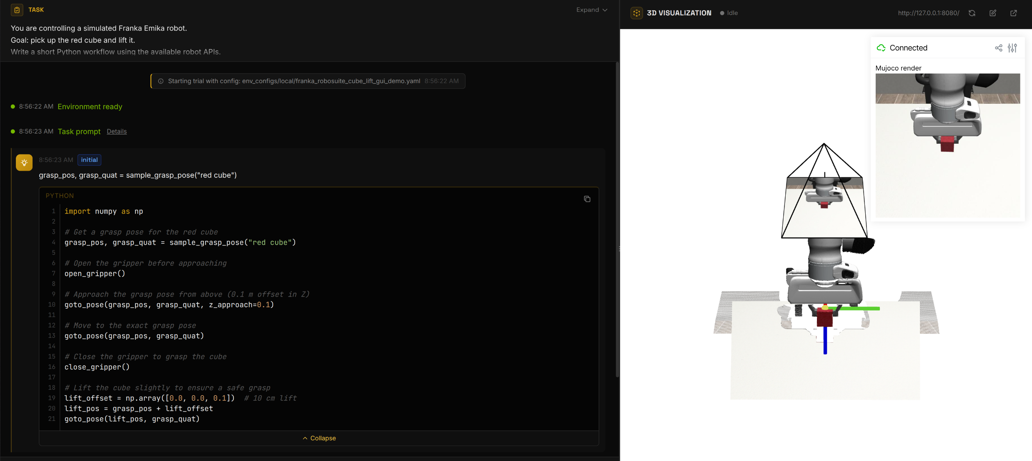
INTERFACE EXAMPLE
CaP-X simulation: workflow and 3D visualization
Executable workflow • task events • MuJoCo view • interactive Viser scene
Screenshot captured from the local Franka cube-lifting demonstration
02

Slide 3
GUI STRUCTURE
How the CaP-X GUI exposes robot execution
1 Pseudo-code interface
2 YAML task configuration
3 3D visualization
WORKFLOW
CONFIG
VISER
High-level, readable robot workflow.
• Object pose / grasp pose
• Motion planning
• Robot and gripper commands
• Execution result
Reproducible task setup.
• Robot and simulator
• APIs and task prompt
• Model / workflow
• Visualization and outputs
Live execution context.
• Robot and object state
• Camera view and frames
• Grasps and trajectories
• Interactive inspection
Task YAML → high-level Python workflow → perception / planning / motion services → live 3D evidence
Reference: local CaP-X Franka cube-lifting demonstration
03

Slide 4
MODULE VIEW
Agentic robot APIs and current implementations
Task intent
CodeAgent
Allowlisted runtime
Robot capabilities
Robot Control API
Perception API
Planning API
Interface
• pose and robot state
• Cartesian/joint motion
• gripper open/close
Current implementation
• ActionApi
• FrankaReal + libfranka bridge
• FrankaSim / PyBullet
Interface
• object segmentation and pose
• point-cloud extraction
• grasp candidates
Current implementation
• SAM3 segmentation service
• Contact-GraspNet grasp service
• Fundation Pose Estimation
• calibrated D455 observations
Interface
• IK and target-pose planning
• collision-aware trajectory
• execute / cancel / report
Current implementation
• PyRoKi motion service (experimental)
• cuMotion + nvblox available in Isaac ROS
Current path: SAM3 → mask • GraspNet → grasp • PyRoKi / cuMotion → trajectory • robot backend → motion
Sources: agentic_robots/apis · agentic_robots/services · Isaac ROS manipulation workflow
04

