Slide 1
UNIFIED ROBOT
CONTROL INTERFACE
A common GUI and integration framework for agentic planning, Isaac ROS execution, and Picker2 learned skills
PLAN
PERCEIVE
AGENTIC
ROS 2
RL SKILLS
ACT
VERIFY
Architecture proposal • grounded in the current repositories

Slide 2
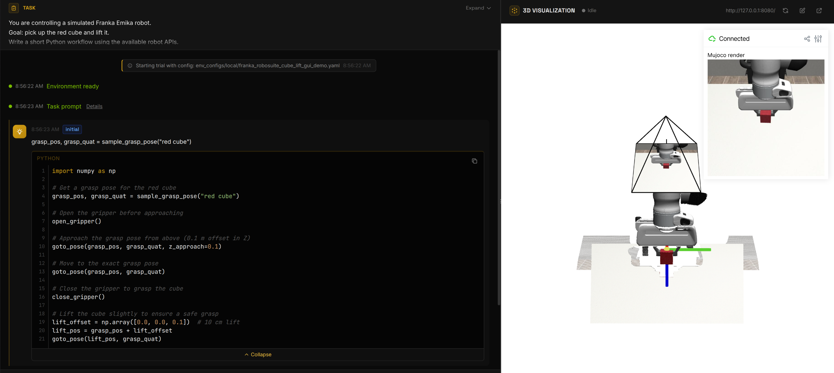
INTERFACE EXAMPLE
CaP-X simulation: workflow and 3D visualization
Executable workflow • task events • MuJoCo view • interactive Viser scene
Screenshot captured from the local Franka cube-lifting demonstration
02

Slide 3
GUI STRUCTURE
How the CaP-X GUI exposes robot execution
1 Pseudo-code interface
2 YAML task configuration
3 3D visualization
WORKFLOW
CONFIG
VISER
High-level, readable robot workflow.
• Object pose / grasp pose
• Motion planning
• Robot and gripper commands
• Execution result
Reproducible task setup.
• Robot and simulator
• APIs and task prompt
• Model / workflow
• Visualization and outputs
Live execution context.
• Robot and object state
• Camera view and frames
• Grasps and trajectories
• Interactive inspection
Task YAML → high-level Python workflow → perception / planning / motion services → live 3D evidence
Reference: local CaP-X Franka cube-lifting demonstration
03

Slide 4
MODULE VIEW
Agentic robot APIs and current implementations
Task intent
CodeAgent
Allowlisted runtime
Robot capabilities
Robot Control API
Perception API
Planning API
Interface
• pose and robot state
• Cartesian/joint motion
• gripper open/close
Current implementation
• ActionApi
• FrankaReal + libfranka bridge
• FrankaSim / PyBullet
Interface
• object segmentation and pose
• point-cloud extraction
• grasp candidates
Current implementation
• SAM3 segmentation service
• Contact-GraspNet grasp service
• Fundation Pose Estimation
• calibrated D455 observations
Interface
• IK and target-pose planning
• collision-aware trajectory
• execute / cancel / report
Current implementation
• PyRoKi motion service (experimental)
• cuMotion + nvblox available in Isaac ROS
Current path: SAM3 → mask • GraspNet → grasp • PyRoKi / cuMotion → trajectory • robot backend → motion
Sources: agentic_robots/apis · agentic_robots/services · Isaac ROS manipulation workflow
04

Slide 5
PICKER2 LEARNING ROADMAP
05
From Genesis simulation to the cargo robot
Four validation gates; each stage preserves physical contact and measurable task success
1
2
3
4
SIMULATION SETUP
STATE-BASED RL
STATE + RGB-D
REAL ROBOT
Robot + D455 + hook fingertips
Two 4 kg suitcase proxies
Cargo platform and 8×8 scene
Privileged geometry + proprioception
Reach → grasp → lift → rotate
Place → release → retreat
Wrist D455 RGB and depth
Visual encoder + robot state
Distill from state-based teacher
Calibration and safety limits
Domain randomization
Slow staged deployment
→
→
→
Final objective: start at home, physically grasp the handle, load flat with handle toward +X, release, and return safe.

Slide 6
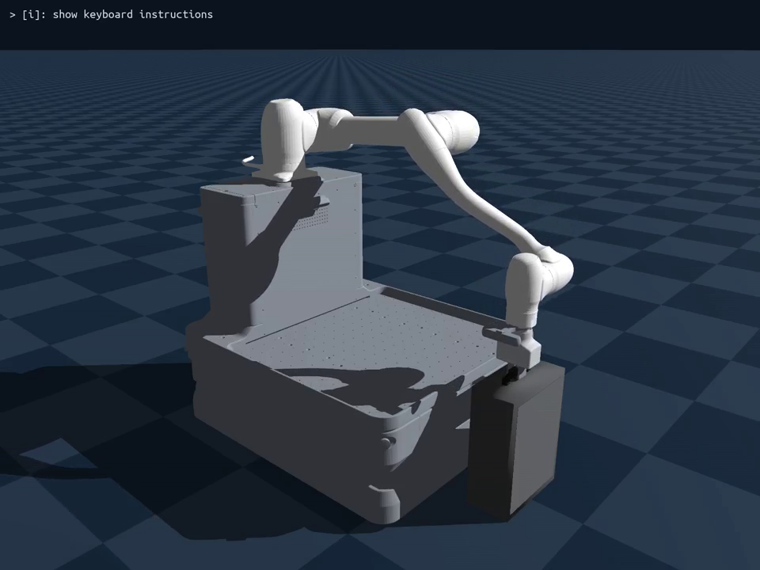
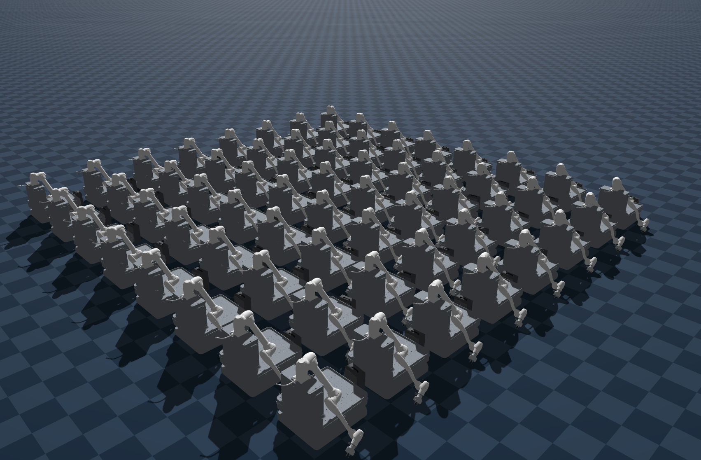
1 · SIMULATION SETUP
06
One Genesis scene, realistic Picker2 contacts
Assets are generated from the Picker2 ROS description; luggage visuals are aligned to collision geometry
8 × 8 TRAINING
SINGLE ENVIRONMENT
Stationary Picker2 base • D455 at the wrist • customized 2FG14 retaining fingertips
Training Environments
Physics: 4 kg luggage · primitive contact proxies · no fixed grasp constraint · bilateral fingertip contact

Slide 7
2 · STATE-BASED RL
07
Actions, observations, rewards, and curriculum
PPO first learns with privileged state; success is determined by physical luggage state—not trajectory completion
ACTION · 7D
OBSERVATION · 63D
REWARD + TERMINATION
• Δx, Δy, Δz
• Δroll, Δpitch, Δyaw
• normalized gripper command
• bounded at every control step
• 46D robot/luggage state
• phase target Δposition + quaternion
• 9D task-phase one-hot + age
• TCP, handle, target and velocities
• target-distance progress
• bilateral contact and retention
• lift, flatness, target pose, +X handle
• release, retreat, success / timeout
Current engineering status: residual-RL bootstrap reaches grasp/lift/transport; rotation and pure end-to-end RL remain open milestones.
PPO
RSL-RL

Slide 8
3 · ROBOT STATE + IMAGE
08
Transition from privileged state to wrist RGB-D
Keep proprioception; replace privileged object pose with learned visual features
D455 INPUT
VISUAL ENCODER
POLICY FUSION
7D CONTROL
RGB frame
Depth / point cloud
Camera intrinsics
Wrist extrinsics
Compact CNN / ViT
Depth-aware fusion
Handle + luggage geometry
Temporal features
Visual latent
Joint + gripper state
TCP velocity
Previous action
Cartesian delta
Orientation delta
Gripper command
Phase / memory
→
→
→
Training recipe: state-policy teacher → synchronized RGB-D rollouts → behavior distillation → PPO fine-tuning with visual randomization.

Slide 9
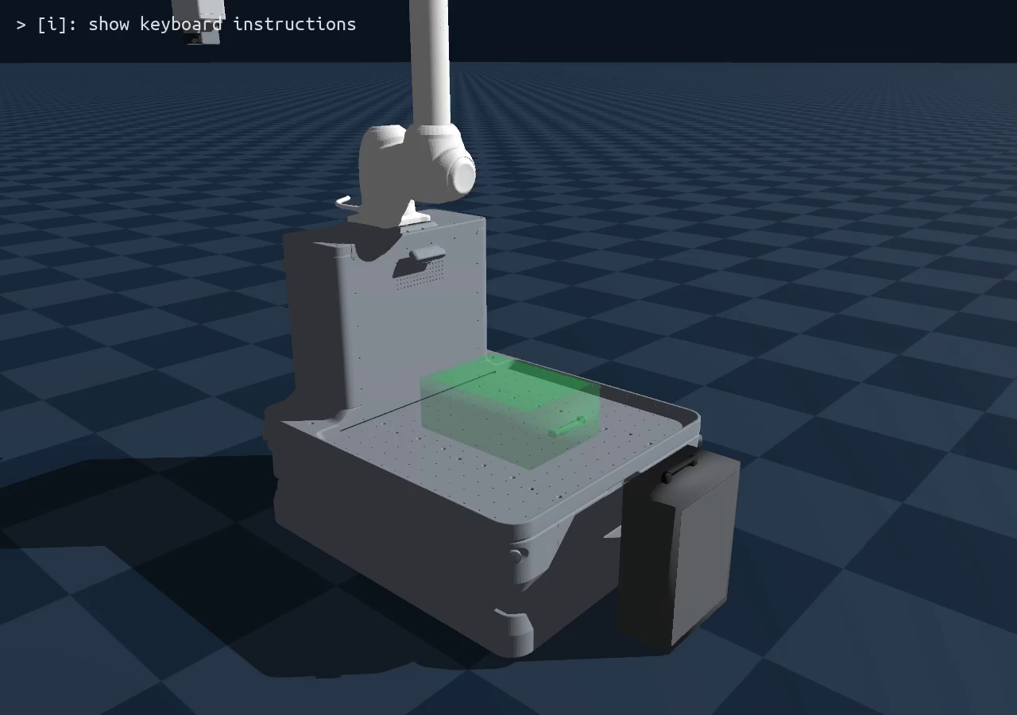
SIMULATION EVIDENCE
10
Current Picker2 Manual Process
Embedded 35-second recording from the local Genesis environment (click Play in presentation mode)
WHAT TO WATCH
• home-position start
• handle approach
• physical grasp
• retained lift
• transport toward platform
• current rotation

