Slide 1
Bring the Analog World to Digital Design
Bin Xu, Conor Naughton, Yimin Xu

Slide 2
Goal
Explore the use of analog signals
Exchange a digital input for a game with an analog input
Store ADC data
Pull data from memory

Slide 3
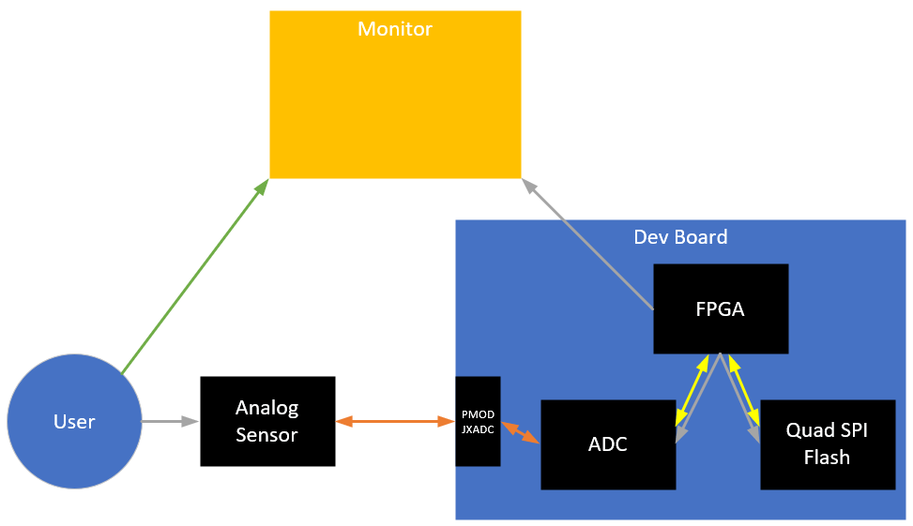
Diagram
Commands
Analog Signal
Digital Signal
Observation

Slide 4
Timelines/Tasks
Game Code Base
Understand how it works
Get it to connect to a monitor
Identify inputs and how we would change them out for our ADC values
ADC
Understand how it works
Define properties (sample rate, measurement range, etc)
Quad SPI Flash
Understand how it works
Enter value into memory, extract value back out

Slide 5
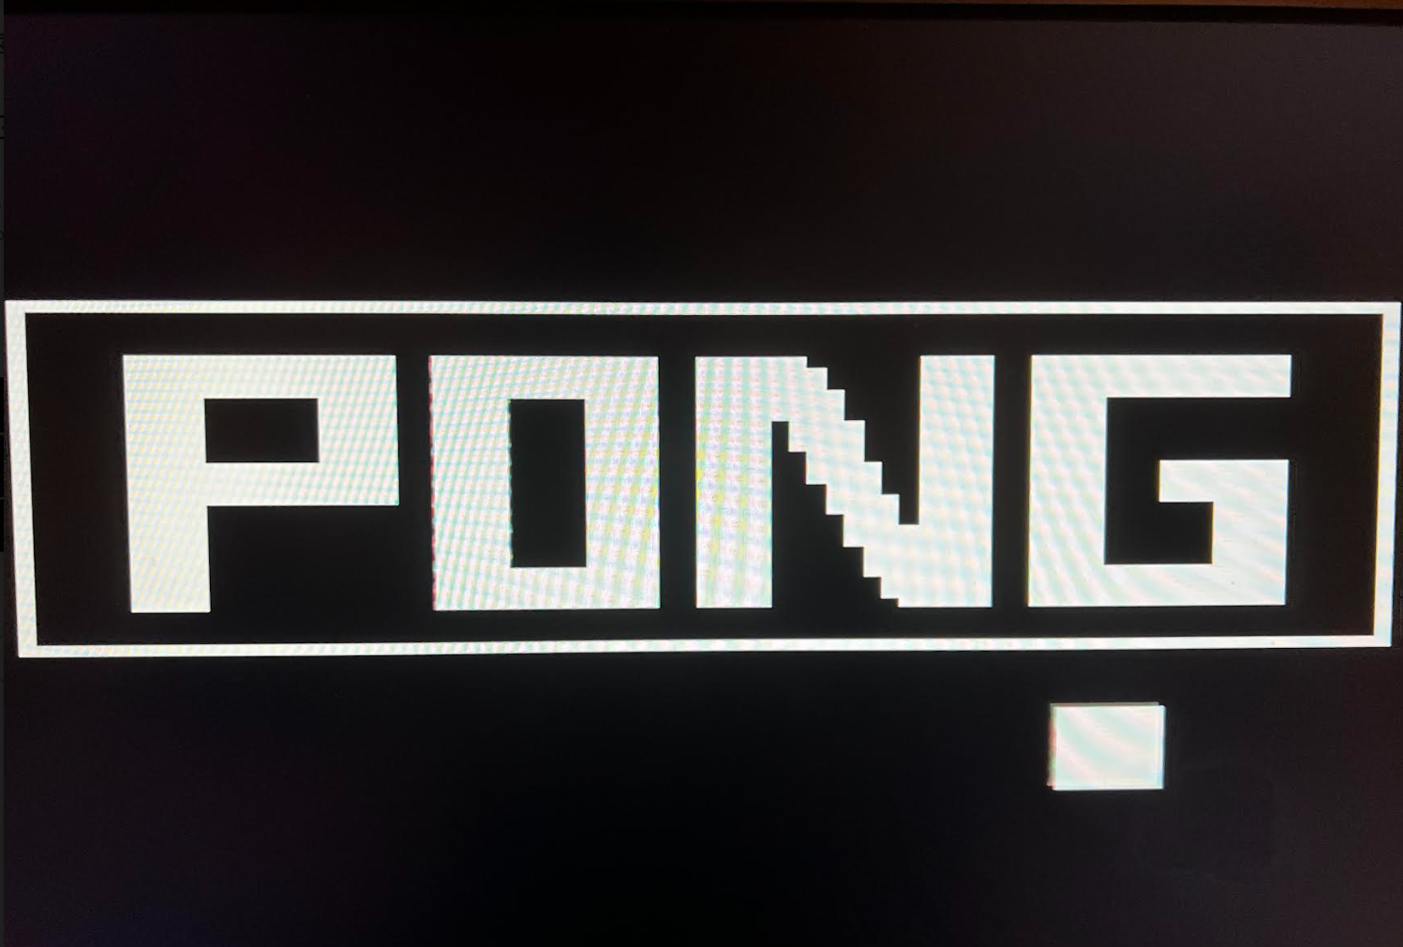
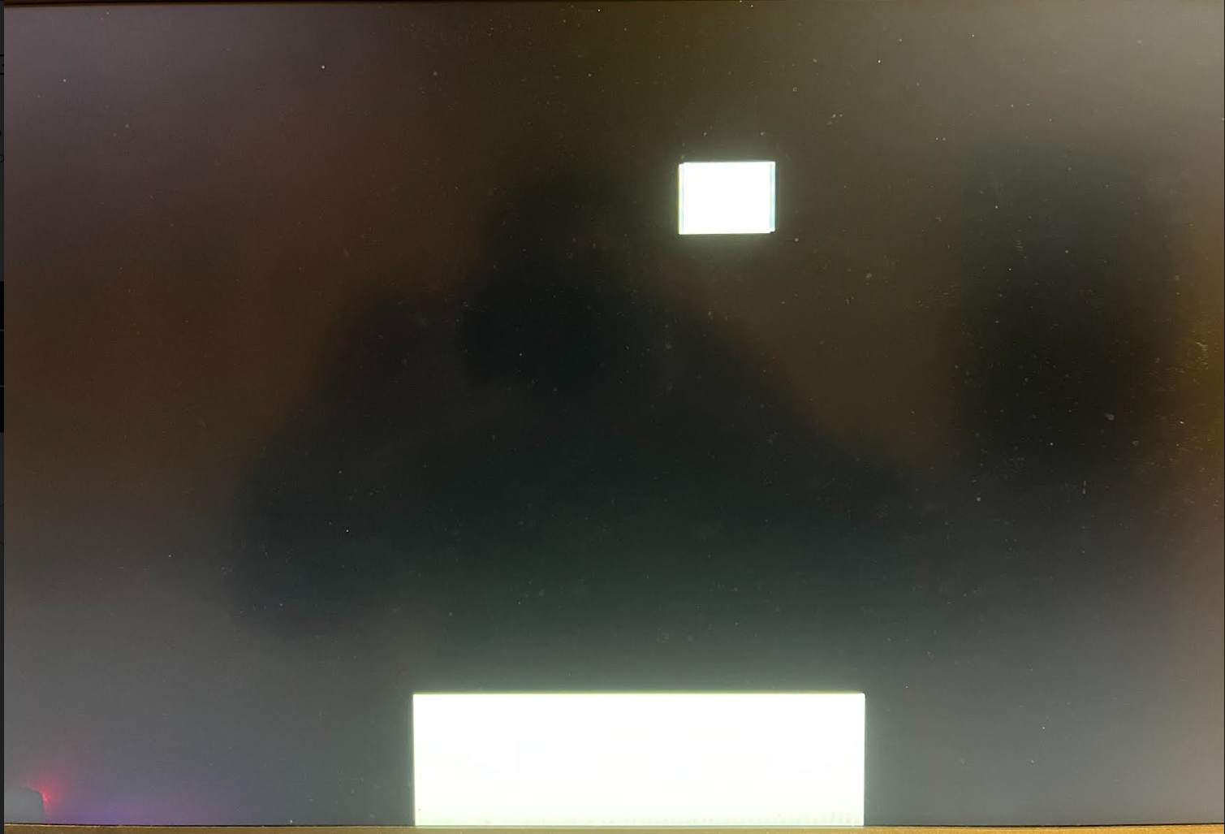
Pong game
Single player, but stores the highest score so players can still compete with their friends
Increase speed with each collision, and to add our own spin on the classic several decoy balls as the game progresses
Have a collision detector that senses when the ball hits the paddle
Use buttons to move the paddle left and right and have a button that starts the game
7segment will show the score of game.

Slide 6
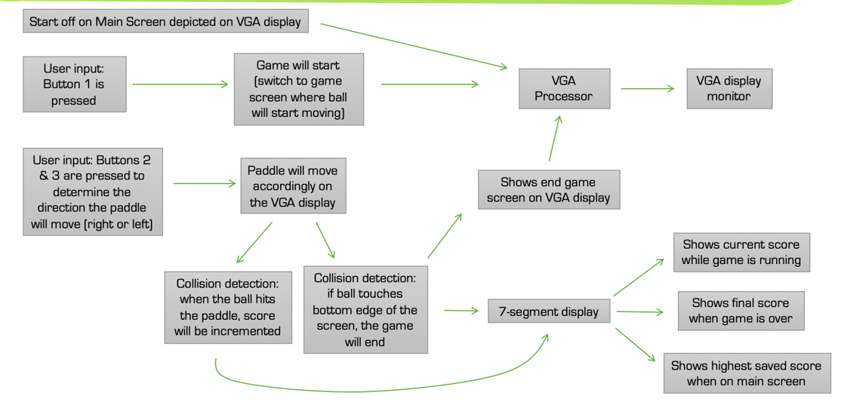
Diagram of game

Slide 7
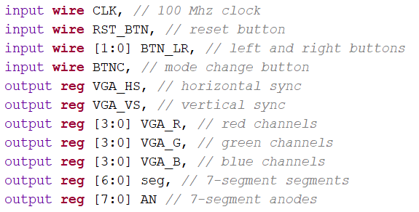
Identify the input
In our project, we will connect the left and right button to analog button.
When the speed of ball bouncing increases, the pressure of pressing analog button will be increased.

