Slide 1
Bringing the Analog World to Digital Design
Team member:
Conor Naughton
Bin Xu
Yimin Xu

Slide 2
Goal
Explore the use of analog signals
Exchange a digital input for a game with an analog input
Store ADC data
Pull data from memory

Slide 3
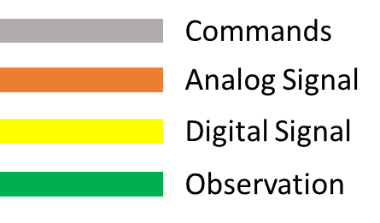
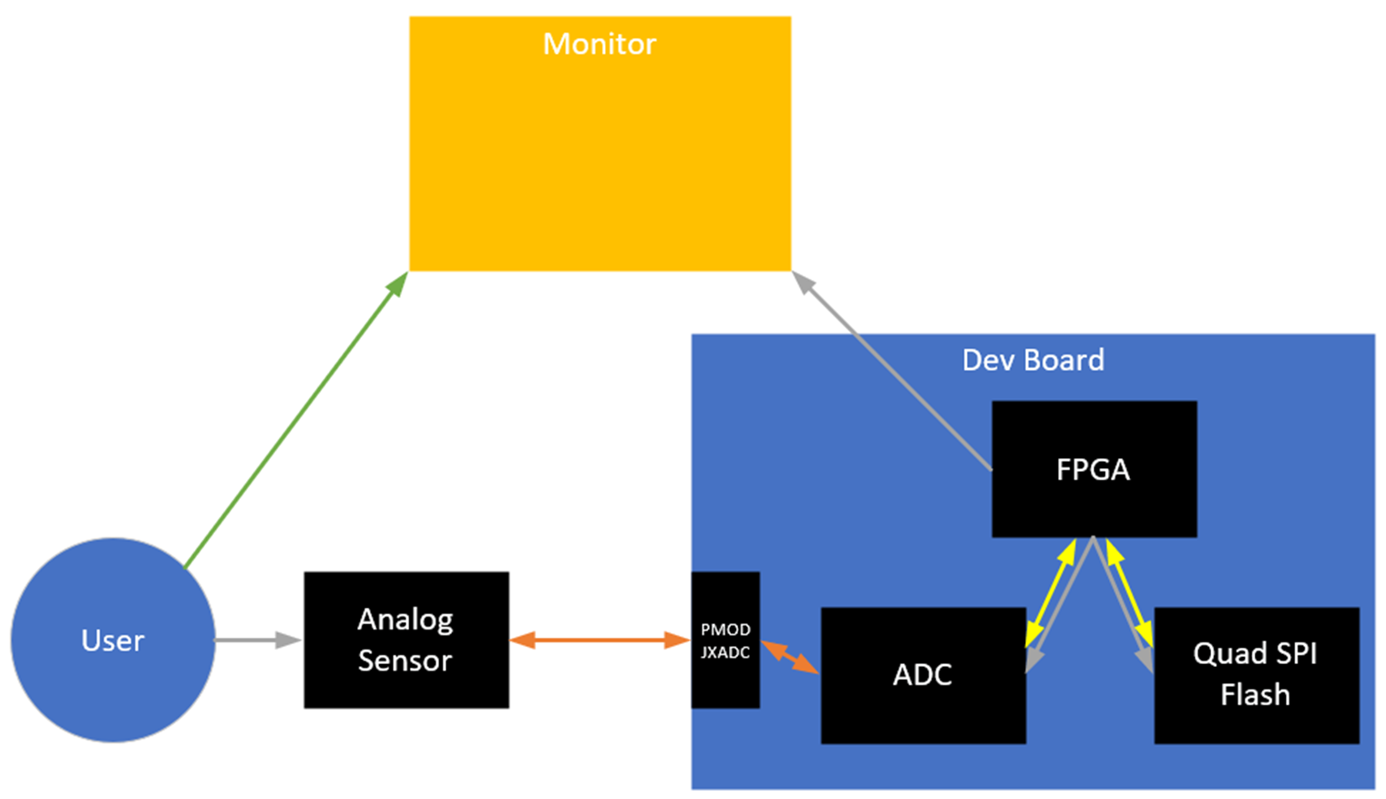
High Level Diagram

Slide 4
Demo Clarification
Game: Pong
User Analog Input Mechanism: Force Sensitive Resistor
As the user pushes harder, the input signal will increase in magnitude
Game Play
User will have two input sensors, one which will make the paddle go up and the other to make it go down.
The harder the user presses on a given sensor, the faster the paddle will move up or down.
Memory
Continuous writing of small amount of gameplay to non volatile RAM which can be displayed after a point is scored even if power is lost.

Slide 5
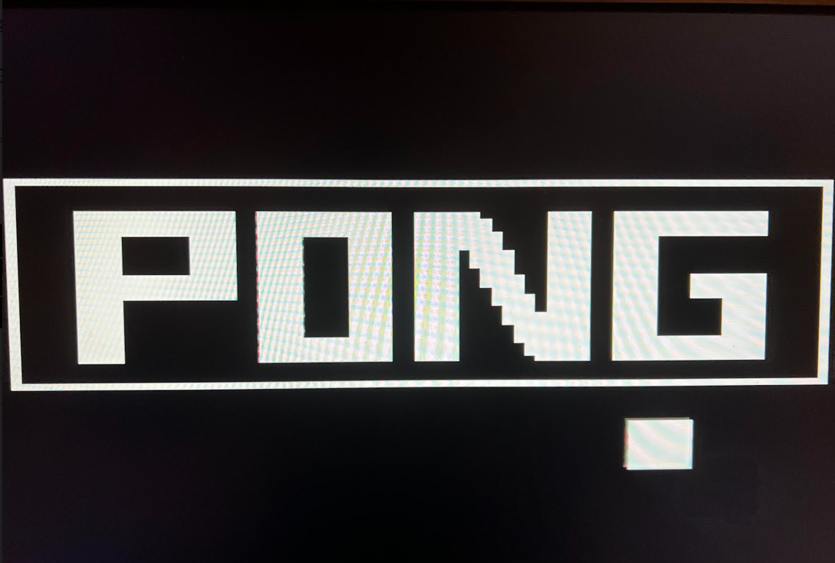
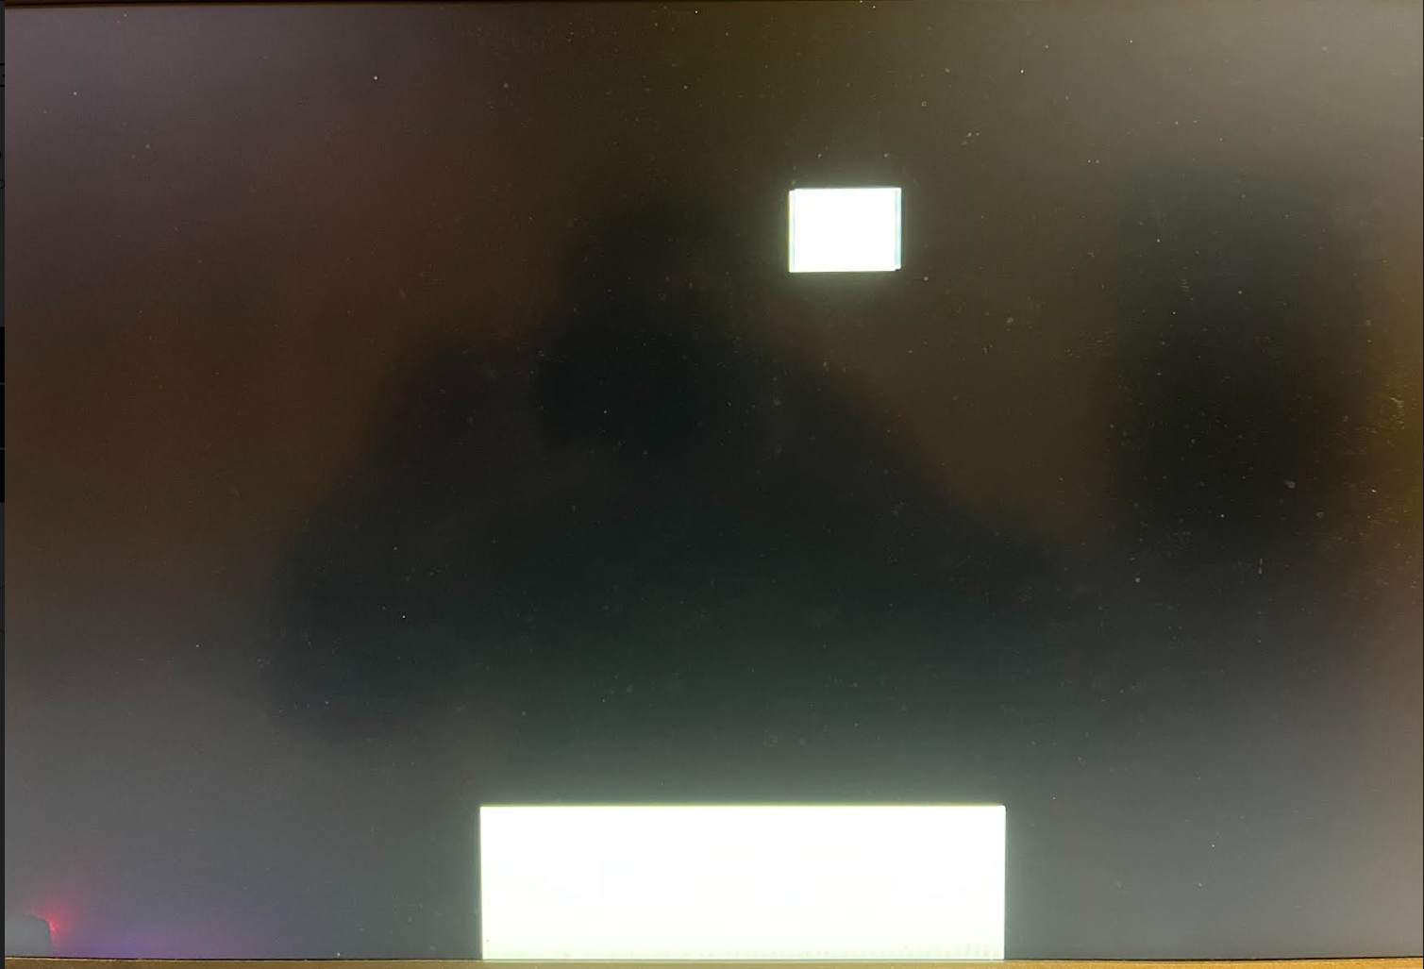
Pong game
Single player, but stores the highest score so players can still compete with their friends
Increase speed with each collision, and to add our own spin on the classic several decoy balls as the game progresses
Have a collision detector that senses when the ball hits the paddle
Use buttons to move the paddle left and right and have a button that starts the game
7segment will show the score of game.

Slide 6
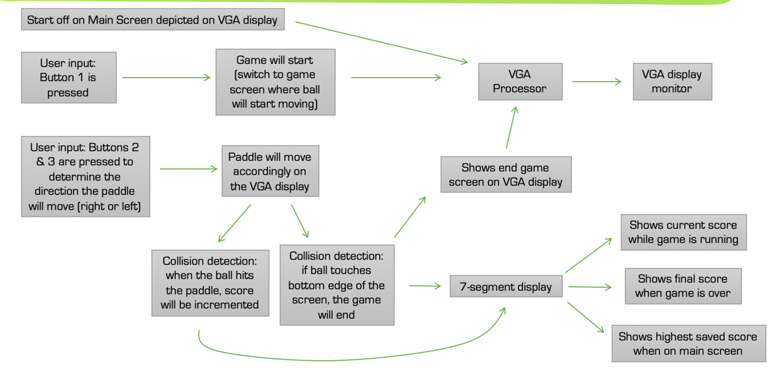
Diagram of Game

Slide 7
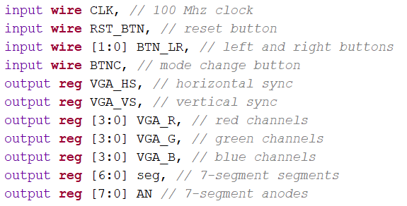
Game Input Discussion
In our project, we will connect the left and right button to analog button.
When the speed of ball bouncing increases, the pressure of pressing analog button will be increased.

Slide 8
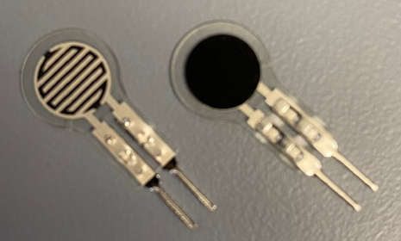
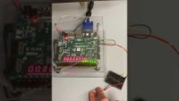
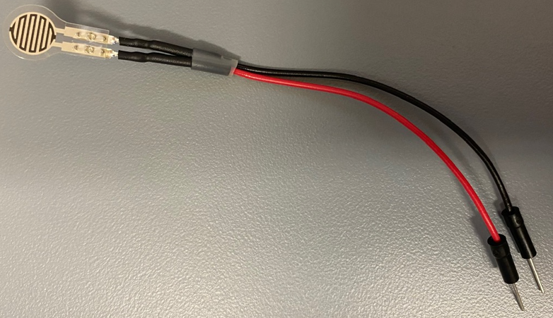
ADC Development

Slide 9
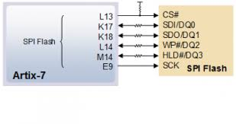
QSPI flash controller
Timing control loop
Reading a word
Reading another word -> loop
The Startup Sequence

Slide 10
What’s Going Well
ADC code working
Force sensitive resistors working
Build a QSPI flash controller
Game code works
Game video is displaying over VGA

Slide 11
What’s Not Going Well
Need to make sensor output more differentiable.
Invert the QSPI flash controller into game.

Slide 12
Timeline and Project Assignments
Game Code Base [Bin Xu]
Understand how it works [10/14] Complete
Identify inputs and how we would change them out for our ADC values [10/28] Complete
Get FPGA to connect to a monitor [11/3] Complete
ADC [Conor N]
Understand how it works [10/14] Complete
Define properties (sample rate, measurement range, etc) [10/21] Complete
Prepare analog sensor for connection to dev board [10/28] Complete
Demonstrate sampling with analog sensor [11/3] Complete
Quad SPI Flash [Yimin Xu]
Understand how it works [10/14] Complete
Identify memory availability to inform how much we can use [10/21] Complete
Demonstrate ability to enter values into memory and extract [11/3] Complete

Slide 13
Path Forward
Game Code Base [Bin Xu]
Change out button input for ADC output [11/11]
Start with simple threshold and maintain single step of paddle
Change from single step to step proportional to ADC output [11/18]
ADC [Conor N]
Figure out how to make measurements more differentiable [11/4]
Likely replace with a load cell but in the mean time, try to find an EE solution
Characterize measurement repeatability, fidelity [11/9]
Finalize gameplay setup and demonstrate functionality [11/18]
Quad SPI Flash [Yimin Xu]
Combine the flash controller into game memory

