Slide 1
Bring the Analog World to Digital Design
Bin Xu, Conor Naughton, Yimin Xu

Slide 2
Goal
Explore the use of analog signals
Exchange a digital input for a game with an analog input
Store ADC data
Pull data from memory

Slide 3
Why
FPGAs work with digital signals however the tasks they are used for often involves analog inputs
Analog is more interesting than digital
Requires interacting with and controlling another component of the development board (Analog to Digital Converter (ADC))

Slide 4
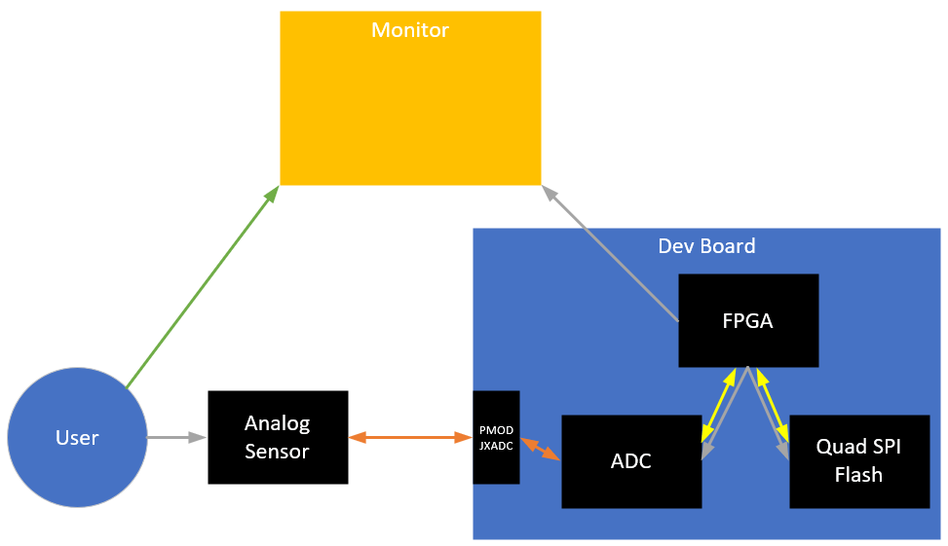
Diagram
Commands
Analog Signal
Digital Signal
Observation

Slide 5
Demo
Play the game

Slide 6
HW/SW Needs
HW
Digilent Basys3 Dev Board
Will work on boards in PHO105
Analog sensor
Force Sensitive Resistor (FSR)
~$10 on Amazon
Will likely require soldering leads
Monitor
Can likely just use laptop
SW
Game code base
GitHub repo identified

Slide 7
Concerns
Communication
FPGA to ADC
FPGA to monitor
Sensor characteristics
Noise
Sensitivity

Slide 8
Timelines/Tasks
Game Code Base
Understand how it works
Get it to connect to a monitor
Identify inputs and how we would change them out for our ADC values
ADC
Understand how it works
Define properties (sample rate, measurement range, etc)
Quad SPI Flash
Understand how it works
Enter value into memory, extract value back out

