Slide 1
Bring the Analog World to Digital Design
Bin Xu, Conor Naughton, Yimin Xu

Slide 2
Goal
Explore the use of analog signals
Exchange a digital input for a game with an analog input
Store ADC data
Pull data from memory

Slide 3
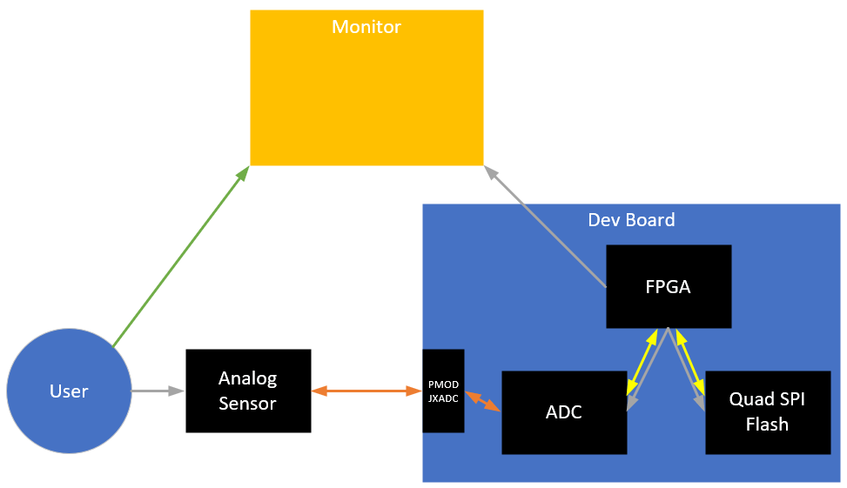
Diagram
Commands
Analog Signal
Digital Signal
Observation

Slide 4
Timelines/Tasks
Game Code Base
Understand how it works
Get it to connect to a monitor
Identify inputs and how we would change them out for our ADC values
ADC
Understand how it works
Define properties (sample rate, measurement range, etc)
Quad SPI Flash
Understand how it works
Enter value into memory, extract value back out

