Slide 1
Smart Lock

Slide 2
Identification of gaps and opportunity
Tendency
Security Of Smart Lock
Management Of The Information
Smart Contract
2016 DEF CON Hacking Conference
https://media.defcon.org/DEF%20CON%2024/DEF%20CON%2024%20presentations/DEFCON-24-Rose-Ramsey-Picking-Bluetooth-Low-Energy-Locks.pdf

Slide 3
Objectives
Combining smart locks and blockchains enables them to have the following features：
Landlords register their locks and set rents for their homes through smart contracts.
The tenant transfers the contract for the house to be rented by looking up the contract address.
The tenant came to the front of the house to show the QR code converted from his own signature.
The smart lock scans and recognizes the QR code and verifies the authenticity of the signature and the legitimacy of the tenant's rental time.

Slide 4
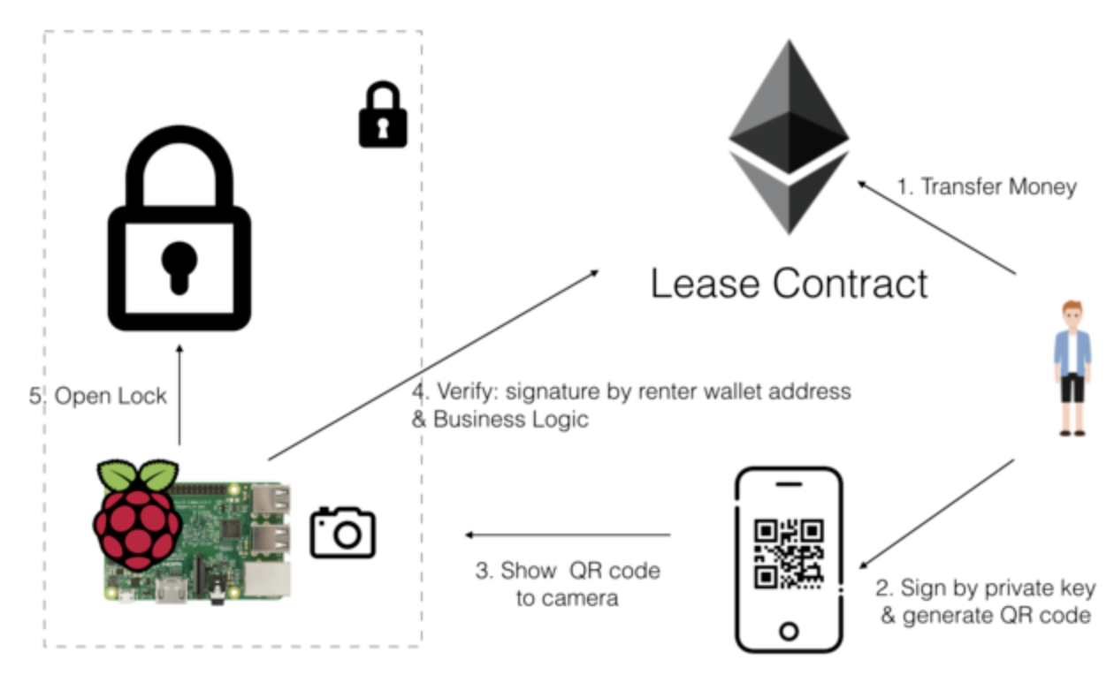
Outline
More potential features：
Establish a smart contract with a cleaning company.
Tenants can also go inside the property (without the landlord) with the permission of the landlord to decide whether to rent .
Suppose someone decides to travel, smart
lock will record his/her calendar and schedule
rental time and maximize the benefits.

