Slide 1
SOFTWARE PROJECT MANAGEMENT AND COST ESTIMATION

Slide 2
“Pick two from three”
Time
Quality
Cost
Notes:
Management of a software project involves managing the resources – crudely these are time, people, and quality.
The tasks involved in project management follow naturally from this. Project planning is the management of all three. Risk management is management of quality. Project scheduling is management of time. People management is management of cost though of course other elements of cost (e.g. equipment) must be considered too.

Slide 3
The Constraint Triangle
Time
Cost
Quality
Notes:
If there is one thing that you take away from this course, it should be this diagram.
(Quotes here are from Rudy Rucker’s book “Software engineering and computer games”, 2003, Addison-Wesley Pearson Education Ltd)
Software engineering is all about working within the constraints imposed by time, cost (usually in terms of people) and quality (in terms of features and/or bugs).
“In a fantasy world we’d like our projects to be done instantly, to cost nothing, and to be of infinitely good quality. However, in the real world we must compromise – it is impossible to achieve all three goals of zero time, zero cost and infinite quality.
You can decrease the time needed but will need to add more staff and/or reduce the quality.
You can reduce the cost by using fewer staff, but the project will take more time and/or reduce in quality
You can opt for high levels of quality, but this means it will cost more and/or take more time.
In general any change in one goal must be compensated for by changes to one or both of the other goals.
If you let your customer (or your manager) specify all three corners of the constraint triangle, your project is doomed to fail.”
Rucker notes that NASA briefly adopted the slogan ‘Faster, cheaper, better’. However, after a series of disastrous projects the slogan was quietly but quickly abandoned. The lesson they had learned was that such a slogan is impossible to satisfy.
Wags in the software engineering world modified the slogan to ‘Faster, cheaper, better: pick two out of three” …

Slide 4
Constraint trade off
Not always possible, so
Cost
Increasing cost/resources will not always reduce time or increase quality
Why is this?
Time
Increasing time will not always increase quality?
Why?

Slide 5
What cause costs?
People
More people → more cost
Hours per person per day
Using bought in software
Outsourcing
Hardware

Slide 6
Time/Cost trade off
To reduce time
Use more people
Buy in external software
Get staff to work longer hours
Constraints
Is software or people available to buy in?
Will people working longer hours produce good software

Slide 7
Time constraint
Software components are often dependent
The more work done with class design, easier it is to decrease the development time … splitting the task..
Remember 20-80 rule, keep specification prioritized
People working longer hours will make more mistakes, which need fixing

Slide 8
Time and testing
Testing cycles take a lot of time
You can increase testing staff to reduce test cycle time
This will
Increase cost
Improve quality hopefully
Reduce time to complete development

Slide 9
Quality/time
More time may deliver more quality but only
If time is spent doing testing and QA and not adding more functionality
If software development is progressive not regressive (see source control)
There are proper processes for QA

Slide 10
Regressive development
2 bugs reported in software
Bugs fixed goes back to testing
4 bugs reported in software
Bug fixes go back to testing
6 bugs reported in software…
Etc..

Slide 11
Testing cycles
Need to be long enough
To test all components
Short enough to keep development flowing
Ideally testing needs to be overlapped with bug fixing
Bugs should be reported immediately and not drip feed.

Slide 12
Why disasters happen ?
Poor schedule monitoring
Poor analysis of slippage resulting in remedies that rely on adding manpower
Milestones and granularity
Fine grained
Notes:
All schedules need to be monitored – failure to monitor the schedules is as bad as not having a schedule in the first place – and leads to disaster.
Similarly, it is no good monitoring that a schedule is slipping if there are no remedies to solve the problem – and for reasons we shall see, just adding manpower is often not a solution. Indeed it may compound the problems.
Finally what should the schedule contain: work blocks; deliverables; tasks; milestones; – or all all of them. Clearly the answer is as many are required for the project in hand.
To monitor the project the schedule one of the most useful is the milestone – a time point where the others (blocks, deliverables and tasks) will be assessed.
Keeping milestones fine grained means that slippage can be discovered sooner than later, it also provides assessment of the progress of the project.

Slide 13
Software Project Estimation
Software development takes time
Estimating the time needed is hard
Disasters continue to happen
Good management and good schedule monitoring are key to avoiding problems
Notes:
We can see that failure to observe the rules of the constraint triangle leads to software engineering disasters – which we can define as projects over time, over budget, and/or not doing what they should do or being full of bugs.
One way to avoid such problems is to have realistic project estimation and to have reliable strategies in place for when the estimates begin to wobble – which they surely will do.
(Put another way, there is a tendency to underestimate the resources required to deliver a particular level of quality).
Last week we noted that software development was hard to do because of the inherent complexity and for this reason developing software takes time.
Because of the complexity we get unpredictability; and for this reason estimating project costs is also hard to do.
To avoid the disasters it is necessary to have good (honest) management, to develop realistic time schedules, to have extensive project monitoring in place and some reliable strategies to resolve the inevitable creeping delays and costs that find their way into the project.

Slide 14

Mythical man month
Author : Fred Brookes
Prof. Comp Science at University of North Carolina
Project manager of IBM 360 OS project
Why mythical?
If 4 programmers can complete a task complete a task in 6 months
How long will it take 24 programmers to complete the same task? (1 month, 3 months, >6)

Slide 15
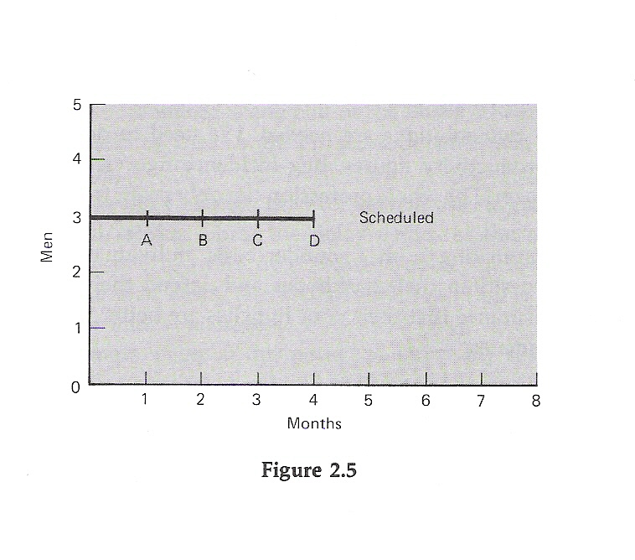
Schedule slippage
Notes:
Imagine this schedule: (taken from Brooks MMM, p22-26)
There is a task estimated to take 12 man months.
It is assigned to 3 staff for four months.
There are 4 mileposts, falling at the end of each month.
Note that months are along the x-axis, and staff allocated to the project along the y-axis.

Slide 16
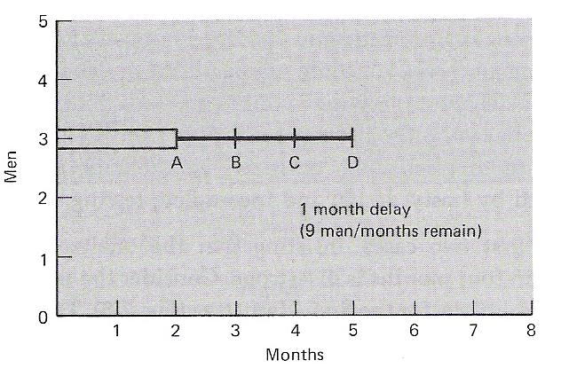
Slippage delay Assumption 1
Assuming only task 1 is underestimated, workload left = 9 mm
To do 9 man/month work in 2 months needs 5 staff, 2 extra
Notes:
Here we illustrate that the the first milepost is not reached until two months have elapsed.
The open line indicates the past, the simple line the future.
There has been slippage of one month.
Notice, incidentally, that because of the milestone we have at least spotted the slippage.
What do we do ? and
What strategies are available to us to remedy the situation ?
Assume that the task must be done on time. Assume that only the first part of the task was mis-estimated so the figure tells the story accurately. This is one months delay for 3 staff leaving 9 man months of estimated effort remaining and 2 months for completion. 9/2 = 5 staff are now required to complete the task, that is 2 extra.

Slide 17
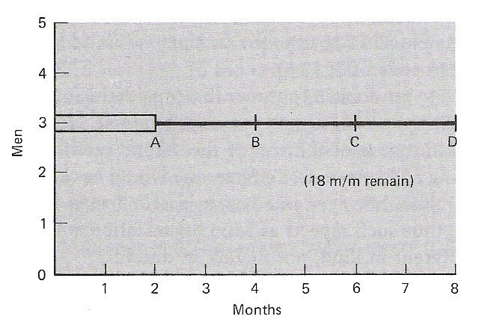
Slippage delay Assumption 2
Assuming all tasks are underestimated, workload left = 18 mm
To do 18 man/month work in 2 months needs 9 staff, 6 extra
Notes:
2) Assume that the task must be done on time. Assume that the whole estimate was uniformly low, so that the figure above is really the situation. That is, it has taken 3 men two months (6 man months) to get here, there are 3 phases left requiring 6*3 = 18 man months of effort. The time left is 2 months, thus 18/2 = 9 staff are required; we need to add 6 to the 3 already on the project.

Slide 18
Further strategies
Strategy 1
Reschedule to take a longer time with the same team
Strategy 2
Trim the task to ensure completion on the same time schedule (use triage to determine trim)

Slide 19
Triage
Feature triage
Must do, good to do, nice to do
Testing/debug triage
Must fix, good to fix, nice to fix
Desirable
Useable
Critical

Slide 20
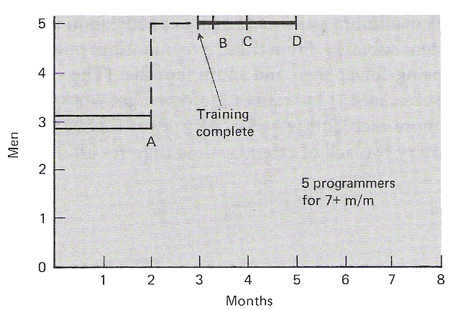
Analysis
Assuming that the project can complete in 4 months is a disaster !
Notes:
The problem is that there is a lag in implementing any solution.
In this case the assumption that we must complete in 4 months is disastrous. Adding people, however talented and assuming rapid recruitment … will divert one of the existing people (say, for a month) wasting his time and one man months effort from each of the new men. (either 3 or 7 m/m).
Further, work already done will be lost and extra work will need to be done by way of testing because more men are now working on the project, and introducing bugs. One solution might be to add yet more men. Using the assumptions of Strategy 1 a total of 7 men would now be required; given training time, etc … the project would be as late as if no further men were added.
The same is true, with even more disastrous cost implications if Strategy 2 were used.
This leads to Brooks’ Law: Adding manpower to a late software project makes it later.
Doing the diagrams is one way to appreciate this. But what are the problems.
Before moving on; it is important to note that working with milestones in this way does not need to affect the other aspects of the planning namely; the work packages, tasks, and deliverables involved but often does so – simply because of the nature of the constraint diagram.

Slide 21
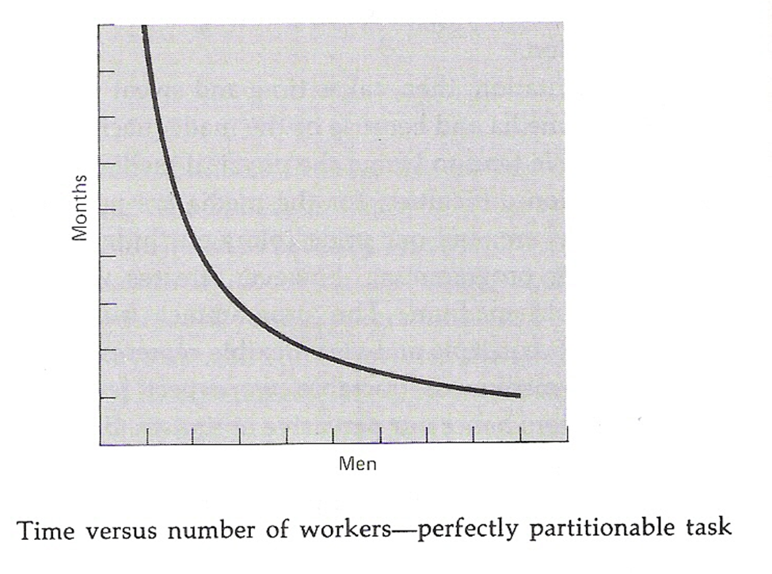
Notes:
The first problem is that while cost does vary as the product of the number of men and the number of months … project progress does not.
The man-month as a unit for measuring the size of a job is dangerous, and worse, deceptive.
Men and months are interchangeable only when a task can be partitioned with the assumption that there is no communication among the workers.
True of (say) gathering crops not even approximately true in software engineering.

Slide 22
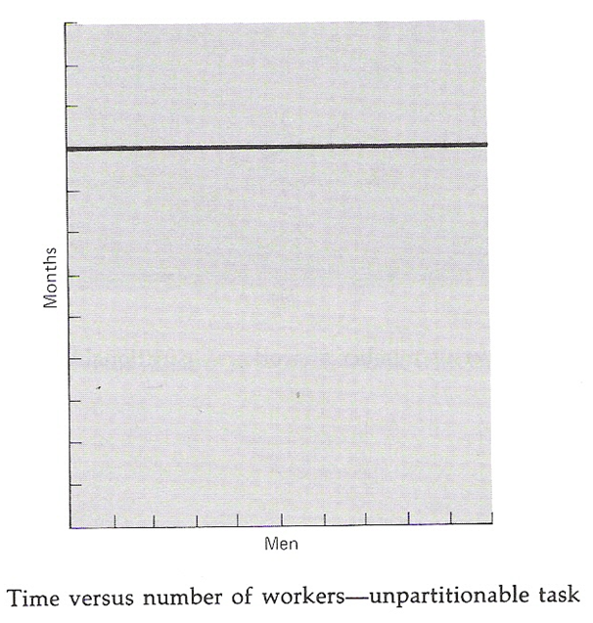
Sequential constraints
Notes:
When a task cannot be partitioned, because of sequential constraints, the time versus men graph is a flatline, the application of more effort has no effect on the schedule.
True of childbirth which takes 9 months, and true of many software engineering tasks such as debugging, because of the sequential nature of the task.
Thus, it is important to know how sequential the task is. If it is highly sequential, then it is highly constrained in terms of time required.
Partitioning tasks is evidently desirable so that more development effort can be added to the project if its running late.

Slide 23
Task partitioning
Partitioning design class by class
Partitioning class up, method by method
Class interface
Defined in the design phase
Class stub
Can be generated automatically
Might need simulation code (e.g. stock ticker to produce random prices)

Slide 24
In practise
Many software engineers/project managers will under-estimate tasks
Lack of experience
Not accounting for contingency
Pressure from management
Assuming everyone is as skilled as you!
Important to manage expectations
x 2 (x 3) all your personal estimates
Keep a record of your forecast against actual performance
Sandbag risky activities (e.g. ones dependent on external parties)

Slide 25
In practise
Managing expectations
Give bad news as it happens (not all at the end of the project)
Give management alternatives (such as delivery in phases)
Put in place plan on how to trim task
Explain how reducing test time for example could lead to commercial disaster
In general most overruns will be in test time

