Slide 1
新增一片網卡

Slide 2

練習:
ens38:
FORward
ens33
GW(Bridge)
ens33:
dhcp4: true
ens38:
dhcp4: no
addresses: [192.168.48.188/24]
ws01(Host only)
ens33:
addresses: [192.168.48.180/24]
gateway4: 192.168.48.188

Slide 3
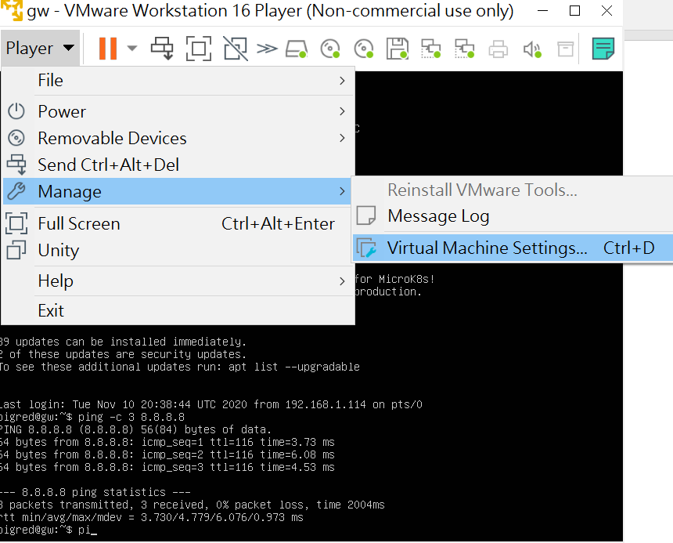
1
2
3

Slide 4
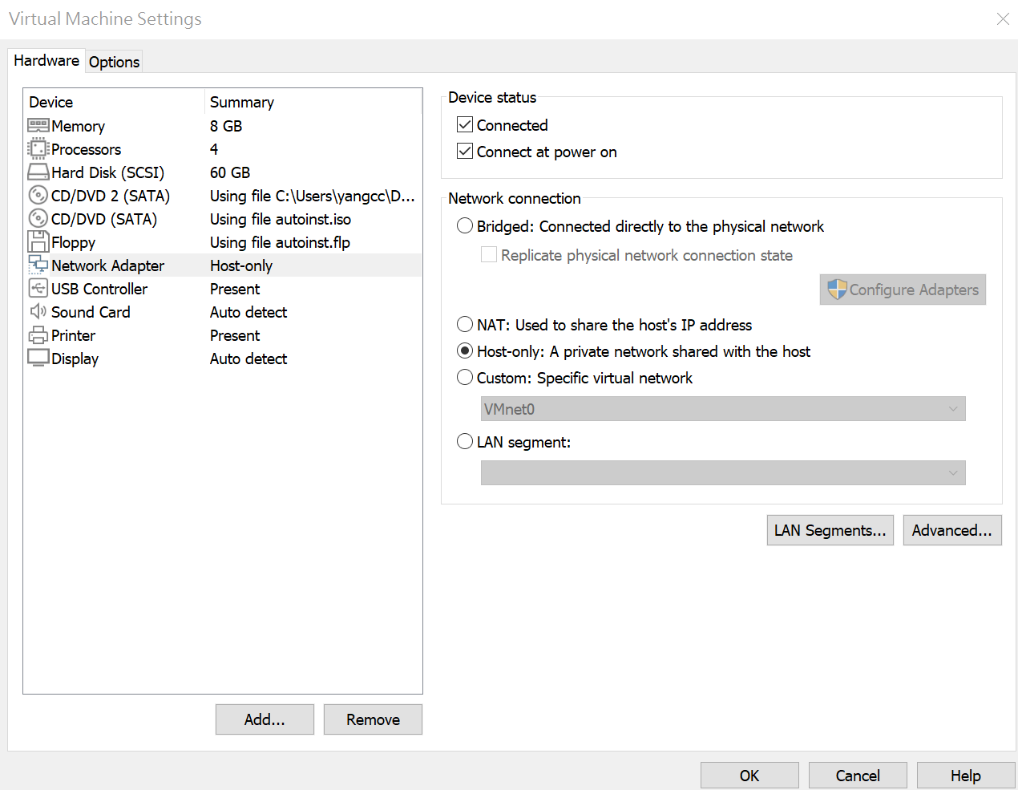
1

Slide 5
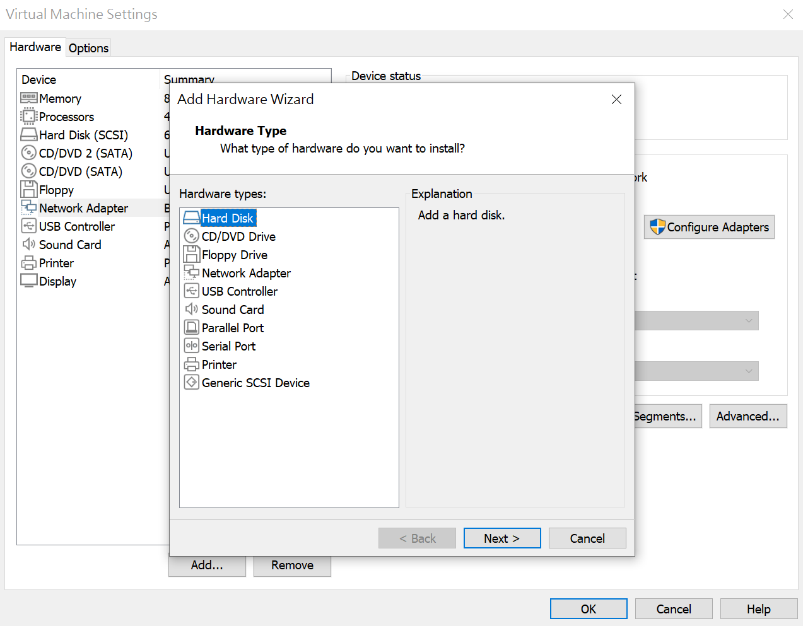
1

Slide 6
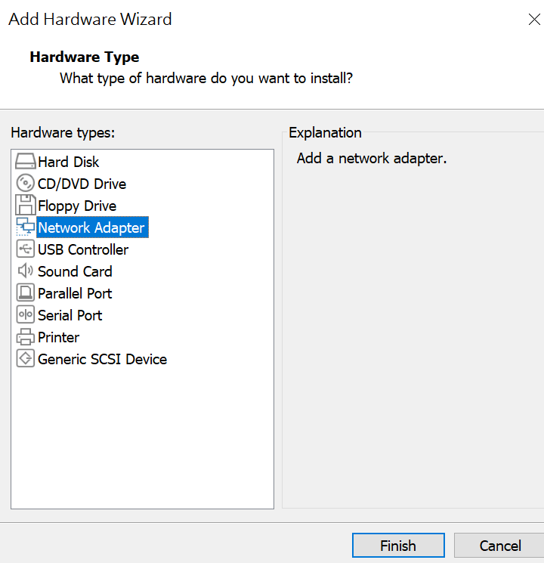
1

Slide 7
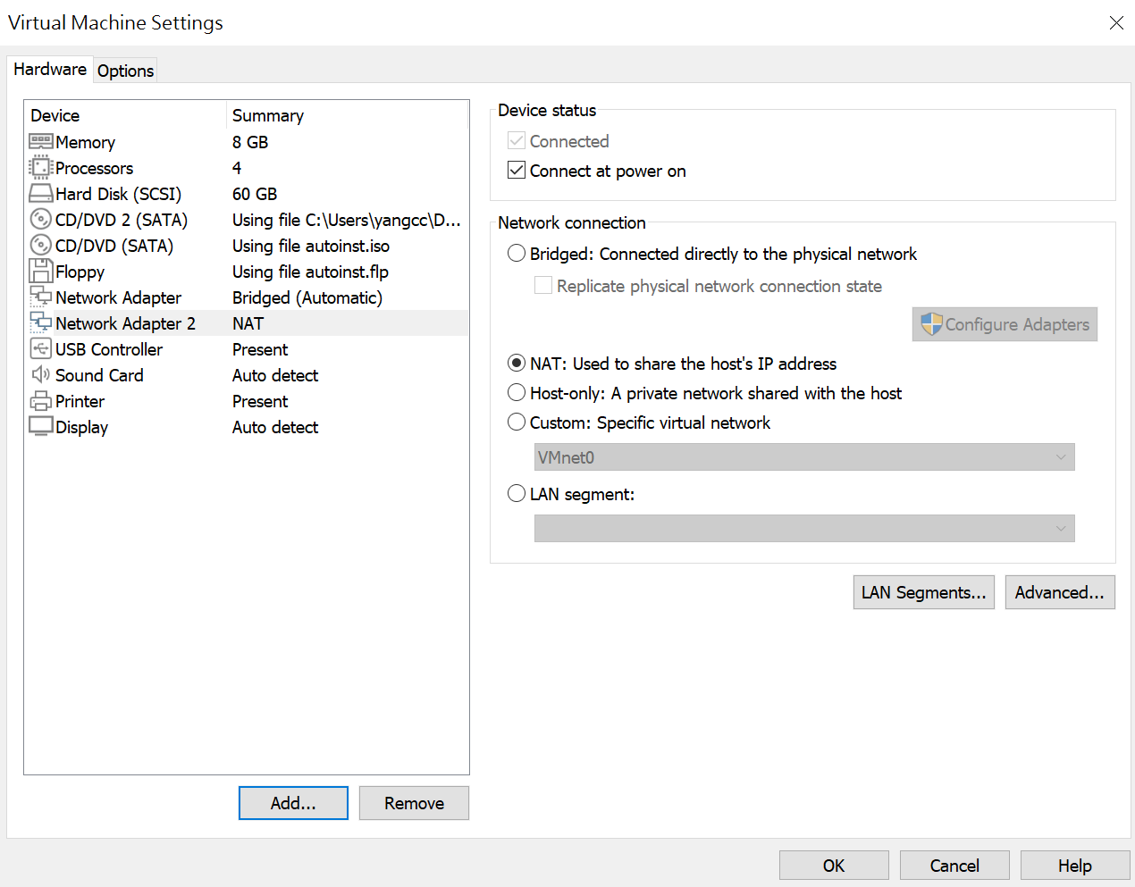
1

Slide 8
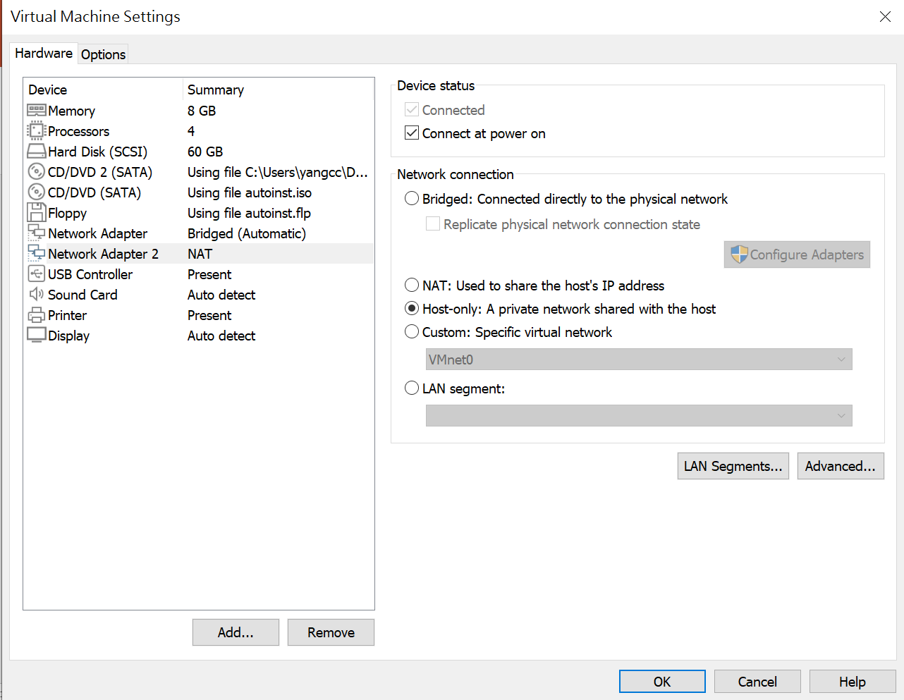
1

Slide 9
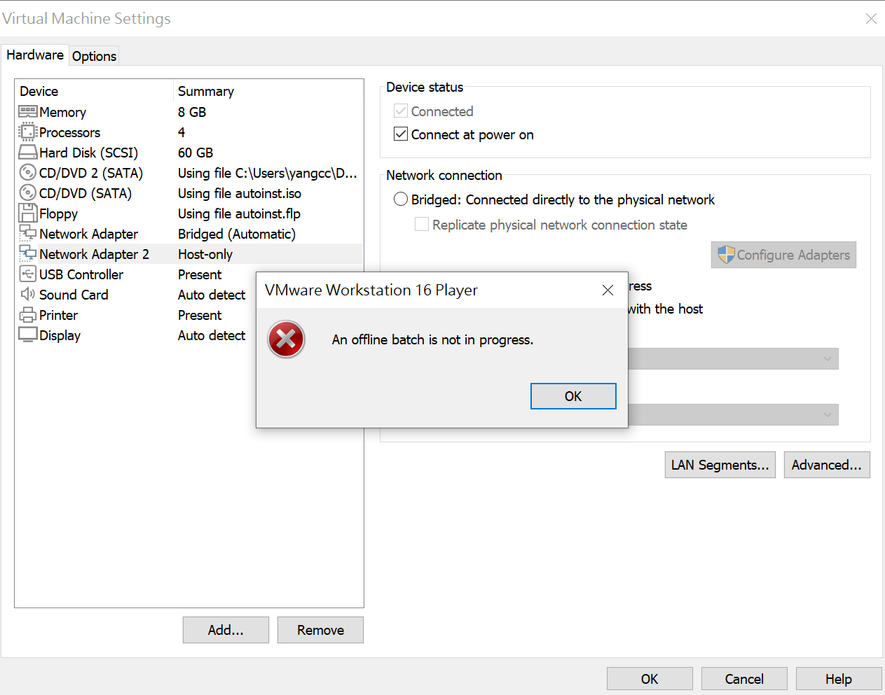
1
2

Slide 10

再啟動

Slide 11
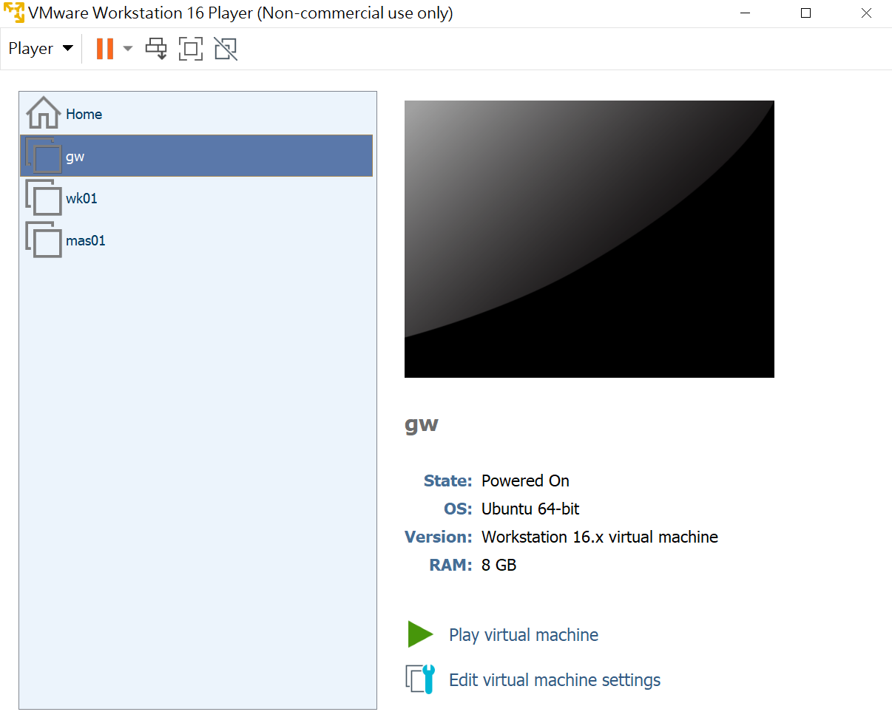

Slide 12
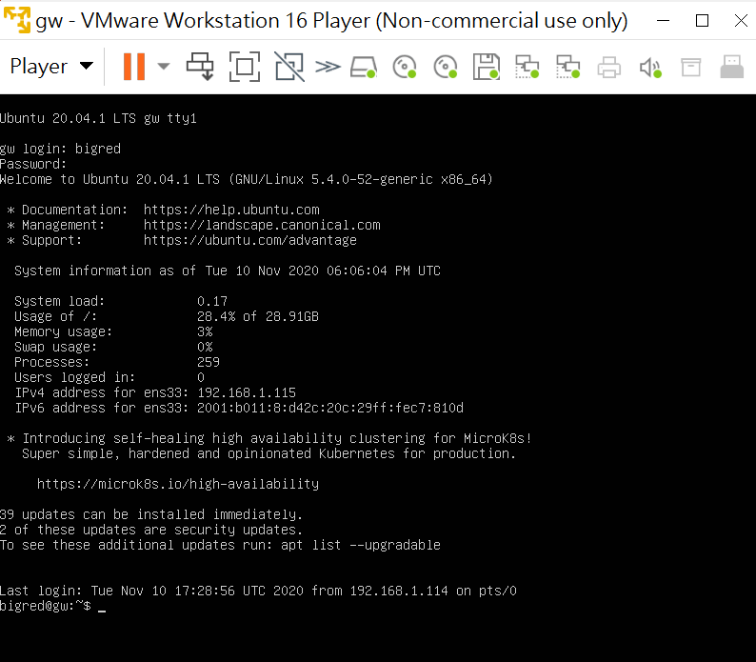

Slide 13
bigred@gw:~$ ifconfig -a
ens33: flags=4163<UP,BROADCAST,RUNNING,MULTICAST> mtu 1500
inet 192.168.1.115 netmask 255.255.255.0 broadcast 192.168.1.255
inet6 fe80::20c:29ff:fec7:810d prefixlen 64 scopeid 0x20<link>
inet6 2001:b011:8:d42c:20c:29ff:fec7:810d prefixlen 64 scopeid 0x0<global>
ether 00:0c:29:c7:81:0d txqueuelen 1000 (Ethernet)
RX packets 255 bytes 79820 (79.8 KB)
RX errors 0 dropped 0 overruns 0 frame 0
TX packets 139 bytes 37330 (37.3 KB)
TX errors 0 dropped 0 overruns 0 carrier 0 collisions 0
ens38: flags=4098<BROADCAST,MULTICAST> mtu 1500
ether 00:0c:29:c7:81:17 txqueuelen 1000 (Ethernet)
RX packets 0 bytes 0 (0.0 B)
RX errors 0 dropped 0 overruns 0 frame 0
TX packets 0 bytes 0 (0.0 B)
TX errors 0 dropped 0 overruns 0 carrier 0 collisions 0
…..

Slide 14
Tab鍵
bigred@gw:~$ sudo nano /etc/netplan/00-installer-config.yaml

Slide 15
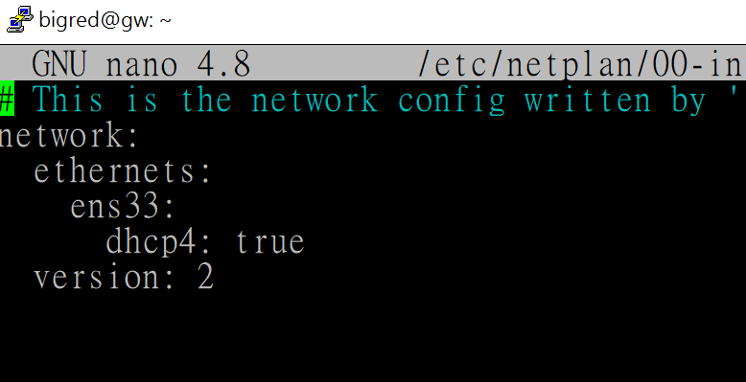
既有內容

Slide 16
改成
network:
ethernets:
ens33:
dhcp4: true
ens38:
dhcp4: no
addresses: [192.168.48.188/24]

Slide 17
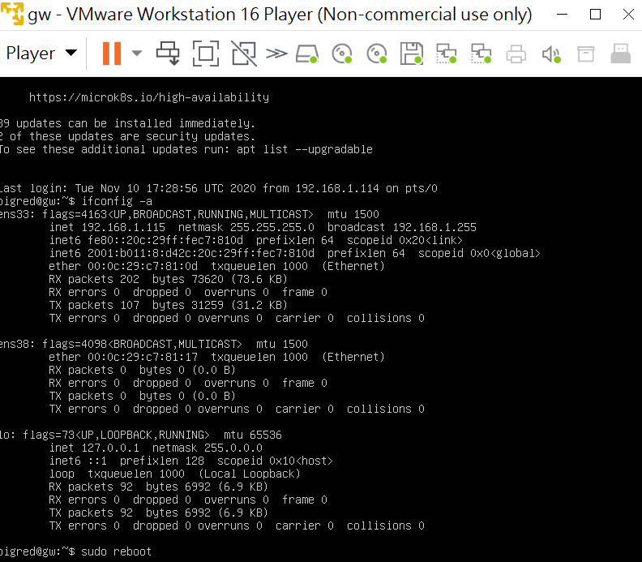
$sudo reboot

Slide 18
login as: bigred bigred@192.168.1.115's password:

Slide 19
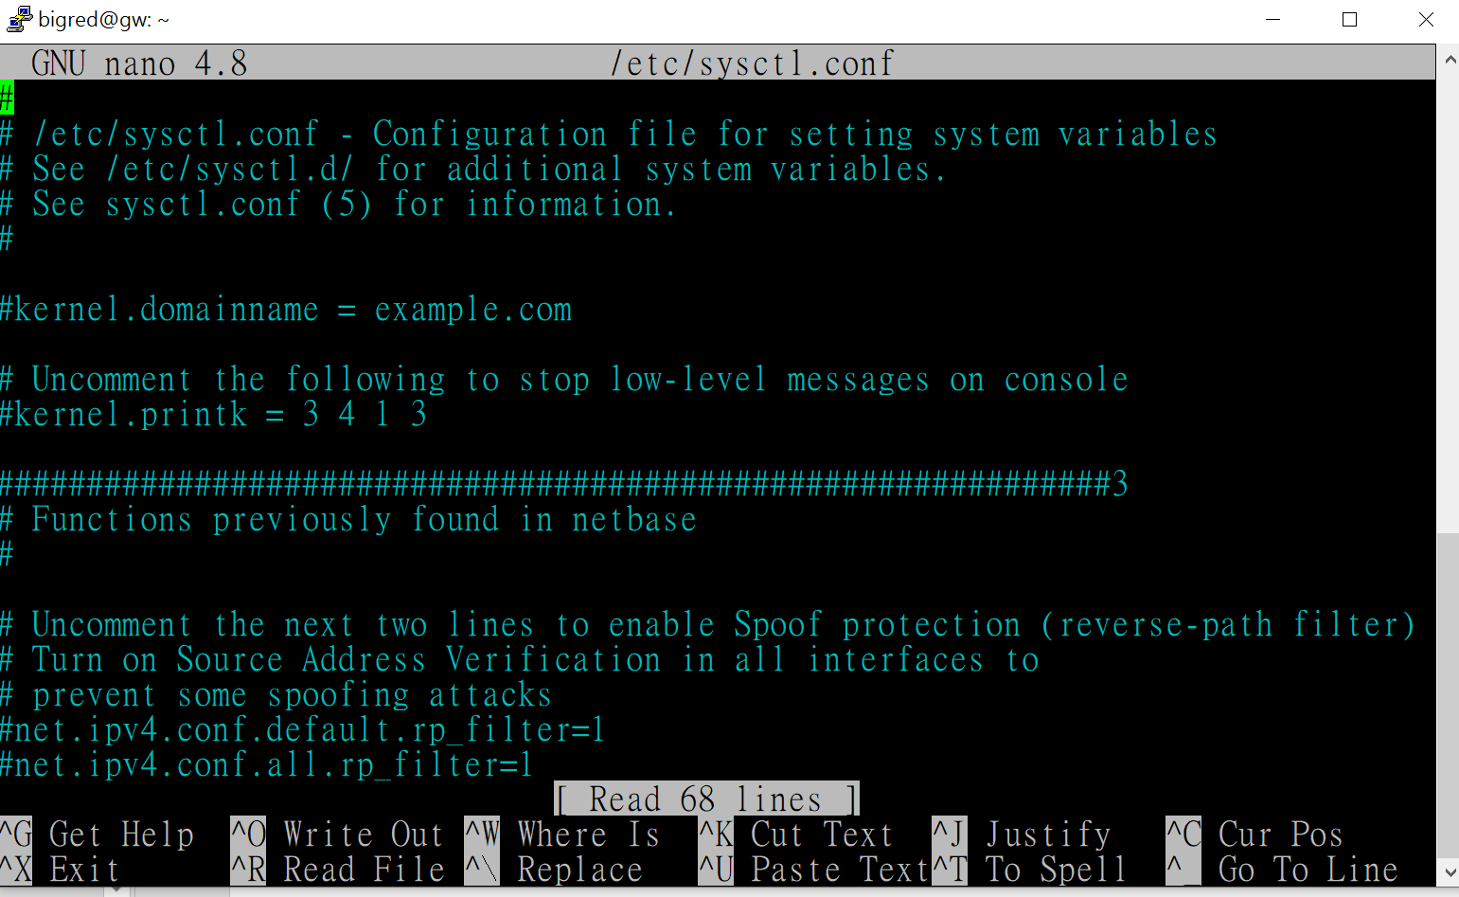
bigred@gw:~$ sudo nano /etc/sysctl.conf

Slide 20
#去掉
#net.ipv4.ip_forward=1
去掉
net.ipv4.ip_forward=1

Slide 21
$sudo reboot

Slide 22
login as: bigred bigred@192.168.1.115's password:

Slide 23
偽裝 bigred@gw:~$ sudo nano /etc/rc.local
#!/bin/bash
iptables -t nat -A POSTROUTING -o ens33 -j MASQUERADE
output
table
大寫
偽裝
Bridge 網路卡代號
本例ens33
轉址
Append to chain

Slide 24
bigred@gw:~$ sudo chmod +x /etc/rc.local

Slide 25
$sudo reboot 會自動執行rc.local

Slide 26
Ws01虛擬機
bigred@ws01:~$ cat /etc/netplan/00-installer-config.yaml
network:
ethernets:
ens33:
dhcp4: no
addresses: [192.168.48.180/24]
gateway4: 192.168.48.188
version: 2

Slide 27
Ws01 能ping到外面
bigred@ws01:~$ ping -c 3 8.8.8.8
PING 8.8.8.8 (8.8.8.8) 56(84) bytes of data.
64 bytes from 8.8.8.8: icmp_seq=1 ttl=115 time=6.98 ms
64 bytes from 8.8.8.8: icmp_seq=2 ttl=115 time=9.69 ms
64 bytes from 8.8.8.8: icmp_seq=3 ttl=115 time=4.90 ms
--- 8.8.8.8 ping statistics ---
3 packets transmitted, 3 received, 0% packet loss, time 2002ms
rtt min/avg/max/mdev = 4.900/7.189/9.689/1.960 ms

