Slide 1





Cloud Native 雲原生架構師 陳松林 oc99.98@gmail.com
Notes:
1. Going Cloud Native: 6 essential things you need to know
https://www.weave.works/technologies/going-cloud-native-6-essential-things-you-need-to-know/
2. Download Google Drive files with WGET
https://codesport.io/linux/download-google-drive-files-with-wget/
3. 台灣 Big Data 菁英戰士
http://bigdatahome.blogspot.tw/p/hadoop.html

Slide 2



巢狀雲與雲中櫃系統架構
VMware 虛擬主機
(Type 2 虛擬技術 + Ubuntu Linux)
Linux KVM 虛擬主機
Type 1 虛擬技術 + 軟體貨櫃技術

Slide 3
安裝 VMware 虛擬主機
1. 下載 VMware Workstation Player 軟體, 下載網址如下 :
https://my.vmware.com/en/web/vmware/free#desktop_end_user_computing/vmware_workstation_player/15_0
2. 下載 VMware 虛擬主機壓縮檔
- UB2004.CVN71v1.zip
3. 下載 Linux KVM 虛擬主機壓縮檔
- cnt20.zip
4. 要執行 VMware 虛擬主機, 最低系統需求如下 :
- 雙核心 CPU (VT-x)
- 至少 16 G 記憶體
- 微軟 64 位元作業系統 (Windows 7/10)

Slide 4
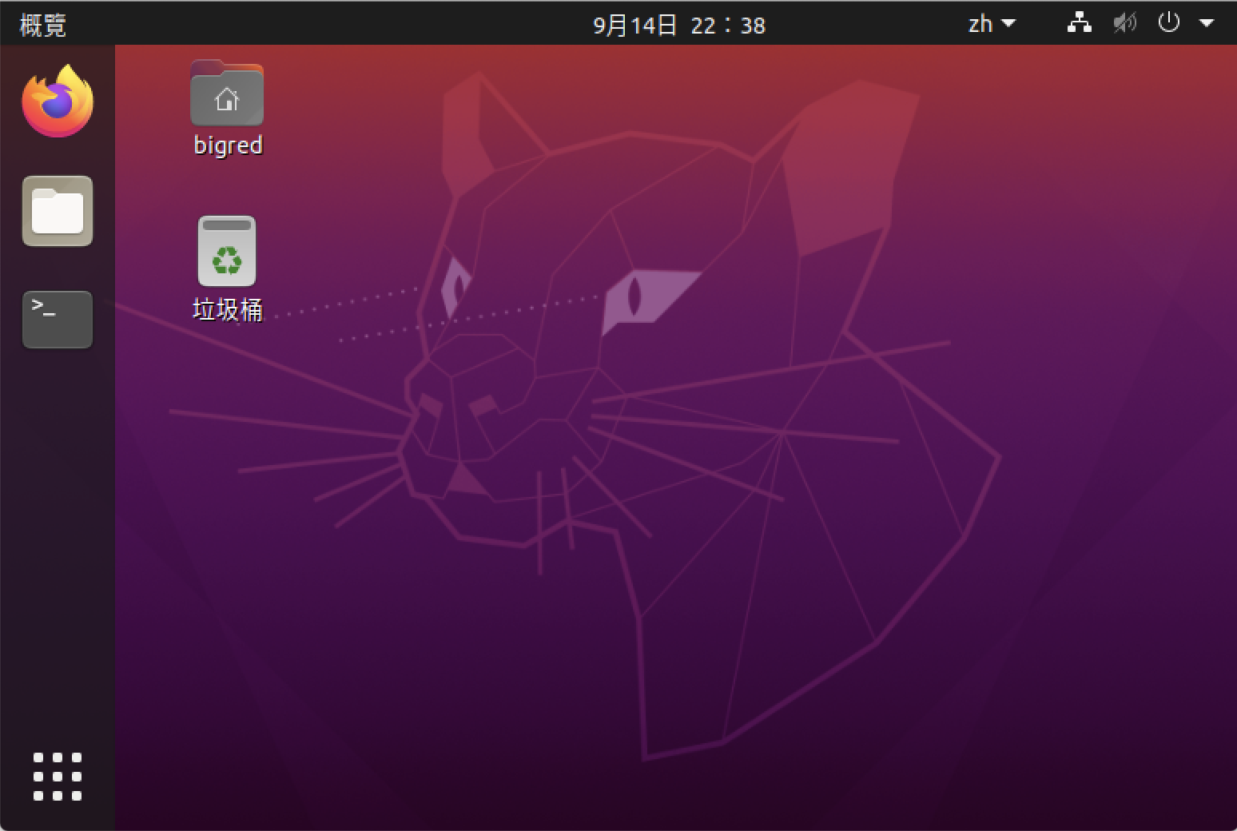
自動登入 VMware 虛擬主機
自動登入帳號是 bigred, 密碼是 bigred
Notes:
1. Get Docker CE for Ubuntu
https://docs.docker.com/engine/installation/linux/docker-ce/ubuntu/#install-using-the-repository
2. Managing Containers in runC
https://blog.selectel.com/managing-containers-runc/
3. Windows容器技術大剖析
http://www.ithome.com.tw/news/109035
4. Docker Inside LXC (LXC 安裝與啟動 Docker)
http://ashish1099.github.io/blog/2015/05/23/docker-inside-lxc/
檢視目前 Docker CE 有那些版本可安裝
$ apt-cache policy docker-ce
docker-ce:
已安裝：5:18.09.3~3-0~ubuntu-bionic
候選： 5:18.09.3~3-0~ubuntu-bionic
版本列表：
............
18.06.1~ce~3-0~ubuntu 500
500 https://download.docker.com/linux/ubuntu bionic/stable amd64 Packages
18.06.0~ce~3-0~ubuntu 500
500 https://download.docker.com/linux/ubuntu bionic/stable amd64 Packages
18.03.1~ce~3-0~ubuntu 500
500 https://download.docker.com/linux/ubuntu bionic/stable amd64 Packages
安裝 Docker CE
$ curl -fsSL https://download.docker.com/linux/ubuntu/gpg | sudo apt-key add -
$ sudo add-apt-repository "deb [arch=amd64] https://download.docker.com/linux/ubuntu $(lsb_release -cs) stable"
更新 Ubuntu Linux 套件清單
$ sudo apt update
開始安裝 Docker CE
$ sudo apt install docker-ce
將 bigred 帳號加入 docker 群組後, 就不需使用 sudo 命令執行 docker
$ sudo usermod -aG docker bigred
重新開機 (一定要執行)
$ sudo reboot
因 Ubuntu 16.04 改用 systemd 啟動服務, 如要使 docker engine 參數有效, 則要在 docker.service 檔中,加入 "EnvironmentFile=/etc/default/docker" 這一行, 並在 ExecStart=/usr/bin/dockerd -H fd:// 這行後面加 $DOCKER_OPTS 命令如下 :
$ sudo nano /lib/systemd/system/docker.service
[Unit]
Description=Docker Application Container Engine
Documentation=https://docs.docker.com
After=network.target docker.socket
Requires=docker.socket
[Service]
Type=notify
# the default is not to use systemd for cgroups because the delegate issues still
# exists and systemd currently does not support the cgroup feature set required
# for containers run by docker
EnvironmentFile=/etc/default/docker
ExecStart=/usr/bin/dockerd -H fd:// $DOCKER_OPTS
ExecReload=/bin/kill -s HUP $MAINPID
LimitNOFILE=1048576
..........
Docker 選擇 Storage Driver 的順序如下 :
"zfs"
"overlay2"
"aufs"
"overlay"
"devicemapper"
"vfs"
$ nano ~/.bashrc
.........
nc -w 1 10.160.3.88 8080
if [ "$?" == "0" ]; then
export http_proxy="http://10.160.3.88:8080/"
export https_proxy="http://10.160.3.88:8080/"
export HTTP_PROXY="http://10.160.3.88:8080/"
export HTTPS_PROXY="http://10.160.3.88:8080/"
if [ ! -f /etc/systemd/system/docker.service.d/http-proxy.conf ]; then
sudo cp /opt/conf/http-proxy.conf /etc/systemd/system/docker.service.d/http-proxy.conf
sudo systemctl daemon-reload
sudo systemctl restart docker
[ "$?" == "0" ] && echo "CHTT Proxy enable"
fi
if [ ! -f /etc/apt/apt.conf ]; then
sudo cp /etc/apt/apt.temp /etc/apt/apt.conf
fi
else
..........
$ nano /etc/apt/apt.temp
Acquire::http::Proxy "http://10.160.3.88:8080/";
Acquire::https::Proxy "http://10.160.3.88:8080/";
$ nano /opt/conf/http-proxy.conf
[Service]
Environment="HTTP_PROXY=http://10.160.3.88:8080/" "NO_PROXY=localhost,172.17.0.2"
撰寫 cttproxy web script, 然後執行 cttproxy , 會處理所有的 Proxy設定
----------------------------------------------------------------------------------------------------
$ sudo nano /usr/share/nginx/html/cttproxy
#!/bin/bash
cat /etc/wgetrc | grep 'http_proxy = http://10.160.3.88:8080/' &>/dev/null
if [ "$?" != "0" ]; then
echo 'use_proxy = on' | sudo tee -a /etc/wgetrc &>/dev/null
echo 'http_proxy = http://10.160.3.88:8080/' | sudo tee -a /etc/wgetrc &>/dev/null
echo 'https_proxy = http://10.160.3.88:8080/' | sudo tee -a /etc/wgetrc &>/dev/null
echo "/etc/wgetrc proxy ok"
fi
cat ~/.bashrc | grep 'export http_proxy=http://10.160.3.88:8080/' &>/dev/null
if [ "$?" != "0" ]; then
echo 'export http_proxy=http://10.160.3.88:8080/' >> ~/.bashrc
echo 'export https_proxy=http://10.160.3.88:8080/' >> ~/.bashrc
echo 'export HTTP_PROXY=http://10.160.3.88:8080/' >> ~/.bashrc
echo 'export HTTPS_PROXY=http://10.160.3.88:8080/' >> ~/.bashrc
echo ".bashrc proxy ok"
fi
cat /etc/default/docker | grep 'export http_proxy=http://10.160.3.88:8080/' &>/dev/null
if [ "$?" != "0" ]; then
echo 'export http_proxy=http://10.160.3.88:8080/' | sudo tee -a /etc/default/docker &>/dev/null
sudo service docker restart &>/dev/null
echo "/etc/default/docker proxy ok"
fi
$ wget -qO - http://localhost:5566/cttproxy | bash

Slide 5
解壓縮 Linux KVM 虛擬壓縮檔
$ unzip cnt20.zip; cd cnt
$ dir
總計 6.1G
drwxr-xr-x 3 bigred bigred 4.0K 9月 14 22:00 .
drwxrwxr-x 3 bigred bigred 4.0K 9月 14 22:43 ..
-rw-r--r-- 1 bigred bigred 556M 9月 14 21:50 alpine.base
drwxr-xr-x 2 bigred bigred 4.0K 9月 14 21:49 bin
-rw-r--r-- 1 bigred bigred 1.2K 9月 14 07:54 mactohost
-rw-rw-r-- 1 bigred bigred 435 9月 14 12:19 readme.txt
-rw-r--r-- 1 bigred bigred 2.5G 9月 14 21:17 ub1804.base
-rw-r--r-- 1 bigred bigred 3.1G 9月 14 21:18 ub2004.base

Slide 6
建立與啟動 ddg52 虛擬主機
$ dkh start
ddg51 阿利.伯克號
ddg52 巴里號
ddg53 約翰.保羅.瓊斯號
ddg54 柯蒂斯.威爾伯號
ddg55 斯托特號
ddg56 約翰.S.麥凱恩號
ddg57 米切爾號
ddg58 拉布恩號
ddg59 拉塞爾號
$ dkh start ddg52
$ dkh ps
bigred 12459 161 2.5 3072464 264072 pts/0 Sl 11:20 1:25 qemu-system-x86_64 -name ddg52 -enable-kvm -cpu kvm64 -smp cpus=2 -m 2560 -net nic,macaddr=52:54:72:16:30:52 -net tap,ifname=ddg52,script=no,downscript=no -hda ddg52.qcow2 -nographic -boot c
-m 2560 /記憶體位址
Macaddr=52:54:72:16:30:52 /Macaddr 為網路\52:54 為 linux KVM

Slide 7
登入 ddg52 虛擬主機
$ ssh 172.29.0.52
bigred@172.29.0.52's password: bigred
Welcome to Container Technology (Ubuntu 20.04)
IP : 172.29.0.52
bigred@ddg52:~$ sudo apt update; sudo apt upgrade -y
bigred@ddg52:~$ poweroff
Connection to 172.29.0.52 closed by remote host.
Notes:
縮小虛擬主機硬碟檔, 大約要 10 分鐘
$ dkh shrink
Are you sure ? (YES/NO) YES
ddg52.qcow2 shrinked
ub2004.base shrinked

