Slide 1
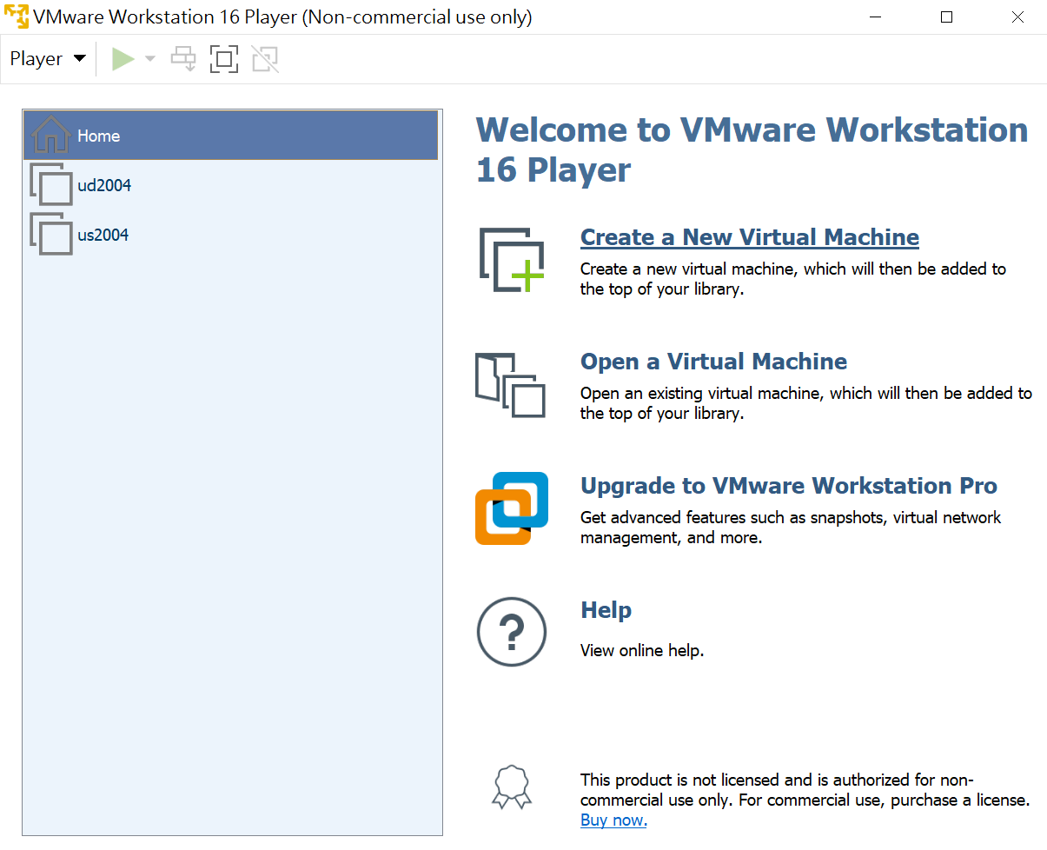
Ubuntu desktop setting
Notes:
USB 4GB+
dual core 2GHz CPU &2GB RAM
Ubuntu 20.04 LTS (Focal Fossa)
support until April 2025
https://www.youtube.com/watch?v=UBCE-ZH_xLA

Slide 2
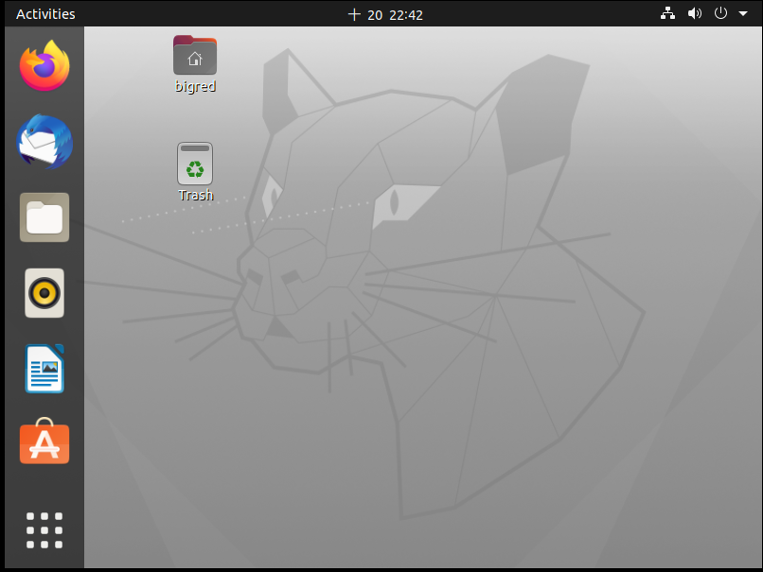

Slide 3
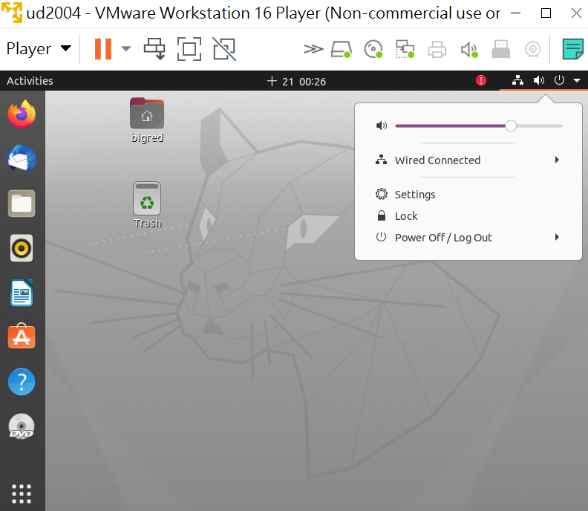
[Setting]

Slide 4
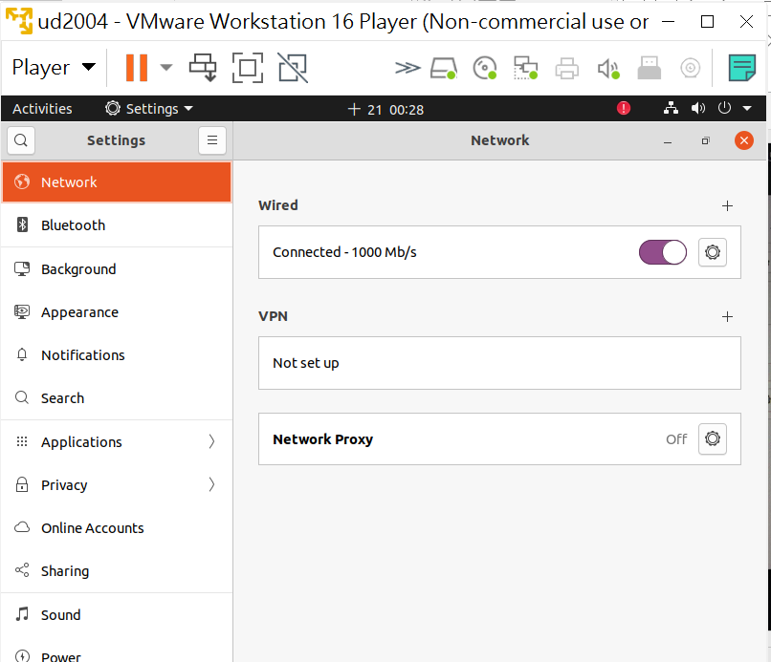
往下移

Slide 5
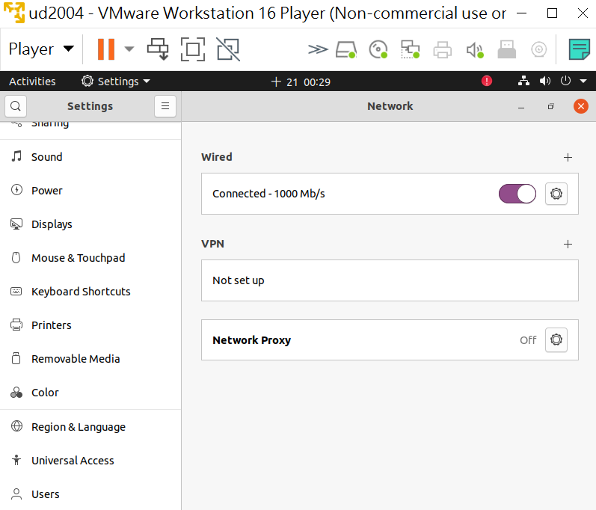
[Displays]

Slide 6
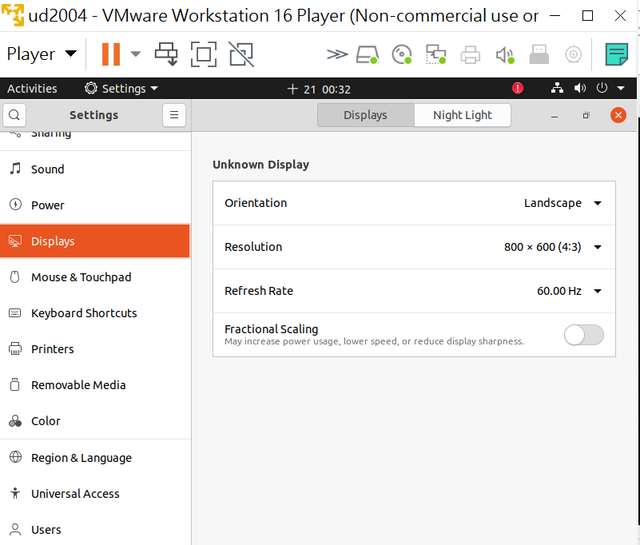
fraction scales分數尺度

Slide 7
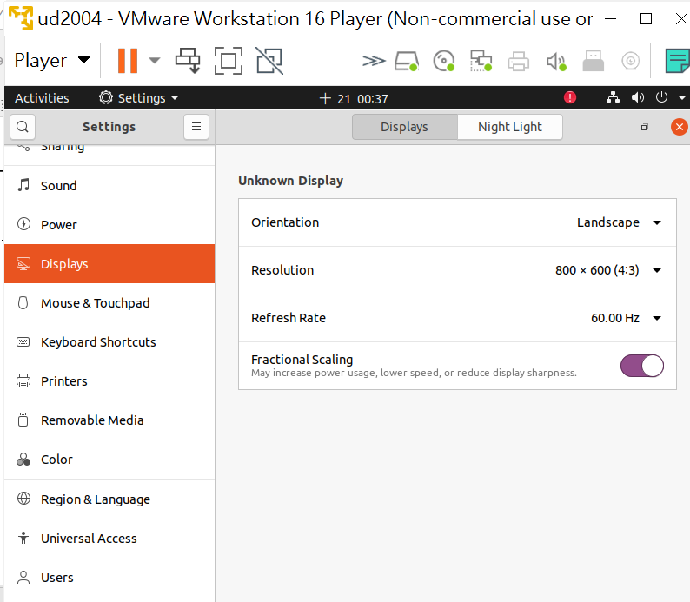
[Resolution]

Slide 8
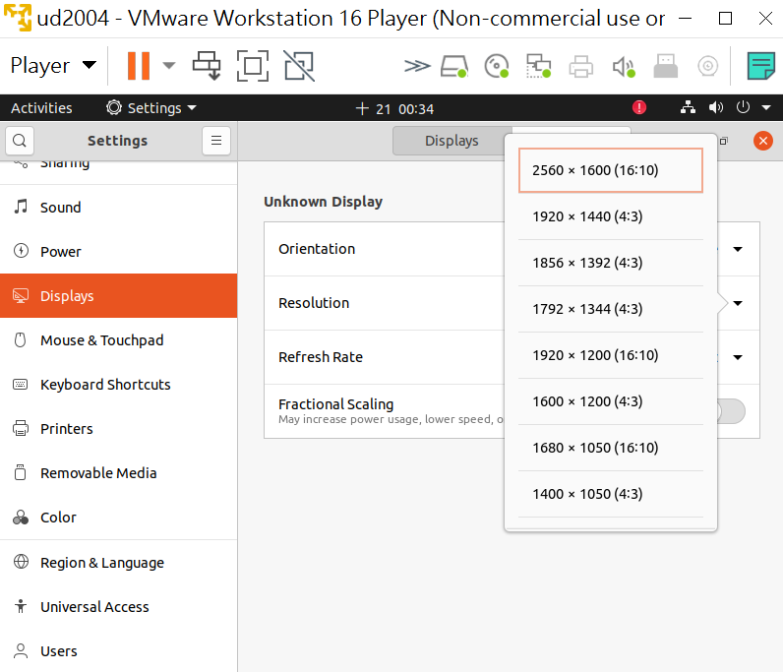
[1920*1200]

Slide 9
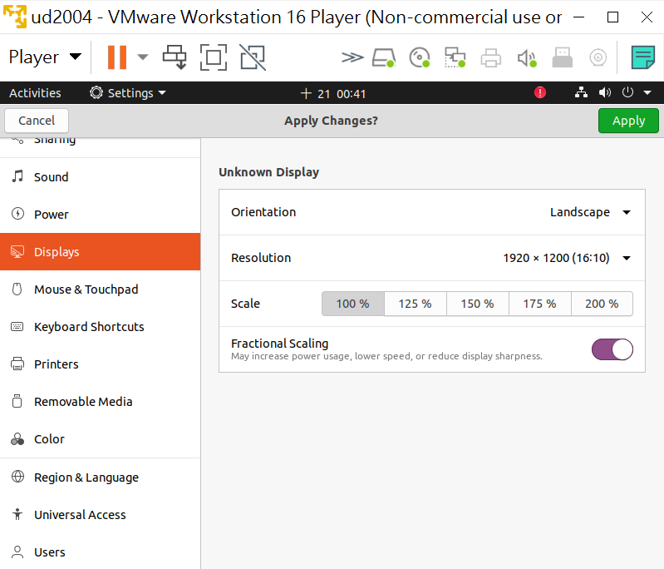
[Apply]

Slide 10
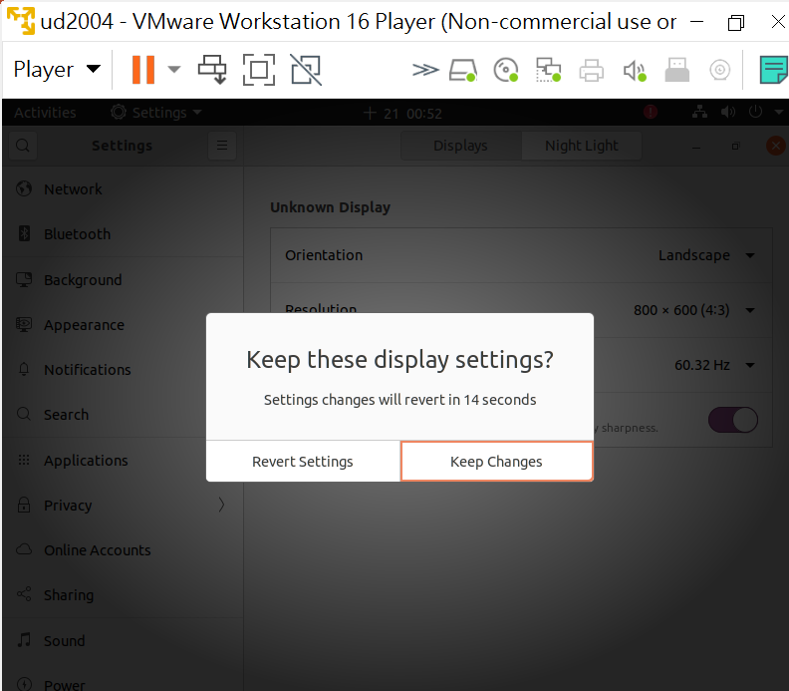
Keep Changes

Slide 11
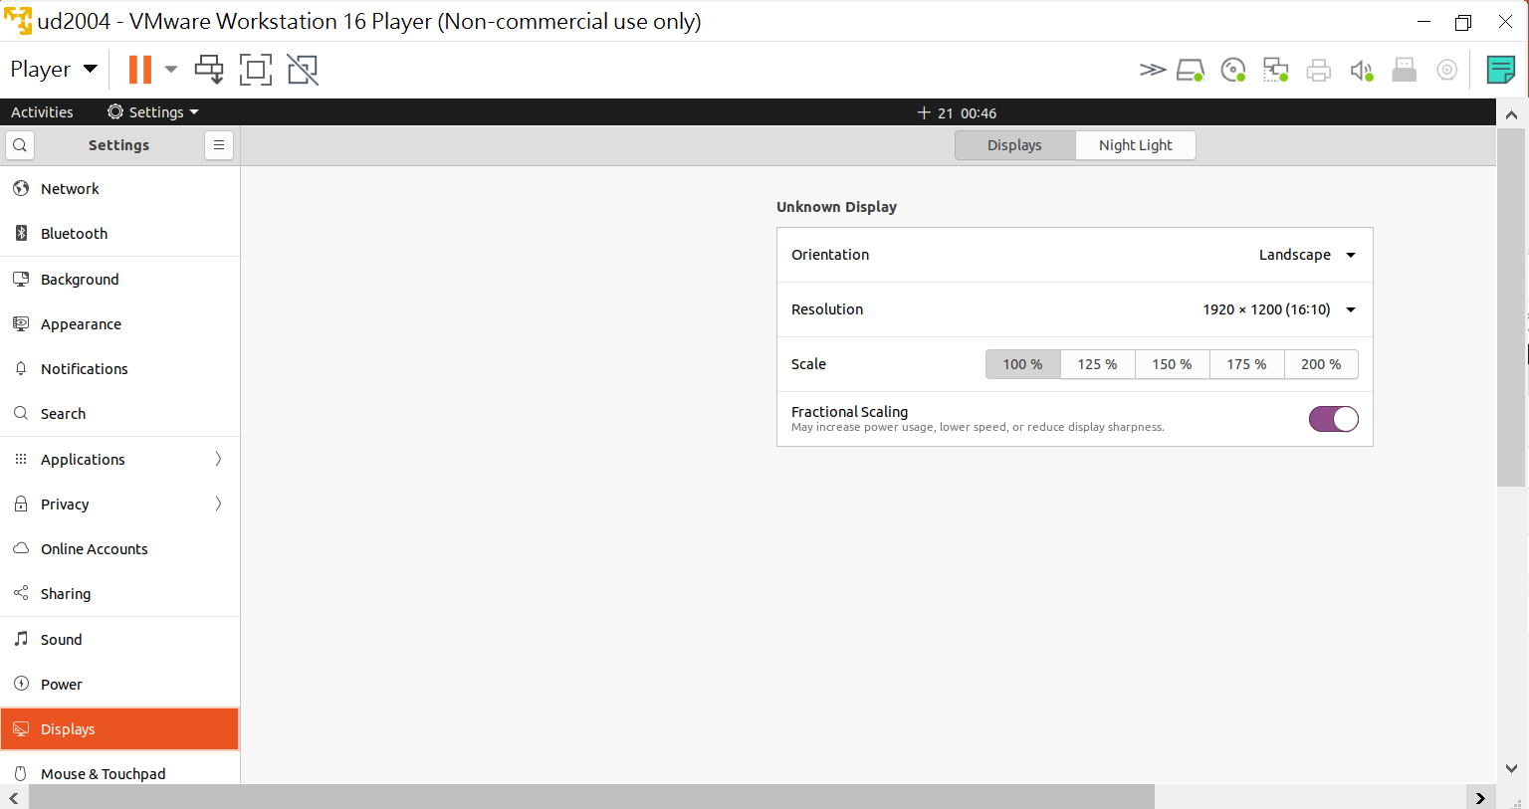
套用結果

Slide 12
補充

Slide 13
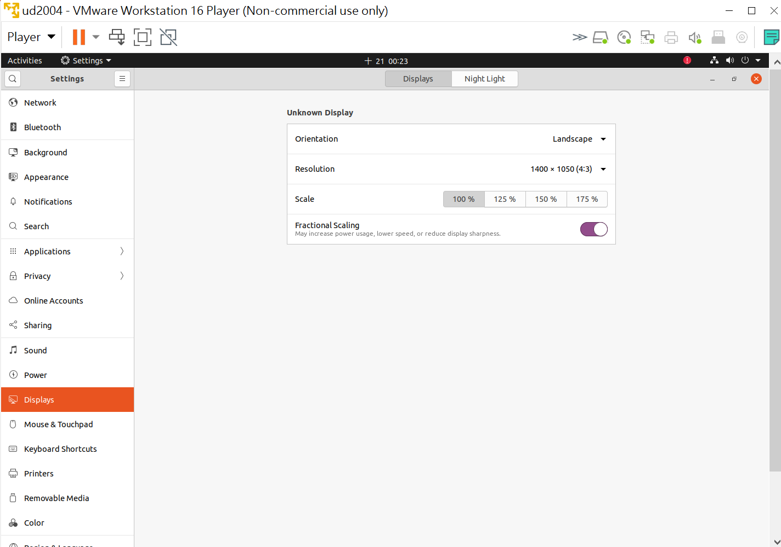
1400*1050 套用結果

Slide 14
按[視窗鍵] 出現 圖示

Slide 15
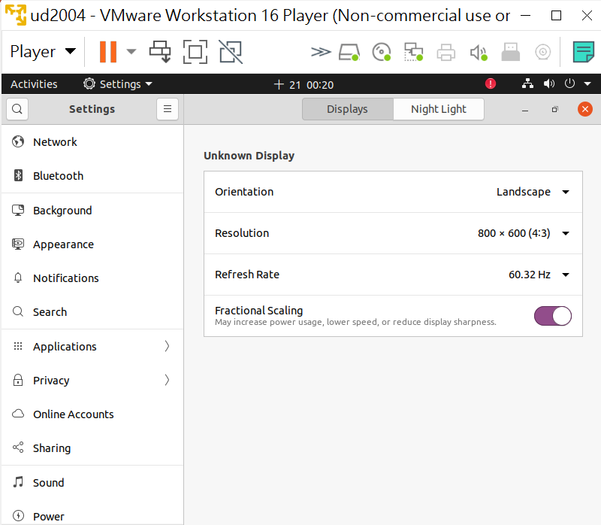
按[視窗鍵]

Slide 16
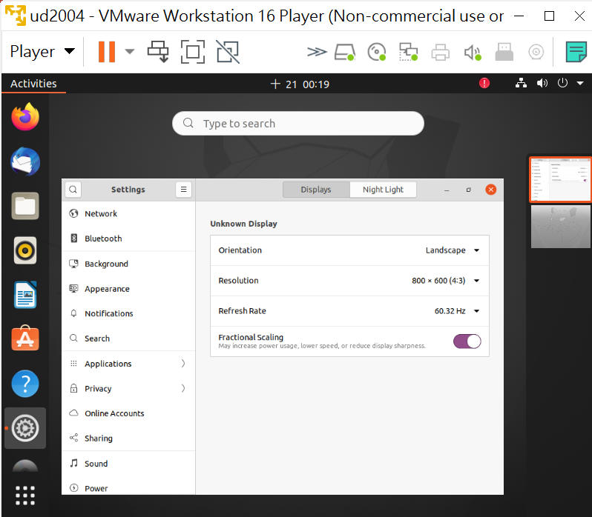

Slide 17
上不了網

Slide 18
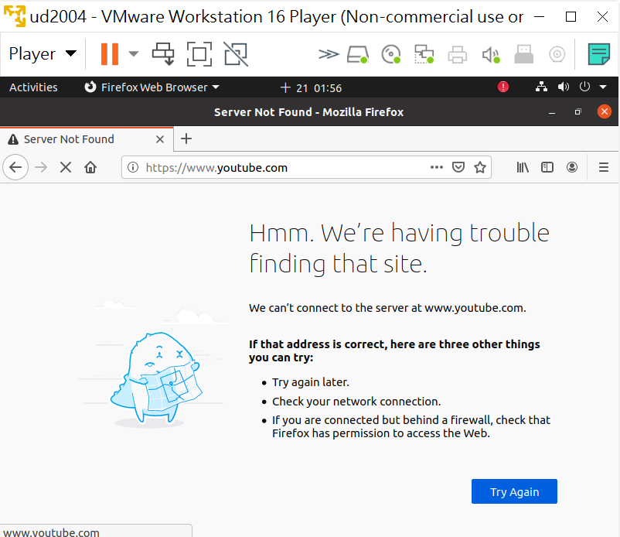

Slide 19
看設定

Slide 20
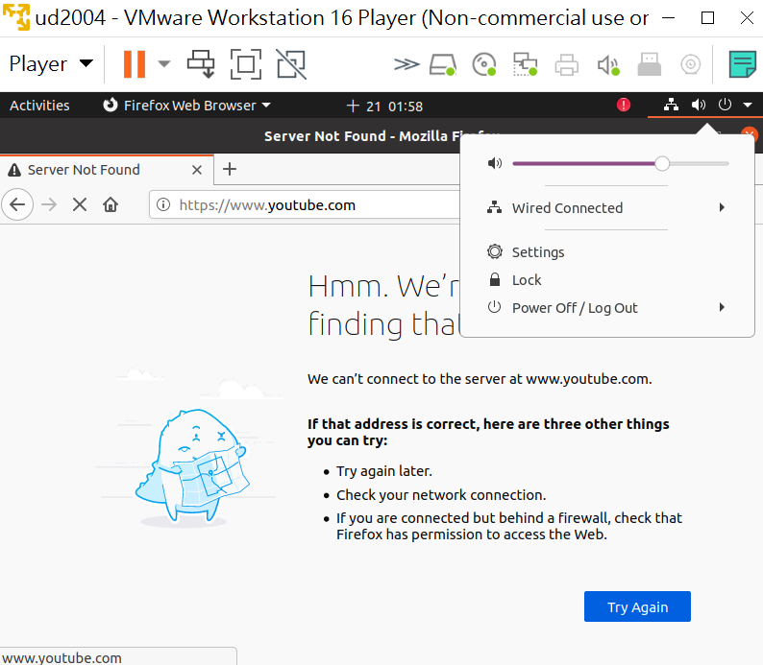
˙

Slide 21
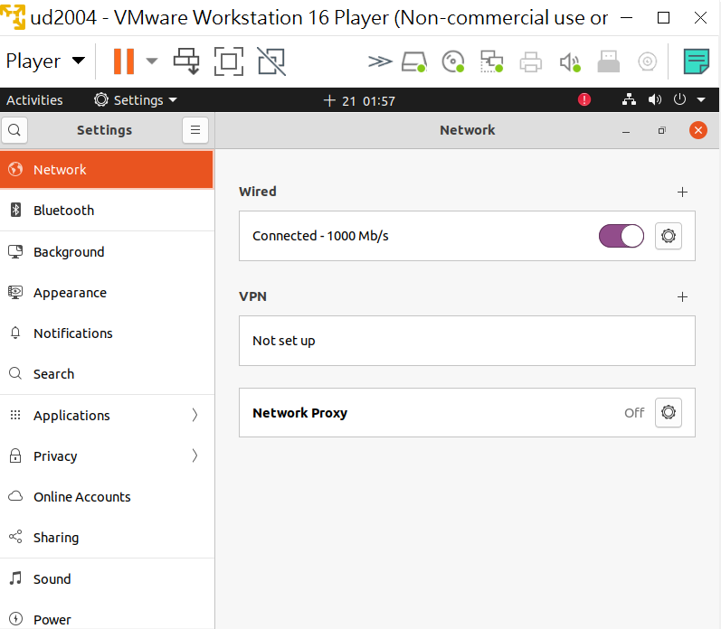
1

Slide 22
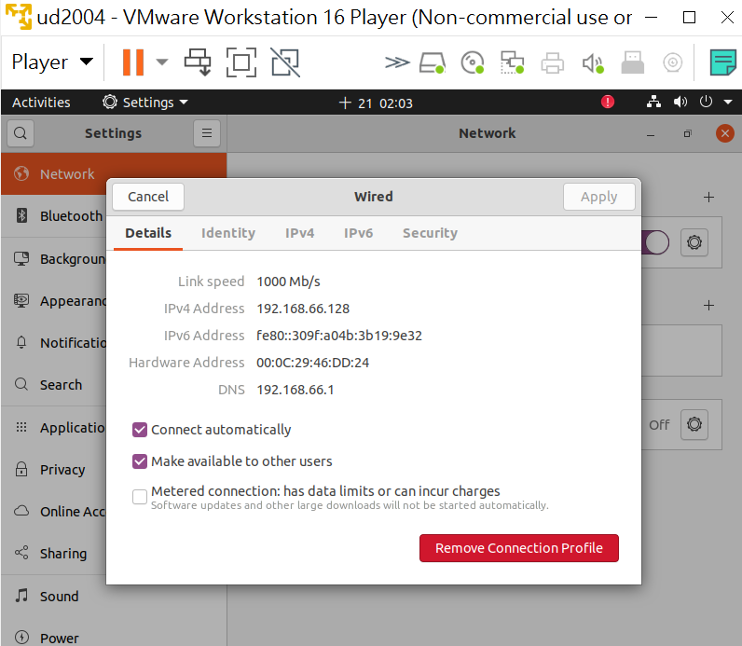
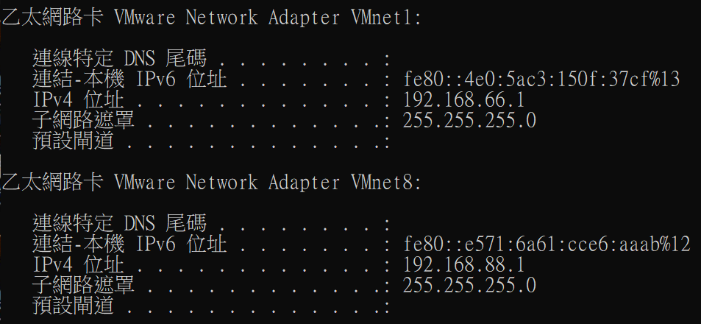
看完選[X]
HOST Only

Slide 23
網卡連接改選 NAT
[Player][Removable Devices][Network Adapter][Setting]

Slide 24
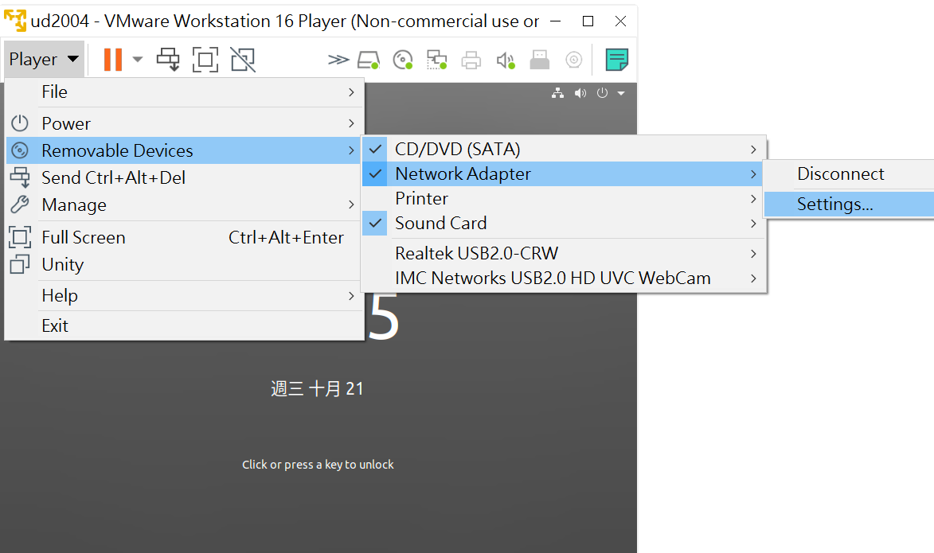
[Player][Removable Devices][Network Adapter][Setting]

Slide 25
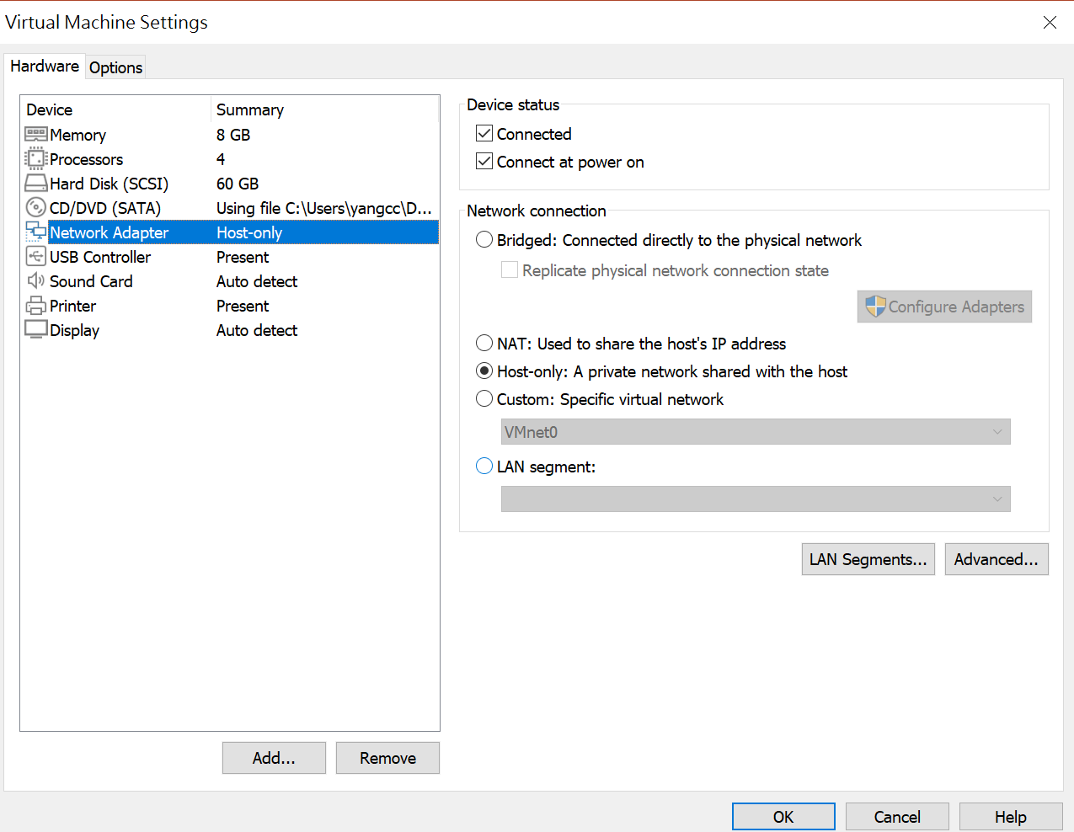
選[NAT]

Slide 26
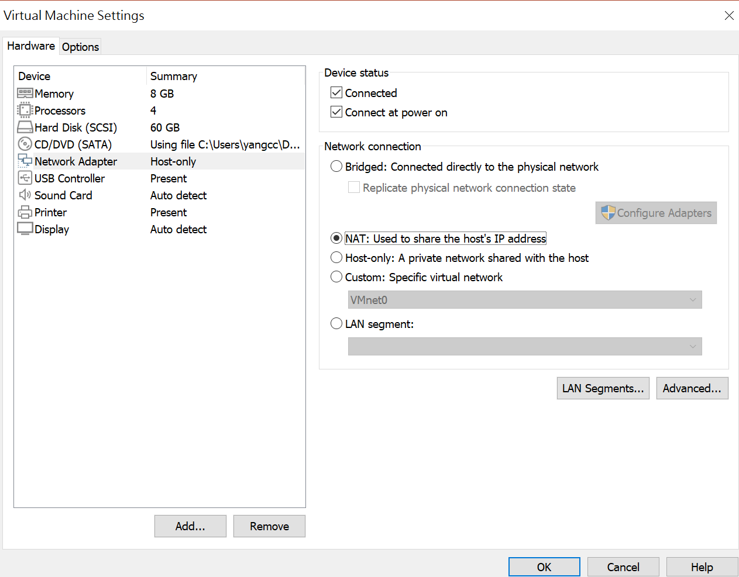
選[OK]

Slide 27
