Slide 1


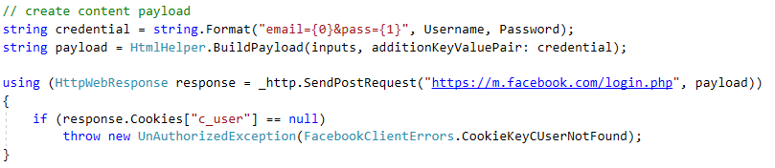
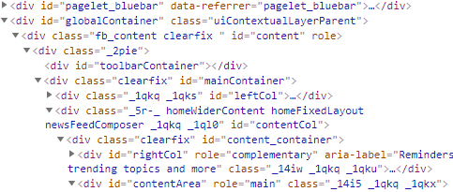
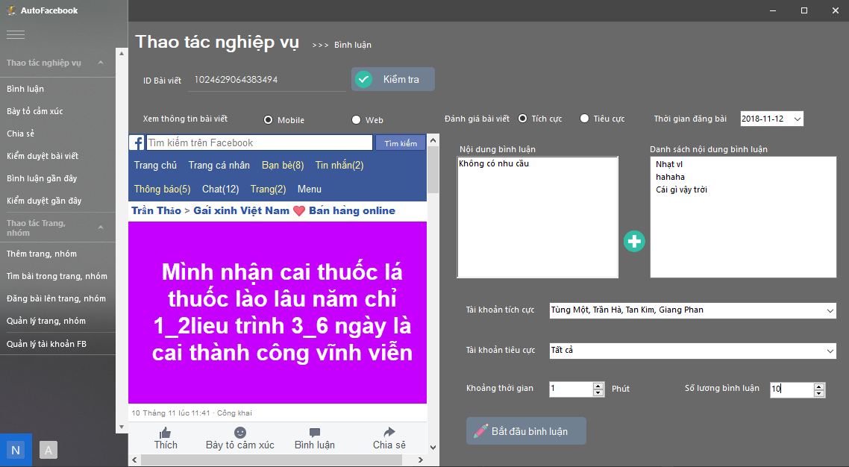
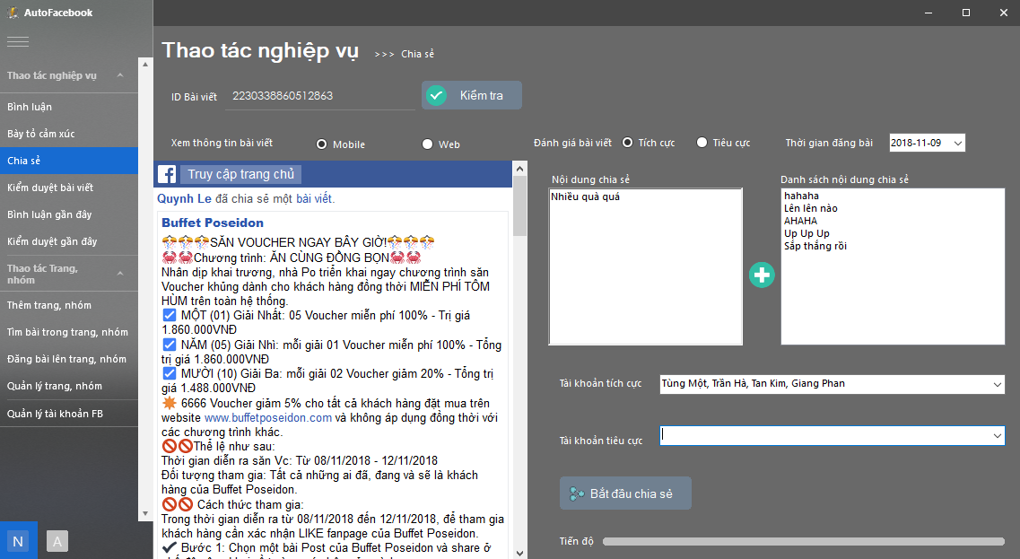
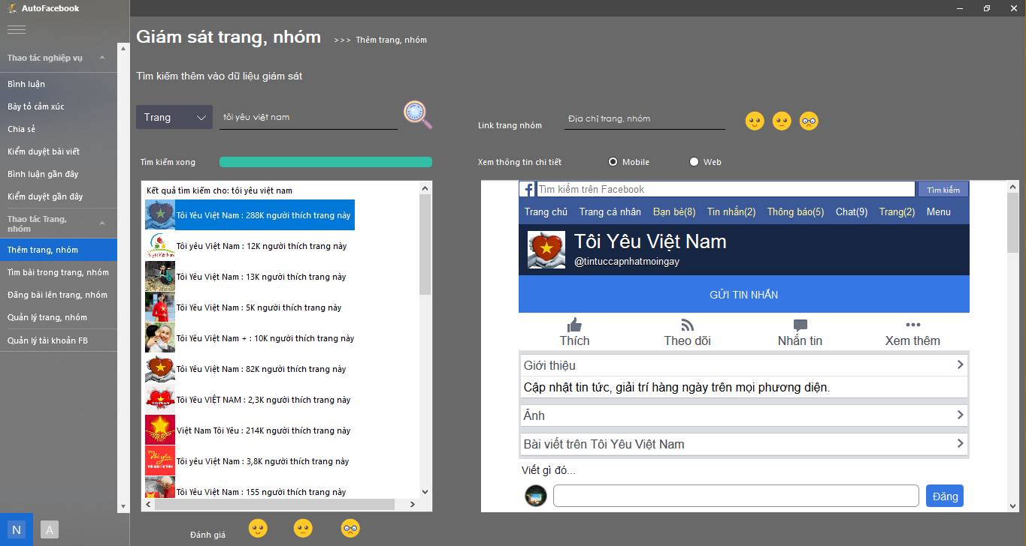
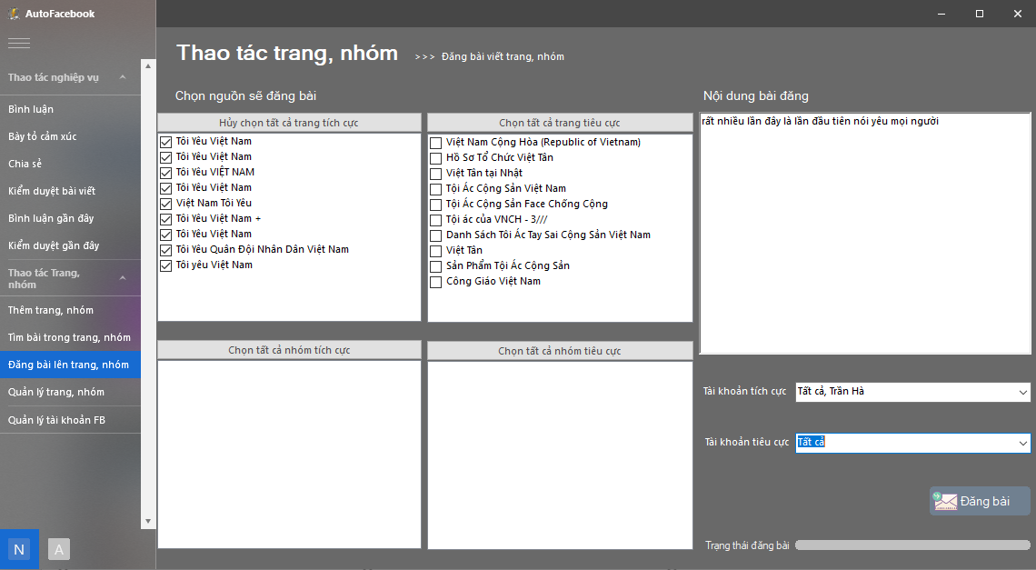
Build interactive tools on Facebook social networking
Author: Tung Nguyen Thanh
Advisor: Ph.D Khanh Nguyen Quoc
Introduction
With the globalization and the development of information technology, the internet in the world and in Vietnam has been growing strongly. The most popular social networking is Facebook. In Vietnam, this is also a source of information for very active users.
However, this is also an environment for hostile forces to oppose the Party's policy lines and the law of state propaganda causing confusion to many users with informal, false sources. Really, distort information ... Incite users of negative thoughts, commit misconduct through postings, seductive comments, misleading the truth to sabotage our country.
It is because of the complexity of many violent elements that always find and spread the false information so many forces to counter the information but also need a powerful tool for the work of counterattack, His commentary as well as the search for negative posts, bad posts provoke.
Programming library
Experiment
WebRequest
This is a Control available in Visual Studio's Window Form Designer. It provides us with a capable, interactive, programmable browser.
SendRequest: In order to get data from Facebook we have two functions: SendGetRequest and SenPostRequest
GetResponseStream: We use this function to receive data from the Facebook server in XML format for further processing
Implementation process:
Send a request to the Facebook server using the request function.
Get the data returned from the Facebook server using the response function.
Excludes data received by the HTMLAgilityPack library.
Request
Response
HTMLAgilityPack
HTMLAgilityPack
After receiving the data in XML format, we use this function to extract the data in the form of tags as specified
Function
Auto comment with many posts with content with different accounts.
Automatically share the post with the contents of the contents with many different account.
Auto search page, group by name, save information to database.
Auto log in content with the page multiple page, with different accounts.
See the comment, post your all users.
Search the activity like like, comment of user in ID User.
Demo
Conclusion
Comment
Share
Through the time of research, study and implementation of the project, I have completed on schedule and achieved certain results. The project has raised the importance of ensuring public opinion, building trust among the people in the Party and the state on social networking. From there, developers and AutoFacebook software support the work of the public opinion, interact automatically and quickly on the social network popular in our country is Facebook. However, due to the lack of access to the forces that need to use in practice, so many functions are not close to the purpose of practical use. In the future to develop more projects, I plan to deploy the system to the right professional level and develop a larger scale of testing to find the limited functionality and improve the quality of system.
Search pages
Post to pages
References
[1] https://stalkscan.com/
[2]https://docs.microsoft.com/en/dotnet/api/system.windows.forms.webbrowser?view=netframework-4.7.2
[3] https://www.technical-recipes.com/2016/using-the-gecko
[4]https://stackoverflow.com/questions/5164733/getting-the-html-source-through-the-webbrowser-control-in-c-sharp
Figure 1. Label in 24pt Calibri.
Faculty Of Information Technology

