Slide 1
COMP4432 Machine Learning
Individual Assignment
Presenter: XI Lexuan
Instructor: Dr. YUEN Kam Fung Kevin
1

Slide 2
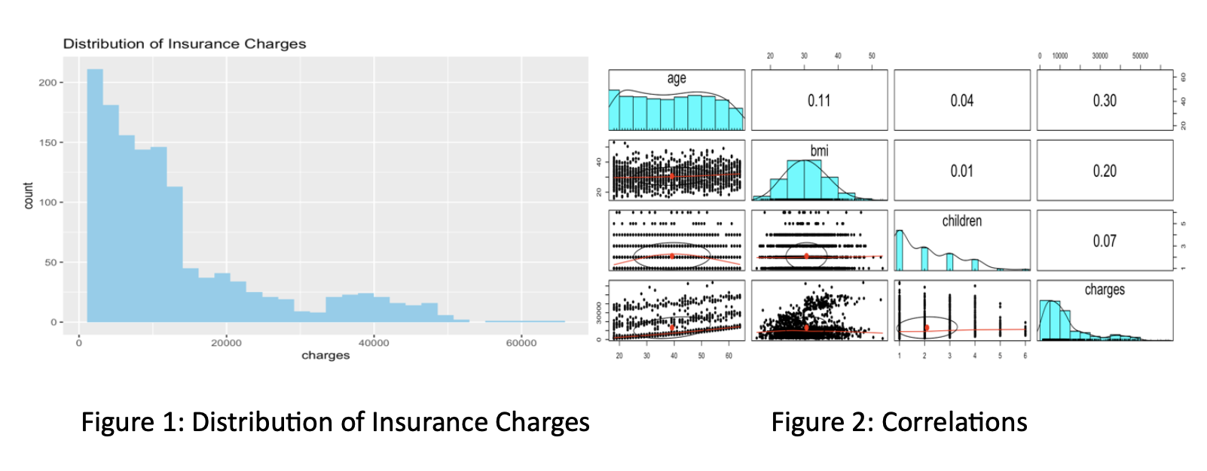
Task 1
Data Visualization
2
Insurance charges skewed to the right
Age correlates with charges

Slide 3
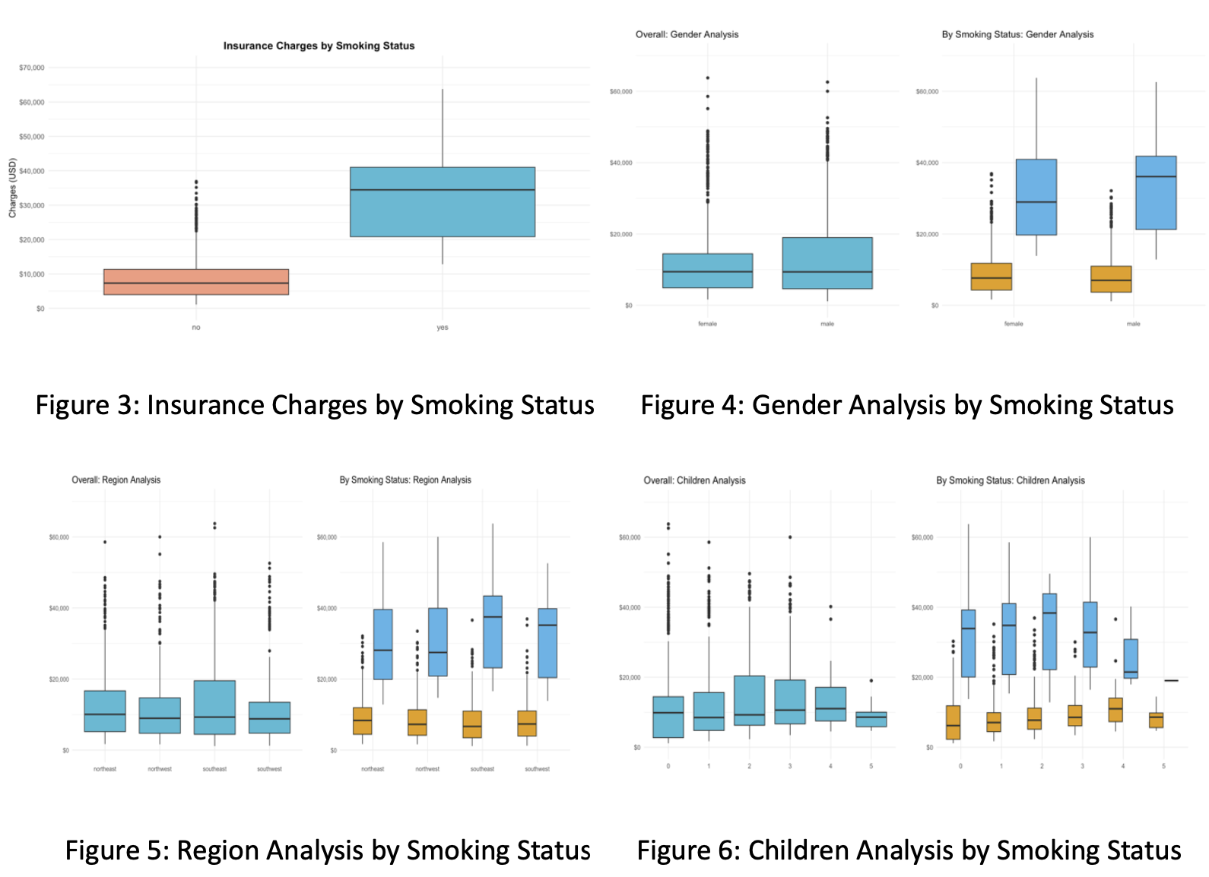
Task 1
Data Visualization
3
1. Smokers pay significantly more to be insured than nonsmokers
2. Gender and region have no significant effect on charges

Slide 4
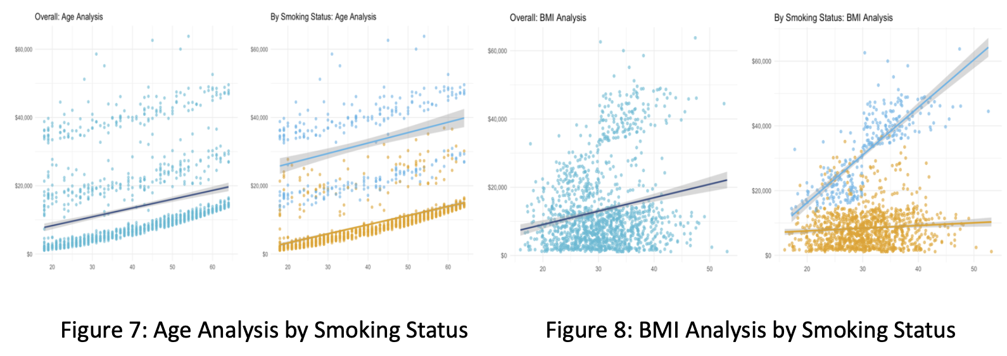
Task 1
Data Visualization
4
1. Age may have a non-linear relationship with charges
2. BMI may interact with smoking; consider converting this numeric variable to a binary indicator (with a cut-off of 30)

Slide 5
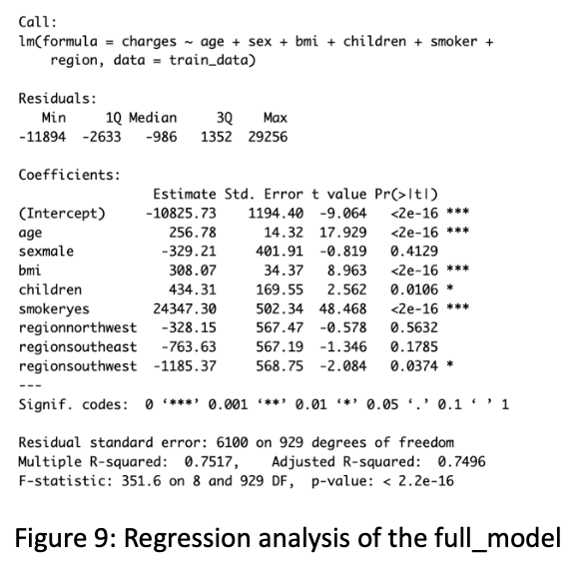
Task 1
Linear Regression Analysis
full_model <- lm(charges ~ age + sex + bmi + children + smoker + region, data = train_data)
(The train_data here is 70% of the insurance.csv and the seed used in task 1 is 4432)
The model exhibits certain deficiencies and can be refined before conclusions are drawn.
5

Slide 6
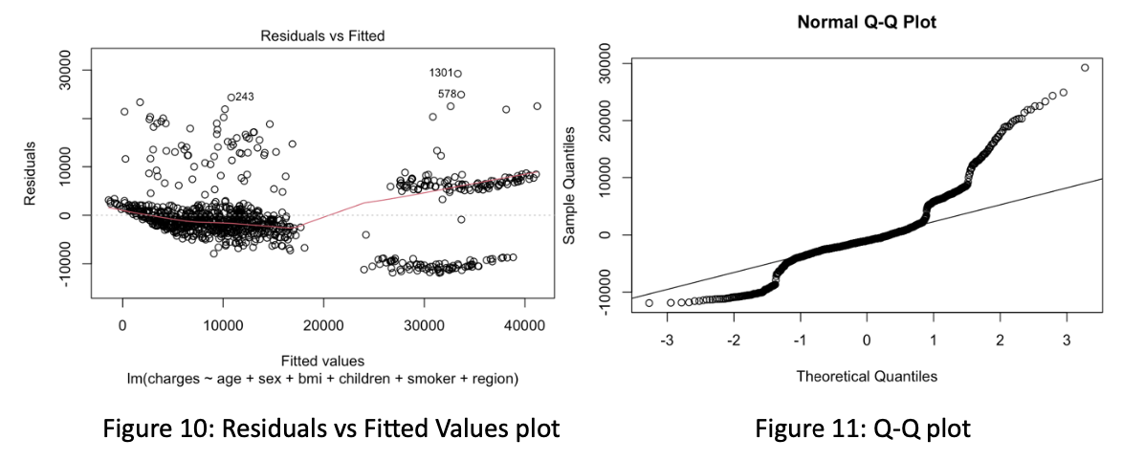
Task 1
Limitations
6
Residuals show a "funnel-shaped" distribution in Figure 10 (spreading out on the right), violating the linearity assumption. A Breusch-Pagan test shows that p < 2.2e-16, heteroscedasticity exists (Asteriou & Hall, 2011).
Points in Figure 11 have a deviation from the straight line. A Shapiro-Wilk test shows that p-value < 2.2e-16, confirming the residuals are not normally distributed (Asteriou & Hall, 2011).

Slide 7
Task 1
Suggestions
To enhance the model further, the following adjustments are made.
Delete insignificant or less significant independent variables "sex" and "region" (ANOVA tested)
Add the square of ages (age2) to capture a non-linear relationship
Create and add BMI indicator (bmi_ind) variable (BMI>=30 is 1, otherwise 0)
Create and add interaction terms of bmi and smokers (smoker_bmi)
7

Slide 8
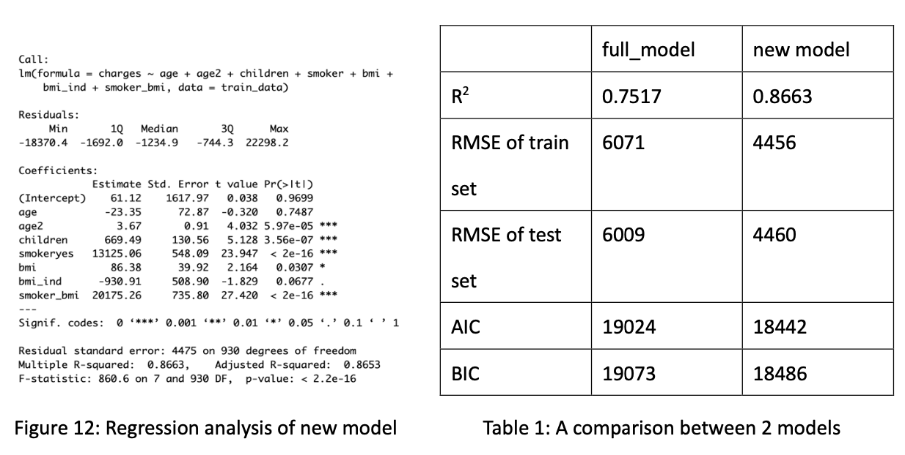
Task 1
New linear model
model <- lm(charges ~ age + age2 + bmi + children + smoker + bmi_ind + smoker_bmi, data = train_data)
(The train_data here is 70% of the insurance.csv (the seed used in task 1 is 4432))
8
As demonstrated in Table 1, the new model outperforms the original model in all five evaluation criteria. Besides, the new model shows minimal overfitting with the test RMSE/train RMSE (4460/4456) ratio close to 1 (James et al., 2013).

Slide 9
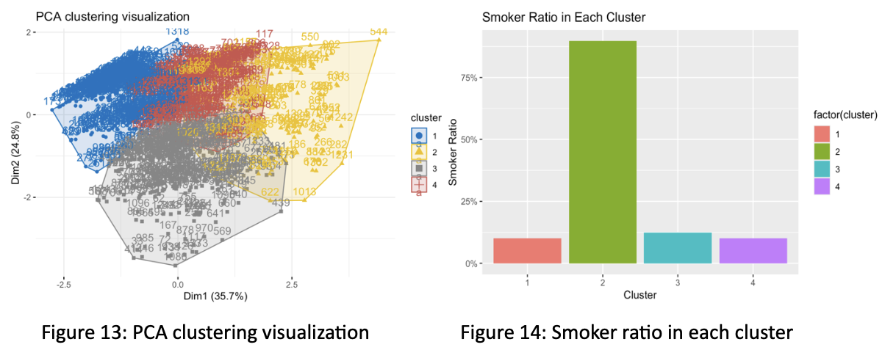
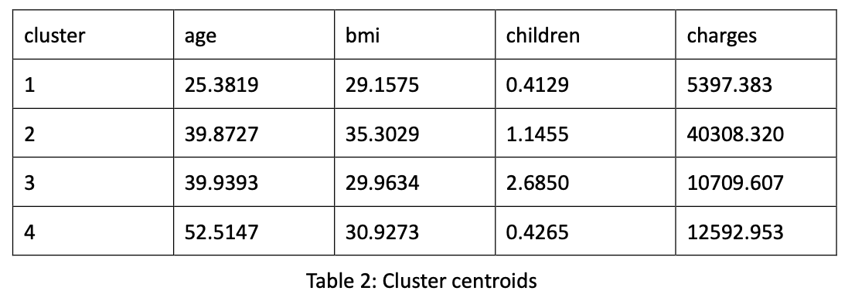
Task 1
K-means clustering
After choosing the optimal K value (4) based on the Calinski-Harabasz index, a 2D PCA approach is used for visualization (Salloum et al., 2024).
9

Slide 10
Task 1
Discussion
The coefficient estimates for each variable are found to be statistically significant. e.g. Besides the increased cost of smoking alone of over $13,125 in the linear model, obese smokers spend an additional $20,175, suggesting that smoking exacerbates obesity-related diseases.
10
The findings of the linear regression model are rational. Older age, smoking, and obesity are often associated with other health problems, and more family members can lead to more visits to the doctor and higher costs for vaccinations.

Slide 11
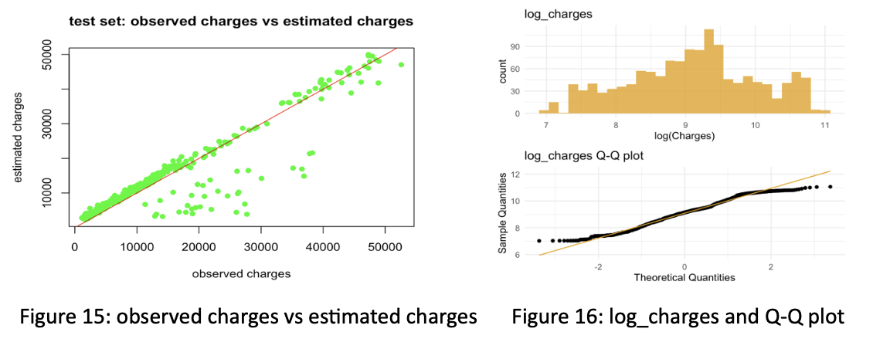
Task 1
Discussion – Future improvement
11
As Figure 15 shows, the model still seems to be improved further. The right-skewed distribution of insurance charges probably causes the deviation of points. A log transformation can help a lot, as shown in Figure 16. However, the transformation leads to a 10% decrease in R² and a much higher RMSE. Therefore, a future investigation into heteroscedasticity and normality is needed.

Slide 12
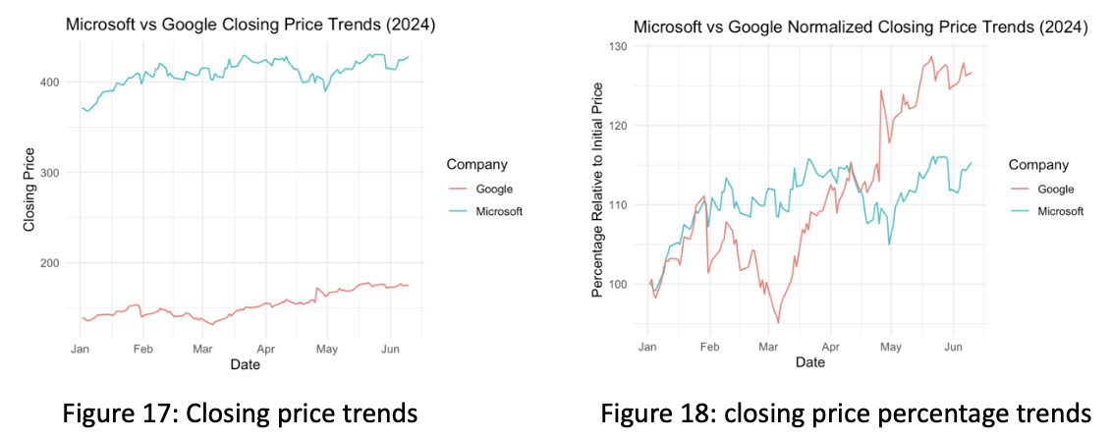
Task 2
Data Visualization
12
The visualization results show that Microsoft's share price is higher, and Google's share price is more volatile.

Slide 13
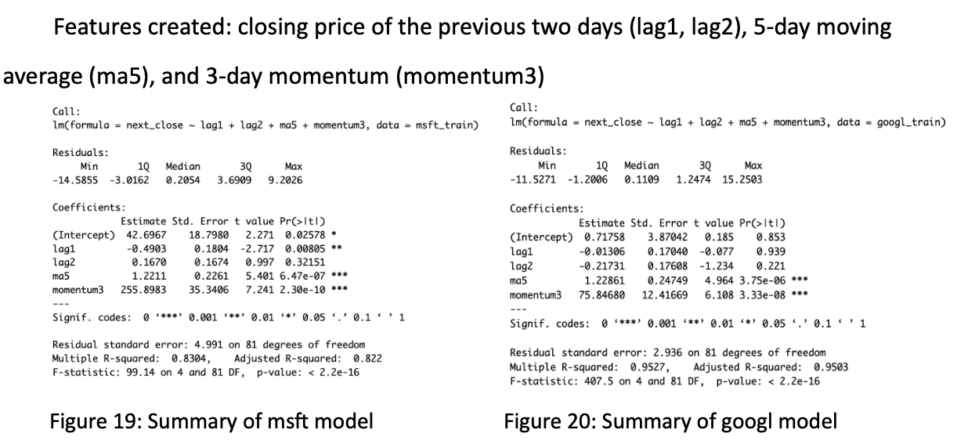
Task 2
Linear Regression Analysis and Discussion
13
(The train data is 80% of the original data, and the seed used in task 2 is 1222.)
The coefficient estimates for ma5 and momentum3 are statistically significant for both models. The next day's closing price of Microsoft is significantly related to the previous day's closing price. In contrast, Google's closing price has an insignificant relationship with the prior day's closing price. Based on the results, the following assumptions are made (next page).

Slide 14
Task 2
Linear Regression Analysis and Discussion
Single-day price data is highly susceptible to market noise and random variables, whereas a 5-day moving average effectively smooths these fluctuations, mitigating stochastic volatility.
Three-day momentum has the highest coefficients and effectively captures short-term price directional changes and magnitude. At the same time, the five-day moving average reflects the overall recent trajectory, providing complementary analytical perspectives.
Share prices are volatile (especially for Google) in this case. The closing price of the previous two days may have a negative or insignificant relationship with the next day's price.
14

Slide 15
Task 2
Linear Regression Model Evaluation
For the Google prediction model, the R² is 0.8304, and the RMSE of the train set and test set are 2.8491 and 3.0176, respectively. Since the ratio is close to 1, there is no significant overfitting problem. For the Microsoft prediction model, the R² is 0.9527, and the RMSE of the train set and test set are 5.2716 and 4.8435, respectively. Since the ratio is close to 1, there is no significant overfitting problem.
Therefore, both prediction models perform well in this case.
15

Slide 16
Task 2
KNN & Random Forest
Considering KNN's sensitivity to feature scaling, centering and standardization were applied to ensure equitable distance calculations across dimensions. A 5-fold cross-validation approach was employed to determine the optimal k-value from a candidate set of odd numbers between 3 and 15, balancing model complexity against predictive performance (James et al., 2013).
The Random Forest model architecture consisted of 500 decision trees, incorporating Bootstrap aggregation (bagging) for sample diversity, random feature subset selection at each node split, and feature importance quantification enabled via the importance parameter (James et al., 2013).
16

Slide 17
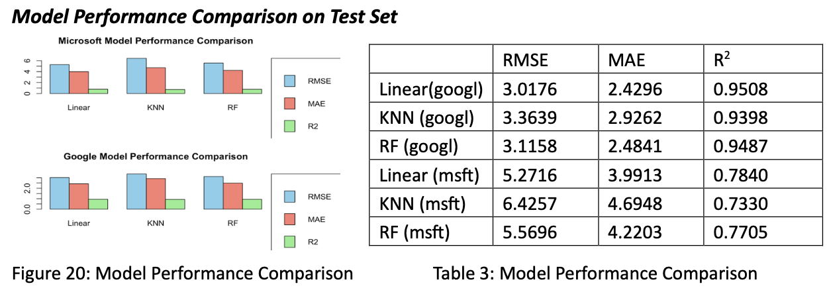
Task 2
3 Models Performance Comparison on Test Set
17
The three prediction models are compared in terms of RMSE, MAE, and R². In this case, the linear model performs best on the test set, and the KNN machine learning model performs worst.

Slide 18
Task 2
Further Discussion
1. Explanation of Random Forest Superiority over KNN in Stock Price Prediction
2. Reasons why linear model performance is the best
18
3. Further Model-Specific Optimization Strategies Suggestions for the 3 models

Slide 19
References
Asteriou, D., & Hall, S. G. (2011). Applied Econometrics. Palgrave Macmillan.
James, G., Witten, D., Hastie, T., & Tibshirani, R. (2013). An introduction to statistical learning. In Springer texts in statistics. https://doi.org/10.1007/978-1-4614-7138-7
Salloum, S., Alhumaid, K., Salloum, A., & Shaalan, K. (2024). K-Means Clustering of Tweet Emotions: A 2D PCA Visualization approach. Procedia Computer Science, 244, 30–36. https://doi.org/10.1016/j.procs.2024.10.175
20

