Slide 1

BLOCKCHAIN IN SCM
Dr. Abdullah YILDIZBASI
Ankara Yıldırım Beyazıt University
www.aybu.edu.tr

Slide 2

WHAT IS BLOCKCHAIN
Blockchain is an open, distributed ledger that can record transactions between two parties efficiently and in a verifiable and permanent way.
Adopted from https://hbr.org/2017/01/the-truth-about-blockchain
Notes:
Blockchain - this technology is making headlines everywhere. Yet for many of us it is a concept difficult to grasp and much mis-alignment exists. It has been proposed as a solution to so many problems and industries that it is difficult to keep up. With its potential impact it makes it crucial to understand blockchain and distinguish the hype from the reality. Today we are going to try to unpack blockchain at a basic level and look in more details at its impact on supply chain and logistics.
Blockchain technology is still a nascent technology. While much of the impact of blockchain technology is still unclear, businesses can not afford to wait until the outcome is evident. So there is really one key question that you need to answer: Do you want to be positioned to capture the benefits of the new, potentially transformative technology that is blockchain?
So let’s look at what blockchain is. It is important to understand that blockchain is not bitcoin. It is not cryptocurrency. Rather, blockchain is the underlying technology to cryptocurrency and blockhain has also many other possible uses.
When thinking about blockchain, think transactions. Organizations have traditionally recorded transactions in a ledger. Organizations keep their own ledger, ledger is the system of record for businesses. their own record. It records what comes in and what goes out. So blockchain is a way to record a transaction, store the transaction data.
The records that Blockchain keeps, are also called ‘blocks’. It is a database that maintains a continuously-growing list of records called blocks. Blockchain is also called distributed ledger technology. So when I refer to blockchain, I’m also referring to distributed ledger technology. Think of it as a steadily-growing spreadsheet of records or “blocks” that create an immutable record where each block is “chained” or linked to the previous block using state-of-the-art cryptography.
Blockchain technology can be programmed to record not just financial transactions, but nearly anything that holds value and can be expressed in code. Anything from birth, death and marriage licenses, to property deeds and titles of ownership, educational certificates, financial accounts, medical procedures, insurance claims, to votes, the possibilities are truly limitless.

Slide 3
How does it work?
Distributed and synchronized
Notes:
Blockchain is one example of a distributive ledger technology. A distributed ledger is a type of database that is shared, replicated and synchronized among the members of a network. The distributed ledger records the transactions, such as exchange of data, among the participants in the network.
The fact that blockchain is a distributed database, means that each party on a blockchain has access to the entire database and its complete history. No single party controls the data or the information. Every party can verify the records of its transaction partners directly, without an intermediary.
The primary benefit of this decentralization comes from creating a common view of all transactions.
It is this common view that streamlines interparty reconciliation.
Reconciliation becomes an internal process, aligning existing accounting records with the records on the blockchain-enabled shared ledger.

Slide 4
How does it work?
Distributed and synchronized
Peer-to-Peer Transmission
Notes:
It also is peer-to-peer transmission, so communication occurs directly between peers instead of through a central party (or intermediary). That direct peer-to-peer transmission also helps with transparency and accountability.

Slide 5
How does it work?
Distributed and synchronized
Peer-to-Peer Transmission
Transparency
Notes:
Because the ledger is distributed, all peers involved in the transaction network can view it – it creates transparency to all.
So in short, blockchain yields transparency and synchronization; it negates the need for trust; and the way data is recorded, stored and connected yields immutability and traceability.
It can help with transaction and accomplishing what few other technologies in the public sector can: providing a more trustworthy and transparent way to document and distribute government interactions.

Slide 6
How does it work?
Distributed and synchronized
Peer-to-Peer Transmission
Transparency
Traceability

Slide 7
How does it work?
Distributed and synchronized
Peer-to-Peer Transmission
Transparency
Traceability
Irreversibility of Records
Notes:
. The recordings on blockchain is immutable. Once a transaction is entered in the database and the accounts are updated, the records cannot be altered, because they’re linked to every transaction record that came before them. Blockchain records the transactions and no records are ever deleted.

Slide 8
How does it work?
Distributed and synchronized
Peer-to-Peer Transmission
Transparency
Traceability
Irreversibility of Records
Computational Logic / Automation
Notes:
You basically embed business terms in the transaction database.
With the blockchain, there is the possibility of digital self-enforcing contracts, widely known as smart contracts. The stipulations in a smart contract are hard-coded into its software meaning it only executes once all requirements are met.
Smart contracts provide one of blockchain technology’s most promising benefits. Smart contracts can improve efficiencies in contract enforcement.
A smart contract is a piece of code which is stored in the blockchain network. It defines the conditions on which all parties using contract agrees and certain actions described in the contract can be executed if the required conditions are met.
Self-executing contracts are creating ways for companies to operate automatically. These smart contracts are automatically enforced and executed through blockchain…this can lead to a more autonomous organization.
So its like an agreement built on its platform. Smart contracts are essentially computer code, contractual conditions could be translated into logical functions which trigger automatically when set conditions are met. So then you don’t need persistent human involvement.
Business terms embedded in transaction database & executed with transactions
The export and import documentation requirements and authority approvals are pre-programmed and built into Blockchain and distributed to and endorsed by the network

Slide 9
How does it work?
Distributed and synchronized
Peer-to-Peer Transmission
Transparency
Traceability
Irreversibility of Records
Computational Logic / Automation
“Trustless”
Notes:
In blockchain, there is no need for a third party or central intermediary to establish and guarantee trust.
So people are always asking me - Is blockchain here to stay? And how long will it take to reach its full potential? Most major innovations go through a long process of technical improvement and change before reaching maturity. Blockchain technology is likely to evolve in a similar fashion through a lengthy period of trial and error. It is still too early to tell if blockchain will become a widely used technology.
That being said, the time is NOW to prepare and to get positioned so you can take advantage of the technology in the future.
It is necessary to mention that there is not one exact way for a blockchain solution to look like. There are different ways the qualities of blockchain can be deployed – to best ensure it meets the needs of a party.

Slide 10
Three types of models
1. Public: Decentralization open to any public participant. Blockchain platform in permissionless mode.
2. Consortium: Decentralization close among trusted members of a consortium. Blockchain platform in a permissioned mode.
3. Private: Decentralization internally in an enterprise that is made of decentralized entities.
Trust
One of very few members
Many members
Notes:
Private versus public
Fully open and transparent blockchain-based databases may not be compatible with the requirements and data protection limitations. In that case, a permissioned/private or consortium/hybrid type of blockchain may offer a more suitable solution.
There is the “open” blockchain…everyone has access and can see everything. But if it is necessary to restrict access on the blockchain, you can do so through a “permissioned” blockchain where the ledger is encrypted so that only parties allowed to view it may do so.
Permissionless blockchain network:
Open to any node to participate in the network, either as a host or wallet.
There is no external control to govern the participation or limit access.
The DCP drives the system behavior.
This deployment model is used by bitcoin and Ethereum platforms.
It enables some anonymity, a property that is not usually desirable in regulated organizations.
In a permissionless deployment model, transactions are fully viewable, but the participants are identified only through a cryptographically derived account address.
Permissioned blockchain network:
A controlled environment in which only authorized nodes can participate in the network as host or wallet.
This is done through the platform's membership services.
Wallet access can be limited to read-only (for transaction validation) or left open to both write and read data (for transaction creation and management).
In a permissioned blockchain, transactions may be fully encrypted and only visible to the parties involved.
Relevant information can be shared with others based on their roles and access privileges.
The consortium model has a spectrum of trust models.
At one extreme, trust may be consolidated in one or a few trusted members responsible for validating transactions.
At the other extreme, many members may be trusted to complete transactions.
Consortiums may start with a small number of members and extend to more members over time.
The scope of consortium services can be limited to use cases that are specific to a single industry or use cases that span multiple industries.
This model uses a mix of algorithmic and traditional trust controls
At one end, the focus is on providing collective trust and general-purpose computing.
The key design goal in these platforms is true decentralization, which requires maximum algorithmic trust control.
At the other end, the focus is on granular trust control among a subset of nodes that participate in a transaction.
The key design goal in these platforms is to augment traditional central trust controls with blockchain properties such as immutability, autonomous assets tracking, shared ledger and some decentralization.
Such as geographical operating units or business units using a blockchain platform.

Slide 11


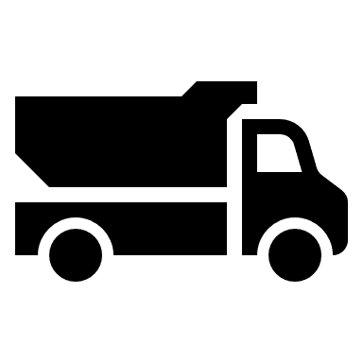





What can it mean to supply chains?
Problem: Difficult to monitor asset ownership and transfers
Inefficient
Mis-alignment
Expensive
Ledger
Ledger
Ledger
Ledger
Ledger
Ledger
Ledger
Ledger
Notes:
Multiple data formats
Too many peer-to-peer interactions
Absence of messaging standard
Lack of real time information
No single version of the truth
Manual, paper based processes
Expensive letter-of-credit processes
Manual data collection

Slide 12
What can it mean to supply chains?
Solution: Blockchain – synchronized, consensus, irreversible, provenance and efficiency
Ledger
Ledger
Ledger
Ledger
Ledger
Ledger
Ledger
Ledger
Notes:
Blockchain platforms can add value by allowing participants in a value chain to use a shared repository for their records of operation
These shared ledgers are distributed among participants in a peer-to-peer network
Can eliminate siloed record keeping infrastructure at a large scale
Remove duplication, inconsistency and the need for reconciliation of records.
We can envisioning these shared ledgers forming an accountability layer in a network environment that enables collective trust among the network participants.
Blockchain can be described as a network of computers, each having an identical copy of the database (distributed). There is no need for any central server or agent to bring trust. Remember, the ledger is distributed, so everyone involved can see the “status” at any point in time and can monitor the progress of the transaction. Since all parties can view the distributed ledger, everyone can agree on how the transaction is progressing while it is ongoing, and how it went once it is complete.
The core characteristics of blockchain, immutability, speed and security, create the ideal platform for tracking and protecting high-value assets and critical data.
Records encrypted on the blockchain are immutable – permanent and cannot be changed. This provides a single version of the truth and provides assurance on the authenticity of the data.
The decentralised nature of blockchain provides security for the records. Information is also secured via cryptographic methods.
A combination of public and permissioned ledgers allows everybody to have viewing accessibility to the provenance of the diamond, but also controls the access to private and confidential information for permissioned users only.

Slide 13
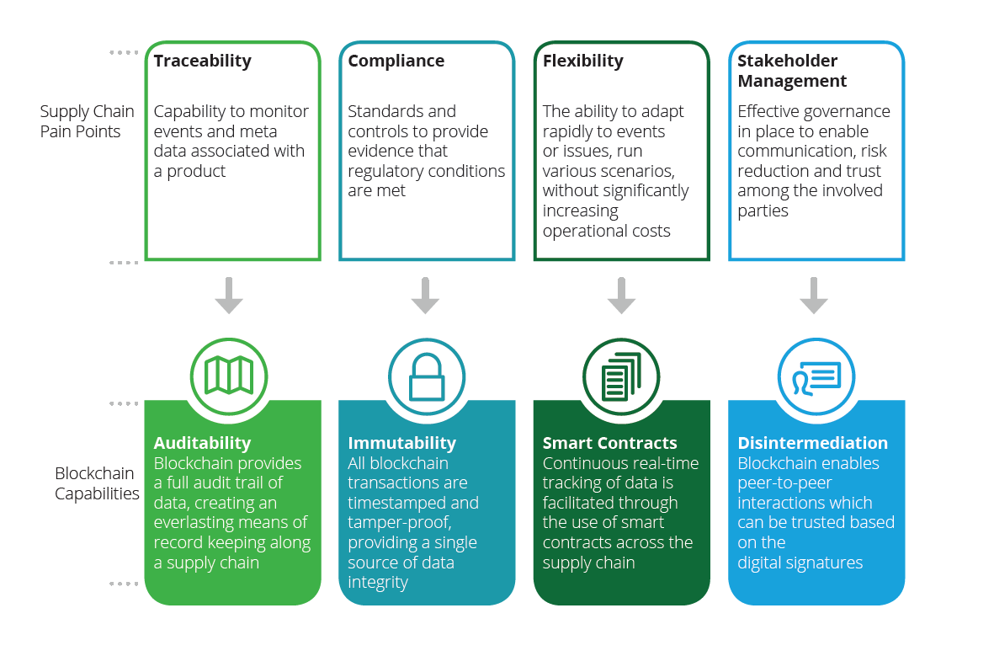
BLOCKCHAIN IN SCM

Slide 14
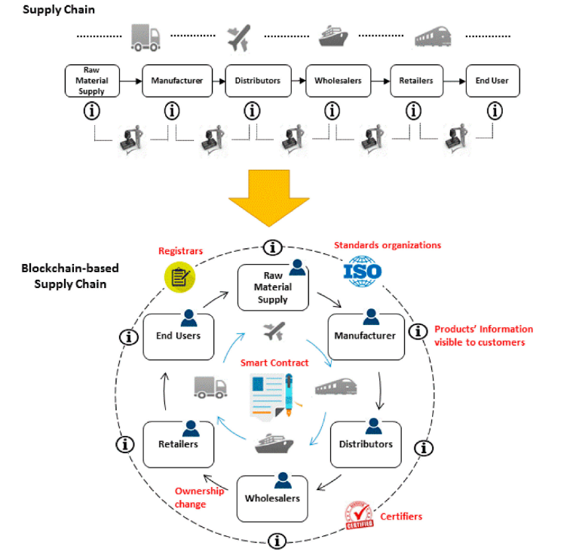
BLOCKCHAIN IN SCM

Slide 15
https://www.youtube.com/watch?v=QWijlTDHLMQ

Slide 16
BLOCKCHAIN INDUSTRY ACTIVITY
Pharmaceutical
Automotive
Food Supply Chain
Humanitarian Aid
and many other industries

Slide 17
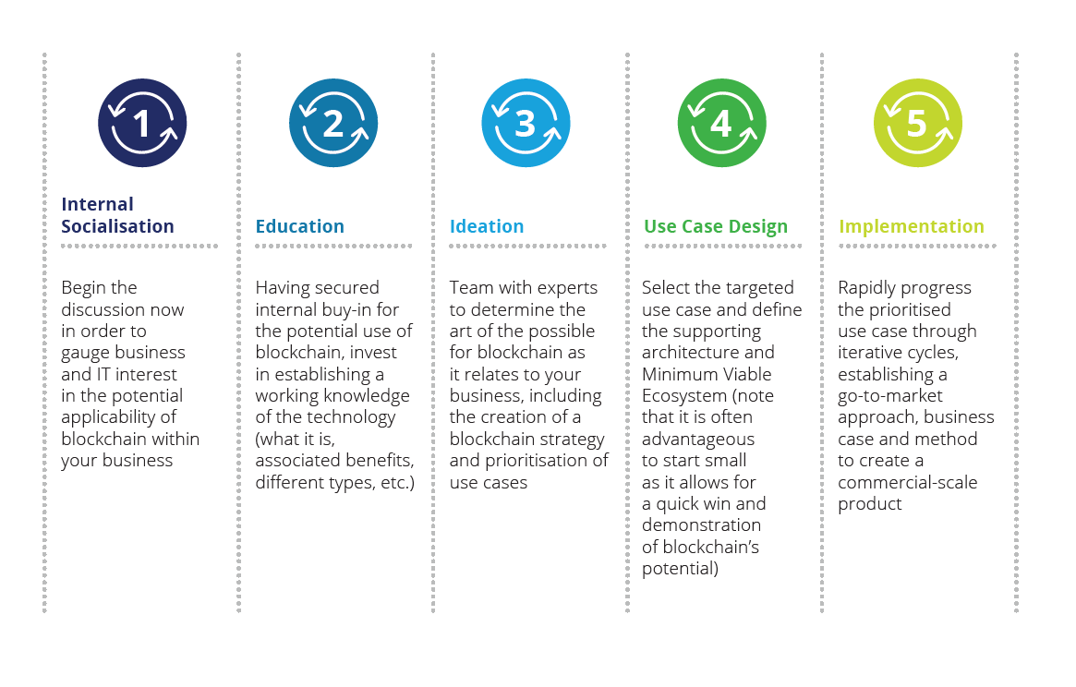
HOW TO TAKE ACTION

