Slide 1
ANGULARJS UNIT TESTING
Content:
Jasmine Framework
Karma Test Runner
Testing Data Service
Testing Service
Testing Controller
Testing Directive

Slide 2
A) Jasmine Framework
What is Unit Test?
Getting started with Jasmine
Expectation and built-in matchers
Specs
Grouping related specs
Setup & Teardown
Spy

Slide 3
What is Unit Test?
Applying to source code
Unit test should be written and run by software developer
Can view unit as smallest testable part of an application
Each test case is independent from the others
Important: don’t think unit test equals to function test

Slide 4
Getting started with Jasmine
Jasmine is a testing framework
Jasmine documentation: http://jasmine.github.io/2.2/introduction.html
How to use Jasmine:
Download library (from Github, include *css and *js)
Installing with npm: npm install jasmine

Slide 5
Expectation & built-in matchers
Using expect function
To compare expected result with real result
Syntax expect(expectedResult).matcher;
One expect one matcher
Used in it function

Slide 6
Built-in matchers
There are several built-in matchers
toEqual toBe toBeDefined
toBeNull toBeNaN toContain
toBeTruthy toBeFalsy …
Sample
expect(user.name).toBeDefined();
Can define custom matcher

Slide 7
Specs
It’s test case
Using it function
Can contain one/more expect function
Cannot contain other specs
Sample
it(‘should define object properties’, function() {
expect(obj.name).toBeDefined();
});

Slide 8
Grouping related specs
Using describe function. Note: describe can be used to define suite/group of specs.
Can contain one/more it function
Can contain other describe functions
Sample
describe(‘Testing getUsers functionality’, function() {
it(some specs code here);
it(other specs code here)
});

Slide 9
Setup & Teardown
Using beforeEach and afterEach functions
Writen inside describe
Applying for each specs in describe
beforeEach: used to prepare some preconditions to run test case.
afterEach: used to collect garbage

Slide 10
Spy
Very useful when you don’t want to execute the content of a function
Using createSpy function to create a spy function without implemented code
var sampleSpy = jasmine.createSpy(‘sample spy’);
Using createSpyObj to create an object that contains multiple spy functions
var tapeObj = jasmine.createSpyObj(‘tape’, [‘play’, ‘pause’, ‘stop’]);

Slide 11
Built-in functions for Spy
.and.callThrough: permit to execute the content of spy function
.and.returnValue: don’t execute function contain, return value after calling function
.and.callFake: execute other implemented code for called function
.and.throwError: all calls to function will throw a specified value as an error
.and.stub: reset original behavior for spy function

Slide 12
B) Karma
What is it?
Installing Karma
Setting up Karma
Running Karma

Slide 13
What is Karma?
It’s a test runner. It’s used to setup and run unit tests
Useful for testing AngularJS project
Can execute tests on every save

Slide 14
Installing Karma
Prerequisite: know about NodeJS, NPM

Slide 15
When should use Directive?
Please give your idea!

Slide 16
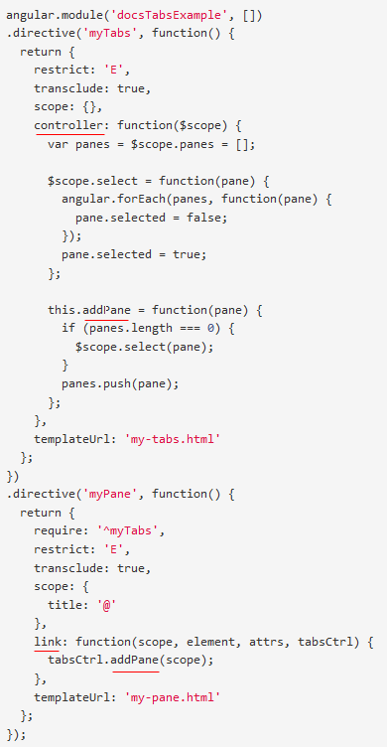
Directive: controller vs link

Slide 17
Directive: controller vs link (cont)
Best practice:
“Using controller when you want to expose an API to other directives. Otherwise use link.”

Slide 18
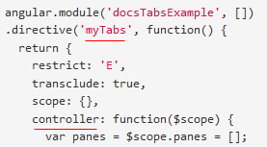
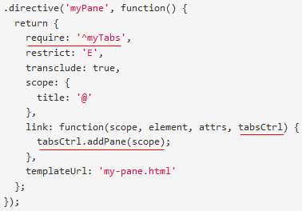
Directive: require controller(s)

Slide 19
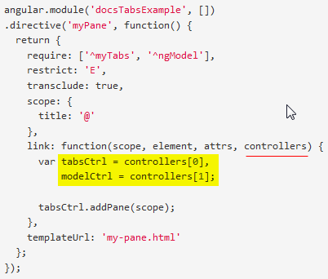
Directive: require controller (cont)
- require: 'nameOfSiblingController'
- require: '^nameOfParentController'
- require: ['nameOfSiblingController', '^nameOfParentController'] ==> multiple controllers
- require: '?nameOfController' ==> return null when can not find nameOfController instead of throw error.
- require: 'nameOfDirective' ==> Using when nameOfDirective use inner controller

Slide 20
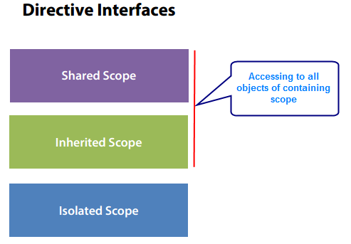
Directive interfaces

Slide 21
Directive interfaces (demo)
Parent directive ⬅ ➔ Child directive

Slide 22
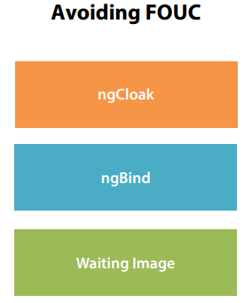
Directive: avoiding FOUC

Slide 23
Directive – Thinking declaratively (DNS)
<header>
<left-panel>
<content-panel>
<right-panel>
<customer-search>
<customer-detail>
<customer-list>
<footer>

Slide 24
C) Testing Data Service
Run webpage
Description and Requirement

Slide 25
D) Testing Service
Run webpage
Description and Requirement

Slide 26
E) Testing Controller
Run webpage
Description and Requirement

Slide 27
F) Testing Directive
Run webpage
Description and Requirement

Slide 28
Q&A
Q&A

Slide 29
Thanks for joining!

