Slide 1
ANGULARJS
Content:
File & Folder organization
About AngularJS directive
Excersive

Slide 2
I) File & Folder organization
Normal example: documents
Naming: controller, directive ...
Coding example
Organize: by Feature
Organize: by Feature then Type
Modules

Slide 3
Naming
How about: student.js?
Controller: *Ctrl
Service (Factory): *Svc
Filter
Directive (partial)
Namespacing

Slide 4
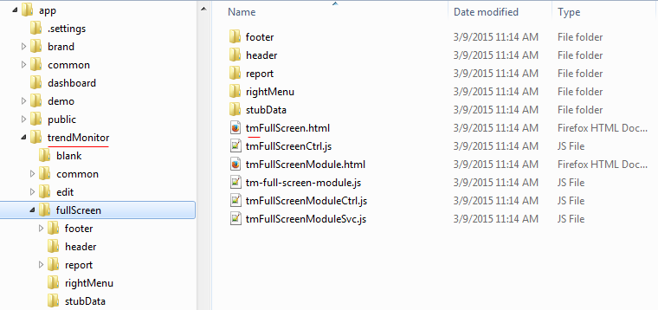
Naming (Namespacing)

Slide 5
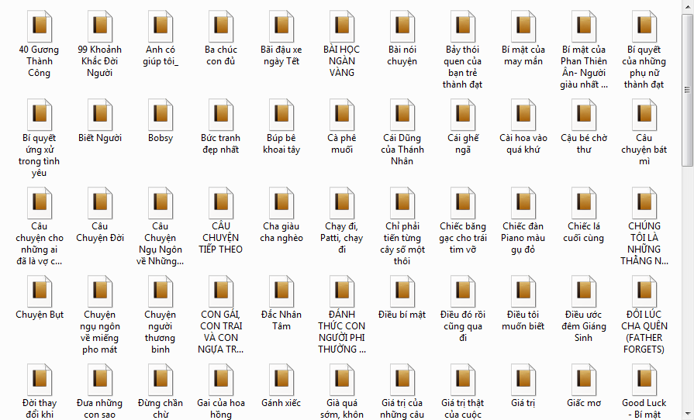
F&F Organization: documents
Business
Romantic

Slide 6
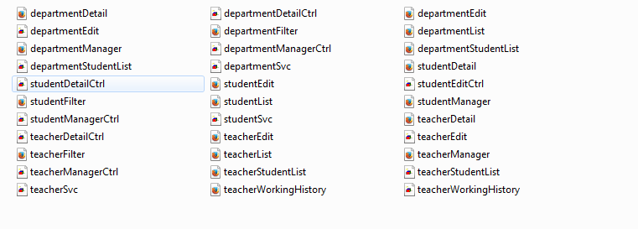
F&F Organization: coding
Show problems
Give solutions

Slide 7
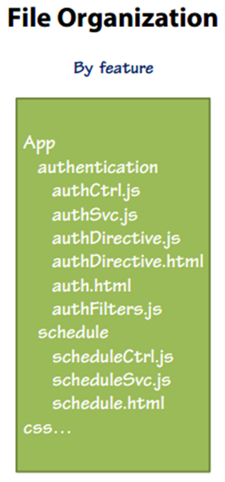
Organization: Feature

Slide 8
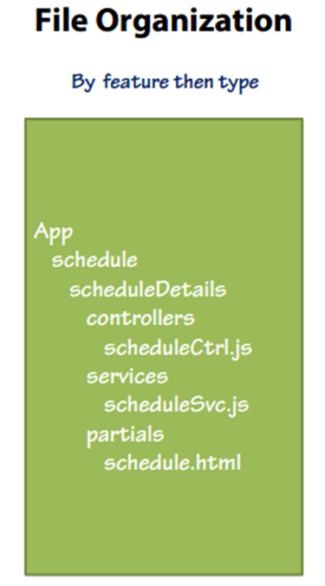
Organization: Feature then Type

Slide 9
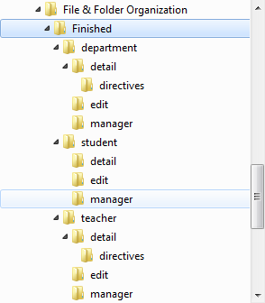
F&F Organization: coding (cont.)

Slide 10
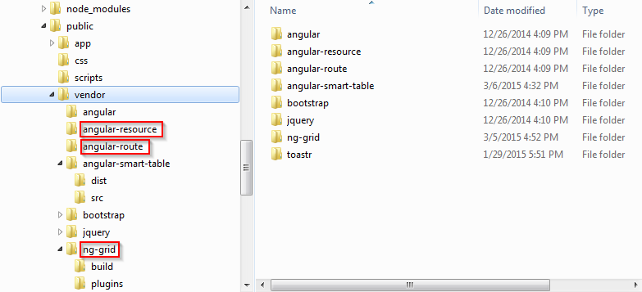
Module
Module
Separated
Injected
…

Slide 11
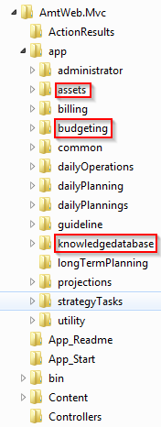
Module (cont)
Any suggestion?

Slide 12
II) Directive
What?
When?
Directives - Controllers vs Link
Directives - Requiring Controllers
Directive Interfaces
Avoiding FOUC in Views
Declaratively - DNS

Slide 13
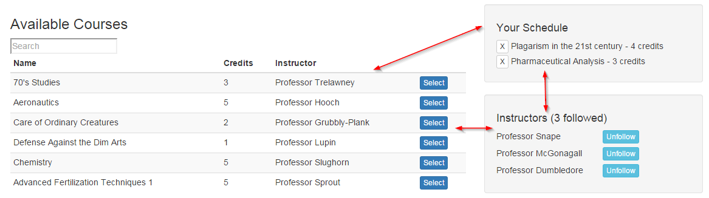
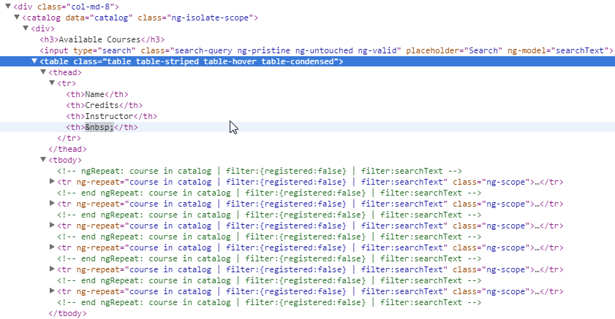
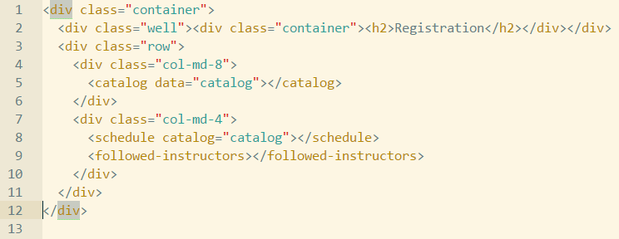
What is directive?
Normal html
Directive

Slide 14
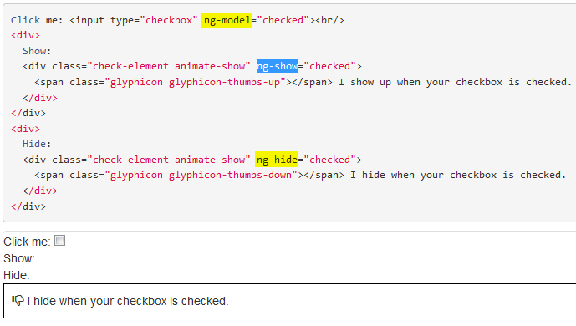
What is directive (cont)

Slide 15
When should use Directive?
Please give your idea!

Slide 16
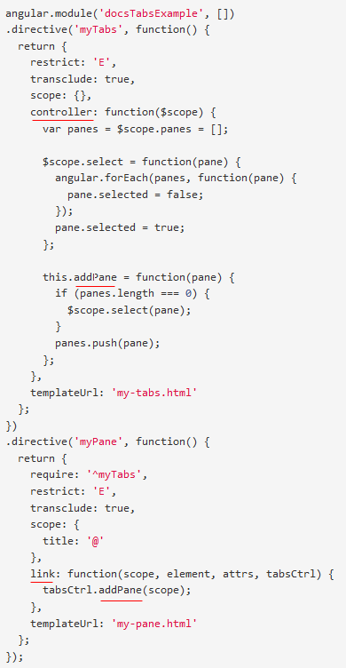
Directive: controller vs link

Slide 17
Directive: controller vs link (cont)
Best practice:
“Using controller when you want to expose an API to other directives. Otherwise use link.”

Slide 18
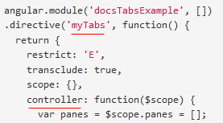
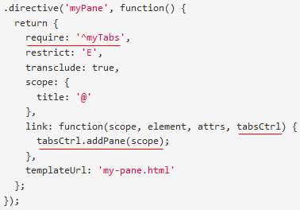
Directive: require controller(s)

Slide 19
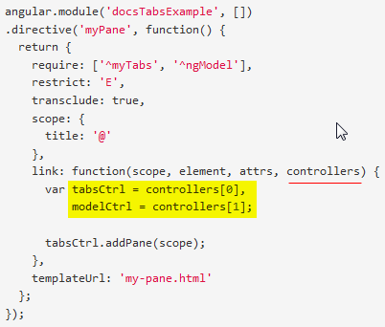
Directive: require controller (cont)
- require: 'nameOfSiblingController'
- require: '^nameOfParentController'
- require: ['nameOfSiblingController', '^nameOfParentController'] ==> multiple controllers
- require: '?nameOfController' ==> return null when can not find nameOfController instead of throw error.
- require: 'nameOfDirective' ==> Using when nameOfDirective use inner controller

Slide 20
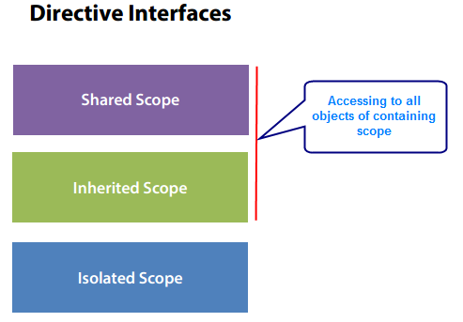
Directive interfaces

Slide 21
Directive interfaces (demo)
Parent directive ⬅ ➔ Child directive

Slide 22
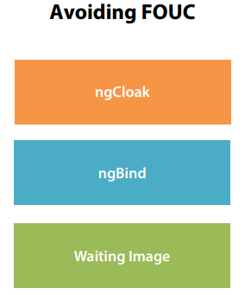
Directive: avoiding FOUC

Slide 23
Directive – Thinking declaratively (DNS)
<header>
<left-panel>
<content-panel>
<right-panel>
<customer-search>
<customer-detail>
<customer-list>
<footer>

Slide 24
III) Excersive
Run webpage
Description and Requirement

Slide 25
Q&A
Q&A

Slide 26
Thanks for joining!

