Slide 1
Introduction to Scrum
Presented at Agile NCR Workshop
By,
Mayank Gupta, GlobalLogic
Deepak Mittal, IntelliGrape

Slide 2
Agenda
Agile Manifesto
Scrum Alliance Survey
What is Scrum
Scrum Framework
Scrum Roles and Ceremonies
Why we might fail using Scrum
Summary

Slide 3
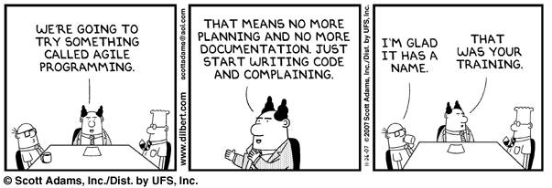
Dilbert goes agile

Slide 4
Agile Manifesto
Individuals and Interactions over processes and tools
Working software over comprehensive documentation
Customer collaboration over contract negotiation
Responding to change over following a plan.
That is, while there is value in the items on the right, we value the items on the left more.

Slide 5
Scrum Alliance Survey - 2007
Seventy-five percent of those who responded report that Scrum is meeting or exceeding their organizations’ needs.
Forty-five percent of respondents report their organizations are either very pleased with Scrum or believe it exceeds their organizations’ expectations.
Nearly 90 percent (87%) of respondents report personal satisfaction with Scrum.

Slide 6
What is Scrum?
Scrum is agile software development framework.
A wrapper for engineering practices
A simple approach to effectively manage complex problems
A process to maximize and maintain productivity
A process to improve collaboration, meaningful communication and maximize cooperation

Slide 7
Scrum Framework
Roles: Product Owner, Scrum Master, Team
Ceremonies: Spring planning, Spring review, Sprint retrospective, Daily Scrum Meeting
Artifacts: Product backlog, Spring backlog, Burndown Chart

Slide 8

Scrum Framework
Scrum Master
Daily Stand-Up
Meeting
Review
x-Week
Sprint
Product Owner
The Team
1
Potentially Shippable Product
1
Commitment
2
2
3
3
4
4
5
5
No Changes
(during sprint)
6
6
7
7
8
8
9
9
Retrospective
10
10
11
11
12
12
13
13

Slide 9

Product Owner
Voice of actual customer
Owns the prioritized list of requirements (Product Backlog)
Available to the team at all times
Participates in sprint planning and review meetings
Responsible for product vision, ROI and release management

Slide 10

Scrum Team
Teams of 7 +/- 2 participants (max -15)
Cross functional
Best experts in the domain area
Self-organizing
  Team decides who shall do what
  They inspect and adapt as the sprint goes along
Have most of the powers during a sprint

Slide 11
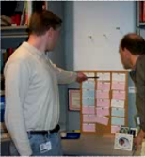
Scrum Master
Facilitator
Protects the team
Removes impediments to the ability of the team
Not the leader of team (Team is self organizing)
Ensures the Scrum process is used as intended
Responsible for Daily Scrum
Coaches the team
Does everything to help the team achieve the sprint deliverables

Slide 12
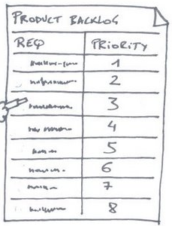
Product Backlog
An ordered list of prioritized items
Ittems: Stories, features, defects, tasks
Used for release planning and Iteration planning
Highest priority Items are picked first

Slide 13
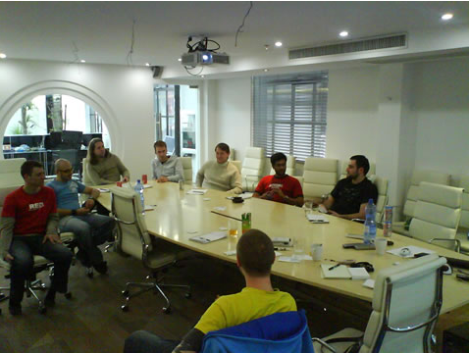
Sprint Planning Meeting
1. Product Owner, Team, and other Stakeholders talk through Product Backlog Items and prioritization.
2. Team determines how much time it has available to commit during the Sprint
3. Team selects as much of the Product Backlog as it can commit to deliver by the end of the Sprint, and turns it into a plan
  - Validates commitment by breaking down into tasks with time estimates
  - Team decides who will do what, when; thinks through sequencing, dependencies, possible task trades, and so forth.

Slide 14
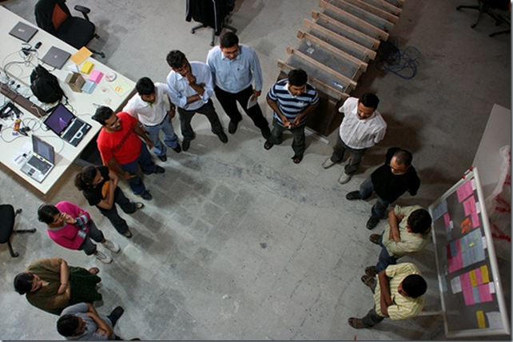
Daily Scrum Meeting
Must not last more than 15 minutes
Held same place, same time, every working day
Anybody can come, but only the team can speak
3 questions
    What did I do yesterday?
    What am I going to do today?
    What are my impediments?

Slide 15
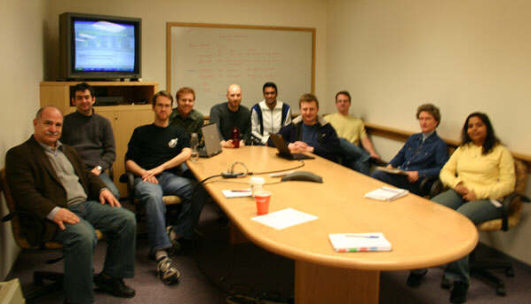
Review/Sprint Demo
Team presents the working demo.
    What have we achieved?
    Should show finished functionality.
    What is missing.
    Maximum of 2 hours for presentation.

Slide 16
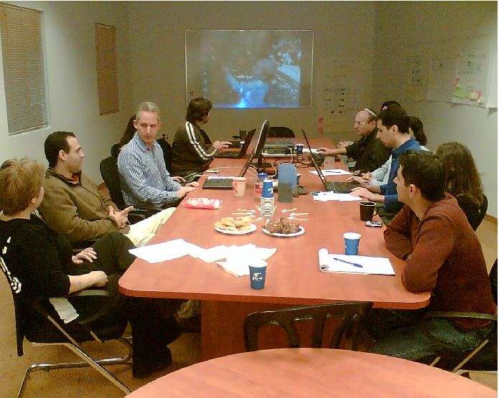
Retrospective
Facilitated by Scrum Master
To increase productivity and
Team reflects on sprint experience and comes up with suggestions.
    What went well?
    What did not go so well?
    How can we improve?

Slide 17
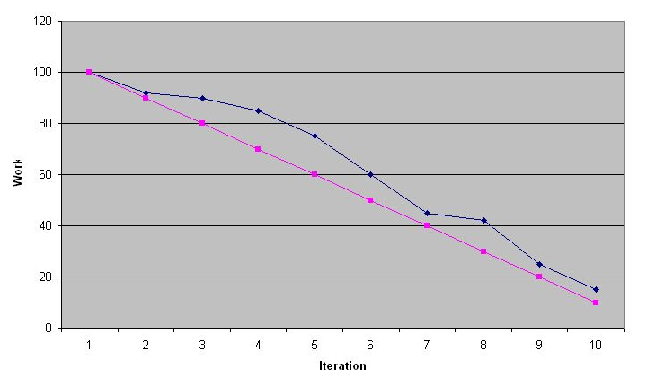
Burndown chart
A graphical representation of work left to do vs. time
Work remaining is the Y axis and time is the X axis.
Useful to predict when all of the work would complete
  Release burndown chart
  Sprint burndown chart

Slide 18
Why we might fail using scrum?
Hard!
Scrum does not fix everything
Scrum makes problems visible - early
Ready for a change?
It makes Products to be delivered faster
Customized/partial Scrum

Slide 19
Summary
  Everything is time-boxed.
  Inspect & Adapt.
  You can-not plan everything.
  Fail early.
  Shippable product at the end of every iteration/sprint.
  Iterative incremental development.
  Cross-functional teams.
  Self-organizing teams.
  Team owns the sprint backlog.

Slide 20
Where Scrum is used?
US Federal Reserve
SAP
H P
Motorola
TransUnion
Google
Microsoft
GlobalLogic
Yahoo
Sun
Siemens
Nokia
Philips
BBC
IBM
Xebia

Slide 21
Thank You
  Questions?

