Slide 1
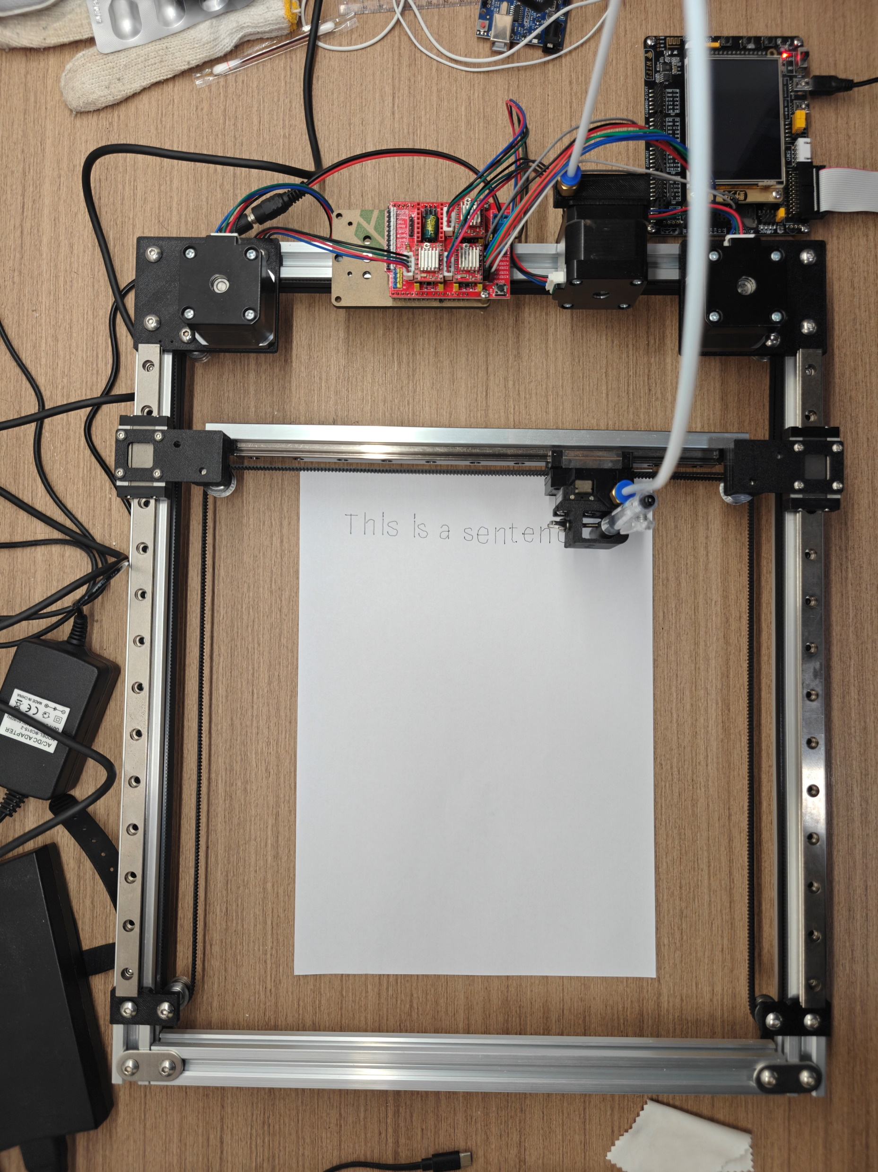
STM32 WRITING ROBOT
GROUP 57
Chiu Chi Keung
Yu Yingxuan

Slide 2
Functionality
PC words input
Words input from PC UI
Draw shapes
Arbitrary direction and length, at assigned location
Data conversion to STM32
Writing with vector data

Slide 3
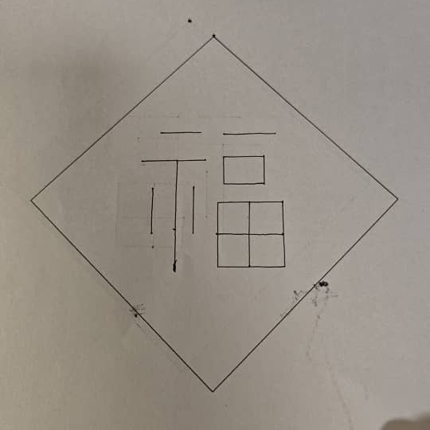
Core Principle: BasicMove & CoreXY
(legacyMove)
BasicMove
Simple, ease to use & call
Octo-directional
Time-based
Good for:
Simple drafting
logos

Slide 4
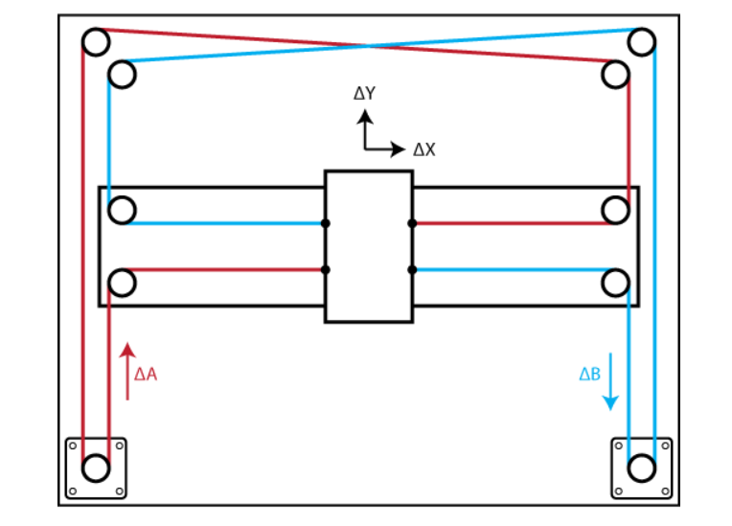
Core Principle: CoreXY
Two Motion Motor
Moves in diagonal
When one motor spins, “L” shaped belt changes length
Why?
CoreXY VS Cartesian: more light weight, faster
Each motor have control to both X and Y axis
Use both motor for single axis movement
One Pen Lift Motor
Control Pen up and down

Slide 5
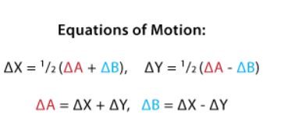
CoreXY: Mechanics
void motorControl(delta_MotorL, delta_MotorR)
Support Draw and Writing of any vector
delta_Motor(L/R):
Motor Spin how much & in what direction
Bresenham's line algorithm:
move in X and Y alternately, in fixed step size (like zigzag)
WorkFlow :
Find absolute steps of each Motor: the larger is base
Setup appropriate error
First, move from the base axis, error adds up
Then, error in that axis exceeded, change axis
Alternate until the vector is drawn
PWM supported: adjust writing speed / step size

Slide 6
CoreXY: Drawing/Writing functions
void updateGlobalXY(delta_X, delta_Y)
Update position data
void moveToAbsoluteXY(target_X, target_Y)
Move to designated position
Calls moveToXY()
void moveToXY(delta_X, delta_Y)
Basic writing command
Calls motorControl() and updateGlobalXY()
void moveAngle(distance, angle)
Translate the math units into steps for Motor
Calls moveToXY()

Slide 7
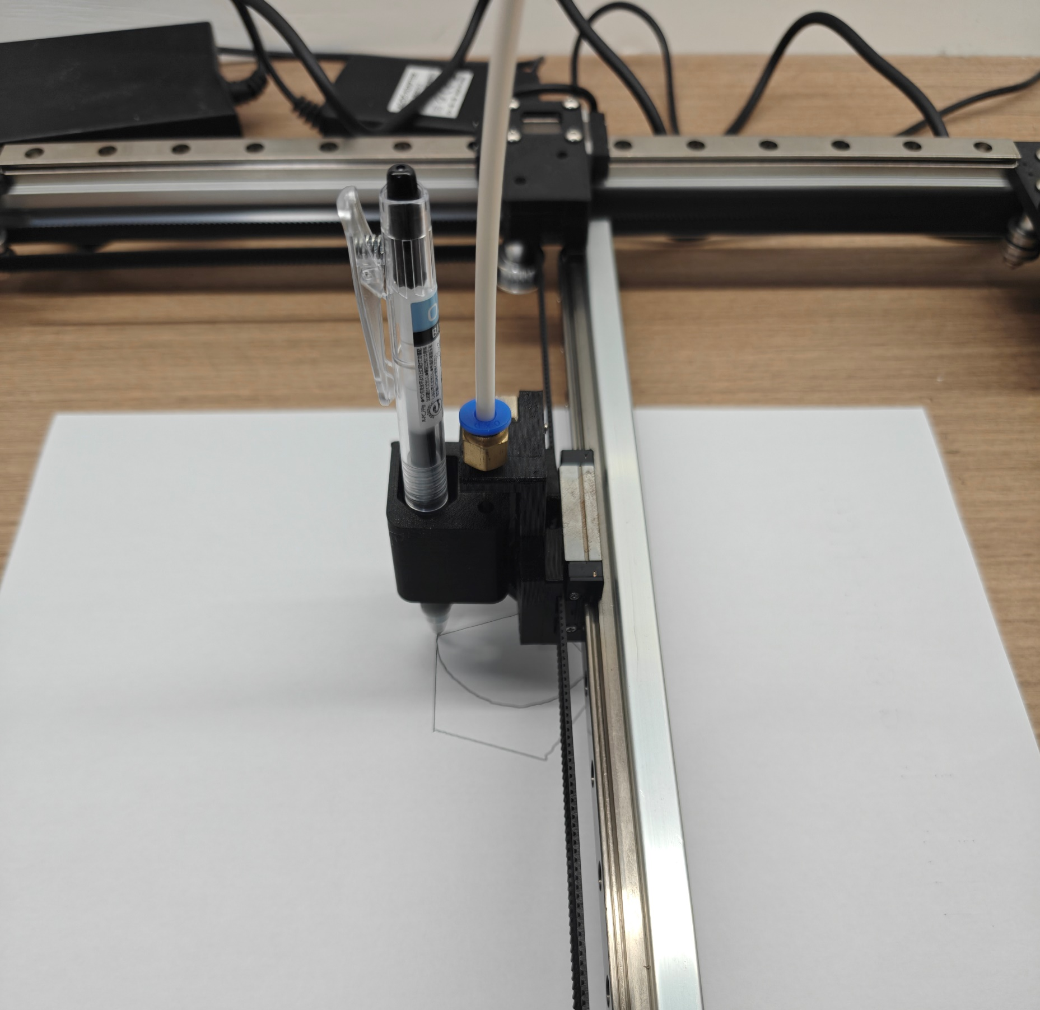
CoreXY: Drawing
Pentagon
Circle

Slide 8
Writing: How it works
Transmission:
USB Change Data Capture (CDC) Client:
capture the JSON data and validate, then pass data to Parsers
STM32:
Parsing: parse incoming JSON data into C data structures, then feed to writing instructions
PC User Interface:
Input: word input in interface textbox, page data in the data box
Convert: JSON data

Slide 9
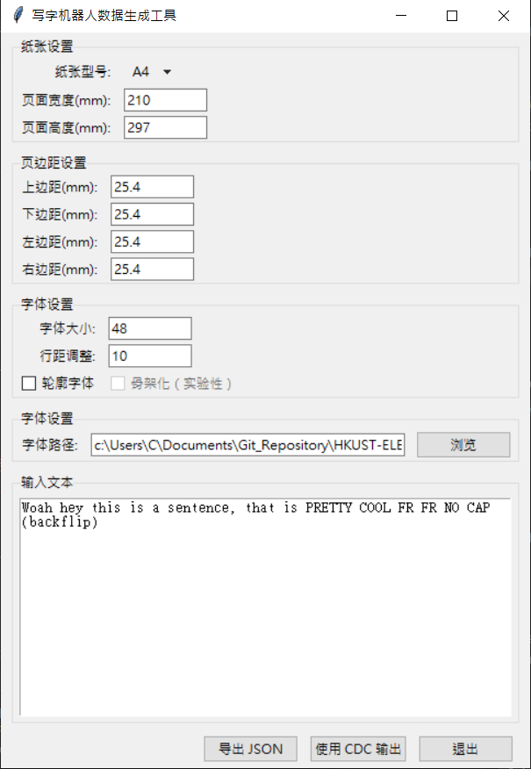
Writing: PC User Interface

Slide 10
Writing: USB Change Data Capture
(CDC) Client
USB CDC Interface:
Transmits data:
Data Flow Protocol:
Handshaking mechanism:
Buffer Management:
for character data: charBuffer
document information first,
for document: infoBuffer
CDC_Receive_FS() callback function
CDC_Transmit_FS() function
with Ready and End signals
virtual serial port over USB
Handles data :
Two-phase transfer:
Separate buffers:
then character by character data

Slide 11
Writing: Data structure (in STM32)
Data hierarchy
Document: Data of the page, Segment within (page width…)
Segment: Group of characters, inter-line data (line gap…)
Character: combination of Vectors, inter-character data (line feed…)
Stroke: Vector data between points
Points: Position data (x & y)
Document -> Segment-> Character -> Stroke -> Point
Unfortunately: Due to limited memory in STM32 (64kb), structure must be changed during transmission

Slide 12
Writing: Data structure (during transmission)
Character-by-Character Transmission
Data hierarchy
Document: Data of the page, Segment within (page width…)
Segment: Group of characters, inter-line data (line gap…)
----------------------------------------------------------------------------------------------
Character: combination of Vectors, inter-character data (line feed…)
Stroke: Vector data between points
Points: Position data (x & y)
Document -> Segment
Character -> Stroke -> Point

Slide 13

Writing: Two Essential instructions
"114514"
The STM32 sends it to the PC to indicate that it is ready for the data for the next character
"1919810"
The PC sends it to the STM32 to indicate that the data just sent is the last character data of the task, and the STM32 should expect new global information of the next writing task

Slide 14
Writing: The Working Loop
The working loop:
Setup (if a new job found)
Processes and Parses document information received via USB
Initializes structures, dimensions and environment
Enables motors
Sends "114514" to PC
Writing
Processes and Parses character information received via USB
Writes individual words (vector) and manage environment (line feeds, change position, etc)
Sends "114514" to PC after the writing job one character has finished
Cleanup (if a job is completed)
Frees all allocated memory
Resets all global variables
Disables motors

Slide 15
Writing: Data Flow
Data initialization & processing:
process[data]() to process incoming data from USB
parse[type]() to convert received data into [type]
init[type]() to create empty container
E.g.:
processChar(*buffer, length) : Catch incoming JSON data, then call initCharacter(), and pass the JSON to parseCharacter().
parseCharacter(*character, *json) : Parse JSON data into a Character properties and related structure.
initCharacter(*character, …) : Create empty Character(s).

Slide 16
Writing: Data handling
Process:
Processes data received over USB (Change Data Capture Client)
Creates global ‘current’ structures (to point at the data working at)
Sets up initial position and sends ready signal
Parse:
Extracts page dimensions and environment data
Parses JSON data into C structures that STM32 can read
Initialize
Initializes C Structures with given data
Allocates dynamic memory for Structures

Slide 17
Writing: The Act
With appropriate C structures and data:
Draw:
Use relative or absolute position data to position the structure
E.g.:
Segments positioning with line_gap
Character relative placement
Stroke's location and vector
Calls Writing functions (e.g. moveToAbsoluteXY) : all data is processed to groups of vectors

Slide 18
Development: Issues We Faced
Wi-Fi module out of grasp:
The system is too complicated
Resolution:
Use USB CDC instead
CDC can only transfer 64 bytes at once:
Resolution:
Sectioned transmission
.json data is spliced into sections of 32 bytes
Each is transmitted with 10ms of delay accordingly

Slide 19
Development: Issues We Faced
STM32 Limited Memory:
During development – not aware of very limited Memory
Document exceeded limit
structure Writing the ‘whole’ document is not possible
Memory cannot hold a full JSON data file
Sending the whole file is not possible
Chinese words’ data cannot be fully sent (plan discarded)
Resolution:
Break down data from PC
Two-phase transfer: Document mostly store environment data, Character mostly store word data
Discrete word data: Character mostly transfer one after one, then freed immediately

Slide 20
Thank you

Slide 21
References:
https://blog.csdn.net/weixin_43492610/article/details/122628863
https://blog.csdn.net/xusiwei1236/article/details/141504722
https://blog.csdn.net/qq_25626001/article/details/119354210
https://shequ.stmicroelectronics.cn/thread-637593-1-1.html
https://www.geeksforgeeks.org/bresenhams-line-generation-algorithm/
https://www.geeksforgeeks.org/change-data-capture-cdc/

