Slide 1
Big Data Project
Professor : Premchand Nair
Student 18 : Thi Thu Hang Nguyen (615716)
Student 19 : Xuan Giap Nguyen (615643)

Slide 2
Agenda
Hadoop Project
Word Count (In-mapper combining)
Average Computation (In-mapper combining)
Relative Frequency – Pair Approach
Relative Frequency – Stripe Approach
Time and resource comparison
Spark Project
Problem statement
Scala code
Demo

Slide 3
Hadoop Project

Slide 4
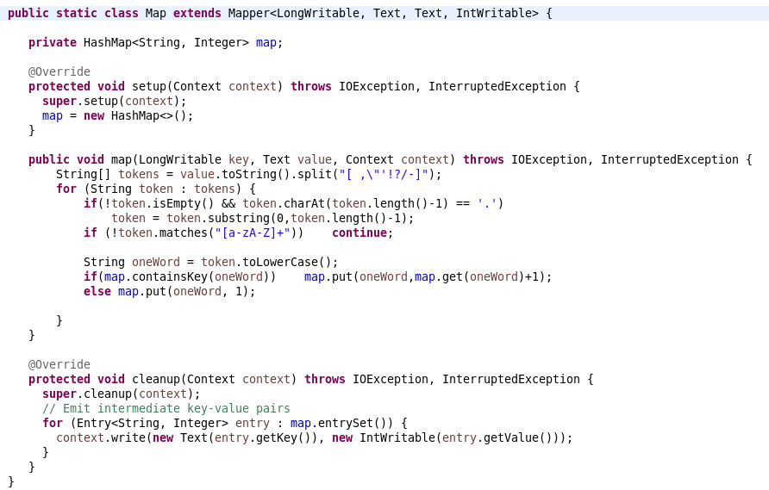
Hadoop Project Part1.Word Count (In-mapper combining) – Mapper

Slide 5
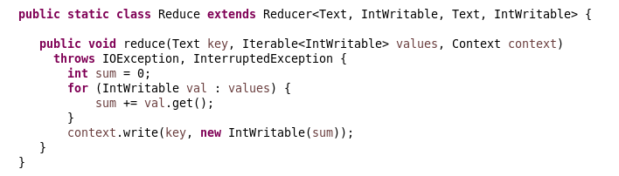
Hadoop Project Part1.Word Count (In-mapper combining) – Reducer

Slide 6
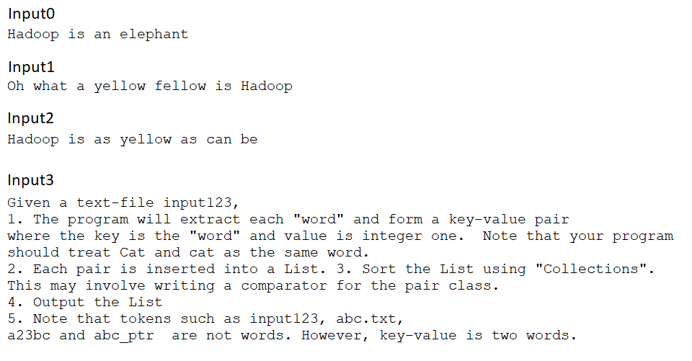
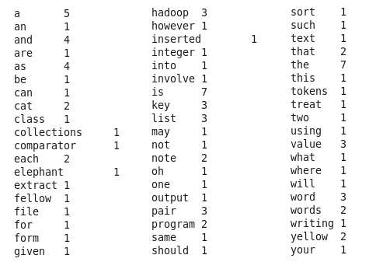
Hadoop Project Part1.Word Count (In-mapper combining) - Result
Input
Output

Slide 7
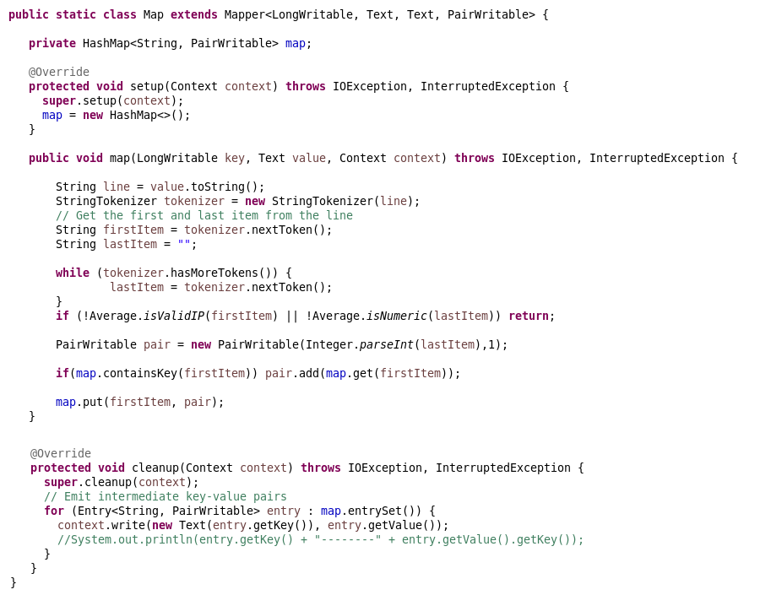
Hadoop Project Part1.Average Computation (In-mapper combining) – Mapper

Slide 8
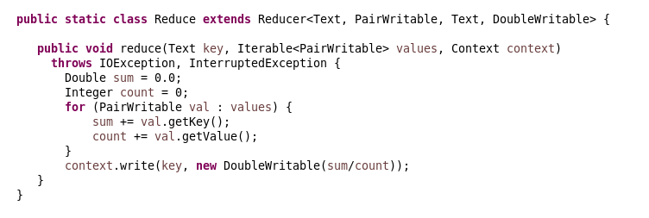
Hadoop Project Part1.Average Computation (In-mapper combining) – Reducer

Slide 9
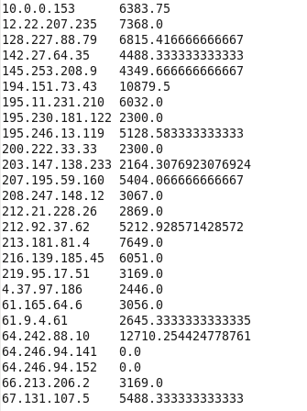
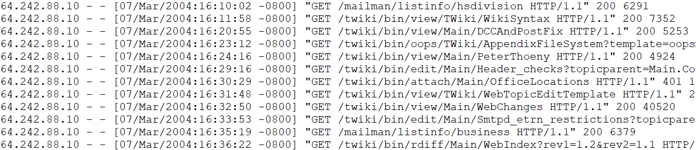
Hadoop Project Part1.Average Computation (In-mapper combining) – Result
Output
Input (access_log)

Slide 10
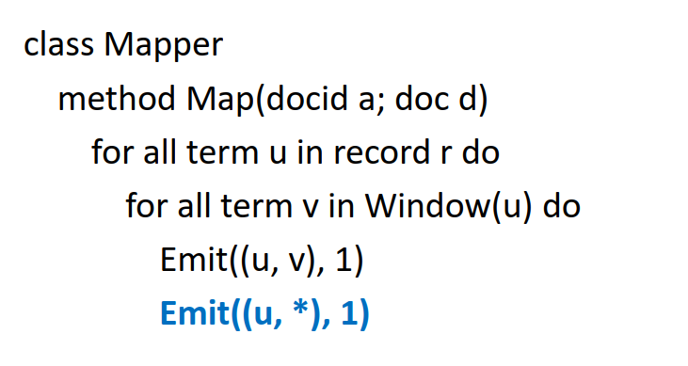
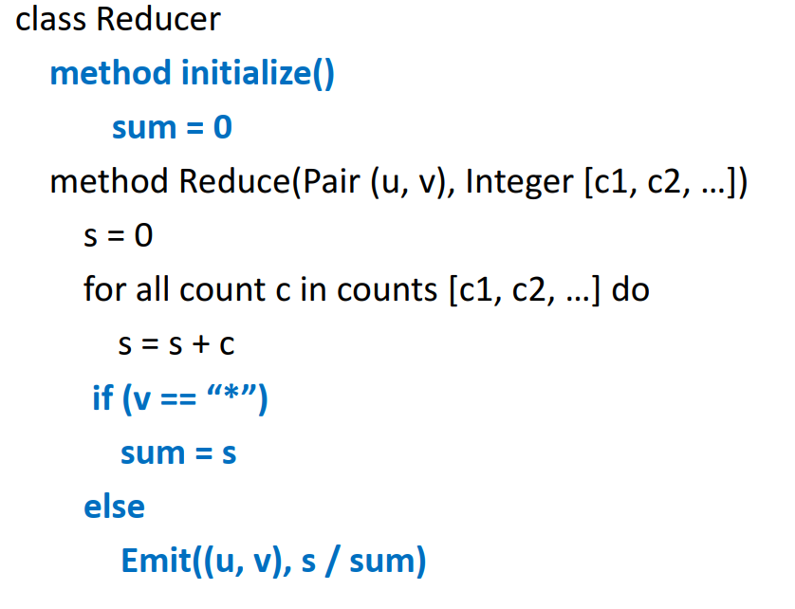
Hadoop Project Part2.Relative Frequency (Pair Approach) – Pseudo code

Slide 11
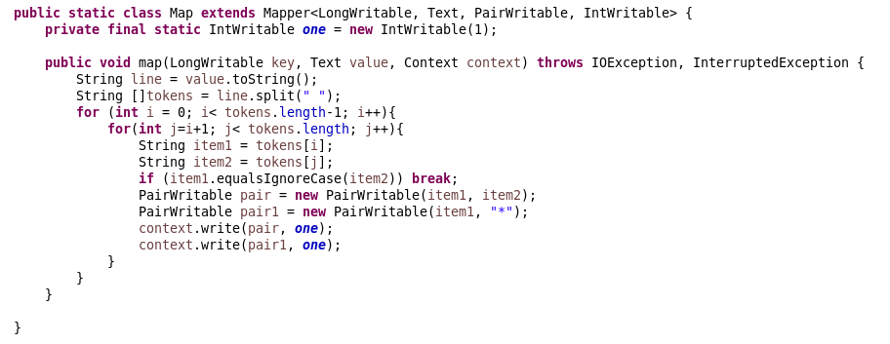
Hadoop Project Part2.Relative Frequency (Pair Approach) – Mapper

Slide 12
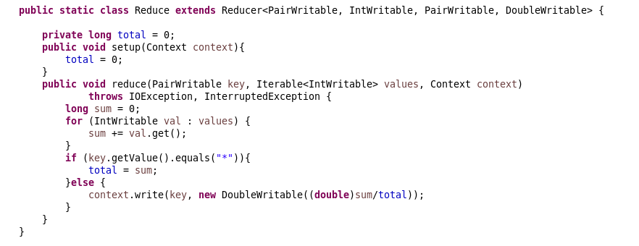
Hadoop Project Part2.Relative Frequency (Pair Approach) – Reducer

Slide 13
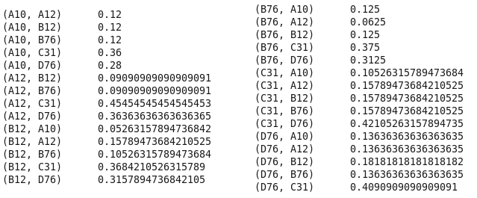
Hadoop Project Part2.Relative Frequency (Pair Approach) – Result
Input
Output

Slide 14
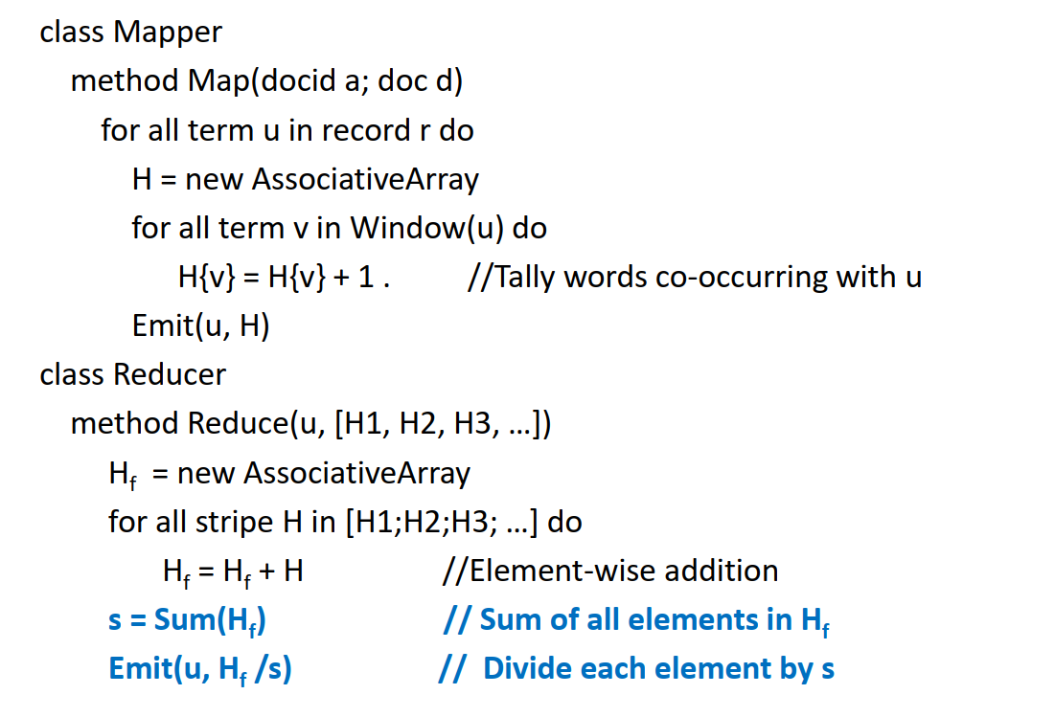
Hadoop Project Part3.Relative Frequency (Stripe Approach) – Pseudo code

Slide 15
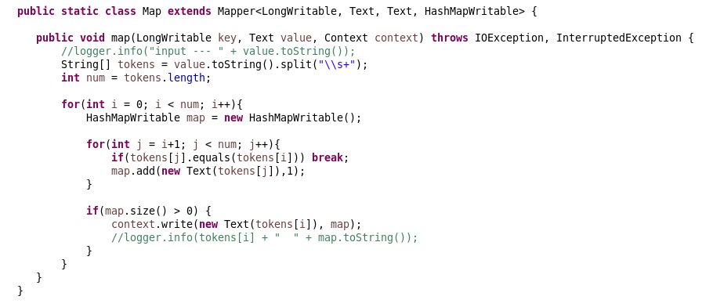
Hadoop Project Part3.Relative Frequency (Stripe Approach) – Mapper

Slide 16
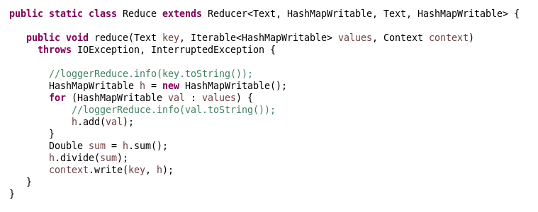
Hadoop Project Part3.Relative Frequency (Stripe Approach) – Reducer

Slide 17
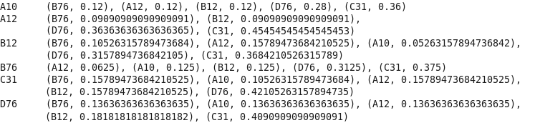
Hadoop Project Part3.Relative Frequency (Stripe Approach) – Result
Input
Output

Slide 18

Hadoop Project Part4.Time and resource comparison

Slide 19
Hadoop Project Part4.Time and resource comparison

Slide 20
Spark Project

Slide 21
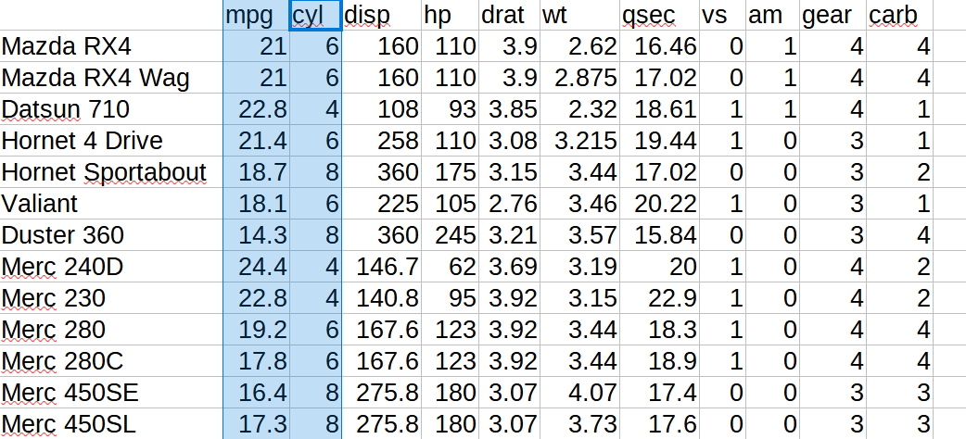
Spark Project Problem statement
- Input: https://vincentarelbundock.github.io/Rdatasets/csv/datasets/mtcars.csv
- Categorical variable: cyl
- Numeric variable: mpg

Slide 22
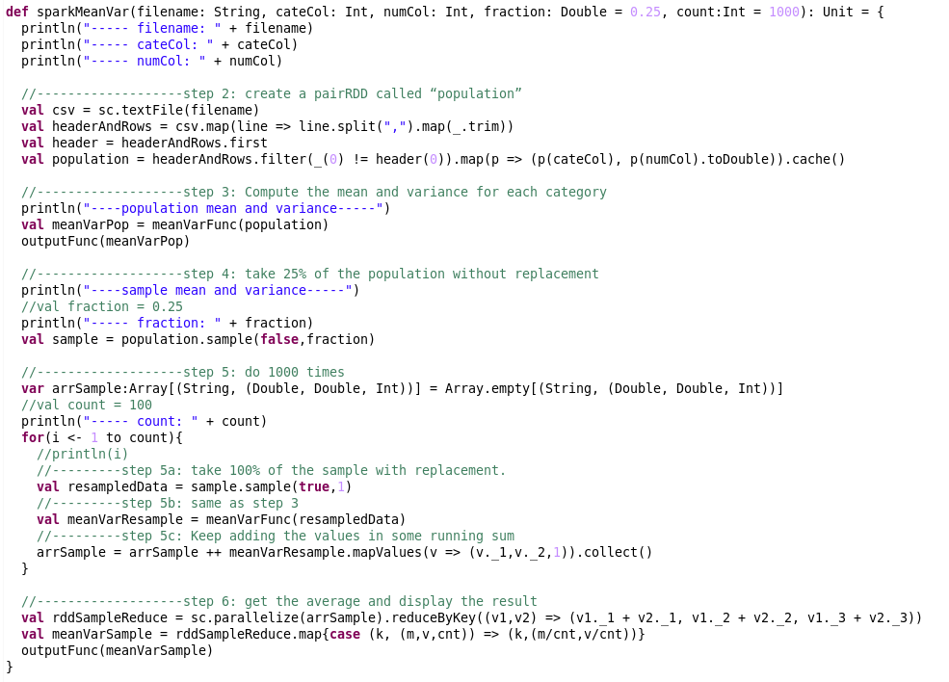
Spark Project Scala code

Slide 23
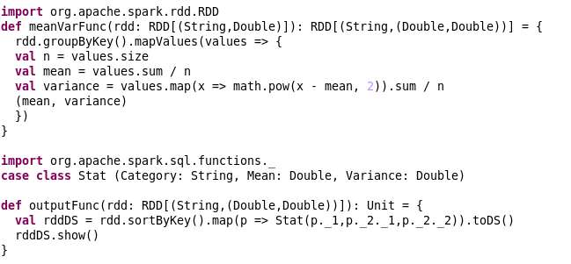
Spark Project Scala code

Slide 24
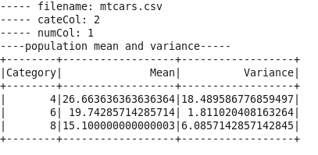
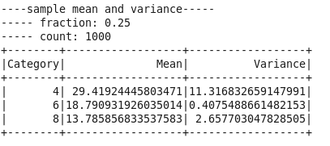
Spark Project Output

Slide 25
Thank you

Slide 26
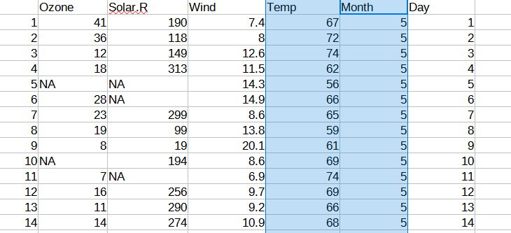
Spark Project Problem statement
- Input: https://vincentarelbundock.github.io/Rdatasets/csv/datasets/airquality.csv
- Categorical variable: Month
- Numeric variable: Temp

Slide 27
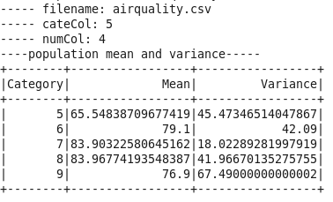
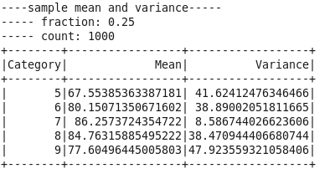
Spark Project Output

Slide 28
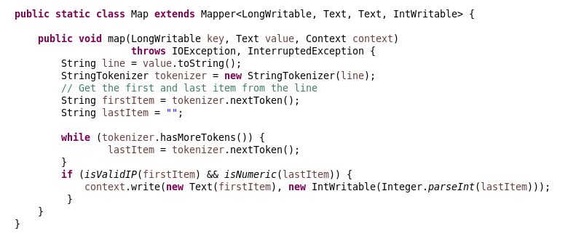
Hadoop Project Average Computation – Mapper

Slide 29
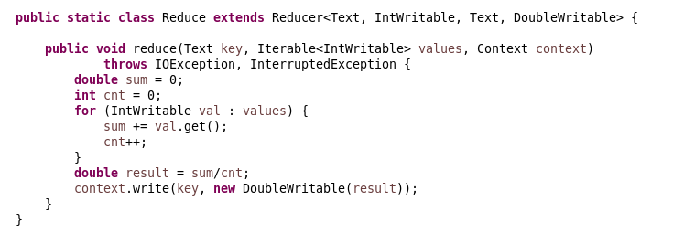
Hadoop Project Average Computation – Reducer

Slide 30
Hadoop Project Average Computation – Result
Output
Input (access_log)

Slide 31
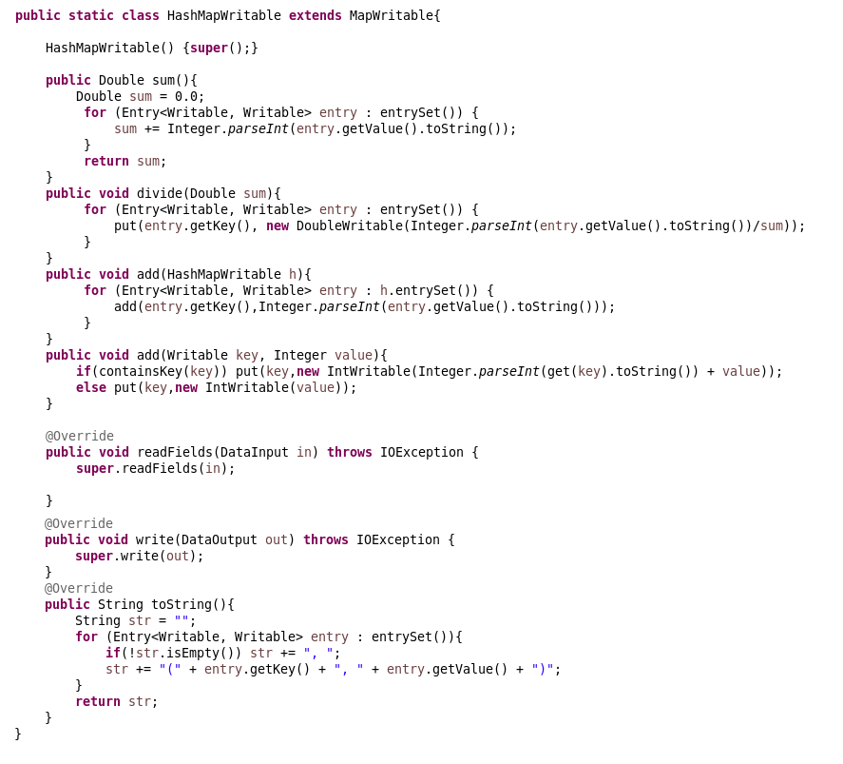
Hadoop Project Relative Frequency (Stripe Approach) – HashMapWritable

