Slide 1
Big Data Project
Professor : Premchand Nair
Student 18 : Thi Thu Hang Nguyen (615716)
Student 19 : Xuan Giap Nguyen (615643)

Slide 2
Agenda
Hadoop Project
Word Count (In-mapper combining)
Average Computation (In-mapper combining)
Relative Frequency – Pair Approach
Relative Frequency – Stripe Approach
Time and resource comparison
Spark Project
Problem statement
Scala code
Demo

Slide 3
Hadoop Project

Slide 4
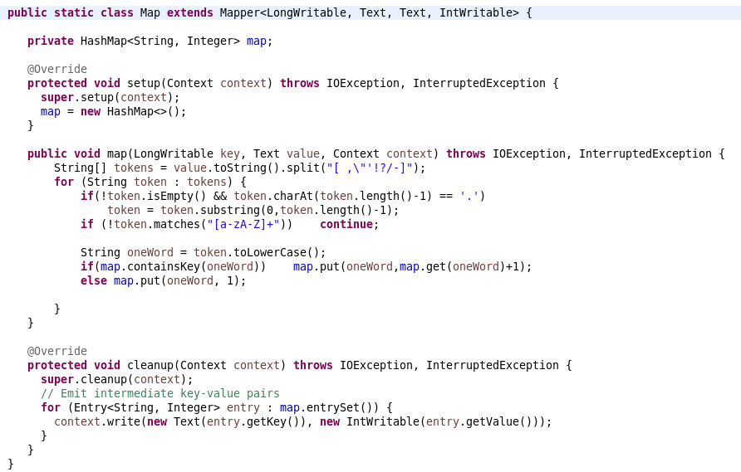
Hadoop Project Part1.Word Count (In-mapper combining) – Mapper

Slide 5
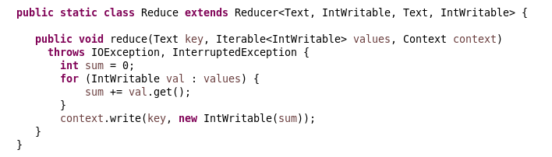
Hadoop Project Part1.Word Count (In-mapper combining) – Reducer

Slide 6
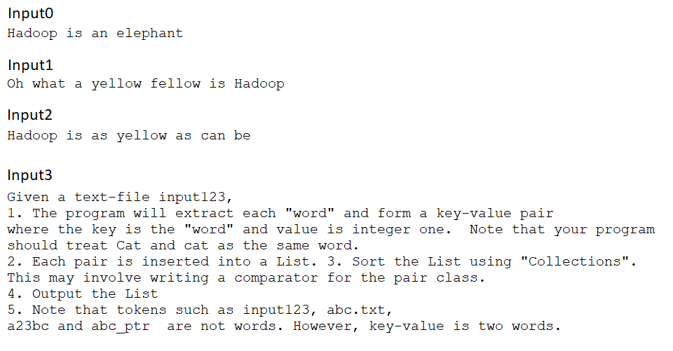
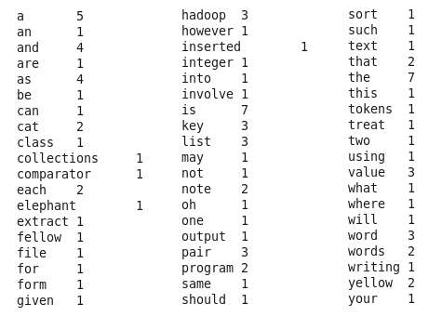
Hadoop Project Part1.Word Count (In-mapper combining) - Result
Input
Output

Slide 7
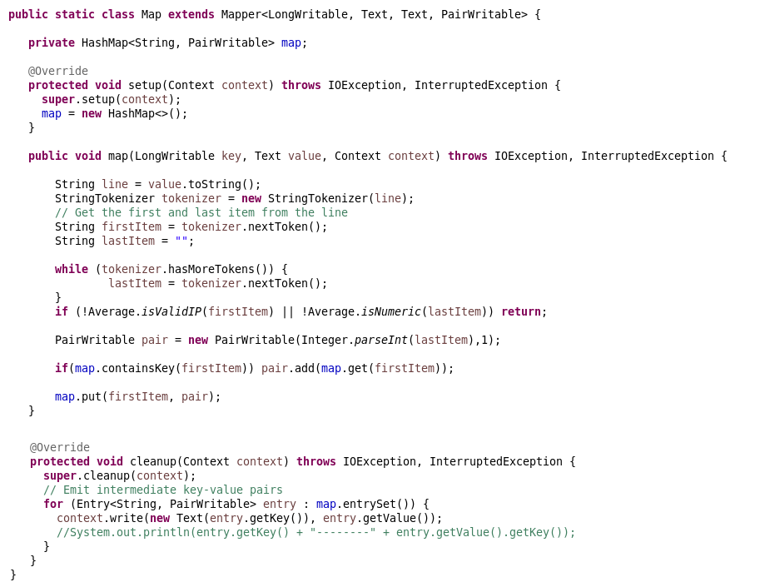
Hadoop Project Part1.Average Computation (In-mapper combining) – Mapper

Slide 8
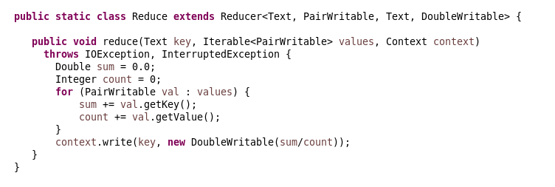
Hadoop Project Part1.Average Computation (In-mapper combining) – Reducer

Slide 9
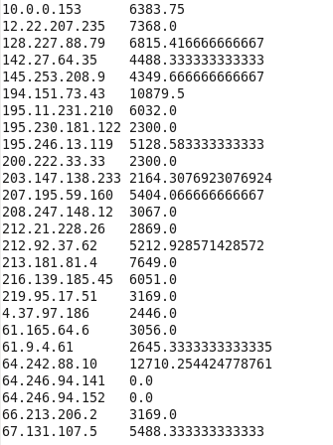
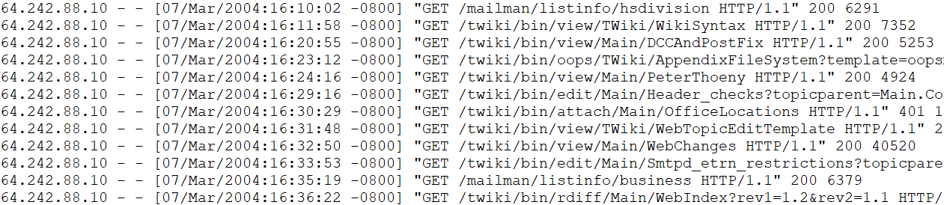
Hadoop Project Part1.Average Computation (In-mapper combining) – Result
Output
Input (access_log)

Slide 10
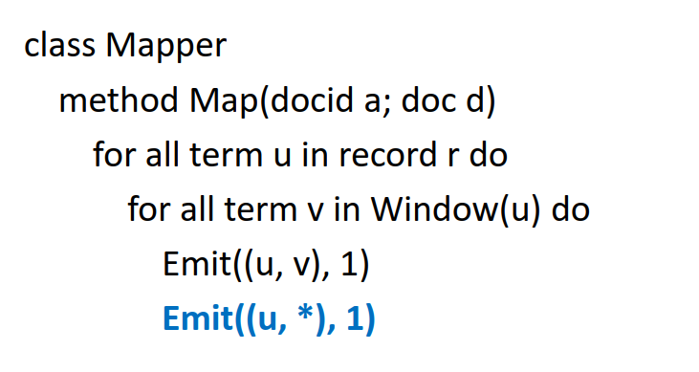
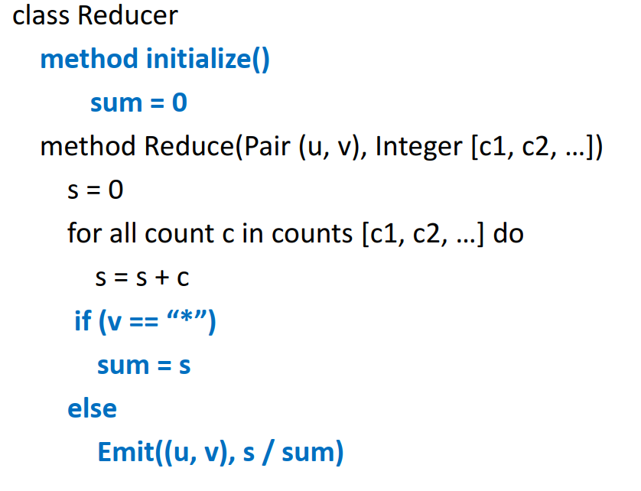
Hadoop Project Part2.Relative Frequency (Pair Approach) – Pseudo code

Slide 11
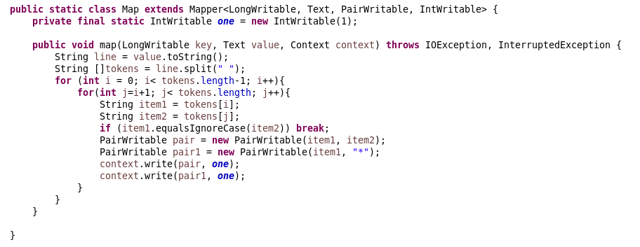
Hadoop Project Part2.Relative Frequency (Pair Approach) – Mapper

Slide 12
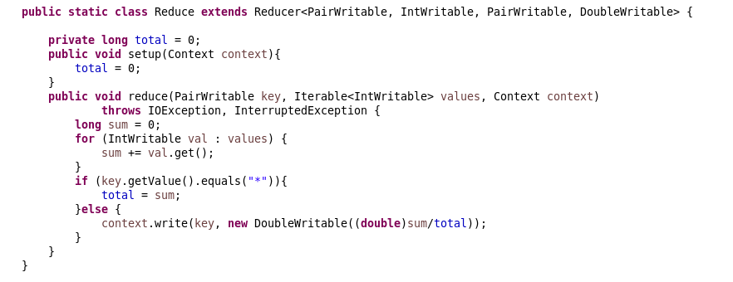
Hadoop Project Part2.Relative Frequency (Pair Approach) – Reducer

Slide 13
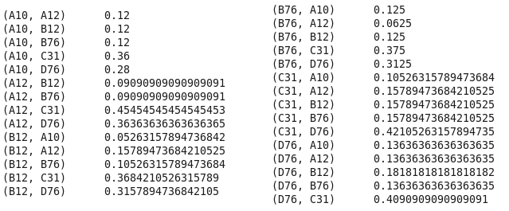
Hadoop Project Part2.Relative Frequency (Pair Approach) – Result
Input
Output

Slide 14
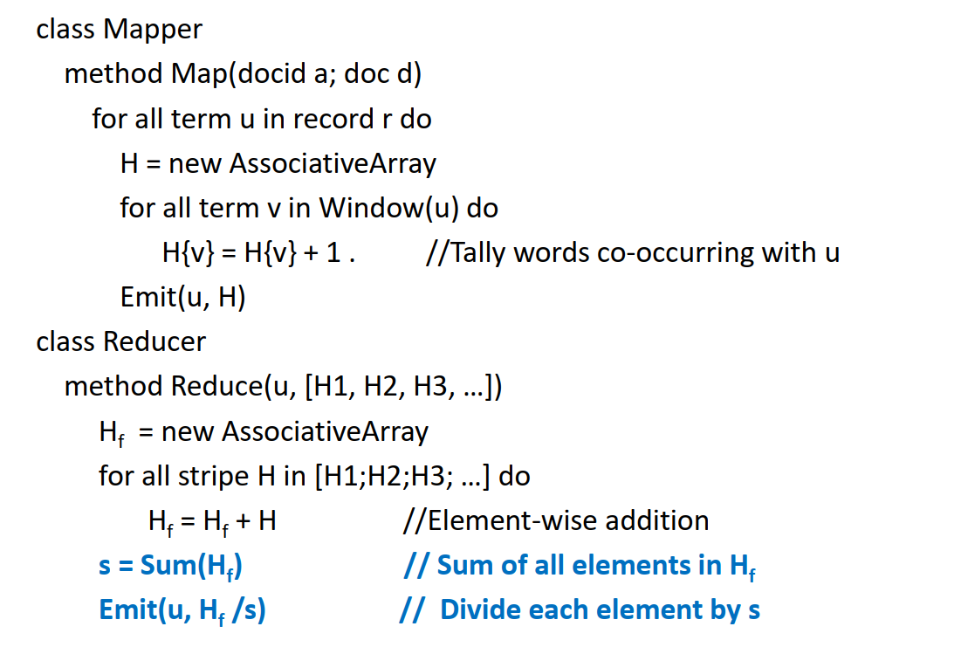
Hadoop Project Part3.Relative Frequency (Stripe Approach) – Pseudo code

Slide 15
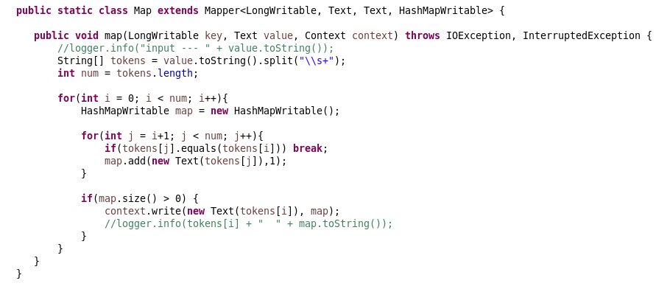
Hadoop Project Part3.Relative Frequency (Stripe Approach) – Mapper

Slide 16
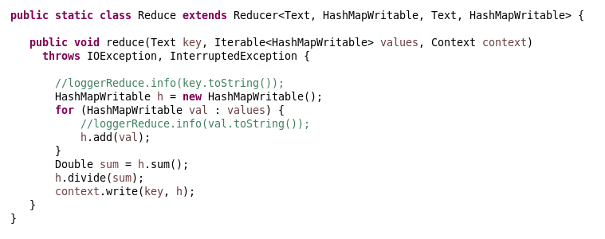
Hadoop Project Part3.Relative Frequency (Stripe Approach) – Reducer

Slide 17
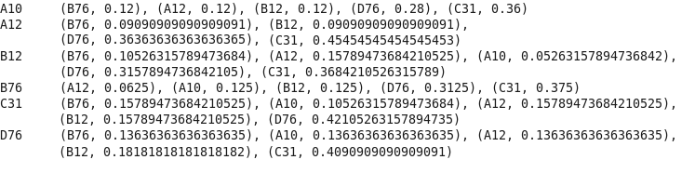
Hadoop Project Part3.Relative Frequency (Stripe Approach) – Result
Input
Output

Slide 18

Hadoop Project Part4.Time and resource comparison

Slide 19
Hadoop Project Part4.Time and resource comparison

Slide 20
Spark Project

Slide 21
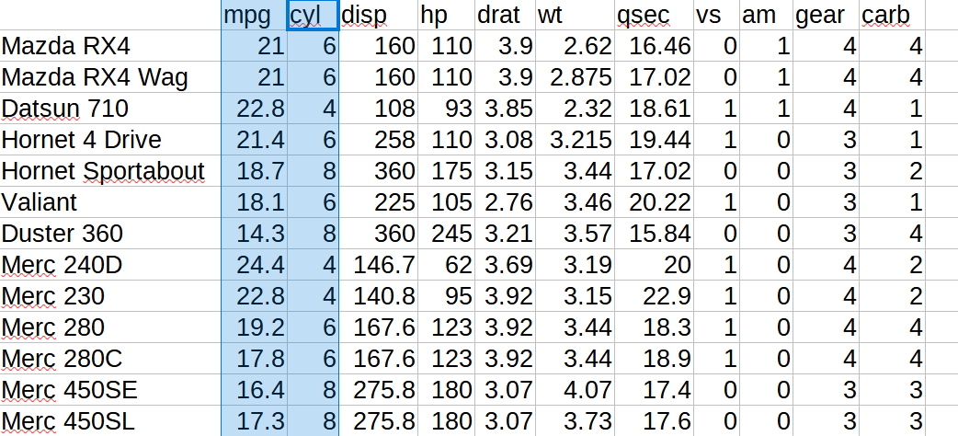
Spark Project Problem statement
- Input: https://vincentarelbundock.github.io/Rdatasets/csv/datasets/mtcars.csv
- Categorical variable: cyl
- Numeric variable: mpg

Slide 22
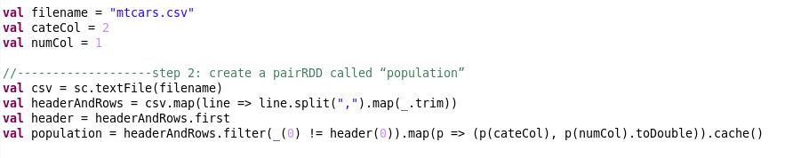

Spark Project Scala code

Slide 23
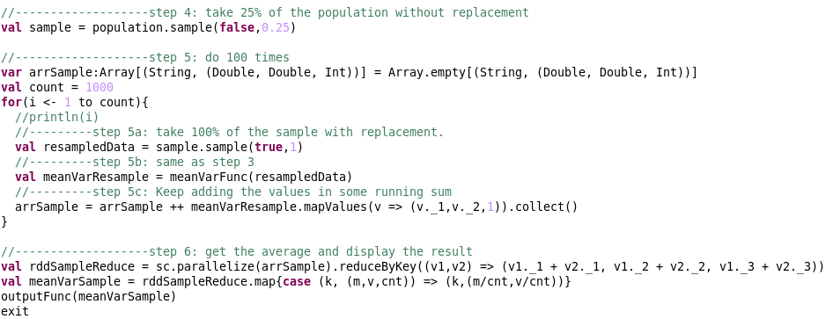
Spark Project Scala code

Slide 24
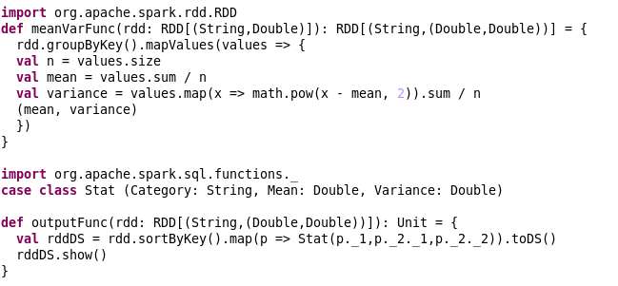
Spark Project Scala code

Slide 25
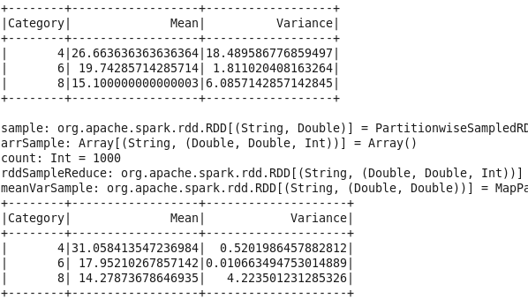
Spark Project Output

Slide 26
Thank you

Slide 27
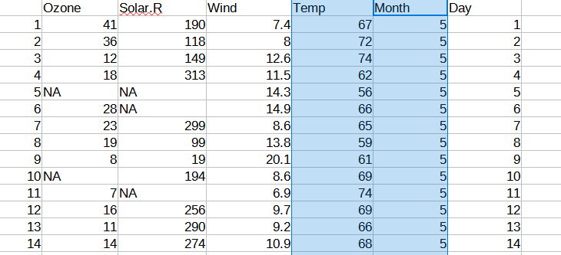
Spark Project Problem statement
- Input: https://vincentarelbundock.github.io/Rdatasets/csv/datasets/airquality.csv
- Categorical variable: Month
- Numeric variable: Temp

Slide 28
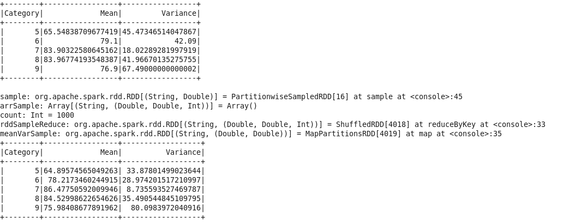
Spark Project Output

Slide 29
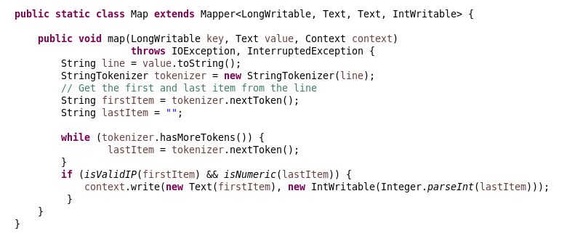
Hadoop Project Average Computation – Mapper

Slide 30
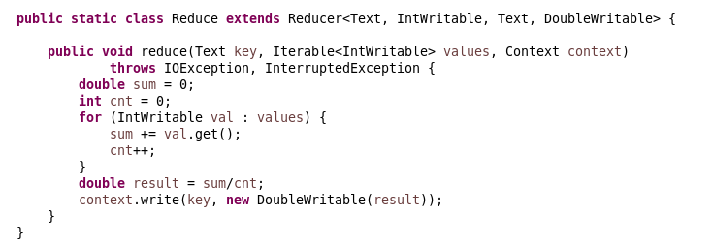
Hadoop Project Average Computation – Reducer

Slide 31
Hadoop Project Average Computation – Result
Output
Input (access_log)

Slide 32
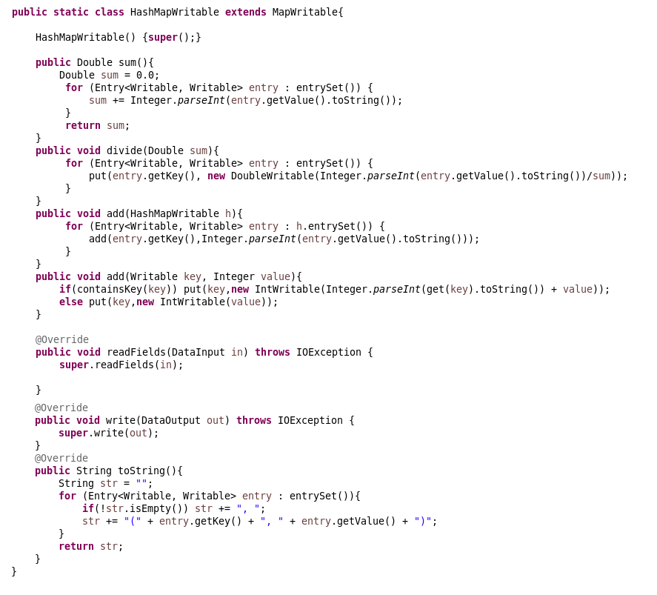
Hadoop Project Relative Frequency (Stripe Approach) – HashMapWritable

