Slide 1

PRODUCT LOOKUP AND RECOMMENDATION SYSTEM IN RETAIL INDUSTRY
SUBMITTED BY:
Nguyen Xuan Hai
Under the Guidance of
Dr. Tran Anh Tuan
In partial fulfillment of requirements for the degree of Bachelor of Data Science

Slide 2
Outline
Abstract
Introduction
Literature Review
Methodology
Experimental Result
Discussion
Conclusion

Slide 3
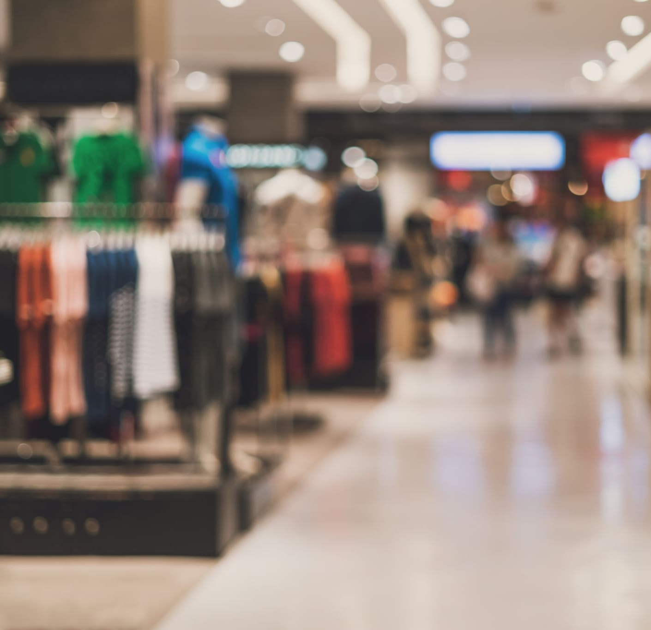
Abstract
Solution to:
Enhance shopping experience
Increase sales
A convenient system
Fine-Grained Recognition
Experiments

Slide 4
1. Introduction
Motivation
Food impacts human body
Attention on nutrition
Problem description
Applications in retail
Product barcode
Organization

Slide 5
2. Literature Review
Related works
Product checkout problem
Lightweight recognition system
Challenges
Problem essence
Dataset
Proposed Approach
One-Shot Learning
Data pre-processing
Contributions
New problem and solution
Handle inappropriate dataset

Slide 6
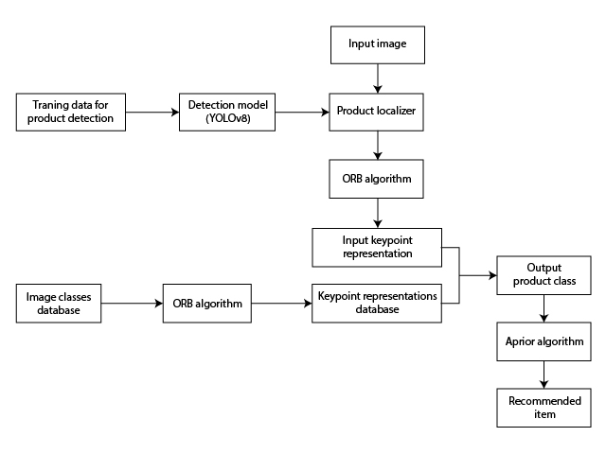
Overview of the system

Slide 7
3. Methodology
Data Pre-processing
Localization
Image Similarity
Recommender System
Overall Process

Slide 8
3. Methodology
Data Pre-processing
Background removal
Image quality
Lighting condition

Slide 9

Background removal
Generative Adversarial Networks (GANs)
Object segmentation
Normal approaches
Saliency object detection

Slide 10
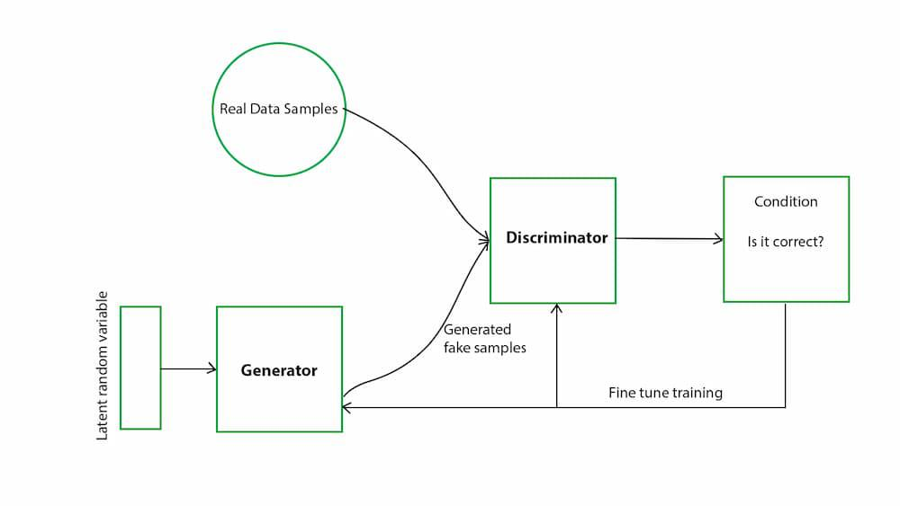
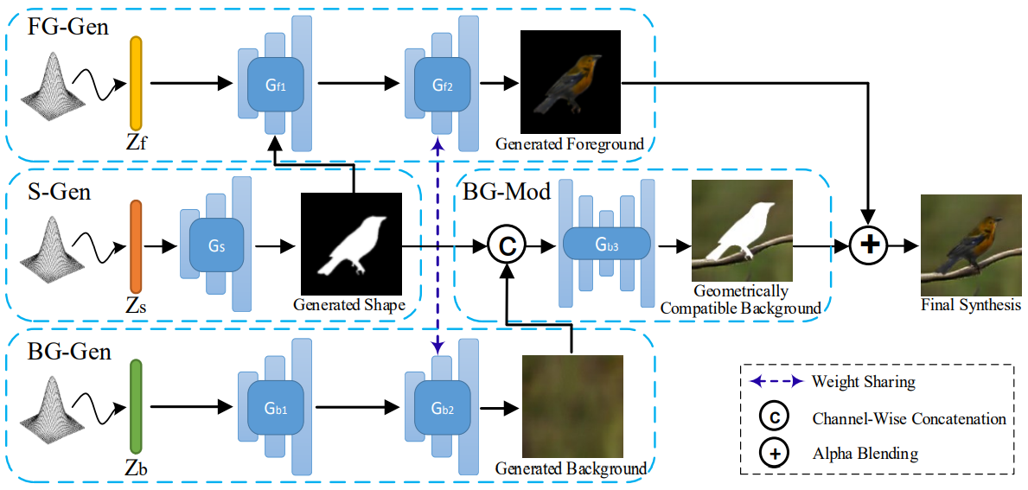
Generative Adversarial Networks
Usual GANs structure
FBC-GAN

Slide 11
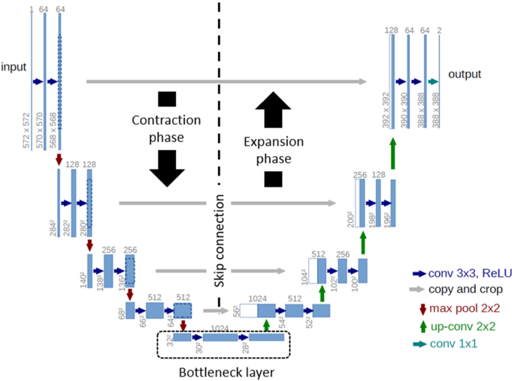
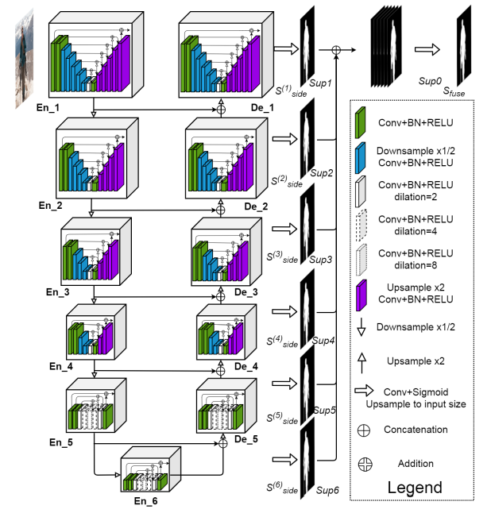
Object Segmentation
U-Net structure
U²-Net structure

Slide 12
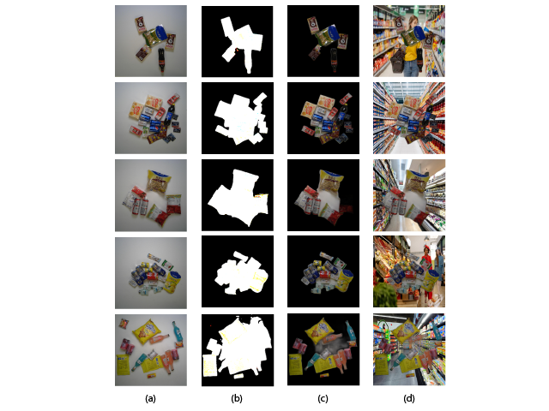
Background changing

Slide 13

Image quality
Augmentations
Usual augmentations
Blur, Motion Blur, Advance Blur
Mosaic
Mixup
Albumentations and Ultralytics

Slide 14

Lighting condition
Illumination-based augmentation
Random Shadows and Highlights augmentation

Slide 15
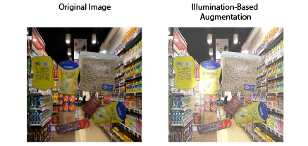
Illumination-based augmentation

Slide 16
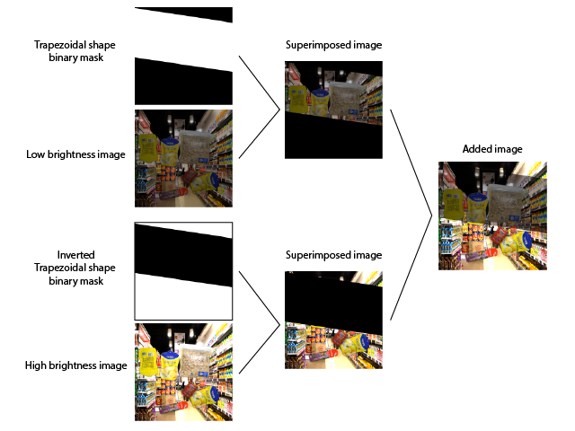
Random Shadows and Highlights augmentation

Slide 17
3. Methodology
Localization
The popular YOLO
Vision Transformer

Slide 18

The popular YOLO
YOLOv8
YOLO-NAS

Slide 19
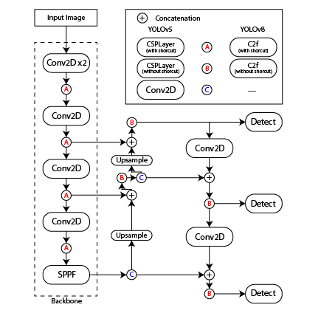
YOLOv8
CSPLayer C2f module
Anchor-free detection

Slide 20
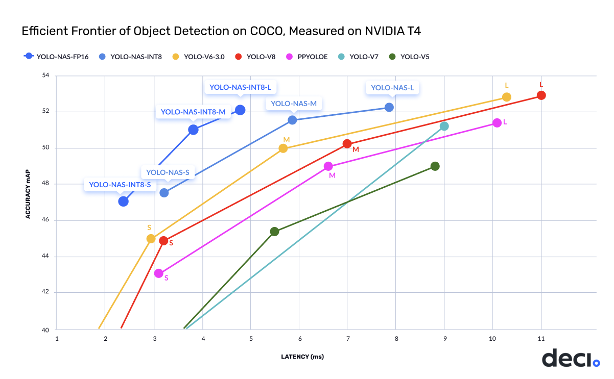
YOLO-NAS
AutoNAC - Neural Architecture Search system
Combine reparameterization and 8-bit quantization
Hybrid quantization

Slide 21
Vision Transformer (ViT)
DETRs
RT-DETR

Slide 22
DERTs
No post-processing
No hand-craft components
High accuracy
High computational cost

Slide 23
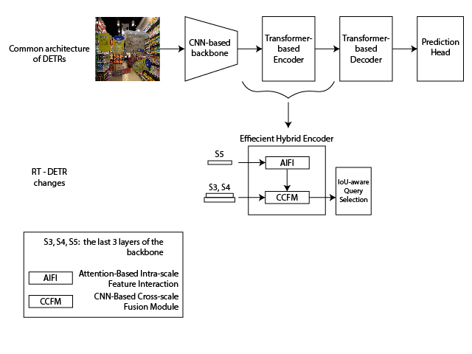
What makes RT-DETR special?

Slide 24
3. Methodology
Image Similarity
Autoencoders
Descriptors

Slide 25
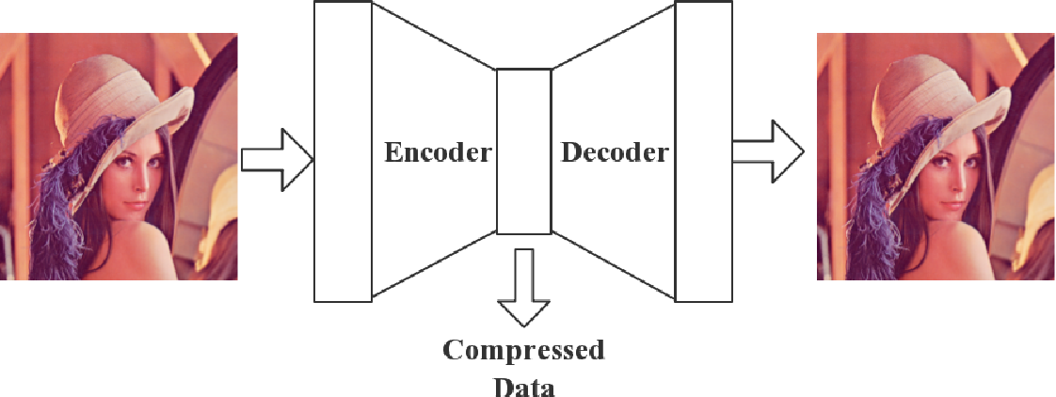
Autoencoders

Slide 26

Descriptors
Scale-Invariance Feature Transform
Oriented FAST and Rotated BRIEF

Slide 27
Scale-Invariance Feature Transform (SIFT)
Keypoint localization
Blob detection
Scale Space architecture
Keypoint orientation
Keypoint descriptor

Slide 28
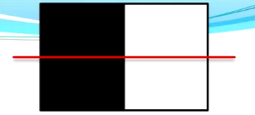
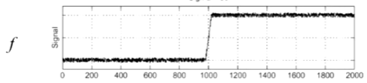
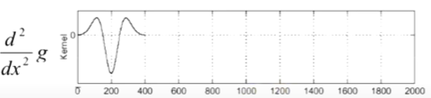
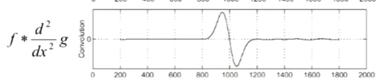
SIFT
Keypoint localization
Blob detection

Slide 29

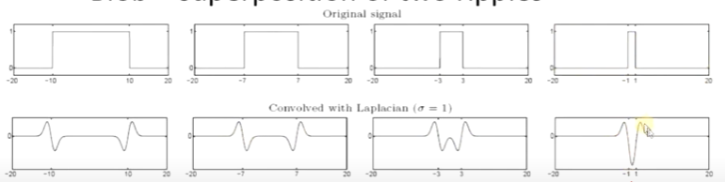
SIFT
Keypoint localization
Blob detection

Slide 30
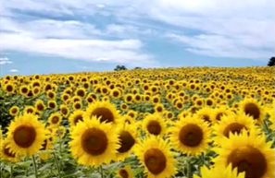
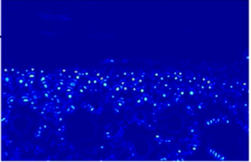
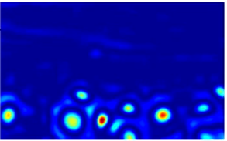
SIFT
Keypoint localization
Blob detection

Slide 31
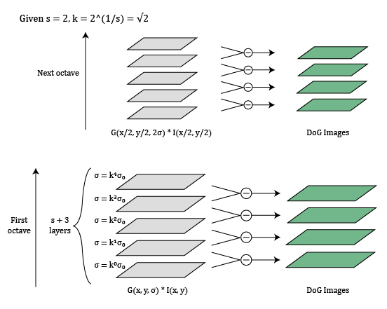
SIFT
Keypoint localization
Scale Space architecture
$$DoG=G\left(x,y,kσ\right)−G\left(x,y,σ\right) ≈LoG$$
$DoG∗I\left(x,y\right)=G\left(x,y,kσ\right)∗I\left(x,y\right)−G\left(x,y,σ\right)∗I(x$, y)

Slide 32
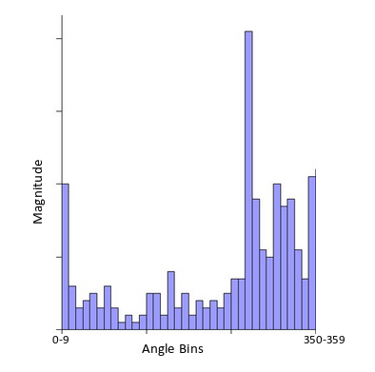
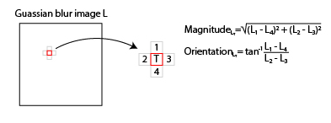
SIFT
Keypoint orientation
Certain number of pixels were picked to 36-bins histogram
Calculating pixel orientation

Slide 33
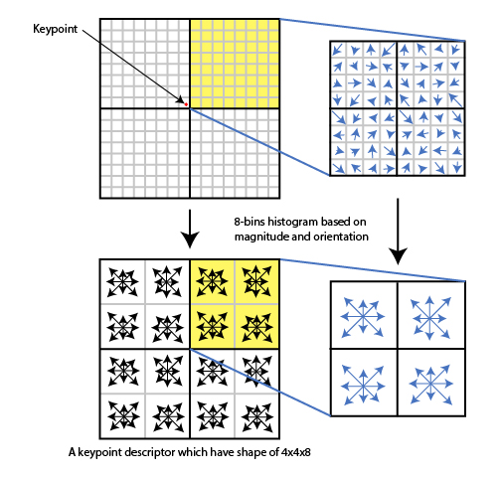
SIFT
Keypoint descriptor

Slide 34
Oriented FAST and Rotated BRIEF (ORB)
Calculating Keypoints
oFAST
Calculating Descriptors
rBRIEF

Slide 35
3. Methodology
Recommender System
Popular recommenders
Apriori

Slide 36
Popular recommenders
Apriori
Collaborative Filtering
User-based RecSys
Item-based RecSys
Matrix Factorization
Content-Based Filtering
Stored association rules
Fast retrieval
Non-personalized
Less requirements

Slide 37
3. Methodology
Overall Process

Slide 38
Input: A image of shape 640x640
Output: A list of recommended items based on association rules
The algorithm works in the following steps:
Step 1
Setting up required parameters, load detection model weight, prepare product database, class representation database and recommender association rules.
Step 2
Capture images from recording device.
Step 3
Process several transform and normalization steps on the image.
Step 4
Transfer the image into detection model and give bounding boxes prediction.
If confident > box_conf, draw the corresponding bounding boxes on the image.
If any confident > box_crop, go to Step 5.
Go to Step 2.
Step 5
Crop images based on the location of bounding boxes.
Transfer those images through a feature extractor to produce representations.
Matching feature from the representations with class representation database.
Give class predictions.
Step 6
Based on the output of Step 5, analyze the product database and the available association rules and to display product information and give recommendations.

Slide 39
4. Experimental Result
Database Overview
Each Step Evaluation
Overall Process Evaluation
Other Approaches Comparison

Slide 40
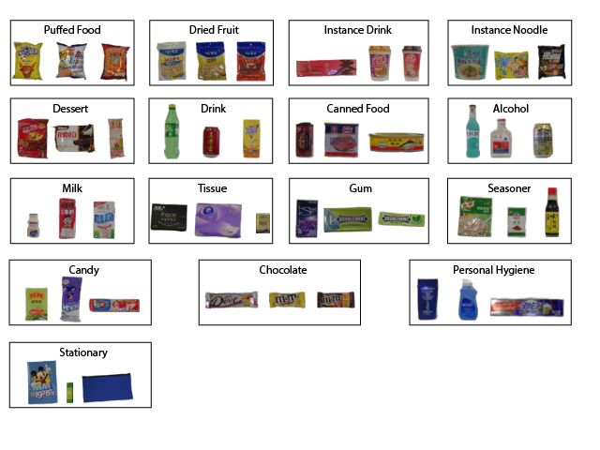
4. Experimental Result
Database Overview
Split | # images | # objects | #objects/image | #categories/image
Training set | 53,739 | 53,739 | 1 | 1
Validation set | 6,000 | 73,602 | 12.27 | 6.33
Test set | 24,000 | 294,333 | 12.26 | 6.31

Slide 41
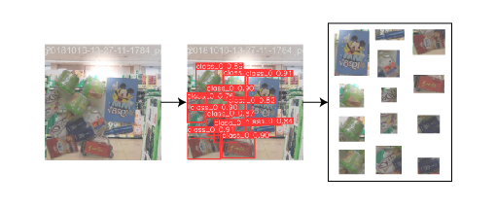
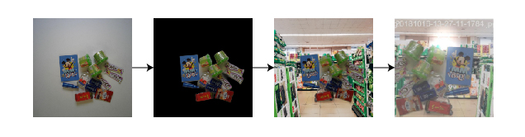
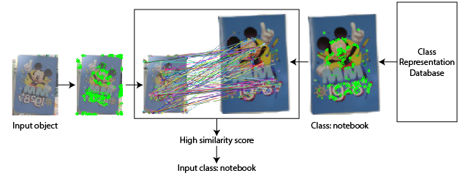
4. Experimental Result
Each Step Evaluation

Slide 42
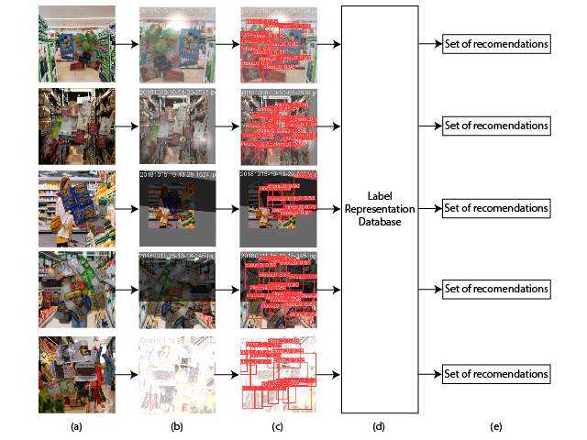
4. Experimental Result
Overall Process Evaluation

Slide 43
4. Experimental Result
Other Approaches Comparison
Validation dataset | Precision (%) | Recall (%) | mAP₅₀ (%) | mAP₅₀₋₉₅ (%)
Original | 99.2 | 99 | 99.5 | 88.7
Augmented | 80.4 | 73.5 | 80.8 | 64.2
Matching methods | Processing time (s)
SIFT | 5.26
ORB | 1.18

Slide 44
4. Experimental Result
Other Approaches Comparison
Models | Params (M) | Precision (%) | Recall (%) | mAP₅₀ (%) | mAP₅₀₋₉₅ (%)
YOLO-NAS-S | 22.2 | 94.9 | 89.2 | 91.8 | 75.6
YOLOv8-M | 25.9 | 99.2 | 89.6 | 94.9 | 80.2
RT-DETR-L | 32 | 98.1 | 90.7 | 95.2 | 81.9
Models on T4 GPU | Preprocessing (ms) | Inference (ms) | Postprocessing (ms) | Total (ms)
YOLOv8-M | 1.6 | 15.2 | 2.7 | 19.5
YOLOv8 (TensorRT) | 1.6 | 5.3 | 1.1 | 8
RT-DETR-L | 3.6 | 55.0 | 0.7 | 59.3
YOLO-NAS-S | - | - | - | 15.9

Slide 45
5. Discussion
Benefits of
Proposed Approach
Limitations of
Proposed Approach
Future Works

Slide 46
Conclusions
Trade-off between speed and accuracy
Room for improvement
Deployment requirements

