Slide 1
Computer Networks EDA387/DIT663
CHALMERS and University of Technology
Computer Science and Engineering Networks and Systems
Fault-tolerant Algorithms for Computer Networks
Dijkstra’s algorithm (Ch.2)

Slide 2
Goal
We would like to understand how to design self-stabilizing network protocols
At the end of this lecture, you should be able to:
Define the network task of token circulation
Propose an algorithm for solving this task
Argue about the correctness of your proposal

Slide 3

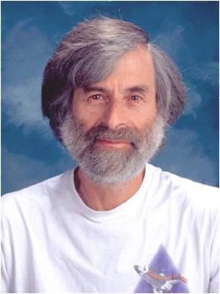
“I regard this as Dijkstra’s most brilliant work. Self-stabilization is a very important concept in fault tolerance.” Lamport [PODC 1984]
Notes:
The first self-stabilizing algorithm is by Dijkstra --- 47 years ago, is considered to be the 1st scientific examination of fault-tolerant systems.
Now there are two books, yearly conference, which I happend to be its general for the 2021 edition as well as different parts of the Internet that were shown to be self-stabilizing.
My aim of my research work is to have different critical infrastructures shown to be self-stabilizing.

Slide 4
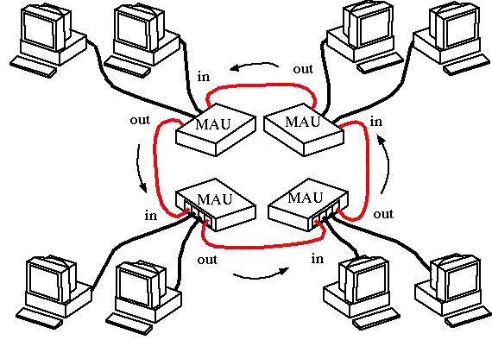

Dijkstra [Commun. ACM 1974]
1st scientific examination of fault-tolerant systems [Lamport’15]
Notes:
Dijkstra’s algorithm considers stations on a token ring LAN and data packets being transmitted sequentially from one ring station to the next. This is facilitated by a control token circulating around the ring and controlling the media access of the nodes.

Slide 5
Dijkstra [Commun. ACM 1974]
Stations on a token ring LAN are logically organized in a ring topology with data being transmitted sequentially from one ring station to the next with a control token circulating around the ring controlling access
A station that holds the token may access the network, i.e., mutual exclusion
1st scientific examination of fault-tolerant systems [Lamport’15]
Notes:
Dijkstra’s algorithm considers stations on a token ring LAN and data packets being transmitted sequentially from one ring station to the next. This is facilitated by a control token circulating around the ring and controlling the media access of the nodes.

Slide 6
Dijkstra [Commun. ACM 1974]
root
The root changes it’s state if equal to its neighbor
The rest – each station copies its neighbor’s state if it is different
01 P₁: do forever
02 if x₁=x_{n} then x₁ := (x₁+1) mod (n+1)
03 P_{i} (i ≠ 1): do forever
04 if x_{i} ≠ x_{i-1} then x_{i} := x_{i-1}
Notes:
The algorithm needs to guarantee that at most one station at a time may access the media.

Slide 7
Dijkstra [Commun. ACM 1974]
root
The root changes it’s state if equal to its neighbor
The rest – each station copies its neighbor’s state if it is different
01 P₁: do forever
02 if x₁=x_{n} then x₁ := (x₁+1) mod (n+1)
03 P_{i} (i ≠ 1): do forever
04 if x_{i} ≠ x_{i-1} then x_{i} := x_{i-1}
Notes:
Also, every station can access the media infinitely often.

Slide 8
Dijkstra [Commun. ACM 1974]
root
The root changes it’s state if equal to its neighbor
The rest – each station copies its neighbor’s state if it is different
01 P₁: do forever
02 if x₁=x_{n} then x₁ := (x₁+1) mod (n+1)
03 P_{i} (i ≠ 1): do forever
04 if x_{i} ≠ x_{i-1} then x_{i} := x_{i-1}
Notes:
Note that the code of the algorithm is writen in the form of a “do forever” loop and all variables are bounded.

Slide 9
Dijkstra [Commun. ACM 1974]
root
The root changes it’s state if equal to its neighbor
The rest – each station copies its neighbor’s state if it is different
01 P₁: do forever
02 if x₁=x_{n} then x₁ := (x₁+1) mod (n+1)
03 P_{i} (i ≠ 1): do forever
04 if x_{i} ≠ x_{i-1} then x_{i} := x_{i-1}
Notes:
These are key characteristics of self-stabilizing algorithms and often the challenge in transforming non-self-stabilizing systems into self-stabilizing ones.

Slide 10
Mutual Exclusion
root (distinguished processor)
The root changes it’s state if equal to its neighbor
The rest – each processor copies its neighbor’s state if it is different

Slide 11
Legal Behavior of Mutual Exclusion
The set LE_{ME} includes all the executions in which each processor may access the critical section infinitely often
Namely, let p_{i} be a processor in the network, E be an execution in LE_{ME} and E’ be a suffix of E. Then, p_{i} may access the critical section infinitely many times
Moreover, while p_{i} is accessing the critical section no other processor may concurrently access that critical section

Slide 12
Dijkstra’s Algorithm
01 p₁: do forever
02 if x₁=x_{n} then
03 x₁:=(x₁+1)mod(n+1)
04 p_{i} (i ≠ 1): do forever
05 if x_{i} ≠ x_{i-1} then
06 x_{i}:=x_{i-1}
Notes:
Dijkstra's self-stabilizing token ring algorithm is a distributed algorithm designed to ensure the correct and stable operation of a token ring network, even in the presence of transient faults and initial system inconsistencies.
Algorithm Description: Dijkstra's Self-Stabilizing Token Ring Algorithm
Objective: The goal of this algorithm is to maintain a stable token ring network where a token circulates among a set of interconnected nodes, allowing them to perform distributed tasks or access shared resources in a coordinated manner.
Assumptions:
Nodes in the token ring network are interconnected in a circular topology, i.e., the network topology is of a clock-wise directed ring with a distinguished processor, called the root.
Initially, the token ring system may be in an arbitrary or inconsistent state due to transient faults or other issues.
Algorithm Steps:
Variables: Each processor processor, p_{i} , holds a singe shared variable, x_{i}.
Token Circulation:
Whenever any of the if-statement conditions in lines 02 and 05 holds, that processor is said to hold the token.
It clock-wise forwards the token by executing the then-clause of the if-statement.

Slide 13
Dijkstra’s alg. is Self-Stabilizing
A configuration of the system is a vector of n integer values (the processors in the system)
The task ME:
exactly one processor can change its state in any configuration,
every processor can change its state in infinitely many configurations in every sequence in ME
One of the safe configurations in ME and Dijkstra’s algorithm is a configuration in which all the x variables have the same value
Notes:
* The task ME is defined by the set of all configuration sequences in which exactly one processor can change its state in any configuration and every processor can change its state in infinitely many configurations in every sequence in ME

Slide 14
Dijkstra’s alg. is Self-Stabilizing
A configuration in which all x variables are equal, is a safe configuration for ME (Lemma 2.2)
For every configuration there exists at least one integer j such that for every i x_{i} ≠j (Lemma 2.3)
For every configuration c, in every fair execution that starts in c, p₁ changes the value of x₁ at least once in every n rounds (Lemma 2.4)
For every possible configuration c, every fair execution that starts in c reaches a safe configuration with relation to ME within O(n²) rounds (Theorem 2.1)
Notes:
* A configuration c in which all the x variables have the same value is a safe configuration for ME and Dijsktra’s method (Lemma 2.2)
* For every possible configuration c, there exists at least one integer j≤n such that for every i x_{i} ≠j in c (Lemma 2.3)
* For every possible configuration c, in every fair execution that starts in c, the special processor P₁ changes the value of x₁ ate least once in every n rounds (Lemma 2.4)

Slide 15
Lemma 2.2
Let z = (y+1) mod (n+1)
What is the system configuration at the end of asynch. round num. #r?
root
#r | System configuration
0 | (x₁=y, x₂=y,…, x_{i}=y ,… x_{n-1}=y, x_{n}=y)
1 | (x₁=z, x₂=y,…, x_{i}=y ,… x_{n-1}=y, x_{n}=y)
2 | (x₁=z, x₂=z,…, x_{i}=y ,… x_{n-1}=y, x_{n}=y)
…
i | (x₁=z, x₂=z,…, x_{i}=z,… x_{n-1}=y, x_{n}=y)
…
n-1 | (x₁=z, x₂=z,…, x_{i}=z,… x_{n-1}=z, x_{n}=y)
n | (x₁=z, x₂=z,…, x_{i}=z ,… x_{n-1}=z, x_{n}=z)
p_{i}

Slide 16

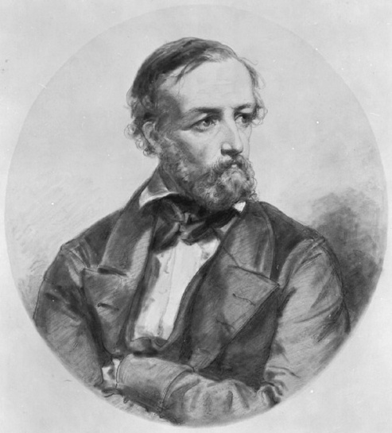
The Pigeonhole Principle
Suppose n items are put into m<n containers,
at least one container contains more than one item
Also called the Dirichlet's box principle
https://news.knowledia.com/US/en/articles/the-pigeonhole-principle-cantor-s-paradise-medium-106743f520ca4b9ad18f0f41b49bc7cc746c803b
Peter Gustav Lejeune Dirichlet

Slide 17
Lemma 2.3
x’s value | Color
1 | ●
2 | ●
3 | ●
4 | ●
5 | ●
6 | ●
7 | ●
8 | ●
9 = j | ●
root

Slide 18
Lemma 2.4
Suppose, towards a contradictions, that p₁ does not change the value of x₁ for at least at least n rounds
root
#r | System configuration
0 | (x₁=z, x₂=*,…, x_{i}=* ,… x_{n-1}=*, x_{n}=*)
1 | (x₁=z, x₂=z,…, x_{i}=* ,… x_{n-1}=*, x_{n}=*)
…
i-1 | (x₁=z, x₂=z,…, x_{i}=z,… x_{n-1}=*, x_{n}=*)
…
n-1 | (x₁=z, x₂=z,…, x_{i}=z,… x_{n-1}=z, x_{n}=z)
n | (x₁≠z, x₂=z,…, x_{i}=z ,… x_{n-1}=z, x_{n}=z)
p_{i-1}
contradiction

Slide 19
Lemma 2.4
Suppose, towards a contradictions, that x1 does not change its value for at least at least n rounds
root
#r | System configuration
1 | (x₁=a₁, x₂=a₂,…, x_{i}=a_{i} ,… x_{n-1}=a_{n-1}, x_{n}=a_{n})
2 | (x₁=a₁, x₂=a₁,…, x_{i}=a_{i} ,… x_{n-1}=a_{n-1}, x_{n}=a_{n})
…
i | (x₁=a₁, x₂=a₁,…, x_{i}=a₁ ,… x_{n-1}=a_{n-1}, x_{n}=a_{n})
…
n-1 | (x₁=a₁, x₂=a₁,…, x_{i}=a₁ ,… x_{n-1}=a₁, x_{n}=a_{n})
n | (x₁=a₁, x₂=a₁,…, x_{i}=a₁ ,… x_{n-1}=a_{n-1}, x_{n}=a₁)

Slide 20
Lemma 2.4
For every configuration c, in every fair execution that starts in c, processor p₁ changes the value of x₁ at least once in every n rounds
Assume, in a way of a proof by contradiction, that there exists a configuration c and a fair execution that starts in c and in which p₁ does not change that value of x₁ during the first n rounds.
Let us c₂ be the configuration that immediately follows the first time p₂ executes an atomic step during the first round.

Slide 21
Lemma 2.4
Clearly, x₁=x₂ in c₂ and in every configuration that follows c₂ in the next n-1 rounds. Let c₃ be the configuration that immediately follows the first time p₃ executes a computation step during the second round.
It holds in c₃ that x₁=x₂=x₃. The same line of arguments repeats itself until we arrive at the configuration c_{n}, which is reached in the (n-1)-th round and in which x₁=x₂=...=x_{n}.
The n-th round, p₁ is activated and changes the value of x₁ , a contradiction. □

Slide 22
Theorem 2.1
For every possible configuration c, every fair execution that starts in c reaches a safe configuration with relation to ME within O(n²) rounds

Slide 23
Theorem 2.1
For every possible configuration c, every fair execution that starts in c reaches a safe configuration with relation to ME within O(n²) rounds
n asynchronous cycles for x₁ to change its value (Lemma 2.4)

Slide 24
Theorem 2.1
For every possible configuration c, every fair execution that starts in c reaches a safe configuration with relation to ME within O(n²) rounds
n asynchronous cycles for x₁ to change its value (Lemma 2.4)

Slide 25
Theorem 2.1
For every possible configuration c, every fair execution that starts in c reaches a safe configuration with relation to ME within O(n²) rounds
n asynchronous cycles for x₁ to change its value (Lemma 2.4)
n² asynchronous cycles for x₁ to change to j, which is missing until then
(Lemma 2.3).

Slide 26
Theorem 2.1
For every possible configuration c, every fair execution that starts in c reaches a safe configuration with relation to ME within O(n²) rounds
n asynchronous cycles for x₁ to change its value (Lemma 2.4)
n² asynchronous cycles for x₁ to change to j, which is missing until then
(Lemma 2.3).
Once x₁ holds j, p₁ does not change x₁’s value until x_{n} holds j. By the proof
details of Lemma 2.4, this happens within n asynchronous cycles.

Slide 27
Theorem 2.1
For every possible configuration c, every fair execution that starts in c reaches a safe configuration with relation to ME within O(n²) rounds
n asynchronous cycles for x₁ to change its value (Lemma 2.4)
n² asynchronous cycles for x₁ to change to j, which is missing until then
(Lemma 2.3).
Once x₁ holds j, p₁ does not change x₁’s value until x_{n} holds j. By the proof
details of Lemma 2.4, this happens within n asynchronous cycles.
To sum up: n² + n ∈ O(n²)

Slide 28
Theorem 2.1
For every possible configuration c, every fair execution that starts in c reaches a safe configuration with relation to ME within O(n²) rounds
In accordance with Lemma 2.3 for every possible configuration c there exists at least one integer 0 ≤ j ≤ n such that, for every 1 ≤ i ≤ n, it holds that x_{i} ≠ j in c.

Slide 29
Theorem 2.1
In accordance with lemma 2.4, for every possible configuration c, in every fair execution that starts in c, the special processor p₁ changes the value of x₁ in every n rounds.
Every time p₁ changes the value of x₁, p₁ increments the values of x₁ module n+1.
Thus, it must hold that every possible value, and in particular the value j, is assigned to x₁ during any fair execution that starts in c.

Slide 30
Theorem 2.1
Let c_{j} be the configuration that immediately follows the first assignment of j in x₁.
Every processor p_{i}, 2 ≤ i ≤ n copies the value x_{i-1} to x_{i}.
Thus, it holds for 1 ≤ i ≤ n that x_{i} ≠ j in every configuration that follows c and precedes c_{j}; it also holds that in c_{j}, the only x variables to hold the value j is x₁.
Processor p₁ does not change the value of x₁ until x_{n}=j.

Slide 31
Theorem 2.1
The only possible sequence of changes of the values of the x variables to the value of j is:
p₂ changes x₂ to the values of x₁ (which is j), then p₃ changes the value of x₃ to j and so on until p_{n} changes the value of x_{n} to j.
Only at this stage is p₁ able to change value again (following c_{j}).
Let c_{n} be the configuration reached following the assignment of x_{n}:=j. c_{n} is a safe configuration.

Slide 32
Theorem 2.1
In accordance with Lemma 2.4, p₁ must assign j to x₁ in every n² rounds.
Thus, a safe configuration must be reached in n²+n rounds. □

Slide 33
Summary
Presented the self-stabilizing token ring algorithm.

