Slide 1
Computer Networks EDA387/DIT663
CHALMERS and University of Technology
Computer Science and Engineering Networks and Systems
Fault-tolerant Algorithms for Computer Networks
Analytical Framework (Ch.2)

Slide 2
Goal
We would like to understand how to design self-stabilizing network protocols.
To that end, we present an analytical framework.
The framework should allow:
Define network tasks
Propose an algorithms for solving these task
Argue about the correctness of these proposals

Slide 3

Perlman’s Vision of the Internet
Her innovations have made a huge impact on how networks self-organize and move data.
She enabled today’s routing to be more robust, scalable, and easy to manage.
Radia Perlman is one of the 20 most influential people in information technology [Data Communications Magazine]
Over 100 issued patents.
National Academy of Engineering; lifetime achievement awards from USENIX and from Association for Computing Machinery
Notes:
Radia Perlman's pioneering work envisioned a self-stabilizing Internet. Her MIT’s master thesis trasformed the Internet routing protocol (RIP) into a self-stabilazing one. Her work enabled today's link-state routing protocols to be robust, scalable, and easy to manage. She also made the ARPANET routing broadcast scheme to become self-stabilizing [Computer Networks 83] and provided a self-stabilizing spanning tree construction for bridge interconnection [Computer Networks 85].

Slide 4
Important Properties of a Network
Scope: A network architecture should solve general problems and support a wide range of applications and technologies.
Scalability: There is a need for network designs to work efficiently with both small and large networks. As networks grow in scale, fault tolerance becomes even more critical to ensure uninterrupted service.
Robustness: Fault-tolerant algorithms are essential components of network robustness. They ensure that even when nodes or links fail or behave improperly, the network can continue to operate, reducing disruptions and maintaining services.
Notes:
Studying fault-tolerant algorithms for computer networks is crucial, as emphasized by Radia Perlman's perspective on network properties. Here's how Perlman's views align with the importance of studying fault-tolerant algorithms in the context of computer networks:
Scope: Radia Perlman emphasizes that a network architecture should aim to solve general problems and support a wide range of applications and technologies. Fault-tolerant algorithms contribute to achieving this broad scope by ensuring that network reliability and resilience are not limited to specific use cases or technologies. When studying fault-tolerant algorithms, network designers can develop solutions that maintain network functionality across various applications and technologies, enhancing the network's overall scope and versatility.
Scalability: Perlman highlights the need for network designs to work efficiently with both small and large networks. Fault-tolerant algorithms play a vital role in achieving scalability by providing mechanisms to handle increasing network size while maintaining fault tolerance. As networks grow in scale, fault tolerance becomes even more critical to ensure uninterrupted service. Studying fault-tolerant algorithms helps network engineers create scalable solutions that can adapt to the demands of growing networks, whether they have a few nodes or millions of nodes.
Incorporating scope and scalability into the importance of studying fault-tolerant algorithms underscores their role in designing network architectures that can accommodate a wide range of applications, technologies, and network sizes while maintaining robustness and reliability in the face of faults and failures.
3. Robustness: Perlman highlights the importance of robustness, which goes beyond basic fault tolerance. Fault-tolerant algorithms are essential components of network robustness. They ensure that even when nodes or links fail or behave improperly, the network can continue to operate, reducing disruptions and maintaining services. Fault-tolerant algorithms contribute to the network's ability to adapt to unexpected issues and recover from them.

Slide 5
Important Properties of a Network
Self-Stabilization: In the event of state corruption, transient hardware malfunctions, or undetected data errors, self-stabilizing algorithms help the network return to normal operation without requiring human intervention. This property ensures that network issues are addressed efficiently and reduces the potential for prolonged network downtime.
Fault Detection: Fault-tolerant algorithms often include mechanisms for detecting faults and anomalies in the network.
Byzantine Robustness: Byzantine failures involve nodes behaving improperly. Fault-tolerant algorithms can address this challenge.
Notes:
Safety Barriers: Perlman mentions safety barriers in network design to prevent disruptions from spreading throughout the network. Fault-tolerant algorithms play a significant role in creating these safety barriers. They can help isolate faults and contain disruptions, limiting their impact to specific network segments. This containment is crucial for maintaining overall network stability.
Self-Stabilization: Fault-tolerant algorithms contribute to self-stabilization, as discussed by Perlman. In the event of database corruption, hardware malfunctions, or undetected data errors, these algorithms help the network return to normal operation without requiring human intervention. This property ensures that network issues are addressed efficiently and reduces the potential for prolonged network downtime.
Fault Detection: Perlman notes that networks should have the ability to detect faults. Fault-tolerant algorithms often include mechanisms for detecting faults and anomalies in the network. This detection is essential for identifying faulty components and taking appropriate action to mitigate their impact.
Byzantine Robustness: While Perlman mentions Byzantine failures, which involve nodes behaving improperly, fault-tolerant algorithms can address this challenge. These algorithms help networks maintain stability and functionality even when a portion of nodes exhibits Byzantine failures. This capability is critical for security and resilience in the face of adversarial actions.
Studying fault-tolerant algorithms for computer networks aligns with Perlman's emphasis on network robustness, safety barriers, self-stabilization, fault detection, and Byzantine robustness. These algorithms are essential tools for ensuring that computer networks can withstand and recover from various types of faults and disruptions, providing reliable and uninterrupted services to users.

Slide 6
Important Properties of a Network
Self-Stabilization: In the event of state corruption, transient hardware malfunctions, or undetected data errors, self-stabilizing algorithms help the network return to normal operation without requiring human intervention. This property ensures that network issues are addressed efficiently and reduces the potential for prolonged network downtime.
Fault Detection: Fault-tolerant algorithms often include mechanisms for detecting faults and anomalies in the network.
Byzantine Robustness: Byzantine failures involve nodes behaving improperly. Fault-tolerant algorithms can address this challenge.
Unfortunately, we don’t cover this part this year

Slide 7
Self-stabilizing Algorithms for Computer Network
Autonomous Recovery: Self-stabilizing algorithms aim to achieve a correct system state without requiring external intervention.
Fault Tolerance: They are inherently fault-tolerant. They can recover from various types of transient faults, such as data corruption, and converge to a consistent system state.
Minimal Assumptions: They often make minimal assumptions about the initial state of the system and the nature of faults.
They are designed to work in a wide range of environments, making them adaptable and versatile.
Notes:
Self-stabilizing algorithms are a class of algorithms designed for computer networks and messages passing systems to achieve a state where they can recover and maintain correct operation automatically, even when they start from an arbitrary, potentially incorrect initial state. These algorithms are particularly valuable in environments where network nodes may experience transient faults or where the initial configuration may be unpredictable.
Key characteristics and concepts of self-stabilizing algorithms for computer networks include:
Autonomous Recovery: Self-stabilizing algorithms aim to achieve a stable and correct system state without requiring external intervention or a pre-established correct state. They are designed to handle situations where nodes or components may start in an arbitrary, faulty, or inconsistent state.
Fault Tolerance: Self-stabilizing algorithms are inherently fault-tolerant. They can recover from various types of transient faults, such as data corruption, and converge to a consistent system state.
Local and Distributed: These algorithms operate in a decentralized manner, with nodes making local decisions based on their immediate observations and interactions with neighboring nodes. Local actions collectively lead to system-wide stabilization.
Convergence: The primary objective of self-stabilizing algorithms is to converge to a legitimate system state where all safety and liveness properties are satisfied. Safety properties ensure that the system remains in a correct state, while liveness properties guarantee that progress continues.
Minimal Assumptions: Self-stabilizing algorithms often make minimal assumptions about the initial state of the system and the nature of faults. They are designed to work in a wide range of environments, making them adaptable and versatile.
Self-stabilizing algorithms are used in various network and distributed system scenarios, including routing protocols, consensus algorithms, distributed databases, and fault-tolerant distributed systems. For instance, they can help a network routing protocol recover from topology changes or a distributed database restore consistency after a partition.
Self-stabilizing algorithms for computer networks are a valuable tool for building robust and fault-tolerant computer networks. They enable networks to recover from unexpected or faulty conditions and reach a stable, correct state without the need for external intervention, making them suitable for dynamic and unpredictable network environments.

Slide 8
What is an Algorithm?
It is a step-by-step set of well-defined instructions or a systematic procedure for solving a specific problem or accomplishing a particular task.
Precise Instructions: unambiguous instructions suitable for implementation in computer programs.
Problem-Specific: tailored to address a particular task.
Correctness: Ensuring correctness often involves rigorous mathematical proof.
Efficiency: Designed to perform their tasks as quickly and with as few computational resources.
Modularity: Complex problems are often solved by breaking them down into smaller, more manageable subproblems. Algorithms can be modular, with each step or subproblem addressed separately.
Optimization: In some cases, algorithms are designed to optimize certain criteria, such as minimizing time, space, etc.
We focus on the stabilization time
Notes:
An algorithm is a step-by-step set of well-defined instructions or a systematic procedure for solving a specific problem or accomplishing a particular task. Algorithms are fundamental to computer science and play a crucial role in various aspects of technology and everyday life.
Here are some key characteristics and components of algorithms:
Precise Instructions: Algorithms provide precise and unambiguous instructions for performing a task. These instructions are typically expressed in a formal and logical manner, making them suitable for implementation in computer programs.
Problem-Specific: Each algorithm is designed for a specific problem or class of problems. While some general-purpose algorithms exist, many are tailored to address particular challenges or tasks efficiently.
Correctness: Algorithms must produce correct results for all valid inputs. Ensuring the correctness of an algorithm often involves rigorous mathematical proof.
Efficiency: Efficiency is a critical consideration in algorithm design. Good algorithms are designed to perform their tasks as quickly and with as few computational resources (such as memory or processing power) as possible.
5. Modularity: Complex problems are often solved by breaking them down into smaller, more manageable subproblems. Algorithms can be modular, with each step or subproblem addressed separately.
6. Optimization: In some cases, algorithms are designed to optimize certain criteria, such as minimizing time, space, or other resources. Optimization algorithms are common in areas like computer science, operations research, and engineering.
Algorithms are not exclusive to computer science but are used across various fields, including mathematics, engineering, data analysis, and artificial intelligence. They are the building blocks of computer programs and systems, allowing us to automate tasks, make decisions, process data, and solve a wide range of problems efficiently and systematically.

Slide 9
Why do we need Models?
Models serve several important purposes, and they are essential for various aspects of algorithm design, analysis, and understanding.
Abstraction: distills the essential characteristics of networks, making them easier to analyze and design algorithms.
Task Formalization: translates real-world problems into requirements.
Analysis: shows algorithm correctness and time/space costs.
Benchmarking: assess strengths/ weaknesses of various algorithms.
Design: provides insights into the problem structure.
Generalization: once an algorithm has been analyzed within a model, its properties can be extended to real-world apps with similar characteristics.
Communication: discussing algorithms and their properties.
Notes:
In the context of algorithms, models serve several important purposes, and they are essential for various aspects of algorithm design, analysis, and understanding.
Here's why we need models when working with algorithms:
Abstraction: Models provide a level of abstraction that simplifies complex real-world scenarios. They distill the essential characteristics of a problem or system, making it easier to analyze and design algorithms. Abstraction allows us to focus on the core elements relevant to algorithmic solutions.
Task Formalization: Models aid in formalizing problem statements and requirements. They help translate real-world problems into well-defined mathematical or computational terms, facilitating the development of algorithmic solutions.
Analysis and Proof: Models facilitate the analysis and formal proof of algorithm correctness and efficiency. By defining a mathematical or computational model of a problem, researchers and algorithm designers can apply mathematical rigor to assess properties like correctness, termination, and time complexity.
Predictability as well as Performance Estimation: Models help us predict the behavior of algorithms under various conditions. They provide a framework for estimating algorithm performance, resource usage, and scalability. This predictability is crucial for making informed decisions about algorithm selection and optimization. Models also provide a means to estimate the expected performance of an algorithm on a specific input or dataset. This estimation is valuable for assessing whether an algorithm is suitable for a particular application.
Benchmarking and Comparison: Models enable benchmarking and the comparison of different algorithms for the same problem. By defining a standard model and problem instance, researchers can objectively assess and compare the strengths and weaknesses of various algorithms, aiding in algorithm selection.
Algorithm Design: Models guide the design of algorithms by providing insights into problem structure and constraints. They help algorithm designers identify relevant data structures, heuristics, and strategies to efficiently solve problems.
Complexity Analysis: Models are instrumental in analyzing the time and space complexity of algorithms. By modeling the algorithm's behavior and resource usage, we can make informed judgments about its efficiency and scalability.
Generalization: Models allow for the generalization of algorithmic principles. Once an algorithm has been analyzed and proven within a model, its properties can often be extended to real-world applications with similar characteristics.
Communication: Models are crucial for communicating algorithmic concepts. They provide a common language and framework for discussing algorithms and their properties among researchers and practitioners.
Models in the context of algorithms provide a structured and abstracted representation of problems and algorithms. They serve as a bridge between real-world problems and algorithmic solutions, enabling analysis, prediction, optimization, and communication in the field of computer science and beyond.

Slide 10
Network Settings
A set of assumptions and characteristics that serve as the basis for designing and analyzing protocols and algorithms for computer networks
Network Topology: The arrangement of network nodes and the communication links between them.
Communications: How nodes in the network communicate with each other? Datagram, stream, or shared memory? Reliable comm. or assumptions about message delivery, ordering, delay, and loss?
Synchrony: Asynchronous or synchronous (access to clocks and bounded comm. delays)? Fairness of message arrival and node execution.
Node Behavior: Can nodes fail by crashing, exhibiting Byzantine failures, or behaving benignly?
Failure Detection: Can a node indicate a link or node recovery?
Resource Constraints: Limited memory, processing power, or bandwidth?
Notes:
The network settings refers to the foundational assumptions and characteristics that define how the computer network operates and how faults or failures may occur within that network. These system settings and assumptions serve as the basis for designing and analyzing fault-tolerant mechanisms, protocols, and systems in the context of computer networks.
Key components of the system model for fault-tolerant computer networks include:
Network Topology: The system model defines the physical or logical structure of the computer network, including the arrangement of network nodes (devices) and the communication links between them. It specifies whether the network topology is centralized, decentralized, hierarchical, or peer-to-peer.
Fault Model: The fault model categorizes and characterizes the types of faults or failures that the network may encounter. It defines what constitutes a fault, the potential fault scenarios, and their severity levels. Common fault types include link failures, node failures, message losses, and network partitions.
Communication Model: This aspect describes how nodes in the network communicate with each other. It includes assumptions about message delivery, message ordering, message delay, and message loss. The communication model influences the design of fault-tolerant communication protocols. The system model may include assumptions about message reliability, such as whether messages are delivered in-order, without duplication, and without errors. Message reliability is critical in fault-tolerant communication.
Synchrony and Fairness: The system model defines the network's timing and synchrony assumptions. It determines whether the network operates synchronously or asynchronously and whether network components have access to clocks and communicate with bounded delays. In cases where nodes lack access to clocks and communication delays are unbounded, the network is categorized as asynchronous. Subsequently, we will explore the importance of specifying fairness assumptions concerning message arrival and node execution in asynchronous networks during in this later lecture.
Node Behavior: The model outlines how individual network nodes behave under normal conditions and in the presence of faults or failures. It specifies whether nodes can fail by crashing, exhibiting Byzantine failures, or behaving benignly. The behavior of nodes can impact the fault tolerance mechanisms needed.
Failure Detection: Some models incorporate assumptions about how faults or failures are detected in the network. This can include assumptions about the timeliness and accuracy of fault detection mechanisms. During later lectures, we will see an example of an algorithm for computer networks in which the node can indicate a link recovery.
Resource Constraints: The system model may consider resource constraints within network nodes, such as limited memory, processing power, or bandwidth. These constraints can affect fault tolerance strategies and algorithm design.
These network settings and assumptions are crucial for understanding the environment in which fault-tolerant mechanisms and protocols in computer networks operate. They guide the development of strategies for fault detection, fault isolation, fault recovery, and network resilience. By defining the system model, network engineers and researchers can make informed decisions about how to ensure network reliability and continuity in the face of faults and failures.

Slide 11
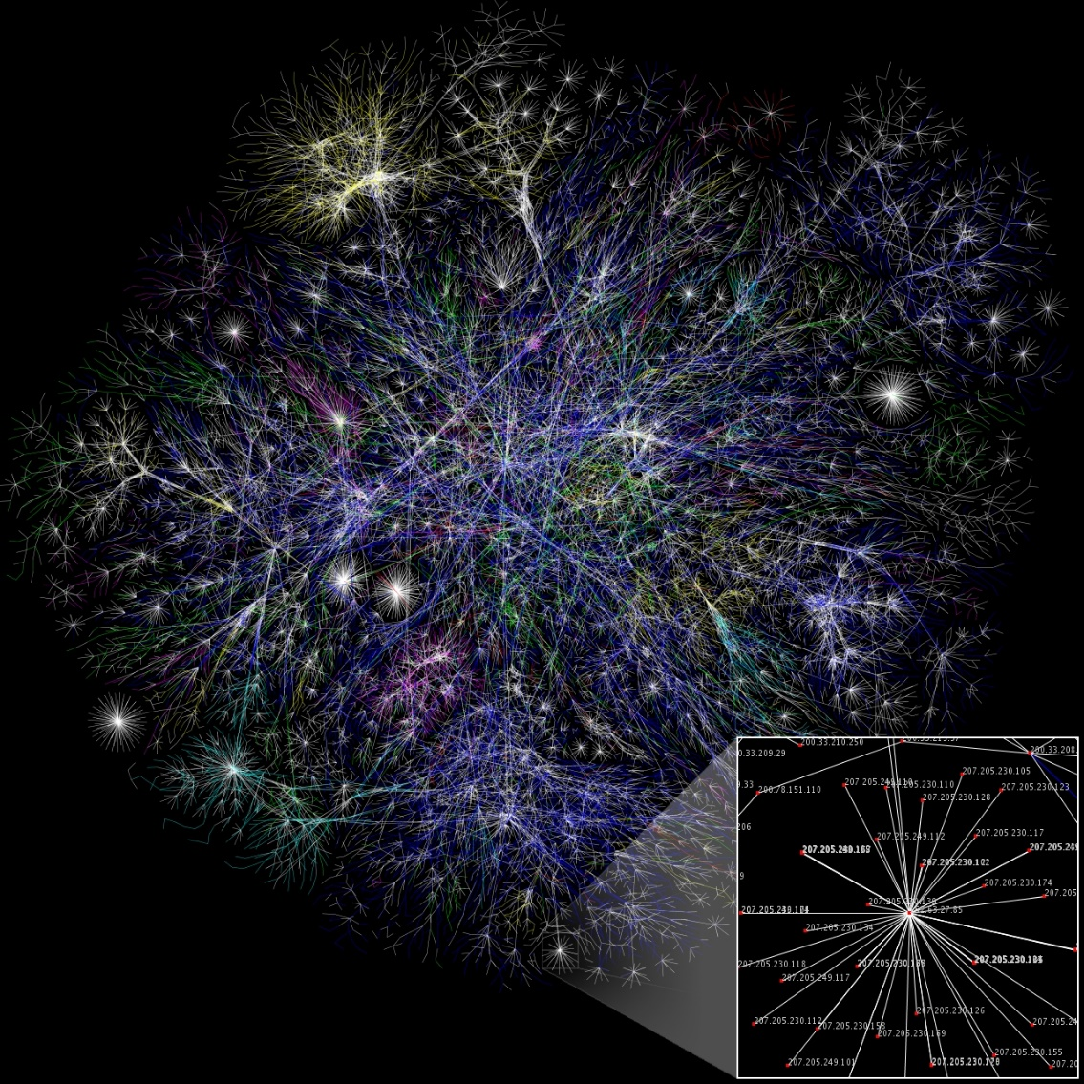
Network Topology
How are the different parts in a communication network (like links and nodes) organized?
Partial map of the Internet (Wikipedia)
Notes:
Network topology refers to how the different parts (like links and nodes) are organized in a communication network. It's a way to describe how various types of computer networks are set up.
Think of network topology as the structure of a network, which can be shown either physically or in a more abstract way. It is kind of like a puzzle, where the devices that communicate with each other are represented as dots (node), and the connections between them are shown as lines (links).

Slide 12
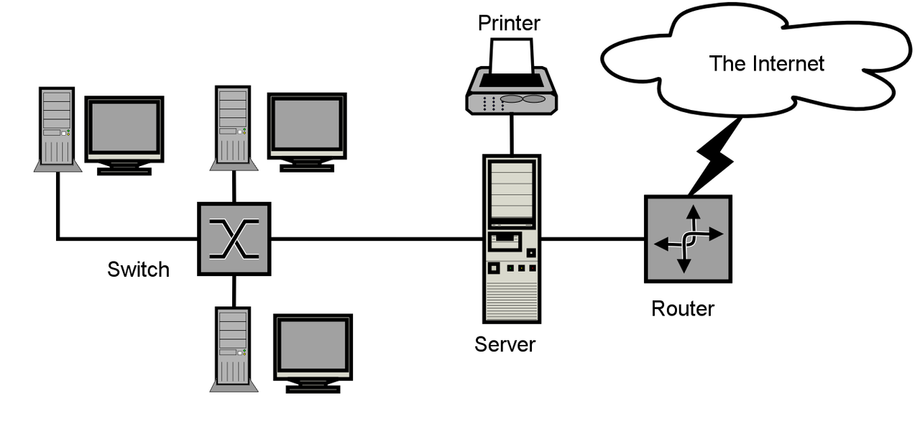
Computer Network Diagrams
A sample network diagram (Wikipedia)
Notes:
A computer network diagram is like a map showing the different points (nodes) and how they are connected in a computer network, or any type of telecommunications network. These diagrams are a key part of network documentation, helping to illustrate how the network is set up.

Slide 13
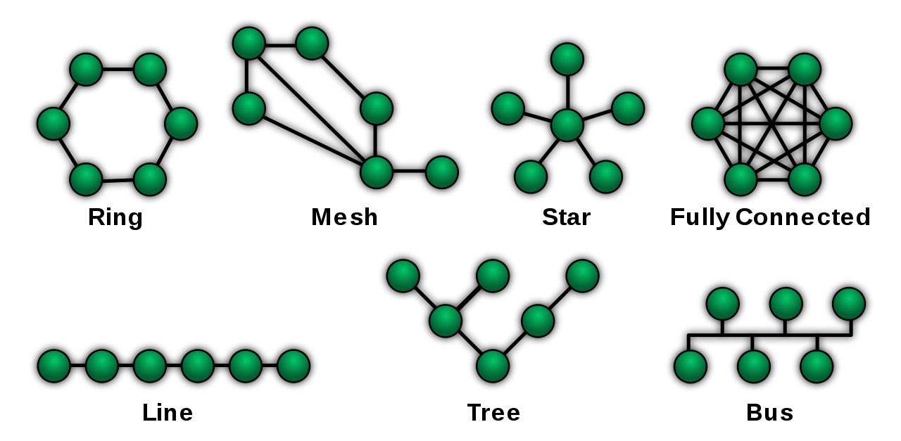
Graph Representation
Different network topologies (Wikipedia)
Notes:
The graph representation models different communicating devices as nodes and the connections between the devices are modeled as links or lines between the nodes.

Slide 14
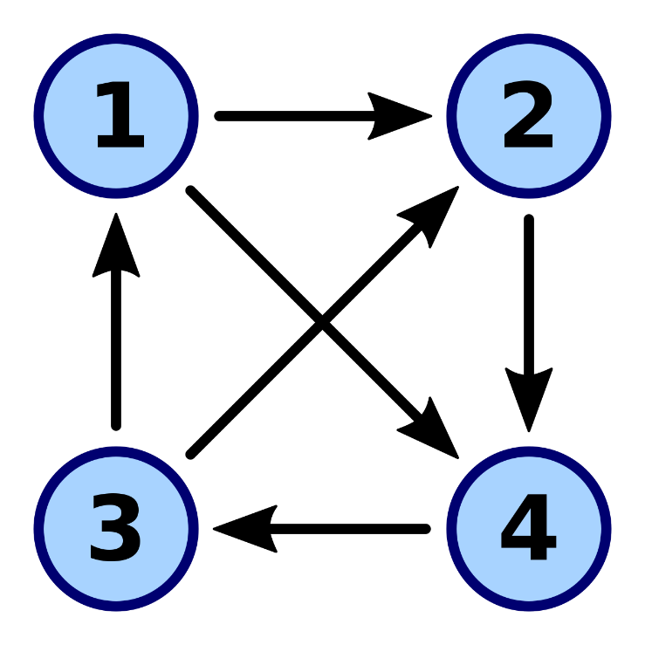
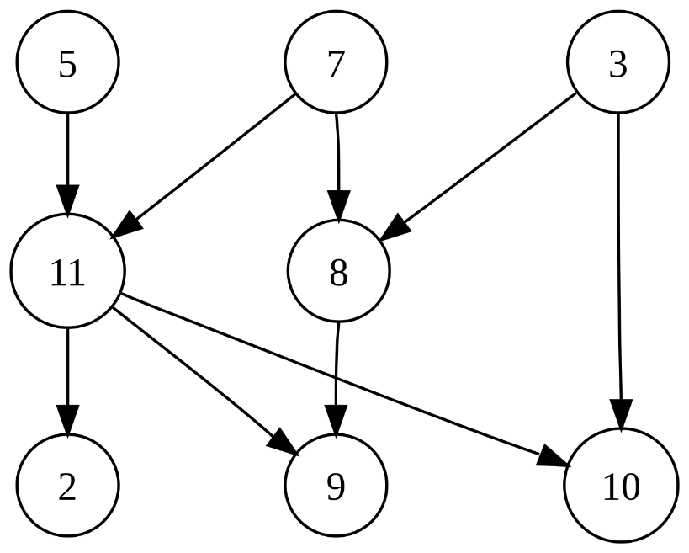
Directed Graph
Different Ring Directed Acyclic Graph (Wikipedia)

Slide 15
What does a Node in a Graph Represent?
A computing and comm. entity
An autonomous system
An OSPF’s area
A local communication network
An Internet host
A multiprocessor computers
A multitasking single processor
A thread
Each computer node is modeled by a finite state machine.
There are n such automata in the system that we call processors
How do they communicate with each other?

Slide 16
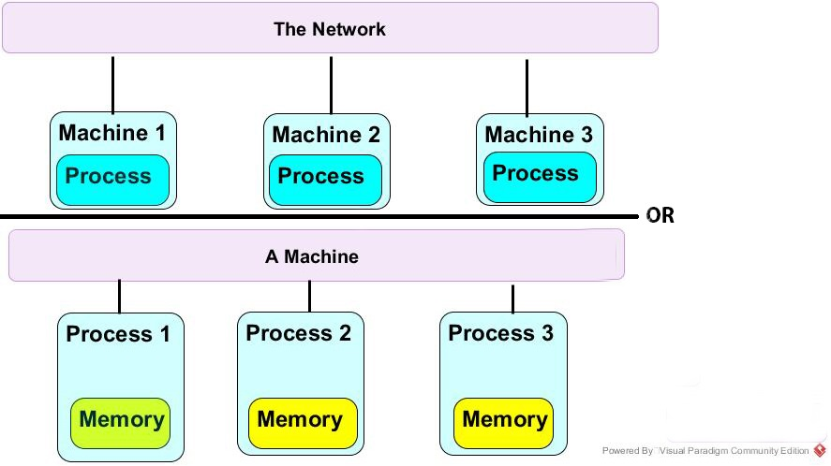
Message Passing vs. Shared Memory
we focus on shared memory
later, we show how to transfer from one model to message-passing
https://www.umsl.edu/~siegelj/CS4740_5740/Overview/MPSM.html

Slide 17
Message Passing vs. Shared Memory
https://www.umsl.edu/~siegelj/CS4740_5740/Overview/MPSM.html

Slide 18
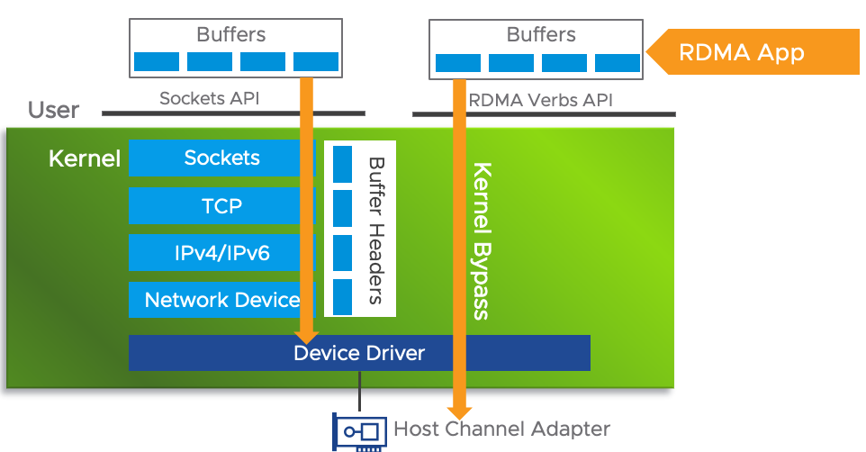
Remote Direct Memory Access
milliseconds
microseconds
https://core.vmware.com/resource/basics-remote-direct-memory-access-rdma-vsphere
Notes:
Typical latency numbers for RDMA and socket-based communication can vary significantly based on various factors, including hardware, network conditions, and the specific use case. However, some rough estimation can give you a general idea of the differences in latency.
RDMA Latency is in microseconds Range: RDMA can achieve extremely low latencies in the range of microseconds (μs). Latencies as low as 1-2 μs are possible with RDMA, especially when using high-performance network technologies like InfiniBand or RoCE.
Socket-Based Communication Latency is in milliseconds Range: Socket-based communication typically has higher latencies compared to RDMA. In a typical Ethernet-based network, socket communication latencies can be in the range of milliseconds (ms) or more, especially in scenarios with network congestion or when communication involves multiple layers of software.
It is important to note that these latency numbers are very rough estimates and can vary widely depending on the specific hardware, software stack, and network conditions. Additionally, advancements in both RDMA and socket-based communication technologies may lead to improvements or changes in these latency figures over time.

Slide 19
Node Identifiers vs. Anonymous
p_{i} - the i^{th} processor, where i is an index used for notation
Neighbors of p_{i} - a set of processors that can communicate directly with p_{i}
p_{i}
Node i = Processor i
Link p_{i}<->p_{j} = p_{i} can communicate with p_{j}
p_{j}

Slide 20
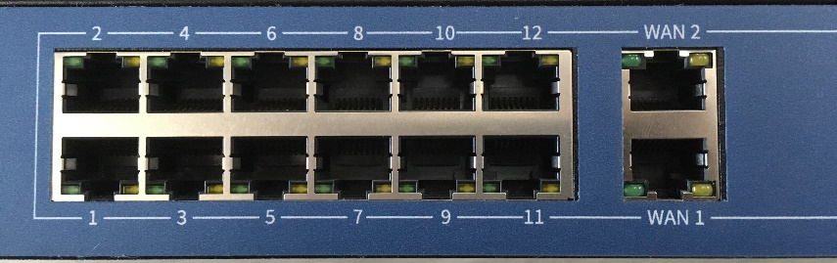
Node Identifiers vs. Anonymous
p_{i} - the i^{th} processor, where i is an index used for notation
Neighbors of p_{i} - a set of processors that can communicate directly with p_{i}
Globaly unique idetifeiers: ID(i) is a number asscoiated with p_{i}, such that there is no p_{j} for which ID(i)=ID(j) and i ≠ j
E.g., MAC address
Locally unique identifiers: port num.

Slide 21
Node Identifiers vs. Anonymous
p_{i} - the i^{th} processor, where i is an index used for notation
Neighbors of p_{i} - a set of processors that can communicate directly with p_{i}
Globaly unique idetifeiers: ID(i) is a number asscoiated with p_{i}, such that there is no p_{j} for which ID(i)=ID(j) and i ≠ j
E.g., MAC address
Locally unique identifiers: port num.
Anonymous networks: all processors run the same program and have access to locally unique identifiers
Semi-anonymous networks: all processors, except exactly one processor in the network (called the distinguished processor), runs the same program. E.g., one server and many clients.

Slide 22
Programming Style
Synchronous
receive all
read all
finite internal computation
finite internal computation
send all
write all
message-passing
shared-memory
All communication delays are bounded by a constant
All processor take their steps simultaneously upon a pulse

Slide 23
Programming Style
Asynchronous
read all
If condition
message arrival
finite internal computation
finite internal computation
finite internal computation
write all
send
shared-memory
message-passing
No bound on the communication delays
Processors take their steps concurrently---No clocks.

Slide 24
How to Represent Communication Channels?
Shared memory
r_{i}= content of communication register of processor p_{i}, or
r_{i,1},r_{i,2},…r_{i,j},…r_{i,n-1} = a vector of registers that p_{i} can write to but p_{j} can only read r_{i,j}
Message-passing
q_{i,j} = a FIFO queue of messages sent from p_{i} to p_{j}

Slide 25
What is a Processor State?
p_{x}
p_{x’}
p_{x’’}
The values stored are all the local variables
p_{i}
p_{y}
p_{y’}
p_{y’’}
The state of p_{i} is denoted by s_{i}

Slide 26
What is a System State?
p_{x}
p_{x’}
p_{x’’}
The values stored are all the local variables
p_{i}
The values of the incoming communication channels
p_{y}
p_{y’}
p_{y’’}
The system configuration (or state) is denoted by c = (s₁,s₂,…,s_{n},r_{1,2},r_{1,3},…r_{i,j},…r_{n,n-1}) where s_{i} = state of p_{i} r_{ij}= content of communication channels/registers

Slide 27
Computation Steps
In the shared memory model …
r₁₂: x
r₁₂: m₁
r₁₂: m₁
P₁ writes
P₂ reads
P₁
P₂
P₁
P₂
P₁
P₂
m₁
m₁
And in the message-passing model …
q₁₂ = (m₁)
q₁₂ = (m₁)
q₁₂ = (m₁)
p₂ send m₄
P₁ receives
P₁
P₂
P₁
P₂
P₁
P₂
q₂₁ = (m₂, m₄)
q₂₁ = (m₂, m₃, m₄)
m₂
q₂₁ = (m₄)

Slide 28
State Transitions
Every state transition of a processor is due to the execution of a communication step
A step will be denoted by a
c₁ ª➔ c₂ denotes the fact that configuration c₂ can be reached from configuration c₁ by a single step a
Step a is applicable to configuration c if, and only if, ∃ c’ : c ª➔ c’

Slide 29
System Executions
An execution E = (c₀,a₀,c₁,a₁,…) , an alternating sequence such that c_{i-1} ª ➔ c_{i} (i>1)
This kind of presentation of system executions is called the interleaving model

Slide 30
Representing Failures
q₁₂ = (m₁)
q₁₂ = (m₁)
q₁₂ = (m₁)
loss₂₁(m₃)
reorder₂₁(m₃, m₄)
P₁
P₂
P₁
P₂
P₁
P₂
q₂₁ = (m₂,m₃,m₄)
q₂₁ = (m₂,m₄)
q₂₁ = (m₄, m₂)
In the message-passing model, the adversary can
data corruption
message omission
message duplication
message reordering

Slide 31
Representing Failures
q₁₂ = (m₁)
q₁₂ = (m₁)
q₁₂ = (m₁)
loss₂₁(m₃)
reorder₂₁(m₃, m₄)
P₁
P₂
P₁
P₂
P₁
P₂
q₂₁ = (m₂,m₃,m₄)
q₂₁ = (m₂,m₄)
q₂₁ = (m₄, m₂)
In the message-passing model, the adversary can
data corruption
message omission
message duplication
message reordering
In the shared-memory model, the adversary can
data corruption

Slide 32



How Often can a Message be Ommited?
If messages are omitted “too often”
it indicates a faulty communication channel.
What is the maximum power we can grant to the adversary in omitting messages without allowing the adversary to render the channel completely nonfunctional?

Slide 33
The Communication Fairness (FC) Property
Communication Fairness: if a message is sent infinitely often,
that message is received infinitely often
NB-1: FC holds even if an infinite num. message are lost eventually
NB-2: between any two successful deliveries,
only a finite num. messages may be lost
otherwise, the communication channel is faulty
Notes:
In asynchronous computer networks, the property of fair communication requires that if a message is sent infinitely often over a given communication channel, then the message is received infinitely often. If the property of communication fairness does not hold with respect to a given communication channel, then we know that the sender can successfully transmit only a finite number of messages since after this number of transmissions, the receiver forever does not receive message, i.e., the link is broken.

Slide 34
Representing Node Failures
A processor that, eventually, stops taking steps forever is said to be crashed.

Slide 35
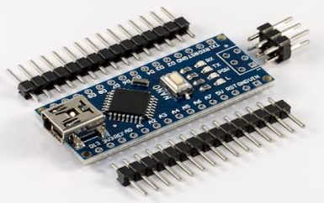
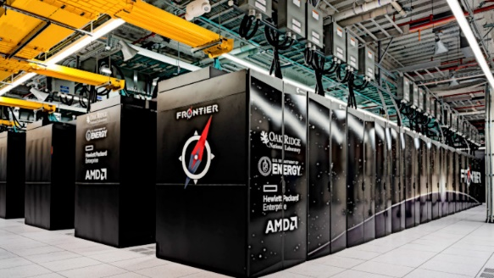

Representing Node Failures
A processor that, eventually, stops taking steps forever is said to be crashed.
But how to distinguish, asynchronous networks, between a slow processor and a crashed one?
For every Arduino step, HP Frontier takes more than 10¹² steps
Atmega328 16 MHz
HP Frontier 1.7 Exa flops

Slide 36
Representing Node Failures
A processor that, eventually, stops taking steps forever is said to be crashed.
But how to distinguish, asynchronous networks, between a slow processor and a crashed one?
For every Arduino step, HP Frontier takes more than 10¹² steps
Atmega328 16 MHz
HP Frontier 1.7 Exa flops
What is the maximum power we can grant to the adversary in “slowing down” processors without allowing the adversary to render a slow processor to be completely nonfunctional?

Slide 37
Execution Fairness
Every step that is applicable infinitely often is executed infinitely often
In other words, even if the HP Frontier is an exponentially growing number of steps more than the Arduino, the execution is still fair.
However, if any set of processors takes an infinite number of steps while the HP Frontier (or Arduino) takes no step, then the HP Frontier (respectively, Arduino) is crashed.

Slide 38
Arbitrary Transient Faults
They represent any violation of the assumptions according to which the system and network were designed to behave
One may assume that CRC-codes always detect memory/messages corruption

Slide 39
Arbitrary Transient Faults
They represent any violation of the assumptions according to which the system and network were designed to behave
One may assume that CRC-codes always detect memory/messages corruption
If such corruption is undetected, stale info. will propagate in the network

Slide 40
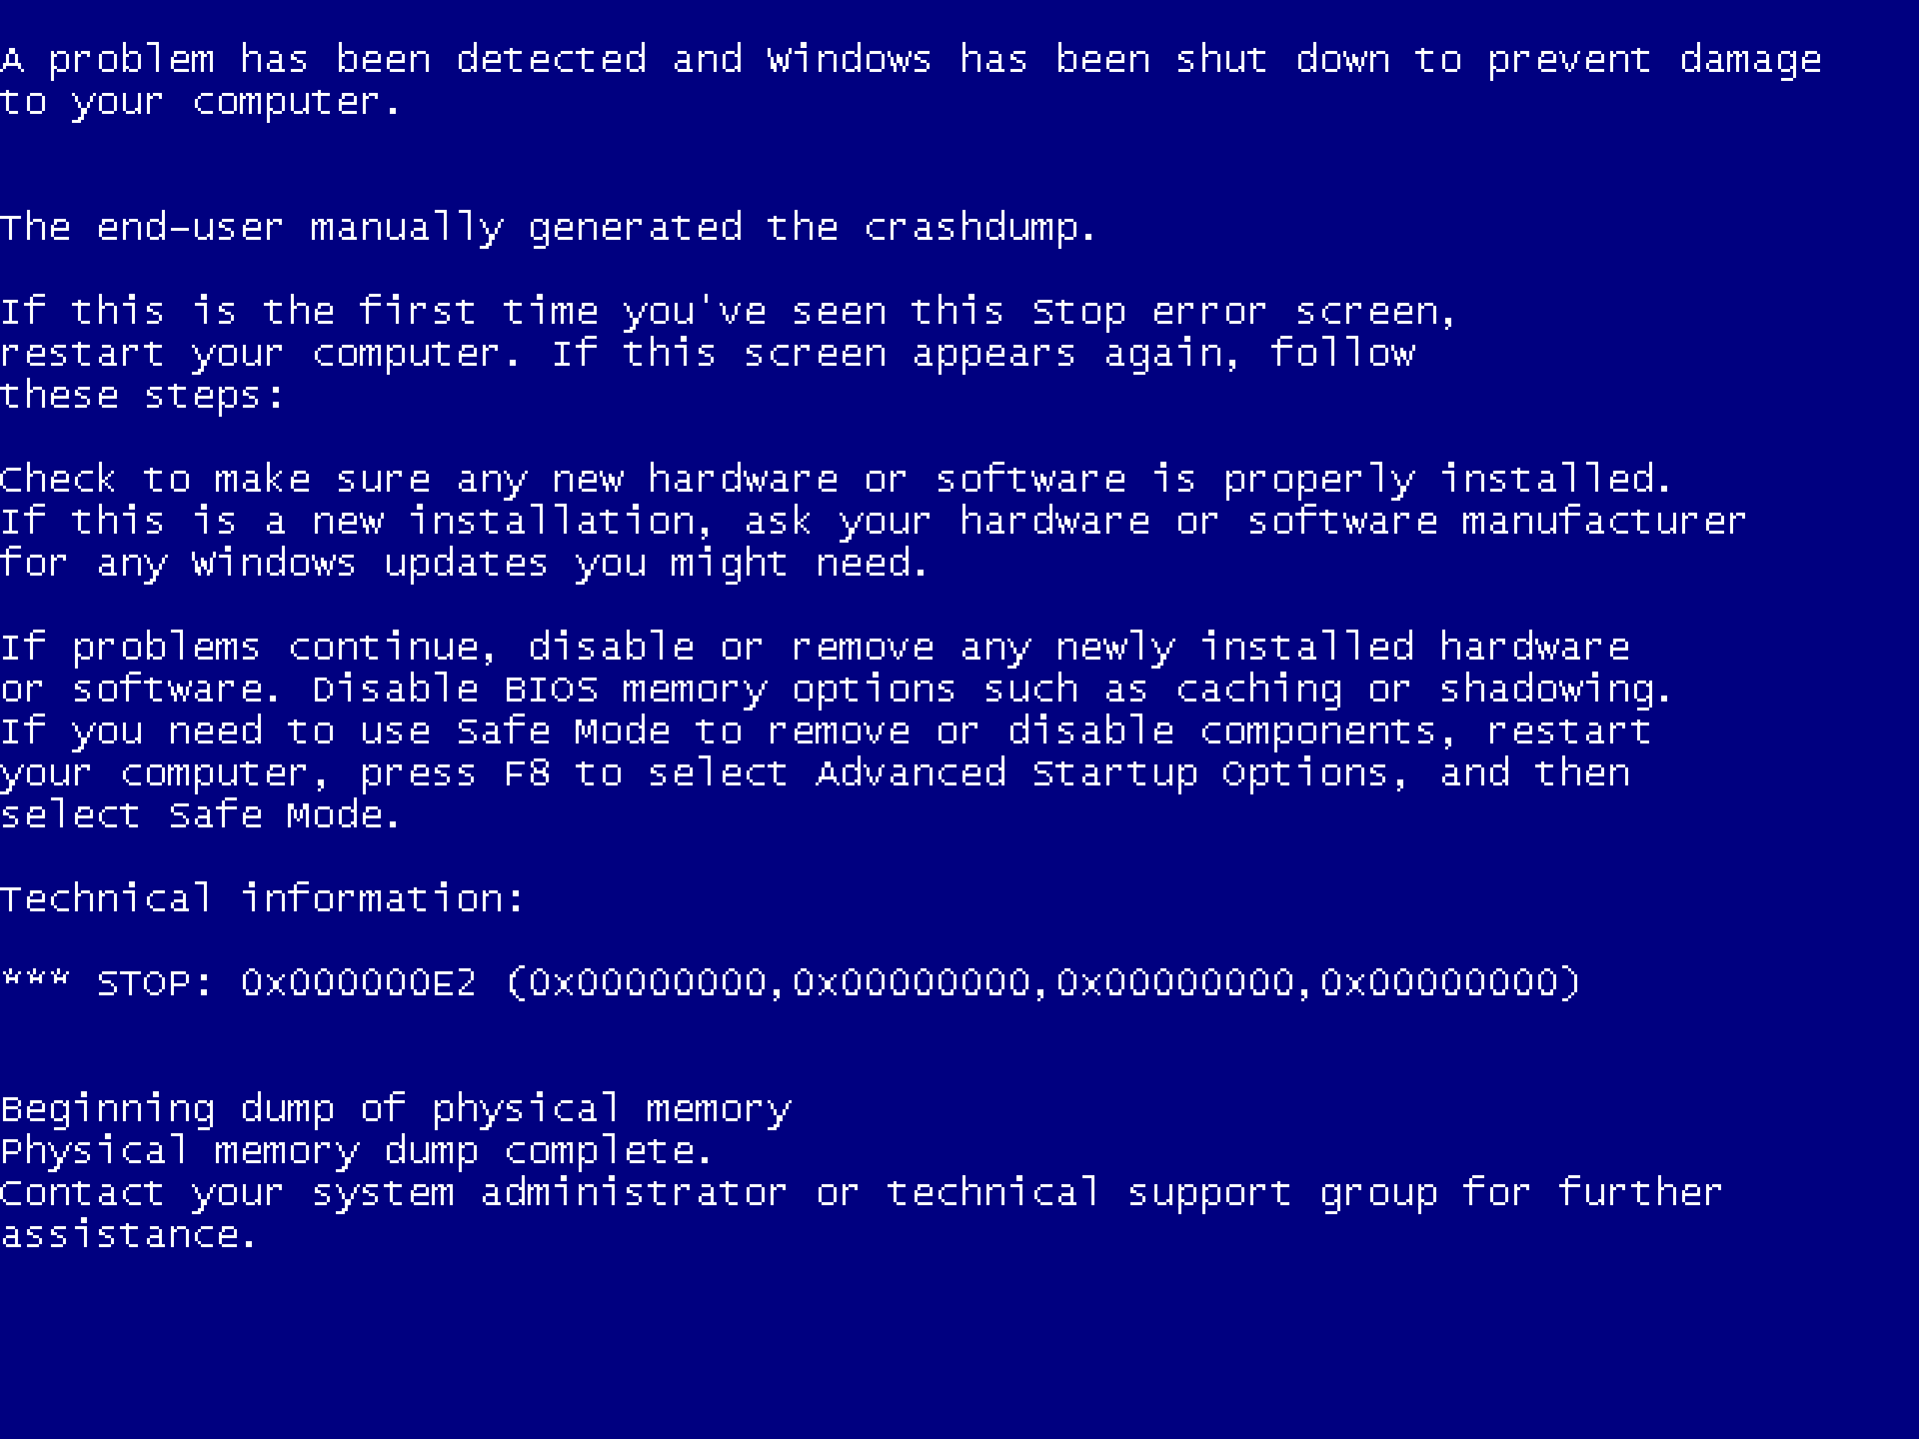

Arbitrary Transient Faults
They represent any violation of the assumptions according to which the system and network were designed to behave
One may assume that CRC-codes always detect memory/messages corruption
If such corruption is undetected, stale info. will propagate in the network

Slide 41
Arbitrary Transient Faults
They represent any violation of the assumptions according to which the system and network were designed to behave
One may assume that CRC-codes always detect memory/messages corruption
If such corruption is undetected, stale info will propagate in the network
An arbitrary combination of such failures can leave the network in an arbitrary state.
If a network starts in an arbitrary configuration, how can the algorithm make the network present a legal behavior?
i.e., satisfy the problem definition?

Slide 42
Legal Behavior
A desired legal behavior is a set of legal executions denoted LE
legal execution
step
step
c’
c_{m}
c²_{safe}
c’’_{safe}
step
c
step
step
step
c’’
c¹_{safe}
c^{t}_{safe}
step
step
c’_{safe}
c_{i}
c^{k}_{safe}
step
c_{l}
A self-stabilizing network can be started in any arbitrary configuration and will eventually exhibit a desired “legal” behavior
Notes:
* A desired legal behavior is a set of legal executions denoted LE
*Defined for a particular system and a particular task
Should have a suffix that appears in LE
*A configuration c is safe with regard to task LE and an algorithm if every fair execution of the algorithm that starts from c belongs to LE
*An algorithm is self-stabilizing for a task LE if every fair execution of the algorithm reaches a safe configuration with relation to LE

Slide 43
Self-stabilizing Networks
Note that we define LE for a particular system and a particular task
An execution of a self-stabilizing system has a suffix that appears in LE
We say that configuration c is safe with regard to task LE and system, if every fair execution of the algorithm that starts from c belongs to LE
An algorithm is self-stabilizing for a task LE if every fair execution of the algorithm reaches a safe configuration with relation to LE

Slide 44
Complexity Measures: num. rounds
The number of rounds = stabilization time
The first asynchronous round in a fair execution E is the shortest prefix E’ of E such that each processor executes at least one step in E’, where E=E’○E’’

Slide 45
Complexity Measures: num. rounds
The number of rounds = stabilization time
The first asynchronous round in a fair execution E is the shortest prefix E’ of E such that each processor executes at least one step in E’, where E=E’○E’’
E.g., let P={p_{i},p_{j}} and E=(c₀, a^{i}₀, c₁, a^{i}₁, c₂ , a^{i}₂, c₃, a^{j}₃, c₄, a^{i}₄, c₅,…)
where a^{k}_{x} is the x-th step in execution E taking by p_{k}
The first asynchronous round is E’=(c₀, a^{i}₀, c₁, a^{i}₁, c₂ , a^{i}₂, c₃, a^{j}₃)

Slide 46
Complexity Measures: num. rounds
The number of rounds = stabilization time
The first asynchronous round in a fair execution E is the shortest prefix E’ of E such that each processor executes at least one step in E’, where E=E’○E’’
E.g., let P={p_{i},p_{j}} and E=(c₀, a^{i}₀, c₁, a^{i}₁, c₂ , a^{i}₂, c₃, a^{j}₃, c₄, a^{i}₄, c₅,…)
where a^{k}_{x} is the x-th step in execution E taking by p_{k}
The first asynchronous round is E’=(c₀, a^{i}₀, c₁, a^{i}₁, c₂ , a^{i}₂, c₃, a^{j}₃)
The second asynchronous round in E is the first asynchronous round in E’’=(c₄, a^{i}₄, c₅,…).

Slide 47
Complexity Measures: num. cycles
A Self-Stabilizing algorithm is usually a do forever loop
receive all
read all
finite internal computation
finite internal computation
send all
write all
message-passing
shared-memory

Slide 48
Complexity Measures: num. cycles
A Self-Stabilizing algorithm is usually a do forever loop
The number of steps required to execute a single iteration of such a loop is O(Δ), where Δ is an upper bound on the number of neighbors of p_{i}
receive all
read all
finite internal computation
finite internal computation
send all
write all
message-passing
shared-memory

Slide 49
Complexity Measures: num. cycles
A Self-Stabilizing algorithm is usually a do forever loop
The number of steps required to execute a single iteration of such a loop is O(Δ), where Δ is an upper bound on the number of neighbors of p_{i}
receive all
read all
finite internal computation
finite internal computation
send all
write all
message-passing
shared-memory
The first asynchronous cycle in an execution E is the shortest prefix E’ of E such that each processor executes at least one complete iteration of the do-forever loop in E’, where E=E’○E’’.
The second asynchronous round in E is the first asynchronous round in E’’

Slide 50
Summary
We presented an analytical framework (model) for studying self-stabilizing algorithms for computer networks

