Slide 1
Computer Networks EDA387/DIT663
CHALMERS and University of Technology
Computer Science and Engineering Networks and Systems
Fault-tolerant Algorithms for Computer Networks
Spanning tree construction (Ch.2)

Slide 2
Goal
We would like to understand how to design self-stabilizing network protocols
At the end of this lecture, you should be able to:
Define network task of spanning tree construction
Propose an algorithm for solving this task
Argue about the correctness of your proposal
我们想了解如何设计自稳定网络协议 在本次讲座结束时，您应该能够： 定义生成树构建的网络任务 提出解决此任务的算法 争论您的提案的正确性

Slide 3
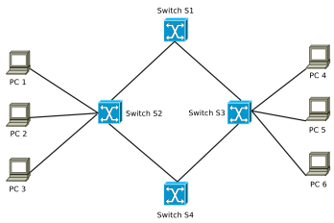
Switching Loop 交换机环路
It occurs when there are several data-link layer paths between two nodes.
They allow the appearance of broadcast storms since the sending of an Ethernet frame can cause it to be forwarded by switches out of every port.
This leads to repeated broadcasting of the frame.
The data-link layer does not use the TTL technique.
when a frame is sent into a looped topology, it can proliferate forever.
https://stackoverflow.com/questions/21081410/avoiding-switch-loop
Notes:
A switching loop happens when multiple data-link layer paths exist between two nodes in a network.
Broadcast Storms
Switching loops can trigger broadcast storms, where an Ethernet frame gets forwarded by switches out of every port.
This results in the frame being repeatedly broadcasted, causing network congestion.
No TTL Mechanism. Unlike some network layers, the data-link layer doesn't use a Time-to-Live (TTL) mechanism to limit frame propagation.
Endless Proliferation
When a frame enters a looped network topology, it can keep circulating indefinitely.
This uncontrolled propagation can disrupt network operations and lead to performance issues.
Switching loops can have severe consequences in network communication, including broadcast storms and persistent frame proliferation, due to the absence of a TTL mechanism at the data-link layer. It's essential to prevent and address switching loops to maintain network stability.

Slide 4
Spanning Tree Protocol (STP)
STP constructs a loop-free logical topology for Ethernet switches.
STP creates a spanning tree that enables some links and disables others in a way that leaves a single active path between any two network nodes.
The aim is to avoid broadcast storms that result from loops.
STP can include backup links upon the failure of active links.
Please watch this video.
Notes:
Loop-Free Logical Topology.
STP (Spanning Tree Protocol) is designed to establish a loop-free logical topology within Ethernet switches.
Creating a Spanning Tree
STP accomplishes this by creating a spanning tree, a hierarchical structure that designates specific links as active while disabling others.
This arrangement ensures that there's always a single active path between any two network nodes.
Preventing Broadcast Storms
A primary goal of STP is to prevent broadcast storms that can occur in networks with loops.
By carefully controlling the active paths, STP avoids the conditions that lead to these storms.
Backup Links
In addition to maintaining active paths, STP can incorporate backup links.
These backup links become active if a primary link fails, ensuring network resilience and continuity.
Spanning Tree Protocol (STP) is a critical tool for creating a stable and loop-free network topology. It prevents broadcast storms by establishing a spanning tree structure and can include backup links to maintain network reliability in the event of link failures.

Slide 5
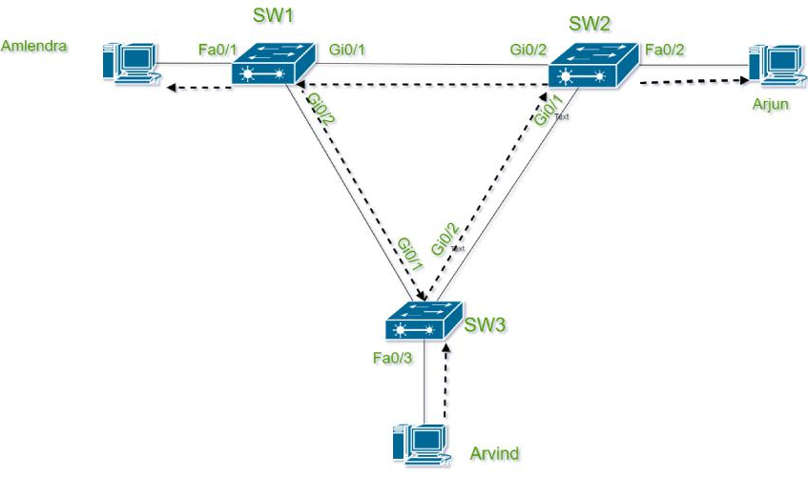
Spanning Tree Protocol (STP)
https://www.geeksforgeeks.org/introduction-of-spanning-tree-protocol-stp/

Slide 6
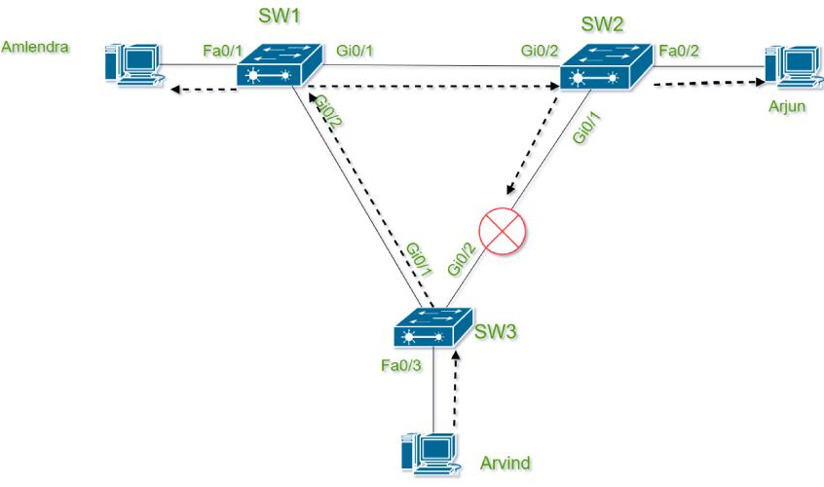
Spanning Tree Protocol (STP)
https://www.geeksforgeeks.org/introduction-of-spanning-tree-protocol-stp/

Slide 7
STP History
STP was originally standardized as IEEE 802.1D
The first STP algorithm is by Radia Perlman, which she wrote for her master thesis!
Watch the video
Rapid Spanning Tree Protocol (RSTP) IEEE introduced in 2001 as 802.1w.
Nowadays, the functionality of 802.1D, 802.1w, and multiple spanning-tree (802.1s) is incorporated into IEEE 802.1Q-2014 standard for Local and metropolitan area networks
Notes:
STP History
Origins of STP
STP (Spanning Tree Protocol) was initially standardized as IEEE 802.1D.
Interestingly, the first STP algorithm was developed by Radia Perlman as part of her master's thesis.
Rapid Spanning Tree Protocol (RSTP)
RSTP, introduced by IEEE in 2001 as IEEE 802.1w, improved upon the original STP.
It aimed to reduce convergence time and enhance network responsiveness.
Integration into IEEE 802.1Q-2014
Today, the functionality of IEEE 802.1D (STP), IEEE 802.1w (RSTP), and multiple spanning-tree (802.1s) protocols is incorporated into the IEEE 802.1Q-2014 standard.
This comprehensive standard is used for Local and Metropolitan Area Networks (LANs/MANs), providing a unified approach to spanning tree operations.
STP has evolved from its initial standardization as IEEE 802.1D to the development of RSTP (802.1w) and its eventual integration into the IEEE 802.1Q-2014 standard. These advancements have significantly improved the efficiency and reliability of network spanning tree operations.

Slide 8
Many Other Related Protocols
Shortest Path Bridging (IEEE 802.1aq)
Bridges and Bridged Networks (IEEE 802.1Q-2014)
Connectivity Fault Management (CFM)
Equal Cost Multiple Paths in Shortest Path Bridging
Automatic Attachment to Provider Backbone Bridging
IS-IS Extensions Supporting Shortest Path Bridging
Notes:
Many Other Related Protocols
Shortest Path Bridging (IEEE 802.1aq)
Shortest Path Bridging, also known as IEEE 802.1aq, is an advanced network protocol.
It offers efficient and flexible routing capabilities, particularly well-suited for large and complex networks.
Bridges and Bridged Networks (IEEE 802.1Q-2014)
IEEE 802.1Q-2014 standardizes bridges and bridged networks.
It includes enhancements for network connectivity, reliability, and scalability.
Connectivity Fault Management (CFM)
CFM is a protocol used for detecting and diagnosing connectivity faults in Ethernet networks.
It helps ensure network reliability and timely fault detection.
Equal Cost Multiple Paths in Shortest Path Bridging
This extension to Shortest Path Bridging (IEEE 802.1aq) allows for load balancing across equal-cost paths.
It optimizes network resource utilization and improves performance.
Automatic Attachment to Provider Backbone Bridging
This protocol simplifies the attachment of customer networks to provider networks.
It's particularly relevant in-service provider environments.
IS-IS Extensions Supporting Shortest Path Bridging
IS-IS (Intermediate System to Intermediate System) is extended to support the operation of Shortest Path Bridging.
This enables the integration of SPB into existing network infrastructures.
These related protocols and standards play crucial roles in enhancing the capabilities and performance of Ethernet and bridged networks. They offer solutions for various network challenges, including efficient routing, fault management, and network attachment in diverse environments.

Slide 9
Sequential BFS Construction
Breadth-first search (BFS) is an algorithm for traversing a network.
The starting node is call the root.
The algorithm explore the neighboring nodes first, before moving to the next level neighbors.
The task here is to construct a directed tree, i.e., a subgraph that its edges are directed towards the root.
Moreover, the directed path from every node to the root is the shortest path on the network.
Watch this video for a detailed ver. of the above sequential solution
Notes:
Background: BFS Construction
Breadth-First Search (BFS)
Breadth-First Search is a fundamental algorithm used for traversing networks, graphs, or trees.
It systematically explores nodes in a structured manner, starting from a designated node called the root.
The Root Node
In BFS, the starting node from which the exploration begins is known as the root node.
The algorithm's progress radiates outwards from this root.
Exploring Neighboring Nodes
BFS focuses on exploring neighboring nodes before moving to nodes at deeper levels.
It ensures that all nodes at a particular level are visited before descending further.
Constructing a Directed Tree
The primary goal of BFS is to construct a directed tree, which is a subgraph of the network.
In this tree, all edges point towards the root node, creating a hierarchical structure.
Shortest Paths to the Root
One of BFS's key properties is that it guarantees the construction of a directed path from every node to the root.
Importantly, these directed paths are also the shortest paths within the network.
Breadth-First Search (BFS) is a powerful algorithm used to explore networks systematically. It begins at a root node, explores neighboring nodes first, and constructs a directed tree where all paths to the root are the shortest possible. This makes BFS invaluable in various applications, including network routing and graph traversal.
--------------------
Here is pseudocode for a sequential solution, none distributed, for the problem of the Breadth-First Search (BFS). The output of this construction is a directed tree.
function BFS(Graph, root):
// Create an empty queue for nodes to visit
queue = Queue()
// Create an empty set to keep track of visited nodes
visited = Set()
// Create an empty directed tree (adjacency list)
tree = {}
// Initialize the queue with the root node
queue.enqueue(root)
// Mark the root node as visited
visited.add(root)
// While there are nodes to visit in the queue
while not queue.isEmpty():
// Dequeue the next node to visit
current = queue.dequeue()
// Add current node to the directed tree
tree[current] = []
// Explore neighbors of the current node
for neighbor in Graph.neighbors(current):
if neighbor not in visited:
// Mark neighbor as visited
visited.add(neighbor)
// Add neighbor to the directed tree as a child of the current node
tree[current].append(neighbor)
// Enqueue neighbor for further exploration
queue.enqueue(neighbor)
// Return the directed tree
return tree
This pseudocode outlines the BFS algorithm for constructing a directed tree starting from a given root node in a graph. The resulting directed tree represents the hierarchical structure of the exploration process, with each node pointing to its children in the tree.

Slide 10

Sequential BFT Construction
0
3
1
1
2
1
2
2

Slide 11
Non-self-stabilizing Distributed BFT
variables: distance, initially 0 for root and ∞ for non-root processors;
root:
send distance to all neighbors
non-root:
upon receiving <d> from p_{j}:
if d+1 < distance then
distance := d+1;
parent := j;
send <distance> to all neighbors;
For details https://www.cs.yale.edu/homes/aspnes/pinewiki/DistributedBreadthFirstSearch.html

Slide 12

Non-self-stabilizing Distributed BFT
0
3
1
1
2
1
2
2

Slide 13
Self-stabilizing Distributed BFT
We will use the shared memory model for this example
The system consists n processors
A processor p_{i} communicates with its neighbor p_{j} by writing in the communication register r_{ij} and reading from r_{ji}
The output is the constructed tree, which the registers encode
r₂₁:
parent = 1
dis = 1
1
5
2
r₅₈:
parent = 1
dis = 3
4
r₇₃:
parent = 0
dis = 2
7
6
3
8

Slide 14
The Constructed BFT Tree
Each node has a register per neighbor with the fields
<child-indication, distance>
0
⟨0,0⟩
⟨0,0⟩
⟨1,1⟩
⟨0,0⟩
3
1
⟨1,3⟩
⟨1,1⟩
⟨0,1⟩
⟨1,1⟩
1
⟨1,2⟩
⟨1,1⟩
⟨0,1⟩
⟨0,1⟩
2
1
⟨1,2⟩
⟨0,1⟩
⟨1,2⟩
⟨0,2⟩
⟨0,2⟩
2
2
⟨0,2⟩
⟨0,2⟩
⟨0,2⟩

Slide 15
The Constructed BFT Tree
Each node has a register per neighbor with the fields
<child-indication, distance>
0
⟨0,0⟩
⟨0,0⟩
⟨1,1⟩
⟨0,0⟩
3
1
⟨1,3⟩
⟨1,1⟩
⟨0,1⟩
⟨1,1⟩
1
⟨1,2⟩
⟨1,1⟩
⟨0,1⟩
⟨0,1⟩
2
1
⟨1,2⟩
⟨0,1⟩
⟨1,2⟩
⟨0,2⟩
⟨0,2⟩
2
2
⟨0,2⟩
⟨0,2⟩
⟨0,2⟩

Slide 16
What is a First-BFS?
Given a graph G:=(V,E) and a root node v ∈ V, can there be more than one BFS tree rooted at v?
0
⟨0,0⟩
⟨0,0⟩
⟨1,1⟩
⟨0,0⟩
3
1
⟨1,3⟩
⟨1,1⟩
⟨0,1⟩
⟨1,1⟩
1
⟨1,2⟩
⟨1,1⟩
⟨0,1⟩
⟨0,1⟩
2
1
⟨1,2⟩
⟨0,1⟩
⟨1,2⟩
⟨0,2⟩
⟨0,2⟩
2
2
⟨0,2⟩
⟨0,2⟩
⟨0,2⟩

Slide 17
What is a First-BFS?
Given a graph G:=(V,E) and a root node v ∈ V, can there be more than one BFS tree rooted at v?
What if one there is a node with several shortest paths to the root?
0
⟨0,0⟩
⟨0,0⟩
⟨1,1⟩
⟨0,0⟩
3
1
⟨1,3⟩
The first-BFT construction selects the ”first” of these paths
⟨1,1⟩
⟨0,1⟩
⟨1,1⟩
1
⟨1,2⟩
⟨1,1⟩
⟨0,1⟩
⟨0,1⟩
2
1
⟨1,2⟩
⟨0,1⟩
⟨*,2⟩
⟨0,2⟩
⟨0,2⟩
2
⟨*,2⟩
2
⟨0,2⟩
⟨0,2⟩
⟨0,2⟩

Slide 18
What is a First-BFS?
Given a graph G:=(V,E) and a root node v ∈ V, can there be more than one BFS tree rooted at v?
What if one there is a node with several shortest paths to the root?
0
⟨0,0⟩
⟨0,0⟩
⟨1,1⟩
⟨0,0⟩
3
1
⟨1,3⟩
The first-BFT consruction selects the ”first” of these paths
Decide on the order
using local identifiers
⟨1,1⟩
⟨0,1⟩
⟨1,1⟩
1
⟨1,2⟩
⟨1,1⟩
⟨0,1⟩
⟨0,1⟩
2
1
⟨1,2⟩
⟨0,1⟩
⟨1,2⟩
⟨0,2⟩
⟨0,2⟩
2
⟨0,2⟩
2
⟨0,2⟩
⟨0,2⟩
⟨0,2⟩

Slide 19
What is a First-BFS?
Given a graph G:=(V,E) and a root node v ∈ V, can there be more than one BFS tree rooted at v?
What if one there is a node with several shortest paths to the root?
0
⟨0,0⟩
⟨0,0⟩
⟨1,1⟩
⟨0,0⟩
3
1
⟨1,3⟩
The first-BFT consruction selects the ”first” of these paths
Decide on the order
using local identifiers
⟨1,1⟩
⟨0,1⟩
⟨1,1⟩
1
⟨1,2⟩
⟨1,1⟩
⟨0,1⟩
⟨0,1⟩
2
1
⟨1,2⟩
⟨0,1⟩
⟨0,2⟩
⟨0,2⟩
⟨0,2⟩
2
⟨1,2⟩
2
⟨0,2⟩
⟨0,2⟩
⟨0,2⟩

Slide 20
Self-stabilizing Distributed BFT
0
The root inform all its neighbors that its distance is 0
The non-root chooses the minimal distance of its neighbors, adds one and updates its neighbors
Correct encoding of the distances allows the correct assignment of the parent-child values
3
1
1
2
1
2
2
The algorithm we study is by Dolev, Israeli, and Moran 1993: Self-stabilization of dynamic systems assuming only read/write atomicity. Distributed Computing, 7(1), 3-16.

Slide 21
First-BFS Construction, code for p_{i}
01 Root: do forever
02 for m := 1 to δ do write r_{im} := ⟨0,0⟩
03 od
04 Other: do forever
05 for m := 1 to δ do lr_{mi} := read(r_{mi})
06 FirstFound := false
07 dist := 1 + min{lr_{mi}.dis ⏐1 ≤ m ≤ δ }
08 for m := 1 to δ
09 do
10 if not FirstFound and lr_{mi}.dis = dist -1
11 write r_{im} := ⟨1,dist⟩
12 FirstFound := true
13 else
14 write r_{im} := ⟨0,dist⟩
15 od
16 od
= num. of processor’s neighbors
i= the writing processor m= for whom the data is written
lr_{ji} (local register ji) the last value of r_{ji} read by P_{i}

Slide 22
Correctness
The legal task ST - every configuration encodes a first BFS tree of the communication graph
Notation:
Δ is the maximum number of links adjacent to a processor
Definitions:
A floating distance in configuration c is a value in r_{ij}.dis that is smaller than the distance of p_{i} from the root
The smallest floating distance in configuration c is the smallest value among the floating distances
Notes:
* A configuration is a vector of the processor states and a vector of communication registers values
The task ST of legitimate sequences is defined as the set of all configuration sequences in which every configuration encodes a BFS tree of the communication graph
Definitions :
*A floating distance in some configuration c is a value in a register r_{ij}.dis that is smaller than the distance of P_{i} from the root
*The smallest floating distance in some configuration c is the smallest value among the floating distance
*Δ is the maximum number of links adjacent to a processor

Slide 23
Proof by Induction
Base Case
The base case is the first step in an inductive proof. In this step, you prove that the statement holds true for the smallest value of the variable (often 1 or 0). It serves as the foundation for the induction process.
Example: To prove that 1+2+3+…+x=x(x+1)/2​ for all positive integers x, we start by verifying the base case for x=1:
1=1(1+1)/2​, which is true.

Slide 24
Proof by Induction
Inductive Hypothesis
Assume that the statement is true for some arbitrary positive integer k, where k is a positive integer. This is known as the inductive hypothesis.
Example: Assuming that 1+2+3+…+k=k(k+1)/2 is true for some positive integer k.

Slide 25
Proof by Induction
Inductive Step
In the inductive step, we use the inductive hypothesis to prove that the statement is true for the next positive integer k+1.
Example: We need to show that 1+2+3+…+k+(k+1)=(k+1)((k+1)+1)/2​.
The proof is in the slide notes.
You are welcome to watch this video.
Notes:
Starting with the left side of the equation, we add k+1 to both sides: 1+2+3+…+k+(k+1)=2k(k+1)​+(k+1).
Factoring out k+1 from the right side: 1+2+3+…+k+(k+1)=(k+1)(2k​+1).
Now, we can simplify 1+2+3+…+k+(k+1)=(k+1)(2k+2​).
By simplifying the right side further: 1+2+3+…+k+(k+1)=2(k+1)((k+1)+1)​.
Thus, we have shown that if the statement is true for k, it is also true for k+1.

Slide 26
Correctness (simpler version than the one in the book)
For every k > 0 and for every configuration that follows 2k asynchronous cycles, it holds that: (Lemma 2.1)
Assertion (1) If there exists a floating distance, then the value of the smallest floating distance is at least k
Assertion (2) The value in the registers of every processor that is within distance k from the root is equal to its distance from the root
Note that once a value in the register of every processor is equal to its distance from the root, a processor p_{i} chooses its parent to be the parent in the first BFS tree, this implies that :
The algorithm presented is Self-Stabilizing for the task ST

Slide 27
Correctness (simpler version than the one in the book)
Recall the definition of asynchronous cycles.
The first asynchronous cycle of fair execution R is the shortest prefix of R in which every processor executes at least one complete iteration of the do forever loop.
The second asynchronous cycle of R starts immediately after the end of the first asynchronous cycle, and so on.
Therefore, in every asynchronous cycle, each processor reads the registers of all its neighbors and writes to each of its registers.
In other words, the root executes an iteration of lines 01 to 03 and non-root nodes execute an iteration of lines 04 to 16.

Slide 28
Base Case: Proof for k=1
Claim 1 implies that in every configuration that follows c₂, there are no non-root processors with value dist < k=1 in their registers. The above proves Assertion (1).
Claim 1: within one asynchronous cycle, the network reach configuration c₂ in which the dist field is zero at the root and at least one at every non-root processor.
Proof: distances stored in the registers and internal variables are non-negative; thus, the value of the smallest floating distance is at least 0 in the starting configuration.

Slide 29
Base Case: Proof for k=1
During the first asynchronous cycle, each non-root processor p_{i}, computes the value of the variable dist (line 7).
The result of each such computation must be greater than or equal to 1.
Let c₁ be the configuration reached following the first computation of the value of dist by each processor.
Each non-root processor writes to each of its registers the computed value of dist during the asynchronous cycle that follow c₁.
Let c₂ be the configuration reached following that asynchronous cycle, which follows c₁.
End of proof for claim 1.

Slide 30
Base Case: Proof for k=1
To prove Assertion (2), note that the root repeatedly writes the distance 0 to its registers in every asynchronous cycle.
Let c₁ be the configuration reached after this asynchronous cycle.
Each processor, p_{i}, that reads the registers of the root, writes to its own registers during the asynchronous cycle that follows c₁.
In this write operation p_{i} assigns dist=1 to its own registers.
Any further read of the root registers returns the value 0; therefore, the value of the registers of each neighbor of the root is dist=1 following the first asynchronous cycle that follows c₁.
Thus, within 2 asynchronous cycle, Assertion (2) holds as well.

Slide 31
Induction Step
We hypothesize the lemma is correct for k ≥ 1 and prove it for k + 1.
Let minFloat≥k be the smallest floating distance in the configuration c_{2k} that follows the first 2k asynchronous cycles.
During the 2 asynchronous cycles that follow c_{2k}, each processor that reads dist=minFloat and chooses minFloat as the smallest value assigns minFloat+1 to its distance and writes this value.
Therefore, the smallest floating distance value is minFloat+1 in the configuration c_{2(k+1)}.
This proves Assertion (1).

Slide 32
Induction Step
Let p_{i} be a processor that its distance from the root is k.
dist=k by Assertion (2)
actual distance from the root is k
p_{x}
p_{x’}
p_{x’’}
actual distance from the root is k+1
p_{i}
dist=k+1 by lines 05 to 14
p_{y}
p_{y’}
p_{y’’}
actual distance from the root is k+2
dist≥k by Assertion (1)

Slide 33
Induction Step
Since the smallest floating distance is minFloat ≥ k, each processor reads the distance of a neighboring processor of distance k from the root and assigns k + 1 to its distance.
(By the hypothesize that the lemma is correct for k, the algorithm will not choose a neighbour that has a distance larger than k. By the assumption that k is the shortest distance of any neighbour to the root, the algorithm cannot choose a neighbour with shorter distance.)
This proves Assertion (2) ■

Slide 34
Proof, cont.
Note that once the value in the registers of every processor is equal to its distance from the root, a processor p_{i} chooses its parent to be the parent in the first BFS tree — p_{i}, chooses the first neighbor according to its internal link ordering, with distance smaller than its own.
Corollary 2.1: The algorithm presented above is self-stabilizing for ST.

Slide 35
Proof (the book version)
Note that in every 2Δ successive rounds, each processor reads the registers of all its neighbors and writes to each of its registers. We prove the lemma by induction over k.

Slide 36
Base Case: Proof for k=1
Distances stored in the registers and internal variables are non-negative; thus, the value of the smallest floating distance is at least 0 in the first configuration.
During the first 2Δ rounds, each non-root processor p_{i}, computes the value of the variable dist (line 7).
The result of each such computation must be greater than or equal to 1.
Let C2 be the configuration reached following the first computation of the value of dist by each processor.

Slide 37
Base Case: Proof for k=1
Each non-root processor writes to each of its registers the computed value of dist during the 2Δ rounds that follow c₂.
Thus, in every configuration that follows the first 4Δ rounds there is no non-root processor with value 0 in its registers. The above proves assertion 1.
To prove assertion 2, note that the root repeatedly writes the distance 0 to its registers in every Δ rounds.
Let c be the configuration reached after these Δ rounds.

Slide 38
Base Case: Proof for k=1
Each processor reads the registers of the root and then writes to its own registers during the 4Δ rounds that follow c₁.
In this write operation the processor assigns 1 to its own registers.
Any further read of the root registers returns the value 0; therefore, the value of the registers of each neighbor of the root is 1 following the first Δ + 4Δ rounds.
Thus, assertion 2 holds as well.

Slide 39
Induction Step
We assume correctness for k ≥ 0 and prove for k + 1.
Let m≥k be the smallest floating distance in the configuration c_{4k} that follows the first Δ + 4kΔ rounds.
During the 4Δ rounds that follow c_{4k}, each processor that reads m and chooses m as the smallest value assigns m + 1 to its distance and writes this value.
Therefore, the smallest floating distance value is m + 1 in the configuration c_{4(k+1)}.
This proves assertion 1.

Slide 40
Induction Step
Since the smallest floating distance is m ≥ k, it is clear that each processor reads the distance of a neighboring processor of distance k and assigns k + 1 to its distance.
(By the algorithm, it will not choose a neighbour that has a distance larger than k and by the assumption that k is the shortest distance of a neighbour the algorithm cannot choose a neighbour with shorter distance.) ■

Slide 41
Proof, cont.
Note that once the value in the registers of every processor is equal to its distance from the root, a processor p_{i} chooses its parent to be the parent in the first BFS tree — p_{i}, chooses the first neighbor according to its internal link ordering, with distance smaller than its own.
Corollary 2.1: The algorithm presented above is self-stabilizing for ST.

Slide 42
Fair Composition
... and mutual exclusion for general communication graphs

Slide 43
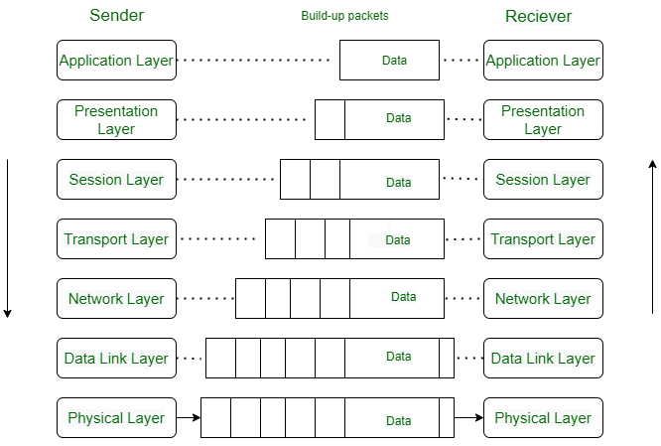
Fair Composition - Some Definitions
The idea – composing self-stabilizing algorithms AL₁,...,AL_{k} so that the stabilized behavior of AL₁,AL₂,...,AL_{i} is used by AL_{i+1}
AL_{i+1} cannot detect whether the algorithms have stabilized, but it is executed as if they have done so
https://www.geeksforgeeks.org/open-systems-interconnection-model-osi/
Notes:
The technique is described for k=2 :
* Two simple algorithms, called a server algorithm and a client algorithm, are combined to obtain a more complex algorithm
* The server algorithm ensures that some properties will hold, and these properties are later used by the client algorithm

Slide 44
Fair Composition - Some Definitions
The idea – composing self-stabilizing algorithms AL₁,...,AL_{k} so that the stabilized behavior of AL₁,AL₂,...,AL_{i} is used by AL_{i+1}
AL_{i+1} cannot detect whether the algorithms have stabilized, but it is executed as if they have done so
The technique is described for k=2:
2 simple algorithms, a server and a client, are combined to obtain a more complex algorithm
The server ensures that some properties will hold to be used by the client
Notes:
The technique is described for k=2 :
* Two simple algorithms, called a server algorithm and a client algorithm, are combined to obtain a more complex algorithm
* The server algorithm ensures that some properties will hold, and these properties are later used by the client algorithm

Slide 45
Fair Composition - More Definitions
Assume the server algorithm AL₁ is for a task defined by a set of legal execution T₁, and the client algorithm AL₂ for T₂
Let A_{i} be the state set of p_{i} in AL₁ and S_{i}= A_{i}×B_{i} the state set of p_{i} in AL₂, where whenever p_{i} executes AL₂, it modifies only the B_{i} components of A_{i}×B_{i}
For a configuration c ∈ S₁× … ×S_{n} , define the A-projection of c as the configuration (ap₁, … , ap_{n}) ∈ A₁× … ×A_{n}
The A-projection of an execution - consist of the A-projection of every configuration of the execution
Notes:
* Assume server algorithm AL₁ is for a task defined by a set of legal execution T₁, and that the client algorithm AL₂ is for a task defined by a set of legal execution T₂
* Let A_{i} be the state set of P_{i} in AL₁ and S_{i}= A_{i}×B_{i} the state set of P_{i} in AL₂ ,where whenever P_{i} executes AL₂ , it modifies only the B_{i} components of A_{i}×B_{i}
* For a configuration c ∈ S₁× … ×S_{n} , define the A-projection of c as the configuration (ap₁, … , ap_{n}) ∈ A₁× … ×A_{n}
* The A-projection of an execution is defined analogously to consist of the A-projection of every configuration of the execution

Slide 46
Fair Composition - More Definitions …
AL₂ is self-stabilizing for task T₂ given task T₁ if any fair execution of AL₂ that has an A-projection in T₁ has a suffix in T₂
AL is a fair composition of AL₁ and AL₂ if, in AL, every processor execute steps of AL₁ and AL₂ alternately
Assume AL₂ is self-stabilizing for task T₂ given task T₁. If AL₁ is self-stabilizing for T₁, then the fair composition of AL₁ and AL₂ is self-stabilizing for T₂ (Theorem 2.2)
Notes:
* We say that algorithm AL₂ is self-stabilizing for task T₂ given task T₁ if any fair execution of AL₂ that has an A-projection in T₁ has a suffix in T₂
* An algorithm AL is a fair composition of AL₁ and AL₂ if, in AL, every processor execute steps of AL₁ and AL₂ alternately
* Note: for an execution E at AL, the A-projection of E is a sub-execution of E corresponding to a fair execution of the server algorithm AL₁
* Theorem (2.2) : Assume that AL₂ is self-stabilizing for task T₂ given task T₁. If AL₁ is self-stabilizing for T₁, then the fair composition of AL₁ and AL₂ is self-stabilizing for T₂

Slide 47
Example: Mutual Exclusion for General Communication Graphs
Will demonstrate the power of fair composition method
We only know two self-stabilizing algorithm
What will we do?
Notes:
The server algorithm is the spanning-tree construction
The client algorithm is the mutual exclusion

Slide 48
Example: Mutual Exclusion for General Communication Graphs
Will demonstrate the power of fair composition method
We only know two self-stabilizing algorithm
What will we do? Compose the spanning-tree construction algorithm with the mutual exclusion algorithm
Server
0
Client
3
1
1
2
1
2
2
Notes:
The server algorithm is the spanning-tree construction
The client algorithm is the mutual exclusion

Slide 49
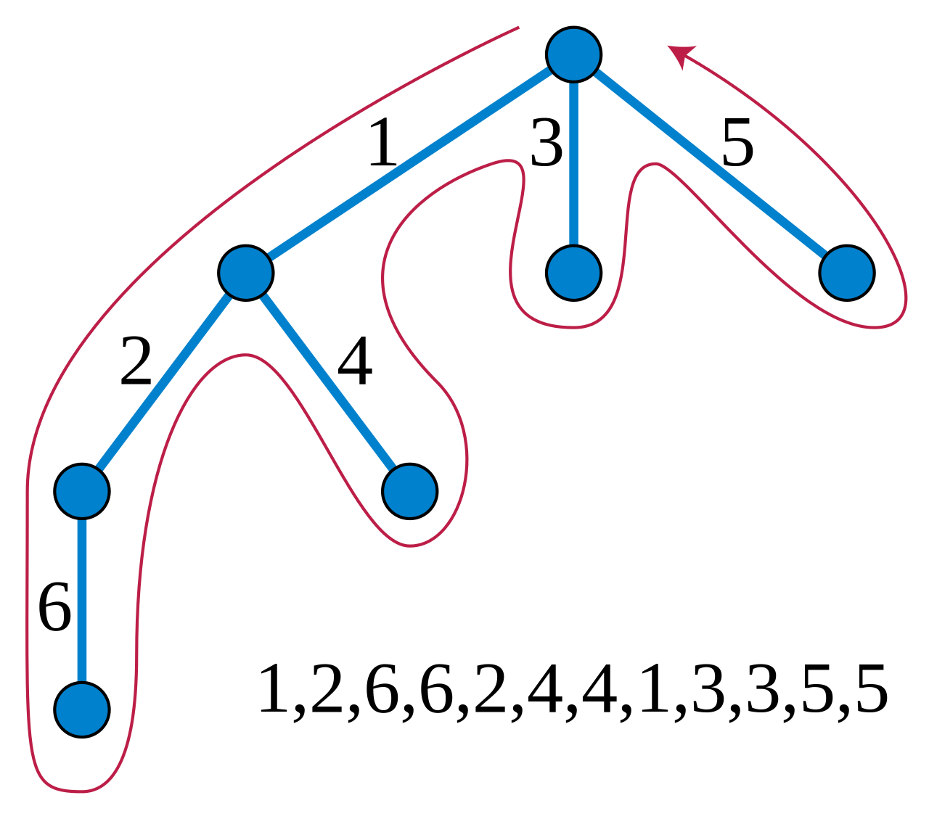
Euler Tour Technique
Euler tour of a rooted tree, with edges labeled to show the order in which they are traversed by the tour
see https://en.wikipedia.org/wiki/Euler_tour_technique

Slide 50
Modified Ver. of the Mutual Exclusion Algorithm
Designed to stabilize in a system in which a rooted spanning tree exists and in which only read/write atomicity is assumed
Euler tour defines a virtual ring
p₁
r_{1,4}
lr_{4,1}
lr_{2,1}
lr_{3,1}
r_{1,3}
r_{1,2}
p₄
r_{4,1}
p₂
r_{2,1}
r_{3,1}
p₃
lr_{1,4}
lr_{1,2}
lr_{1,3}

Slide 51
Mutual Exclusion for Tree Structure, for p_{i}
01 Root: do forever
02 lr_{1,i} := read (r_{1,i})
03 if lr_{δ,i} = r_{i,1} then
04 (* critical section*)
05 write r_{i,2} := (lr_{1,i} + 1 mod (4n -5))
06 for m := 2 to δ do
07 lr_{m,i} = read(r_{m,i} )
08 write r_{i,m+1} := lr_{m,i}
09 od
10 od
11 Other: do forever
12 lr_{1,i} := read (r_{1,i})
13 if lr_{1,i} ≠ r_{i,2}
14 (* critical section*)
15 write r_{i,2} := lr_{1,i}
16 for m := 2 to δ do
17 lr_{m,i} := read (r_{m,i})
18 write r_{i,m+1} := lr_{m,i}
19 od
20 od

Slide 52
Mutual Exclusion for Communication Graphs
Mutual-exclusion can be applied to a spanning tree of the system using the ring defined by the Euler tour
NB: a parent field in the spanning-tree defines the parent of each processor in the tree
When the server reaches the stabilizing state, the mutual-exclusion algorithm is in an arbitrary state, from there converges to reach the safe configuration
Notes:
Let α_{i} = i₁, i₂, … , i_{δ} be the arbitrary ordering of the tree edges incident to a non-root node v_{i} ∈V, where the first edge is the edge leading to the parent of v_{i} in the tree
*…(page 25)
he mutual-exclusion algorithm can be applied to a spanning tree of the system using the ring defined by the Euler tour on the tree
* Note - the value of the parent fields of the server algorithm (spanning-tree) eventually defines the parent of each processor in the tree
* Until the server algorithm reaches the stabilized state the clients execution may not be as considered during the design of the algorithm. Consequently, once the tree is fixed, the self-stabilizing mutual-exclusion algorithm is in an arbitrary state from which it converges to reach a safe configuration

Slide 53
Summary
Presented solution for BFS construction
Learnt about fair composition
Proposed a solution for token circulation in a general networks that have one distinguished processor

