Slide 1
COMP3028 Software Architecture
Patterns and Tactics

Slide 2
What is a Pattern?
An architecture pattern is a package of design decisions that is found repeatedly in practice
An architecture pattern has known properties that permits reuse, and describes a class of architectures

Slide 3
Architectural Patterns
Module patterns
Layered pattern
Component-and-Connector patterns
Broker pattern
Model-View-Controller pattern
Pipe-and-Filter pattern
Client-Server pattern
Peer-to-Peer pattern
Service-Oriented Architecture (SOA) pattern
Publish-Subscribe pattern
Shared-Data pattern
Allocation patterns
Map-Reduce pattern
Multi-tier Pattern

Slide 4
Layer Pattern
Context: Modules of the system may be independently developed and maintained.
Problem: To minimize the interaction among the different development organizations, and support portability, modifiability, and reuse.

Slide 5
Layer Pattern
Solution: the layered pattern divides the software into units called layers.
Each layer is a grouping of modules that offers a cohesive set of services.
Each layer is exposed through a public interface.
The usage must be unidirectional.

Slide 6
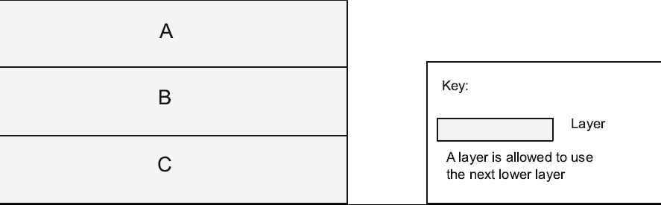
Layer Pattern Example

Slide 7
Layer Pattern Solution
The layered pattern defines layers and a unidirectional allowed-to-use relation among the layers.
Elements: Layer, a kind of module.
Relations: Allowed to use.
Constraints:
Every piece of software is allocated to exactly one layer.
There are at least two layers
The allowed-to-use relations should not be circular
Weaknesses:
The addition of layers adds up cost and complexity to a system.
Layers contribute a performance penalty.

Slide 8
Example of a three layered applications
UI
Web UI
Rich Client
Command Line
Business Logic
Data Access
Local Data Access
Remote Data Access

Slide 9
Broker Pattern
Context: Many systems are constructed from a collection of services distributed across multiple servers
Problem: How do we structure distributed software so that service users do not need to know the nature and location of service providers?
Solution: The broker pattern separates clients from providers servers by inserting an intermediary, called a broker.
When a client needs a service, it queries a broker via a service interface. The broker then forwards the client’s service request to a server, which processes the request.

Slide 10
Broker Solution
Overview: The broker pattern defines a runtime component, called a broker, that mediates the communication between a number of clients and servers.
Elements:
Client, a requester of services
Server, a provider of services
Broker, an intermediary that locates an appropriate server to fulfill a client’s request, forwards the request to the server, and returns the results to the client
Constraints: The client can only attach to a broker. The server can only attach to a broker.
Weaknesses:
Brokers add latency between clients and servers, and it may be a communication bottleneck.
The broker can be a single point of failure (this means if just this single component fails, the whole system fails)
A broker may be a target for security attacks.

Slide 11
Model-View-Controller Pattern
Context: User interface software is the most frequently modified portion of an interactive application.
Problem: How can user interface functionality be kept separate from application functionality and yet still be responsive to user input, or to changes in the underlying application’s data?
And how can multiple views of the user interface be created, maintained, and coordinated when the underlying application data changes?

Slide 12
Model-View-Controller Pattern
Solution: The model-view-controller (MVC) pattern separates application functionality into three kinds of components:
A model, which contains the application’s data
A view, which displays some portion of the underlying data and interacts with the user
A controller, which mediates between the model and the view and manages the notifications of state changes

Slide 13
MVC Solution
Elements: the model , view, and controller
Relations: The notifies relation connects instances of model, view, and controller, notifying elements of relevant state changes.
Constraints:
There must be at least one instance for each of model, view, and controller.
The model component should not interact directly with the controller.
Weaknesses:
The complexity may not be worth it for simple user interfaces.

Slide 14
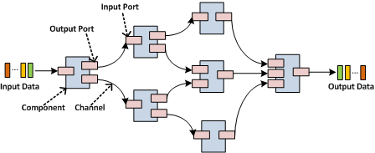
Pipe and Filter Pattern
Context: Streaming data processing
Problem: How to speed up the data processing?
Solution: Data arrives at a filter’s input port, is transformed, and then is passed via its output port through a pipe to the next filter.
A single filter can consume data from, or produce data to, one or more ports.

Slide 15
Pipe and Filter Solution
Elements:
Filter, which is a component that transforms data read on its input port to data written on its output port.
Pipe, which is a connector that conveys data from a filter’s output port to another filter’s input port.
Relations: The attachment relation associates the output of filters with the input of pipes and vice versa.
Constraints:
Connected filters must agree on the type of data being passed along the connecting pipe.

Slide 16
Client-Server Pattern
Context: There are shared resources and services that large numbers of distributed clients wish to access, and for which we wish to control access or quality of service.
Problem: To improve scalability and availability by centralizing the control of these resources and services.
Solution: Clients interact by requesting services of servers.
Some components may act as both clients and servers. There may be one central server or multiple distributed ones.

Slide 17
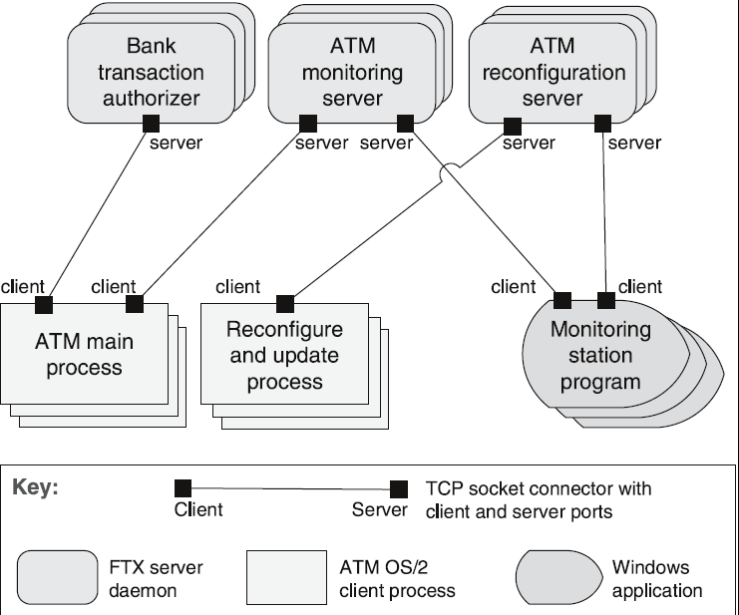
Client-Server Example

Slide 18
Client-Server Solution
Elements:
Client, a component that invokes services of a server component.
Server: a component that provides services to clients. Servers have ports that describe the services they provide.
Request/reply connector: a data connector employing a request/reply protocol. Important characteristics include whether the calls are local or remote, and whether data is encrypted.

Slide 19
Client-Server Solution
Relations: The attachment relation associates clients with servers.
Constraints:
Clients are connected to servers through request/reply connectors.
Server components can be clients to other servers.
Weaknesses:
Server can be a performance bottleneck.
Server can be a single point of failure.
Decisions about where to locate functionality (in the client or in the server) are often complex and costly to change after a system has been built.

Slide 20
Peer-to-Peer Pattern
Context: Distributed computational entities need to cooperate and collaborate to provide a service to a distributed community of users.
Problem: How can a set of “equal” distributed computational entities be connected to each other via a common protocol, such that they can organize and share their services with high availability and scalability?
Solution: In the peer-to-peer (P2P) pattern, components directly interact as peers. All peers are “equal”.
Peer-to-peer communication is typically a request/reply interaction without the asymmetry found in the client-server pattern.

Slide 21
Peer-to-Peer Solution
Elements:
Peer, which is an independent component running on a network node.
Request/reply connector, which is used to connect to the peer network.
Relations: The relation associates peers with their connectors. Attachments may change at runtime.
Constraints:
The number of allowable attachments to any given peer
The number of hops used for searching for a peer
Which peers know about which other peers
Some P2P networks are organized with star topologies, in which peers only connect to supernodes.
Weaknesses:
Managing data consistency, data/service availability, backup, and recovery are all more complex.
Small peer-to-peer systems may not be able to achieve quality goals such as performance and availability.

Slide 22
Service Oriented Architecture Pattern
Context: Service consumers need to be able to understand and use services without any knowledge of their implementation.
Problem: How can we support interoperability of distributed components running on different platforms and written in different implementation languages, provided by different organizations, and distributed across the Internet?
Solution: The service-oriented architecture (SOA) pattern describes a collection of distributed components that provide and/or consume services.

Slide 23
Service Oriented Architecture Solution - 1
Elements:
Components:
Service providers, which provide one or more services through published interfaces.
Service consumers, which invoke services directly or through an intermediary.
Enterprise Service Bus (ESB), which is an intermediary element that can route and transform messages between service providers and consumers.
Registry of services, which may be used by providers to register their services and by consumers to discover services at runtime.

Slide 24
Service Oriented Architecture Solution - 2
Connectors:
SOAP connector, which uses the SOAP protocol for synchronous communication between web services, typically over HTTP.
REST connector, which relies on the basic request/reply operations of the HTTP protocol.
Asynchronous messaging connector, which uses a messaging system to offer point-to-point or publish-subscribe asynchronous message exchanges.

Slide 25
Service Oriented Architecture Solution - 3
Constraints: Service consumers are connected to service providers, but intermediary components (e.g., ESB, registry) may be used.
Weaknesses:
You don’t control the evolution of independent services.
There is a performance overhead associated with the middleware, which may be performance bottlenecks, and typically do not provide performance guarantees.

Slide 26
Publish-Subscribe Pattern
Context: The precise number and nature of the data producers and consumers are not predetermined or fixed.
Problem: To transmit messages among the producers and consumers so they are unaware of each other’s identity, or even their existence?

Slide 27
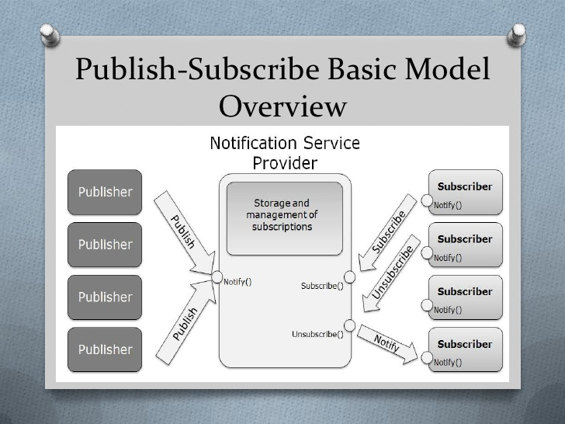
Publish-Subscribe Example

Slide 28
Shared-Data Pattern
Context: Various computational components need to share and manipulate large amounts of data. This data does not belong solely to any one of those components.
Problem: How can systems store and manipulate persistent data that is accessed by multiple independent components?
Solution: In the shared-data pattern, interaction is dominated by the exchange of persistent data between multiple data accessors and at least one shared-data store.
Exchange may be initiated by the accessors or the data store. The connector type is data reading and writing.

Slide 29
Shared Data Solution - 1
Communication between data accessors is mediated by a shared data store.
Data is made persistent by the data store.
Elements:
Shared-data store. Concerns include types of data stored, data distribution, and number of accessors permitted.
Data accessor
Data reading and writing connector.

Slide 30
Shared Data Solution - 2
Constraints: Data accessors interact only with the data store(s).
Weaknesses:
The shared-data store may be a performance bottleneck.
The shared-data store may be a single point of failure.
Producers and consumers of data may be tightly coupled. E.g., concurrency control is needed in database

Slide 31
Google File System (GFS)
Notes:
Fault-tolerance:
heart beat message between Master and ChunkServers
data replication

Slide 32
MapReduce Pattern
Origin from Google, [OSDI’04]
A simple programming model
Functional model
For large-scale data processing
Exploits large set of commodity computers
Executes process in distributed manner
Offers high availability

Slide 33
Multi-Tier Pattern
The execution structures of many systems are organized as a set of logical groupings of software and hardware.
Each grouping is termed a tier.

Slide 34
Multi-Tier Example

Slide 35
In this session we have studied some useful architectural patterns
Earlier, we have studied tactics for different quality attributes
Let us see what are the relationships between them

Slide 36
Relationships Between Tactics and Patterns
Patterns are built from tactics; if a pattern is a molecule, a tactic is an atom.
For example, MVC pattern utilizes the tactics:
Increase semantic coherence
Encapsulation
Use an intermediary

Slide 37
Relationships Between Tactics and Patterns
Tactics Augment Patterns
Patterns solve a specific problem but may have weaknesses with respect to other qualities.
Consider the broker pattern
May have performance bottlenecks
May have a single point of failure

Slide 38
Example
You decided to use the broker pattern in the system you are designing.
The system also has high availability requirements.
You are aware that one of the weaknesses of the broker pattern is that the broker may become a single point of failure, therefore the availability might be compromised.
How to solve this problem?

Slide 39

Multiple Choice(single)
Points: 1
Remark
You decided to use the broker pattern in the system you are designing. The system also has high availability requirements. You are aware that one of the weaknesses of the broker pattern is that the broker may become a single point of failure, therefore the availability might be compromised. How to solve this problem?
For example, we can use the availability tactics “maintain multiple copies” – add more brokers to the system
A
There is nothing we can do
B
We can augment the broker pattern by using some tactics for availability
C
Use another pattern
Submit
Text\Image\Formula are allowed and all the content should be placed in this area

Slide 40
Relationships Between Tactics and Patterns
Tactics Augment Patterns
Patterns solve a specific problem but may have weaknesses with respect to other qualities.
Consider the broker pattern
May have performance bottlenecks
May have a single point of failure
We can solve these problems by using tactics such as
Increase resources will help performance
Maintain multiple copies will help availability

Slide 41
We have just studied the relationships between patterns and tactics
The next question we will study is what are the interactions between the tactics? How do we use tactics together?

Slide 42
Tactics and Interactions
Each tactic has pluses (its reason for being) and minuses – side effects.
Use of tactics can help alleviate the minuses.
But nothing is free…

Slide 43
Tactics and Interactions - example
Assume we want to design a system with high availability requirements
We will use a common tactic for detecting faults - Ping/Echo.
Notes:
Tactic is fine grain adjustment of quality attributes within a pattern

Slide 44
Tactics and Interactions - example
However, common side-effects of Ping/Echo are:
security: how to prevent a ping flood attack?
performance: how to ensure that the performance overhead of ping/echo is small?
modifiability: how to add ping/echo to the existing architecture?
Notes:
Tactic is fine grain adjustment of quality attributes within a pattern

Slide 45
Tactics and Interactions - example
System
Ping/Echo
Add to
system
Ping
flood
Performance
overhead
Notes:
Tactic is fine grain adjustment of quality attributes within a pattern

Slide 46
Multiple Choice(single)
Points: 1
Remark
What is the next step we can take?
A
There is nothing we can do
B
Use tactics for performance
Submit
Text\Image\Formula are allowed and all the content should be placed in this area

Slide 47
Open Question
Points: 10
What tactics for performance can we use?
Open Question is only supported on Version 2.0 or newer.
Answer

Slide 48
Tactics and Interactions - example
A tactic to address the performance side-effect that we will use is “Increase Available Resources”.
Notes:
Tactic is fine grain adjustment of quality attributes within a pattern

Slide 49
Open Question
Points: 10
Remark
Will using the tactics “increase available resources” introduce any side effects to the system?
Yes, for example, cost: increased resources cost more
performance: how to utilize the increase resources efficiently?
Open Question is only supported on Version 2.0 or newer.
Answer
Text\Image\Formula are allowed and all the content should be placed in this area

Slide 50
Tactics and Interactions - example
Common side effects of Increase Available Resources are:
cost: increased resources cost more
performance: how to utilize the increase resources efficiently?
Notes:
Tactic is fine grain adjustment of quality attributes within a pattern

Slide 51
Tactics and Interactions - example
System
Ping/Echo
Add to
system
Ping
flood
Performance
overhead
Increase Available
Resources
Cost
Resource
Utilization
Notes:
Tactic is fine grain adjustment of quality attributes within a pattern

Slide 52
Open Question
Points: 10
Remark
What is the next step we can take?
Address the problem of the efficient use of resources side-effect by applying relevant performance tactics
Open Question is only supported on Version 2.0 or newer.
Answer
Text\Image\Formula are allowed and all the content should be placed in this area

Slide 53
Tactics and Interactions - example
A tactic to address the efficient use of resources side-effect is “Scheduling Policy”.
Notes:
Tactic is fine grain adjustment of quality attributes within a pattern

Slide 54
Tactics and Interactions - example
However, common side effects of Scheduling Policy are:
modifiability: how to add the scheduling policy to the existing architecture
modifiability: how to change the scheduling policy in the future?
Notes:
Tactic is fine grain adjustment of quality attributes within a pattern

Slide 55
Tactics and Interactions - example
System
Ping/Echo
Add to
system
Ping
flood
Performance
overhead
Increase Available
Resources
Cost
Resource
Utilization
Scheduling
Policy
Add to
system
Modify
policy
Notes:
Tactic is fine grain adjustment of quality attributes within a pattern

Slide 56
Tactics and Interactions - example
A tactic to address the addition of the scheduler to the system is “Use an Intermediary”.
Common side effects of Use an Intermediary are:
modifiability: how to ensure that all communication passes through the intermediary?
Notes:
Tactic is fine grain adjustment of quality attributes within a pattern

Slide 57
How Does This Process End?
Each use of tactic introduces new concerns.
Each new concern causes new tactics to be added.
Are we in an infinite progression?

Slide 58
How Does This Process End?
Each use of tactic introduces new concerns.
Each new concern causes new tactics to be added.
Are we in an infinite progression?
No. Eventually the side-effects of each tactic become small enough to ignore.

Slide 59
Summary
An architectural pattern
is a package of design decisions that is found repeatedly in practice,
has known properties that permit reuse, and
describes a class of architectures.
Tactics are simpler than patterns
Patterns are underspecified with respect to real systems so they have to be augmented with tactics.
Augmentation ends when requirements for a specific system are satisfied.

