Slide 1
COMP3028 Software Architecture
Designing for architecturally significant requirements

Slide 2
Architecturally Significant Requirement
Architectures exist to build systems that satisfy requirements.
But, to an architect, not all requirements are created equal.
An Architecturally Significant Requirement (ASR) is a requirement that will have a profound effect on the architecture.
How do we find those?

Slide 3
Approaches to Capture ASRs
From Requirements Document
By Interviewing Stakeholders
By Understanding the Business Goals
In Utility Tree

Slide 4
ASRs and Requirements Documents
An obvious location to look for candidate ASRs is in the requirements documents
Requirements should be in requirements documents!
Unfortunately, this is not usually the case.

Slide 5
Don’t Get Your Hopes Up
Many projects don’t create or maintain the detailed, high-quality requirements documents.
Standard requirements pay more attention to functionality than quality attributes.
The architecture is driven by quality attribute requirements rather than functionalities
Most requirements specification does not affect the architecture.
Quality attributes are often captured poorly, e.g.
“The system shall be modular”
“The system shall exhibit high usability”
“The system shall meet users’ performance expectations”
Much of what is useful to an architect is not in even the best requirements document
ASRs often derive from business goals in the development organization itself

Slide 6
Gathering ASRs from Stakeholders
Stakeholders often have no idea what QAs they want in a system
if you insist on quantitative QA requirements, you’re likely to get numbers that are arbitrary.
at least some of those requirements will be very difficult to satisfy.
Architects often have very good ideas about what QAs are reasonable to provide.
Interviewing the stakeholders is the surest way to learn what they know and need.

Slide 7

Multiple Choice(single)
Points: 1
“The system shall meet users’ performance expectations”- this is an example of a poorly captured quality attribute requirement. Do you know a tool to help us express quality requirements in a better way?
A
No, there is no better way.
B
There should be a better way, but I do not know how
C
Yes – use a quality attribute scenario and make sure all 6 parts are included
Submit

Slide 8
Gathering ASRs from Stakeholders
The results of stakeholder interviews should include
a list of architectural drivers
a set of QA scenarios that the stakeholders (as a group) prioritized.
This information can be used to:
refine system and software requirements
understand and clarify the system’s architectural drivers
provide rationale for why the architect subsequently made certain design decisions
guide the development of prototypes and simulations
influence the order in which the architecture is developed.

Slide 9
Quality Attribute Workshop
The QAW is a facilitated, stakeholder-focused method to generate, prioritize, and refine quality attribute scenarios before the software architecture is completed.

Slide 10
Quality Attribute Scenario: Example
Our vehicle information system sends our current location to the traffic monitoring system.
The traffic monitoring system combines our location with other information, overlays this information on a Google Map, and broadcasts it.
Our location information is correctly included with a probability of 99.9%.

Slide 11
Quality Attribute Scenario: Example
The developer wishes to change the user interface by modifying the code at design time. The modifications are made with no side effects within three hours.
Stimulus – Wishes to change UI
Artifact – Code
Environment: Design time
Response – Change made
Response measure – No side effects in three hours
Source - Developer

Slide 12
Quality Attribute Scenario: Example
Users initiate transactions under normal operations. The system processes the transactions with an average latency of two seconds.
Stimulus: transaction arrivals
Source: users
Artifact: the system
Response: process the transactions
Response measure: average latency of two seconds
Environment: under normal operation

Slide 13
Quality Attribute Scenario: Example
A disgruntled employee from a remote location attempts to modify the pay rate table during normal operations. The system maintains an audit trail and the correct data is restored within a day.
Stimulus: unauthorized attempts to modify the pay rate table
Stimulus source: a disgruntled employee
Artifact: the system with pay rate table
Environment: during normal operation
Response: maintains an audit trail
Response measure: correct data is restored within a day

Slide 14
Quality Attribute Scenario: Example
The user downloads a new application and is using it productively after two minutes of experimentation.
Source: user
Stimulus: download a new application
Artifact: system
Environment: runtime
Response: user uses application productively
Response measure: within two minutes of experimentation

Slide 15
Quality Attribute Workshop
The QAW is a facilitated, stakeholder-focused method to generate, prioritize, and refine quality attribute scenarios before the software architecture is completed.

Slide 16
QAW Steps
Step 1: QAW Presentation and Introductions.
QAW facilitators describe the motivation for the QAW and explain each step of the QAW.
Step 2: Business/Mission Presentation.
The stakeholder representing the business concerns presents the system’s business context, broad functional requirements, constraints, and known quality attribute requirements.
The quality attributes will be derived largely from the business/mission needs
Step 3: Architectural Plan Presentation.
The architect will present the system architectural plans
This lets stakeholders know the current architectural thinking

Slide 17
QAW Steps
Step 4: Identification of Architectural Drivers.
The facilitators will share their list of key architectural drivers assembled during Steps 2 and 3,
Architectural drivers includes overall requirements, business drivers, constraints, and quality attributes.
ask the stakeholders for clarifications, additions, deletions, and corrections, and achieve a consensus on the architectural drivers

Slide 18
QAW Steps
Step 5: Scenario Brainstorming.
Each stakeholder expresses a scenario representing his or her concerns with respect to the system.
Facilitators ensure that each scenario has an explicit stimulus and response.
Make at least one representative scenario for each architectural driver listed in Step 4.

Slide 19
QAW Steps
Step 6: Scenario Consolidation.
Similar scenarios are consolidated where reasonable.
Step 7: Scenario Prioritization.
Allocating each stakeholder a number of votes equal to 30 percent of the total number of scenarios
Each stakeholder allocate their votes to scenario
Step 8: Scenario Refinement.
The top scenarios are refined and elaborated.
Facilitators help the stakeholders put the scenarios in the six-part scenario form

Slide 20
Capturing ASRs in a Utility Tree
An ASR must have the following characteristics:
A profound impact on the architecture
Including this requirement will very likely result in a different architecture than if it were not included.
A high business or mission value
If the architecture is going to satisfy this requirement it must be of high value to important stakeholders.

Slide 21
Utility Tree
A way to record ASRs all in one place.
Establishes priority of each ASR in terms of
Impact on architecture
Business or mission value
ASRs are captured as scenarios.
Root of tree is placeholder node called “Utility”.
Second level of tree contains broad QA categories.
Third level of tree refines those categories.
Leaf nodes are the concrete quality attribute scenarios

Slide 22
Utility Tree Example (excerpt)
Utility
Key:
H=high
M=medium
L=low
components
…

Slide 23
Utility Tree: Next Steps
ASRs that rate a (H,H) rating are the ones that deserve the most attention
A very large number of these might be a cause for concern: Is the system achievable?
Stakeholders can review the utility tree to make sure their concerns are addressed.

Slide 24
Tying the Methods Together
How should you employ requirements documents, stakeholder interviews, Quality Attribute Workshops, and utility trees together?
If important stakeholders have been overlooked in the requirements-gathering process, use interviews or a QAW.
Use a quality attribute utility tree as a repository for the scenarios produced by a QAW.

Slide 25
Reminder
Next week, we will start practical exercises in which we will design parts of the architecture for a real system.
In the first session, we will collect the ASR for this system and build a utility tree.

Slide 26
Designing an Architecture

Slide 27
Design Strategy
Decomposition
Designing to Architecturally Significant Requirements
Generate and Test

Slide 28
Decomposition
Architecture determines quality attributes
Important quality attributes are characteristics of the whole system.
Design begins with the whole system
The whole system is decomposed into parts
Each part may inherit all or part of the quality attribute requirements

Slide 29
Design Doesn’t Mean Green Field
If you are given components to be used in the final design, then the decomposition must accommodate those components.
New component
New
Component
Given components
New
Component
New
Component

Slide 30
Designing to Architecturally Significant Requirements
Remember architecturally significant requirements (ASRs)?
These are the requirements that you must satisfy with the design
There are a small number of these
They are the most important (by definition)
Two questions:
What happens to the other requirement?
Do I design for one ASR at a time or all at once?

Slide 31
What About Other Quality Requirements?
If your design does not satisfy a particular non ASR quality requirement
Adjust your design so that the ASRs are still satisfied and so is this additional requirement or
Weaken the additional requirement so that it can be satisfied either by the current design or by a modification of the current design or
Change the priorities so that the one not satisfied becomes one of the ASRs or
Declare the additional requirement non-satisfiable in conjunction with the ASRs.

Slide 32
How Many ASRs Simultaneously?
If you are inexperienced in design then design for the ASRs one at a time beginning with the most important.
As you gain experience, you will be able to design for multiple ASRs simultaneously.

Slide 33
Generate and Test
View the current design as a hypothesis.
Ask whether the current design satisfies the requirements (test)
If not, then generate a new hypothesis
Generate Initial Hypothesis
Test hypothesis
Generate Next Hypothesis

Slide 34
Raises the Following Questions
Where does initial hypothesis come from?
How do I test a hypothesis?
How do I generate the next hypothesis?
When am I done?

Slide 35
Where Does the Initial Hypothesis Come From?
Existing systems
Very few systems are completely constructed from the scratch
Frameworks
A partial design that provides services that are common in particular domains, e.g., web applications, middleware
A design framework may constrain communication to be via a broker, or publish-subscribe system

Slide 36
Where Does the Initial Hypothesis Come From?
Less desirable sources
Patterns and tactics
Design checklists
Why “less desirable”?
The less desirable ones do not cover all of the requirements.
They typically omit many of the quality attribute requirements.

Slide 37
How Do I Test a Hypothesis?
The analysis technique described previously
Design checklists from quality attribute discussion.
Architecturally significant requirements
What is the output of the tests?
List of requirements – either responsibilities or quality – not met by current design.

Slide 38
How Do I Generate the Next Hypothesis?
Add missing responsibilities.
Use tactics to adjust quality attribute behavior of hypothesis.
The choice of tactics will depend on which quality attribute requirements are not met.
Be mindful of the side effects of a tactic.

Slide 39
When Am I Done?
All ASRs are satisfied and/or…
You run out of budget for design activity
In this case, use the best hypothesis so far and begin implementation
To relax or eliminate the requirement
To argue for more budget

Slide 40
The Attribute-Driven Design Method
An iterative method. At each iteration you
Choose a part of the system to design.
Marshal all the architecturally significant requirements for that part.
Generate and test a design for that part.
ADD does not result in a complete design
Set of containers with responsibilities
Interactions and information flow among containers
Does not produce an API for containers.

Slide 41
ADD Inputs
Requirements
Functional, quality, constraints
A context description
What are the boundary of the system being designed?
What are the external systems, devices, users and environment conditions with which the system being designed must interact?

Slide 42
ADD Outputs
Architectural elements and their relationship
Responsibility of elements
Interactions
Information flow among the elements
Requirements
Functional
Quality
Constraints
ADD Process
Containers
Responsibilities
Interactions
Information flow

Slide 43
The Steps of ADD
Choose an element of the system to design.
Identify the ASRs for the chosen element.
Generate a design solution for the chosen element.
Inventory remaining requirements and select the input for the next iteration.
Repeat steps 1–4 until all the ASRs have been satisfied.

Slide 44
Step 1: Choose an Element of the System to Design
For green field designs, the element chosen is usually the whole system.
For legacy designs, the element is the portion to be added.
After the first iteration:
Whole System
Element 1
Element N

Slide 45
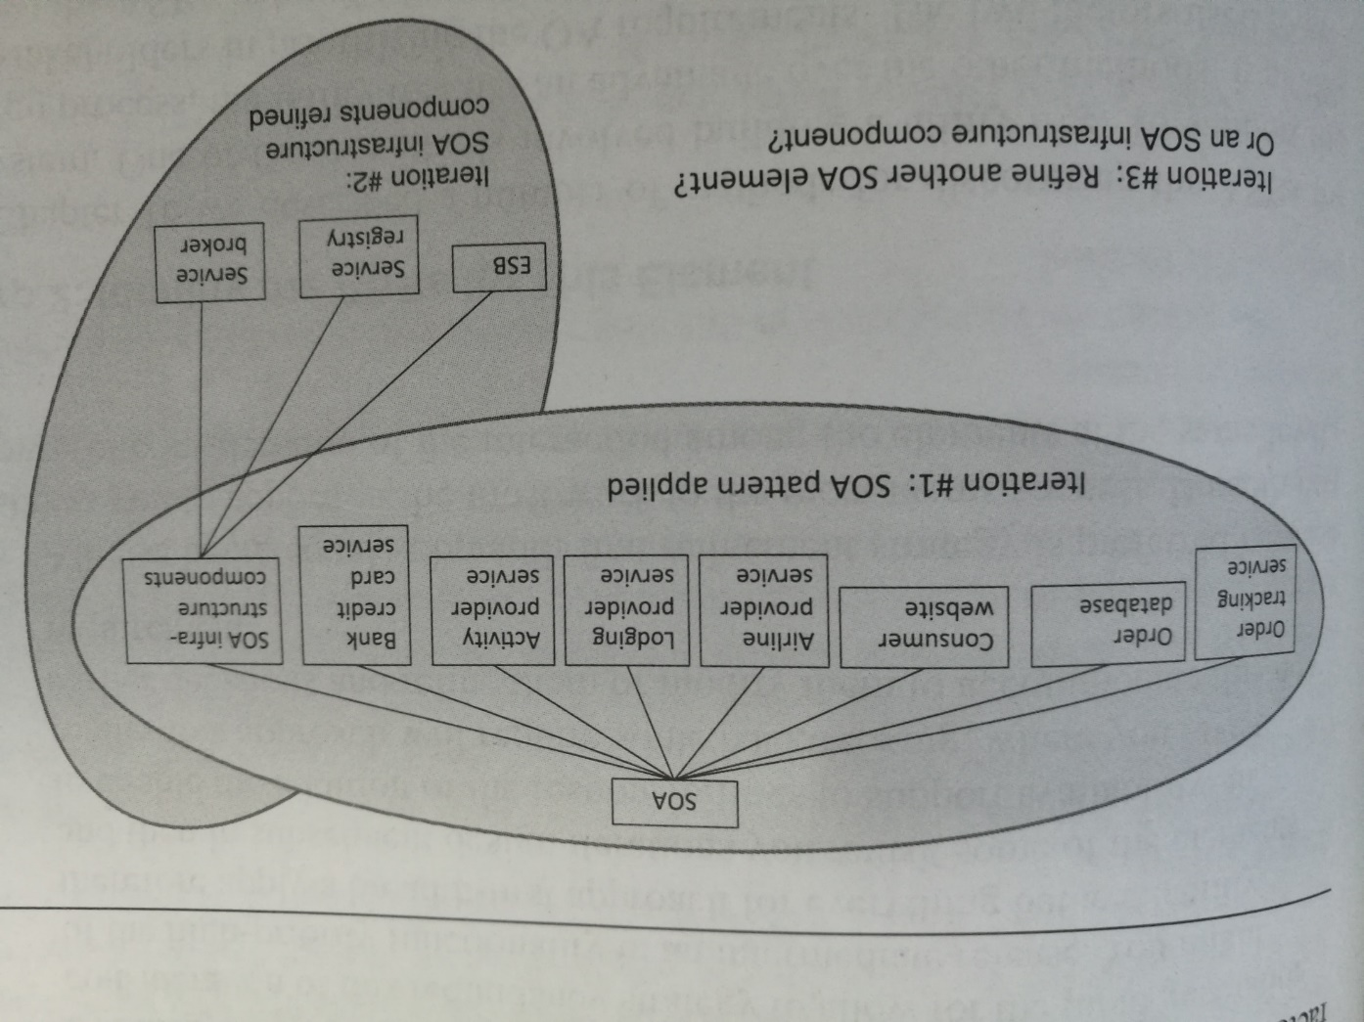

Slide 46
Step 1 example
We want to design a system for online travel agency

Slide 47
Step 1 example
In iteration #1, we decide to apply SOA pattern (Service Oriented Architecture, where functions of the system will become services)
We decompose our system into necessary components based on SOA pattern

Slide 48
Step 1 example
Then, we need to choose which part of the system to design next,
In iteration #2, we choose to further design SOA infrastructure components element
We decide to decompose it into 3 components

Slide 49
Step 1 example
Then, we need to choose which part of the system to design next,
In iteration #3, which element should we choose to design?
Refine one of the remaining SOA elements?
Refine one of the SOA infrastructure components?

Slide 50
Which Element Comes Next?
Two basic refinement strategies:
Breadth first
Depth first
Which one to choose?
If using new technology => depth first: explore the implications of using that technology.
If a team needs work => depth first: generate requirements for that team.
Otherwise => breadth first.

Slide 51
Step 2: Identify the ASRs for the Chosen Element
If the chosen element is the whole system, then use a utility tree (as described earlier).
If the chosen element is further down the decomposition tree, then generate a utility tree from the requirements for that element.

Slide 52
Step 3: Generate a Design Solution for the Chosen Element
Apply generate and test to the chosen element with its ASRs
Generate Initial Hypothesis
Test hypothesis
Generate Next Hypothesis

Slide 53
Step 4
Inventory remaining requirements and select the input for the next iteration
We need to consider 3 kinds of requirements
Functional requirements
Quality attribute requirements
Constraints

Slide 54
Step 4: Select the Input for the Next Iteration
For each functional requirement
Ensure that requirement has been satisfied.
If not, then add responsibilities to satisfy the requirement.
Add them to container with similar requirements
If no such container, may need to create new one or add to container with dissimilar responsibilities (coherence)
If container has too many requirements for a team, split it into two portions. Try to achieve loose coupling when splitting.

Slide 55
Quality Attribute Requirements
If the quality attribute requirement has been satisfied, it does not need to be further considered.
If the quality attribute requirement has not been satisfied then either
Delegate it to one of the child elements
Split it among the child elements
If the quality attribute cannot be satisfied, see if it can be weakened. If it cannot be satisfied or weakened then it cannot be met.

Slide 56
Constraints
Constraints are treated as quality attribute requirements have been treated.
Satisfied
Delegated
Split
Unsatisfiable

Slide 57
Repeat Steps 1–4 Until All ASRs are Satisfied
At end of step 4, each child element will have associated with it a set of:
functional requirements,
quality attribute requirements, and
constraints.
This sets up the child element for the next iteration of the method.

Slide 58
Summary
Architectures are driven by Architecturally Significant Requirements (ASRs):
requirements that will have profound effects on the architecture.
ASRs may be captured
from requirements documents,
by interviewing stakeholders, or
by conducting a Quality Attribute Workshop.
A useful representation of quality attribute requirements is in a utility tree.
The utility tree helps to capture these requirements in a structured form.
Scenarios are prioritized.
This prioritized set defines your “marching orders” as an architect.
Designing Strategies
Decomposition
Designing to Architecturally Significant Requirements
Generate and Test

