Slide 1
COMP3028
Software Architecture
Introduction to
Software Architecture

Slide 2
Software architecture
- main concepts

Slide 3
Architecture
The process of planning, designing and constructing structures
  Building
  Business
  Cognitive
  Computer
  Software
  …..

Slide 4
Software Architecture
– definition from our textbook
The software architecture of a system is the set of structures needed to reason about the system, which comprise software elements, relations among them, and properties of both.

Slide 5
Consider this example
You work as a software developer and your client asked you to develop a file sharing application for them.
  What kind of questions do you need to ask your client before you start your work? What information do you need to know?

Slide 6
Consider this example – cont.
Perhaps you ask your client what functions the software needs to have.
The client gave you these simple functional requirements.
  The application should enable sharing files with other users all around the world.
  Users need to be able to upload the files for sharing.
  Users need to be able to download the files they are interested in.
How will you design this software?

Slide 7
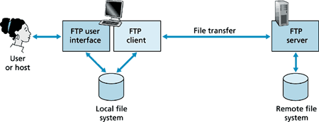
A simple solution
You decide to use a client-server model
There will be 2 main components
  Client - clients initiate the transfer
  Server – servers satisfy the request
In your design, the server is centralized and there can be many clients requesting the files from the server
In fact, the same model is used in The File Transfer Protocol (FTP) - a standard communication protocol used for the transfer of computer files from a server to a client on a computer network

Slide 8
Example – cont.
You develop the software based on this design, deploy it, and receive a feedback from the client that they are satisfied with the software.

Slide 9
Example – cont.
After a while, another client asks you to develop a software for them. After initial consultation, you find out that the functional requirements are almost the same
  The application should enable sharing files with other users all around the world → the same
  Users need to be able to upload the files for sharing → the same
  Users need to be able to download the files they are interested in →the same
  Users need to be able to delete the uploaded files → new function

Slide 10
Example – cont.
Since the functional requirements are the same, and the first client was happy with the software, you decide to use a client-server model for this project as well.
You also add additional functions for the users to meet the new functional requirements.

Slide 11
Example – cont.
You develop the software based on this design, deploy it, and receive a feedback from the client that they are NOT satisfied with the software.
What went wrong?

Slide 12
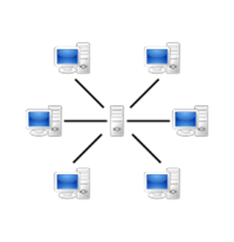
Example – cont.
After discussion with the client, you find out that the server crashes often and none of the users are able to download the file at this time.
You investigate further and find out that while the first client had less than a hundred of users of the software, the second client had thousands of users that made requests from the same server at the same time.
  The server became overloaded and this resulted in crashes or slowing down of the connection.

Slide 13
So what went wrong?
Although the two clients had the same functional requirements, but their quality requirements were different
  The quality requirements were not discussed at the early stages of software design.
  The choice of software architecture was not guided by the quality requirements.

Slide 14
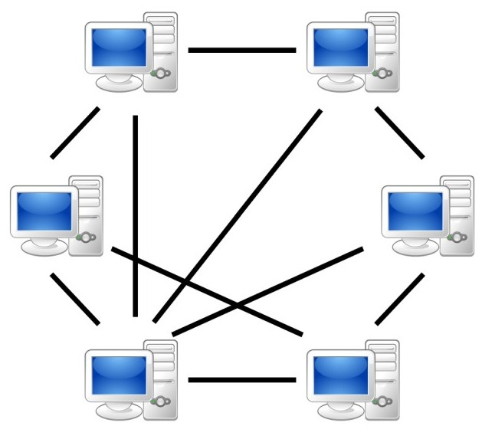
How to avoid this problem?
Select the software architecture that will be more fit for the quality requirements in the second scenario.
For example, for the second file sharing system, to avoid the bottleneck caused by the central server in client-server model, you can choose P2P architecture.

Slide 15
Example - conclusions
Two systems with the same functionality can have different architectures
  Architectural decisions are NOT made based on functional requirements
  Architecture is driven by quality requirements

Slide 16
Bonus conclusion
Two systems with different functionality can have the same architectures
Example→ client-server model can be used in
  File sharing systems
  Online banking
  Email
  Network printing
  Ecommerce
  …

Slide 17
Recall our course objectives
Master the basic knowledge and methods of software architecture
  have the ability of system analysis, modelling and design oriented to the particular scenario
  be able to make the best architectural design decisions according to the actual architectural requirements of large and complex software systems
Master the architecture technology of constructing modern large-scale and complex software system
  be able to select the best technology according to the architectural requirements of the actual software project

Slide 18
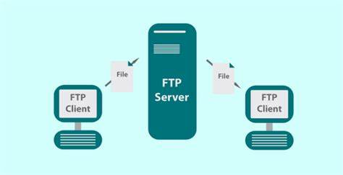
Recall Software Architecture definition
The software architecture of a system is the set of structures needed to reason about the system, which comprise software elements, relations among them, and properties of both.

Slide 19
Software Architecture
Structures of a software system
The discipline of creating such structures and systems

Slide 20
Software Architecture
= Structures of a software system
Each structure compromises
  Software elements
  Relations among the elements
  Properties of elements
  Properties of relations

Slide 21
Software Architecture
= the discipline of creating such structures and systems
Blueprint for the system and the developing project, laying out the task necessary to be executed by the design teams.

Slide 22
Software Architecture
The software architecture of a program or computing system is the structure or structures of the system, which comprise software elements, the externally visible properties of those elements, and the relationships among them.
Notes:
软件架构是指在一定的设计原则基础上，从不同角度对组成系统的各部分进行搭配和安排，形成系统的多个结构而组成架构，它包括该系统的各个组件，组件的外部可见属性及组件之间的相互关系。组件的外部可见属性是指其他组件对该组件所做的假设。

Slide 23
Architecture Is a Set of Software Structures
A structure is a set of elements held together by a relation.
Software systems are composed of many structures, and no single structure holds claim to being the architecture.
There are three important categories of architectural structures.
  Module
  Component and Connector
  Allocation

Slide 24
Architecture vs Design
The architecture - the selection of architectural elements, their interaction and the restrictions on those elements and their interactions.
The design - modularization and the detailed interfaces of the elements of the system, their algorithms and procedures, and the kinds of data needed to support the architecture and satisfy the requirements.

Slide 25
What is Software Architecture?
The software architecture of a system is the set of structures needed to reason about the system, which comprise software elements, relations among them, and properties of both.

Slide 26
Architecture is an Abstraction
An architecture specifically omits certain information about elements that is not useful for reasoning about the system.
The architectural abstraction lets us look at the system in terms of its elements, how they are arranged, how they interact, how they are composed, and so forth.
This abstraction is essential to taming the complexity of an architecture.

Slide 27

Multiple Choice(multiple)
Points: 1
What does it mean that architecture is an abstraction?
A
If the information about element is no useful for reasoning about the system, architecture will omit it.
B
Architecture shows the system in an abstract way - in terms of its elements and their relationships.
C
Architecture describes the detailed interfaces of the elements of the system.
D
The algorithms and procedures of the elements are always described by the architecture.
Answers C and D – this information is too detailed to be decided on the architecture level. Issues like this will be decided during the design phase.

Slide 28
Structures and Views
A view is a representation of a coherent set of architectural elements, as written by and read by system stakeholders.
A structure is the set of elements itself, as they exist in software or hardware.
In short, a view is a representation of a structure.
  For example, a module structure is the set of the system’s modules and their organization.
  A module view is the representation of that structure, documented according to a template in a chosen notation, and used by some system stakeholders.
Architects design structures. They document views of those structures.

Slide 29
Multiple Choice(multiple)
Points: 1
Which sentences refer to a view?
Answer “a” refers to the structure. Architects design structures and document them with views, therefore views are the representation of structures.
A
the set of elements itself, as they exist in software or hardware
B
a representation of a coherent set of architectural elements
C
is written by the architects
D
may be read by the testers or the project clients
Submit

Slide 30
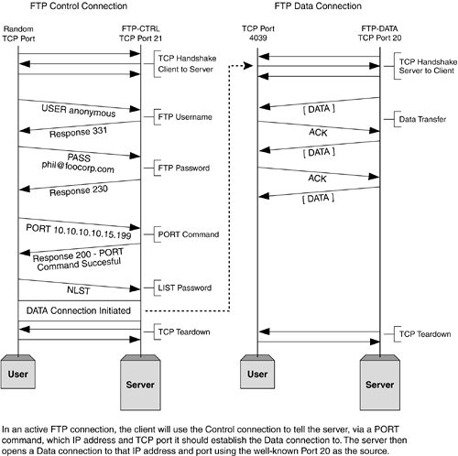

Example of views of a file sharing system

Slide 31


Pattern
a model or design used as a guide
an example for others to follow

Slide 32
Architectural Patterns
Architectural elements can be composed in ways that solve particular problems.
  The compositions have been found useful over time, and over many different domains
  They have been documented and disseminated.
  These compositions of architectural elements, called architectural patterns.
  Patterns provide packaged strategies for solving some of the problems facing a system.
An architectural pattern delineates the element types and their forms of interaction used in solving the problem.

Slide 33
Remark
Multiple Choice(single)
Points: 1
If a certain composition of architectural elements that solves a particular problem was found useful over time and over many domains, has been documented and disseminated, it may become a/an….
Tactics is another term taht will learn about later.
A
Tactics
B
Strategy
C
Architectural pattern
Submit
Text\Image\Formula are allowed and all the content should be placed in this area

Slide 34
Architectural patterns vs Design patterns
Architectural patterns are broader in scope than Design patterns
  Architectural pattern focuses more on the abstract view of idea while Design pattern focuses on the implementation view of idea
  Design patterns provide very specific software related tasks whereas Architectural pattern are solutions for business problems
One Architectural pattern can be implemented by using many design patterns
  There is one to many relationships between architectural pattern and design pattern.

Slide 35
Every System has a Software Architecture
But the architecture may not be known to anyone.
  Perhaps all of the people who designed the system are long gone
  Perhaps the documentation has vanished (or was never produced)
  Perhaps the source code has been lost (or was never delivered)
An architecture can exist independently of its description or specification

Slide 36
What Makes a “Good” Architecture?
Can we compare two architectures and say that one is better than the other?
When can we say that the architecture is good?
What can we do to produce a good architecture?

Slide 37
What Makes a “Good” Architecture?
There is no such thing as an inherently good or bad architecture.
Architectures can be evaluated but only in the context of specific stated goals.
Architectures are either more or less fit for some purpose.
There are, however, good rules of thumb.
  Process “Rules of Thumb”
    how the work should be organized to produce a “good” architecture
  Structural “Rules of Thumb”
    how a “good” architecture should look like

Slide 38
Process “Rules of Thumb”
The architecture should be the product of a single architect or a small group of architects with an identified technical leader.
The architect (or architecture team) should base the architecture on a prioritized list of well-specified quality attribute requirements.
The architecture should be documented using views.
The architecture should be evaluated for its ability to deliver the system’s important quality attributes.
The architecture should lend itself to incremental implementation.
Notes:
The architecture should be the product of a single architect or a small group of architects with an identified technical leader.
This approach gives the architecture its conceptual integrity and technical consistency. This recommendation holds for Agile and open source projects as well as “traditional” ones.
There should be a strong connection between the architect(s) and the development team.
The architect (or architecture team) should base the architecture on a prioritized list of well-specified quality attribute requirements.
These will inform the tradeoffs that always occur.
Functionality matters less.
The architecture should be documented using views. The views should address the concerns of the most important stakeholders in support of the project timeline.
The architecture should be evaluated for its ability to deliver the system’s important quality attributes.
This should occur early in the life cycle, when it returns the most benefit, and repeated as appropriate.
The architecture should lend itself to incremental implementation,
Create a “skeletal” system in which the communication paths are exercised but which at first has minimal functionality.

Slide 39
Structural “Rules of Thumb”
The architecture should feature well-defined modules
The architecture should never depend on a particular version of a commercial product or tool
Modules that produce data should be separate from modules that consume data.
  This tends to increase modifiability
Don’t expect a one-to-one correspondence between modules and components.
Every process should be written so that its assignment to a specific processor can be easily changed, perhaps even at runtime.
The architecture should feature a small number of ways for components to interact.
  The system should do the same things in the same way throughout.

Slide 40
Software architecture
- importance
Why is Software Architecture Important?

Slide 41
Inhibiting or Enabling System’s Quality Attributes
Whether a system will be able to exhibit its desired (or required) quality attributes is substantially determined by its architecture.
  Performance
  Modifiability
  Security
  Scalability
  Reusability
  …

Slide 42
Reasoning About and Managing Change
About 80 percent of a typical software system’s total cost occurs after initial deployment
  accommodate new features
  adapt to new environments
  fix bugs, and so forth
Every architecture partitions possible changes into three categories
  A local change can be accomplished by modifying a single element.
  A nonlocal change requires multiple element modifications but leaves the underlying architectural approach intact.
  An architectural change affects the fundamental ways in which the elements interact with each other and will require changes all over the system.

Slide 43
Poll
1 answer(s) at most
Which kind of a change in the system is most desirable?
A
A local change that can be accomplished by modifying a single element.
B
A nonlocal change that requires multiple element modifications but leaves the underlying architectural approach intact.
C
An architectural change that affects the fundamental ways in which the elements interact with each other and will require changes all over the system.
Submit

Slide 44
Reasoning About and Managing Change
Obviously, local changes are the most desirable.
A good architecture is one in which the most common changes are local, and hence easy to make.

Slide 45
Predicting System Qualities
When we examine an architecture we can confidently predict that the architecture will exhibit the associated qualities.
The earlier you can find a problem in your design, the cheaper, easier, and less disruptive it will be to fix.

Slide 46
Enhancing Communication Among Stakeholders
The architecture—or at least parts of it—is sufficiently abstract that most nontechnical people can understand it.
Most of the system’s stakeholders can use as a basis for creating mutual understanding, negotiating, forming consensus, and communicating with each other.
Each stakeholder of a software system is concerned with different characteristics of the system.
  Users, client, manager, architect

Slide 47
Earliest Design Decisions
Software architecture is a manifestation of the earliest design decisions about a system.
These early decisions affect the system’s remaining development, its deployment, and its maintenance life.
What are these early design decisions?
  Will the system run on one processor or be distributed across multiple processors?
  Will the software be layered? If so, how many layers will there be? What will each one do?
  Will components communicate synchronously or asynchronously?
  What communication protocol will we choose?
  Will the system depend on specific features of the operating system or hardware?
  Will the information that flows through the system be encrypted or not?

Slide 48
Defining Constraints on an Implementation
An implementation exhibits an architecture if it conforms to the design decisions prescribed by the architecture.
  The implementation must be implemented as the set of prescribed elements
  These elements must interact with each other in the prescribed fashion
Each of these prescriptions is a constraint on the implementer.

Slide 49
Influencing the Organizational Structure
Architecture prescribes the structure of the system being developed.
The architecture is typically used as the basis for the work-breakdown structure.
The work-breakdown structure in turn dictates
  units of planning, scheduling, and budget
  interteam communication channels
  configuration and file-system organization
  integration and test plans and procedures
  the maintenance activity

Slide 50
Enabling Evolutionary Prototyping
Once an architecture has been defined, it can be prototyped as a skeletal system.
  A skeletal system is one in which at least some of the infrastructure is built before much of the system’s functionality has been created.
The fidelity of the system increases as prototype parts are replaced with complete versions of these parts.
This approach aids the development process because the system is executable early in the product’s life cycle.
This approach allows potential performance problems to be identified early in the product’s life cycle.
These benefits reduce the potential risk in the project.

Slide 51
Improving Cost and Schedule Estimates
Architecture is used to help the project manager create cost and schedule estimates early in the project life cycle.
Top-down estimates are useful for setting goals and apportioning budgets.
Bottom-up understanding of the system’s pieces are typically more accurate than those that are based purely on top-down system knowledge.
The best cost and schedule estimates will typically emerge from a consensus between the top-down estimates (created by the architect and project manager) and the bottom-up estimates (created by the developers).

Slide 52
Transferable, Reusable Model
Reuse of architectures provides tremendous benefits for systems with similar requirements.
  Not only can code be reused, but so can the requirements that led to the architecture in the first place
  When architectural decisions can be reused across multiple systems, all of the early-decision consequences are also transferred

Slide 53
Using Independently Developed Components
Architecture-based development often focuses on components that are likely to have been developed separately, even independently
Commercial off-the-shelf components, open source software, publicly available apps, and networked services are example of interchangeable software components.
The payoff can be
  Decreased time to market
  Increased reliability
  Lower cost
  Flexibility (if the component you want to buy is not terribly special purpose, it’s likely to be available from several sources)

Slide 54
Poll
1 answer(s) at most
Do you think that from the architect point of view it is better to have less design choices (choices of elements and their interactions) or more?
A
Less is always better
B
I want more choices
Submit

Slide 55
Restricting Design Vocabulary
As useful architectural patterns are collected, we see the benefit in restricting ourselves to a relatively small number of choices of elements and their interactions.
  We minimize the design complexity of the system we are building.
  Enhanced reuse
  More regular and simpler designs that are more easily understood and communicated
  More capable analysis
  Shorter selection time
  Greater interoperability

Slide 56
Basis for Training
The architecture can serve as the first introduction to the system for new project members.
Module views show someone the structure of a project.
  Who does what, which teams are assigned to which parts of the system, and so forth.
Component-and-connector explains how the system is expected to work and accomplish its job.

Slide 57
The Many Contexts of Software Architecture

Slide 58
How is Architecture Influenced?

Slide 59
Contexts of Software Architecture
We put software architecture in its place relative to four contexts:
  Technical. What technical role does the software architecture play in the system?
  Project life cycle. How does a software architecture relate to the other phases of a software development life cycle?
  Business. How does the presence of a software architecture affect an organization’s business environment?
  Professional. What is the role of a software architect in an organization or a development project?

Slide 60
Technical Context
The most important technical context factor is the set of quality attributes that the architecture can help to achieve.
The architecture’s current technical environment is also an important factor.
  Standard industry practices.
  Software engineering techniques prevalent in the architect’s professional community.

Slide 61
Project Life-cycle Context
Software development processes are standard approaches for developing software systems.
They tell the members of the team what to do next.
There are four dominant software development processes:
  Waterfall
  Iterative
  Agile
  Model-driven development

Slide 62
Architecture Activities
Architecture is a special kind of design, so architecture finds a home in each process of software development.
There are activities involved in creating a software architecture, using it to realize a complete design, and then implementing.
  Understanding the architecturally significant requirements
  Creating or selecting the architecture
  Documenting and communicating the architecture
  Analyzing or evaluating the architecture
  Implementing and testing the system based on the architecture
  Ensuring that the implementation conforms to the architecture

Slide 63
Business Context
Systems are created to satisfy the business goals of one or more organizations.
  Development organizations: e.g., make a profit, or capture market, or help their customers do their jobs better, or keep their staff employed, or make their stockholders happy.
  Customers have their own goals: e.g. ,make their lives easier or more productive.
  Other organizations, such as subcontractors or government regulatory agencies, have their own goals.
Architects need to understand the goals.
Many of these goals will influence the architecture.

Slide 64
Architecture and business goals
Notes:
Beat the market competition product -> in performance, or security, or usability
Lower the cost -> modifiability, flexibility
Have long term collaboration with some platform providers -> build the architecture based on the platform
- low the development cost -> move the office to some cheap living place, allow people to work at home

Slide 65
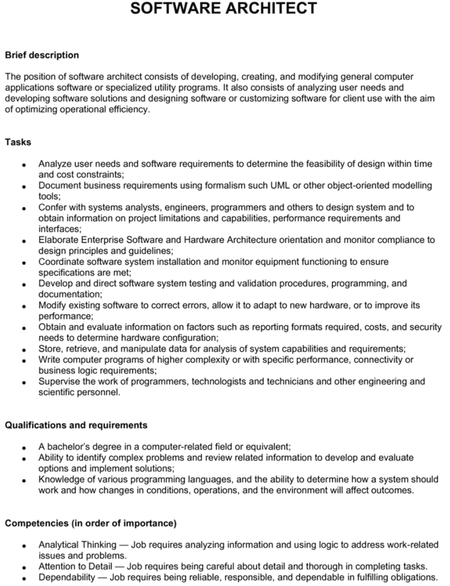
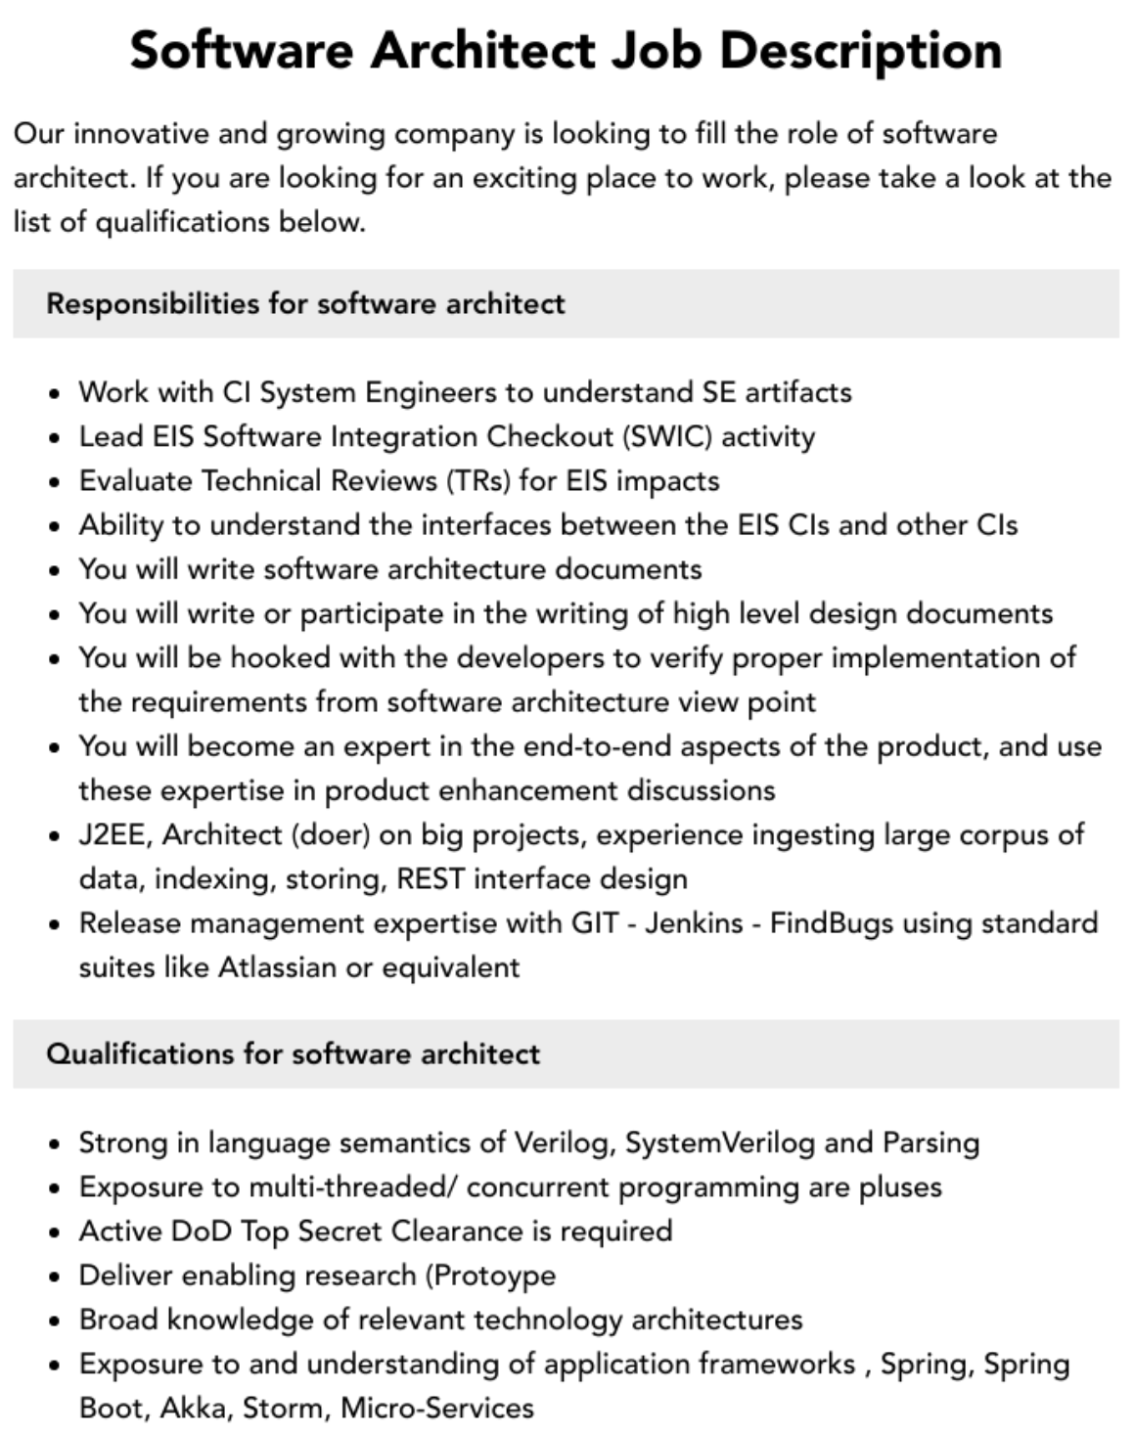
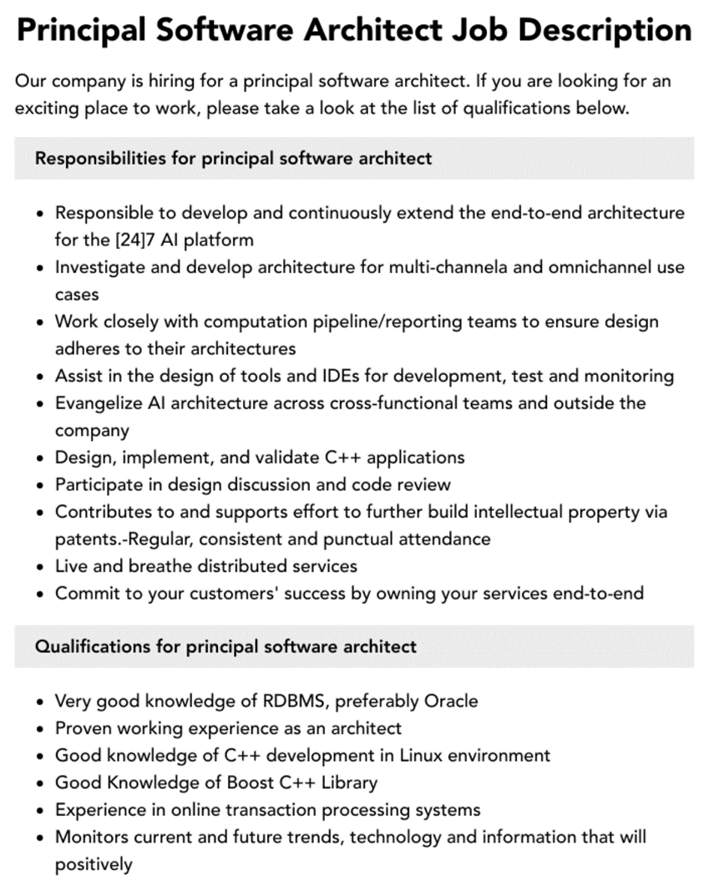
Professional Context
Software architect is a career choice.

Slide 66
Professional Context
Architects need more than just technical skills.
  Architects need diplomatic, negotiation, and communication skills.
  Architects need the ability to communicate ideas clearly.
Architects need up-to-date knowledge.
  Know about (for example) patterns, or database platforms, or web services standards.
  Know about business considerations.
Notes:
Architects need to explain to one stakeholder the chosen, and why particular stakeholders are not having all of their expectations fulfilled.

Slide 67
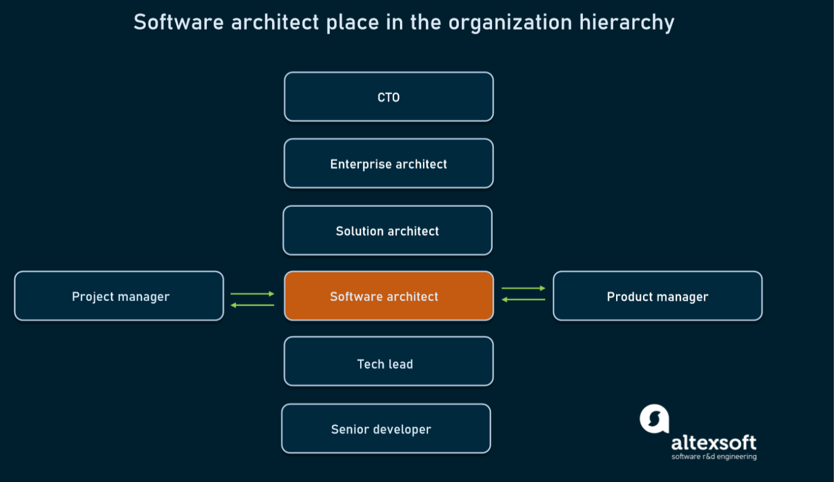
Professional Context

Slide 68
Stakeholders
A stakeholder is anyone who has a stake in the success of the system.
Stakeholders typically have different specific concerns on the system.
Early engagement of stakeholders to understand the constraints of the task, manage expectations, negotiate priorities, and make tradeoffs.

Slide 69
Stakeholders

Slide 70
Open Question
Points: 10
University Town, has directed its software development subsidiary, Campus Software, to develop a cafeteria system that supports a network of cafeteria Kiosks and POSs (points of sale). Kiosks are distributed in diverse locations of University Town near cafeterias and POSs are located near meal serving stations inside of cafeterias. The users are students, faculty and other employees of University Town. They use Kiosks to make queries, and funds transfers from their bank accounts to their cafeteria accounts. They use POSs to pay for their meals.
Identify as many stakeholders of this system as you can. What are their needs regarding the system?
Open Question is only supported on Version 2.0 or newer.
Answer

Slide 71
What Do Architectures Influence?

Slide 72
Architecture Influence Cycle
Contexts the architecture is influenced by
  Business
  Technical
  Project
  Professional
Contexts the architecture influences
  Business
  Technical
  Project
  Professional

Slide 73
What Do Architectures Influence?
Technical context
  The architecture can affect stakeholder’s requirements for the next system.
  A customer may relax some of their requirements.
  Shrinkwrapped software has affected people’s requirements, as it is inexpensive and of high quality.

Slide 74
What Do Architectures Influence?
Project context
  The architecture affects the structure of the developing organization.
  An architecture prescribes the units of software to be implemented and integrated to the system.
  These units are the basis for the development project’s structure.
  the development, test, and integration activities all revolve around the units.

Slide 75
What Do Architectures Influence?
Business context
  The architecture can affect the business goals of the developing organization.
  The architecture can provide opportunities for the efficient production and deployment of similar systems, and the organization may adjust its goals to take advantage of its newfound expertise.

Slide 76
What Do Architectures Influence?
Professional context
  The process of system building will affect the architect’s experience.
  A system that was successfully built will make the architect more inclined to build systems using the same approach in the future.
  Architectures that fail are less likely to be chosen for future projects.

Slide 77
Architecture Influence Cycle

Slide 78
Summary
The software architecture of a system is the set of structures needed to reason about the system, which comprise software elements, relations among them, and properties of both.
An architecture has an impact on the architect, the organization, and, potentially, the industry.

