Slide 1
COMP3028 Software Architecture
Quality attributes: Interoperability

Slide 2
What is Interoperability?
Interoperability is about the degree to which two or more systems can usefully exchange meaningful information via interfaces in a particular context.
Any discussion of a system’s interoperability needs to identify with whom, and under what circumstance.
Syntactic interoperability is the ability to exchange data.
Semantic interoperability is the ability to interpret the data being exchanged.

Slide 3
Questions to think about when designing system for interoperability
Will this system need to provide services to other system(s)? What do we know about these systems?
Will this system be constructed by combining capabilities from other systems?

Slide 4
What is Interoperability?
Two perspectives for achieving interoperability
With the knowledge about the interfaces of external systems, design that knowledge into the system
Without the knowledge about other systems, design the system to interoperate in a more general fashion

Slide 5
Motivation
The system provides a service to be used by a collection of unknown systems, e.g., Google Maps
The system is constructed from existing systems, for example
Producing a representation of what was sensed
Interpreting the data
Processing the raw data
Sensing the environment

Slide 6
Two Important Aspects of Interoperability
Discovery. The consumer of a service must discover the location, identity, and interface of service
Handling the response. Three possibilities:
The service reports back to the requester
The service sends its response on to another system
The service broadcasts its response to any interested parties

Slide 7

Open Question
Points: 10
What question can you ask the client to find out if the system has requirements of interoperability?
You cannot use word “interoperability” in your question
Open Question is only supported on Version 2.0 or newer.
Answer

Slide 8
Example
Will this system need to provide services to other system(s)? What do we know about these systems?
Will this system be constructed by combining capabilities from other systems?
Example - a traffic sensing system where the input comes from individual vehicles, the raw data is processed into common units of measurement, is interpreted and fused, and traffic congestion information is broadcast
one of the existing systems is responsible for sensing its environment
another one is responsible for processing the raw data
a third is responsible for interpreting the data
a final one is responsible for producing and distributing a representation of what was sensed

Slide 9
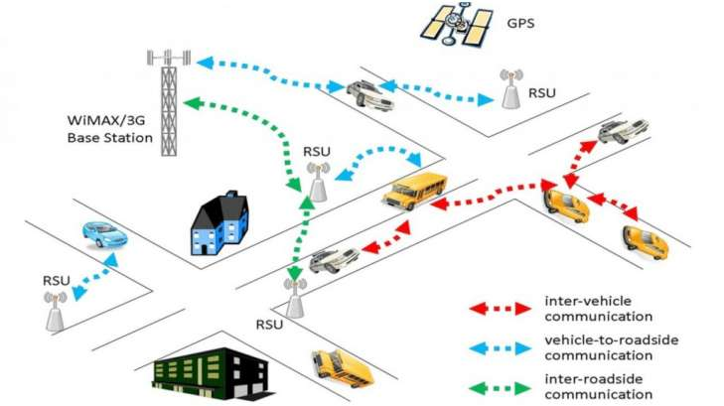
Intelligent transportation system

Slide 10
Interoperability General Scenario
Portion of Scenario | Possible Values
Source | A system
Stimulus | A request to exchange information among system(s).
Artifact | The systems that wish to interoperate
Environment | System(s) wishing to interoperate are discovered at run time or known prior to run time.
Response | One or more of the following: the request is (appropriately) rejected and appropriate entities (people or systems) are notified the request is (appropriately) accepted and information is exchanged successfully the request is logged by one or more of the involved systems
Response Measure | One or more of the following: percentage of information exchanges correctly processed percentage of information exchanges rejected

Slide 11
Sample Concrete Interoperability Scenario
Our vehicle information system sends our current location to the traffic monitoring system.
The traffic monitoring system combines our location with other information, overlays this information on a Google Map, and broadcasts it.
Our location information is correctly included with a probability of 99.9%.

Slide 12
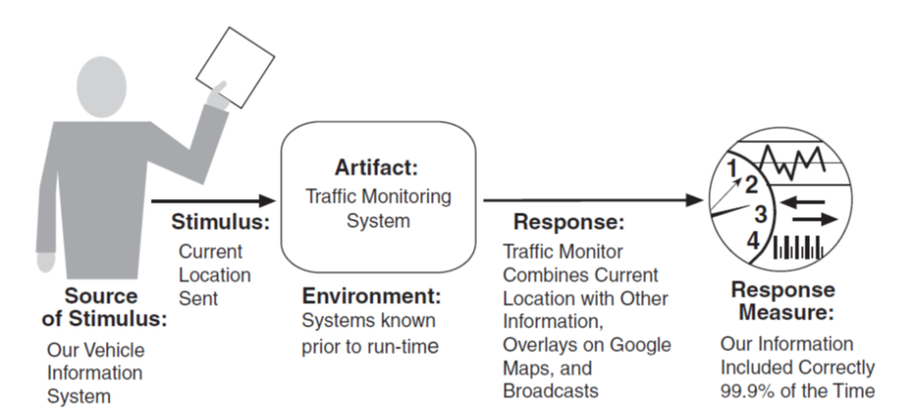
Sample Concrete Interoperability Scenario

Slide 13
Open Question
Points: 10
You want to develop a system that will help customers save money on their online shopping. The customers will specify the products they want to buy on platforms such as Taobao, JD, Pinduoduo, etc, and the system will track the prices and notify the customers by sending them WeChat messages.
Discuss interoperability requirements for this system
Write several concrete interoperability scenarios for this system.
Open Question is only supported on Version 2.0 or newer.
Answer

Slide 14
SOAP v.s. REST
Two technology options to allow the web-based application to interoperate
SOAP is used in SOA systems along with a set of protocols
Service description& discovery, e.g., WSDL, UDDI
Service composition, e.g., BPEL
SOAP is more complex and used for exchange messages with structured data, while REST is simple and used for small messages

Slide 15
Goal of Interoperability Tactics
For two or more systems to usefully exchange information they must
Know about each other. That is the purpose behind the locate tactics.
Exchange information in a semantically meaningful fashion. That is the purpose behind the manage interfaces tactics. Two aspects of the exchange are
Provide services in the correct sequence
Modify information produced by one actor to a form acceptable to the second actor.

Slide 16
Goal of Interoperability Tactics

Slide 17
Interoperability Tactics

Slide 18
Locate
Service Discovery : Locate a service through searching
There are many service discovery mechanisms:
UDDI for Webservices
Jini for Java objects
Simple Service Discovery Protocol (SSDP) as used in Universal plug-and-play (UPnP)
DNS Service Discovery (DNS-SD)
Bluetooth Service Discovery Protocol (SDP)

Slide 19
Service Discovery – Necessary conditions
The searcher wants to find the searched entity and the searched entity wants to be found
The searched entity must have identifiers
The searcher must acquire sufficient identifiers to identify the searched entity

Slide 20
Open Question
Points: 10
What are the different mechanisms to enable searching for information?
(tip: you can consider trying to find information about good restaurants in the new city that you want to visit. What are the different ways?)
Open Question is only supported on Version 2.0 or newer.
Answer

Slide 21
Locate
Service Discovery : Locate a service through searching

Slide 22
Searching methods
Searcher’s initiative
Searched initiative
Registration – a middleman

Slide 23
Multiple Choice(multiple)
Points: 1
(select more than one correct answer) Which of the searching methods are initiated by the searcher? (searcher: an entity that searches for some other entity)
A
Broadcast request
B
Continuous advertisement
C
Successive request
D
Advertisement upon arrival of new entity
Submit

Slide 24
Searching Method – Searcher’s initiative
Flood/Broadcast request
Ask every entity and wait for answer
Examples
Paging in the location area to find the mobile terminal
DHCP discover: the client broadcasts on the local subnet to find available servers to ask for IP address
Efficient and less resource consuming for the searcher
Low resource consuming for the searched
But disturbing and resource consuming for the environment

Slide 25
Searching Method – Searcher’s initiative
Successive request:
Ask one entity at the time and perform matching
If no match, continue with next until finding a match
Less efficient and high resource consuming for the searcher
But less disturbing and less resource consuming for the environment

Slide 26
Searching Method – Searched’s initiative
Continuous/periodical advertisement:
Continuously or periodically publish advertisement such that every searcher can notice and respond
Efficient but high resource consuming for the searched
Low resource demanding for the searcher
Disturbing and resource consuming for the environment

Slide 27
Searching Method – Searched’s initiative
Advertisement upon arrival of new entity
E.g., present himself when a new person enters the lobby
Require detection mechanism upon new entity arrival
Less resource consuming for the searched
Low resource demanding for the searcher
Less disturbing and resource consuming for the environment

Slide 28
Searching Method – Registration
Introduction of the “middlemen”, registry
The searched entity registers to a registry
The searcher can address to the registry to get information and find the searched entity
Example
Service providers register their web services at UDDI registry which can be searched and found by Service Requestors

Slide 29
Searching Method – Registration
Less resource consumption on both searchers, searched, and less disturbing to environment, but the registry must be available, reliable, and correct

Slide 30
Example
Service discovery in web services architecture

Slide 31
Web Service
Describes any computational functionality that can be found and invoked over any network (e.g. the Internet)
Represents a self-describing, self-contained application
Designed to be used by other programs or applications rather than humans

Slide 32
Web Service Architecture

Slide 33
Web Service Architecture

Slide 34
UDDI Registries
A network of UDDI registries resembling the Domain Name System (DNS)
All UDDI registers exchange information
Accessing one registry provides all information contained in all registries

Slide 35
Interoperability Tactics

Slide 36
Manage Interfaces
Orchestrate: uses a control mechanism to coordinate, manage and sequence the invocation of services.
Orchestration is used when systems must interact in a complex fashion to accomplish a complex task.
Tailor Interface: add or remove capabilities to an interface such as translation, buffering, or data-smoothing.

Slide 37
Checklist for Interoperability
Allocation of Responsibility
Coordination Model
Data Model
Mapping among Architectural Elements
Resource Management
Binding Time

Slide 38
Allocation of Responsibility
Ensure that responsibility has been allocated
to detect a request to interoperate with external systems
to accept/reject the request
to exchange the information
to notify appropriate entities
log the request, which is essential for interoperability in an untrusted environment

Slide 39
Coordination Model
Volume of traffic on the network both created by the systems under your control and generated by system not under your control
Timeliness of the messages being sent by your systems
Jitter of the messages’ arrival times
The system under your control makes assumptions about protocols and underlying networks that are consistent with systems not under your control

Slide 40
Multiple Choice(multiple)
Points: 1
(multiple answers are correct) To design the architecture for a system with high interoperability requirement, we need to make design decisions regarding the data model
A
Decide on the syntax of the major data abstractions to be exchanged with other systems and make sure the chosen data abstractions are consistent with the data from the interoperating systems.
B
Make sure that components that communicate externally are hosted on processors that can reach the network
C
Decide on semantics of the major data abstractions to be exchanged with other systems and make sure the chosen data abstractions are consistent with the data from the interoperating systems.
D
Make sure that the interoperation with another system will never exhaust critical system resources
Answer B describes decisions we make regarding mapping among architectural elements
Answer C describes decisions we make regarding resource management

Slide 41
Data Model
Determine the syntax and semantics of the major data abstractions to be exchanged
Ensure that these data abstractions are consistent with data from the interoperating systems
If a system’s data model is confidential, it is needed to transform to and from the data abstraction with which it interoperates

Slide 42
Mapping among Architectural Elements
For interoperability, the critical mapping is that of components to processors
Make sure that components that communicate externally are hosted on processors that can reach the network

Slide 43
Open Question
Points: 10
You are an architect on the team that designs the architecture for a system with high interoperability requirement. What design decisions regarding the resource management will you need to make?
Open Question is only supported on Version 2.0 or newer.
Answer

Slide 44
Resource Management
Interoperation with another system can never exhaust critical system resources
E.g., can a flood of requests cause service to be denied
Resource load imposed by communications is acceptable
If interoperation requires that resources be shared among the participating systems, an adequate policy is in place
E.g., bandwidth scheduling for video sharing

Slide 45
Binding Time
Determine when the systems become known to each other
It has a policy for dealing with binding to both known and unknown external systems
It has mechanisms to reject unacceptable bindings and to log such requests

Slide 46
Summary
Interoperability refers to the ability of systems to usefully exchange information.
Achieving interoperability involves the relevant systems locating each other and then managing the interfaces so that they can exchange information.

Slide 47
Universal Adaptor: A Novel Approach to Supporting Multi-protocol Service Discovery in Pervasive Computing
Joanna Izabela Siebert, Jiannong Cao, Yu Zhou, Miaomiao Wang, and Vaskar Raychoudhury,
In Proceedings of International Conference on Embedded and Ubiquitous Computing (EUC’07), pp. 683-693, December, 2007,
Notes:
47

Slide 48
Your task
While listening to this part of our topic, try to think about this question “which tactics was used in this research to achieve interoperability between the discovery mechanisms?”

Slide 49
Background
Heterogeneity - different environments supported by different service management systems, which may use standard protocols as well as tailored made mechanisms
software,
hardware devices,
network infrastructures
Diverse service discovery mechanisms
How to integrate or bridge these service discovery schemes ?

Slide 50
Interoperability Requirements
No change should be imposed on the existing service discovery mechanisms
No change should be imposed on the services registered in domains
No functionality of the environment should be compromised
The system should be lightweight, scalable, and extendable
Support both standard and tailor-made service discovery mechanisms

Slide 51
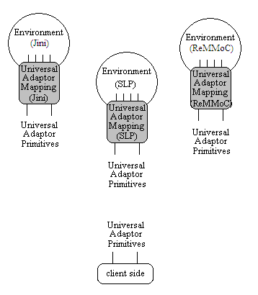
System Model and Architecture
Environment
Service Discovery Domain, where a native service discovery system is able to find a specified resources if they are available in the domain.
Services
provided by hardware devices, software, and other entities
Examples: weather forecast, stock quotes, and language translation. - provided directly or via another device

Slide 52
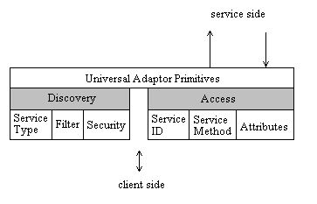
Universal Adaptor Primitives (UAP)
[Return_Values] Primitive_Name [Parameters]
[RV_ST, RV_F, RV_S] Discovery (Service Type, Filter, Security)
[RV_status] Access (ServiceID, Service Method, Attributes)

Slide 53
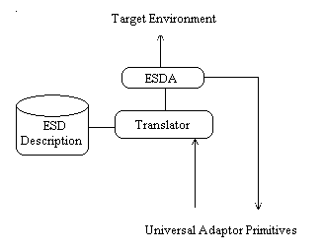
Universal Adaptor Mapping (UAM)
ESDA - Agent that uses the algorithm generated by Translator to perform service discovery in the target environment. Depending on the native service discovery protocol, ESDA can register for service advertisements or performs active service discovery
Translator - Module that translates UA primitives into native primitives, and outputs an algorithm for service discovery using the native primitives
ESD Description - Rules specifying the characteristics of the service discovery protocol used in the particular environment, in the form of the primitives extracted from the native protocol

Slide 54
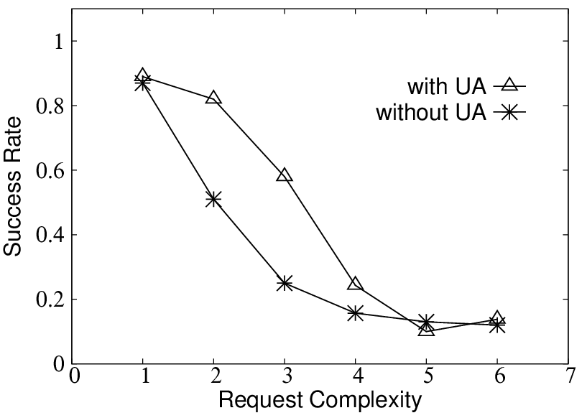
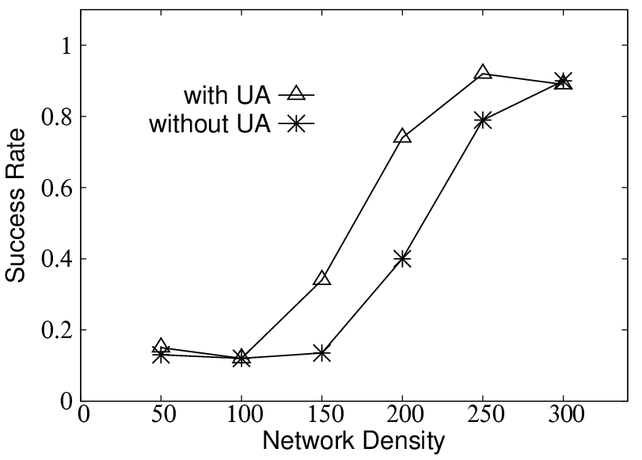
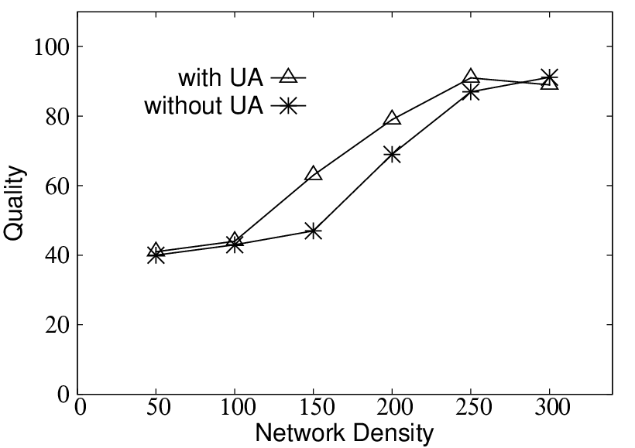
Simulation Results
For the too sparse network, neither approach with UA not without UA can achieve good results.
The more neighbors the node has the bigger success rate of finding the preferred collaboration partner, quality improves as well.
When the network is very dense, the improvement is not visible any more - additional neighbors available for the node to choose from are treated as duplication.
Approach with UA always results with providing bigger choice to the node, which in turn gives better success rate and higher quality.
With UA and without UA results are not very symmetric. The network for the approach with UA becomes “too dense” earlier than for the approach without UA.

Slide 55
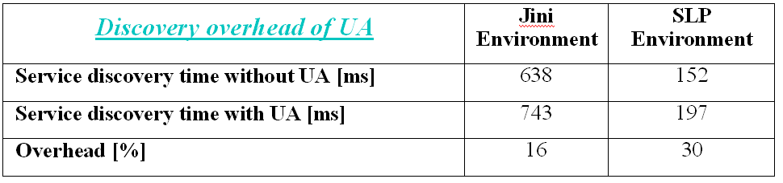
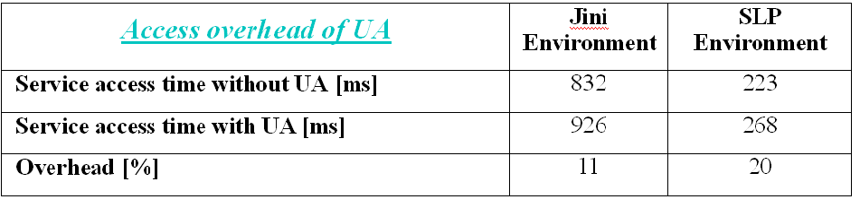
Experiment Results
Two service discovery environments:
Jini - Jini2_1
SLP - jSLP
Example: a weather information service

Slide 56
Interoperability Tactics

Slide 57
Multiple Choice(single)
Points: 1
Which tactics was used in this research to achieve interoperability between the discovery mechanisms?
A
Discover service
B
Orchestrate
C
Tailor interface
Submit

Slide 58
Universal Adaptor Primitives (UAP)
Interface primitives
[Return_Values] Primitive_Name [Parameters]
[RV_ST, RV_F, RV_S] Discovery (Service Type, Filter, Security)
[RV_status] Access (ServiceID, Service Method, Attributes)

Slide 59
Universal Adaptor Mapping (UAM)
ESDA - Agent that uses the algorithm generated by Translator to perform service discovery in the target environment. Depending on the native service discovery protocol, ESDA can register for service advertisements or performs active service discovery
Translator - Module that translates UA primitives into native primitives, and outputs an algorithm for service discovery using the native primitives
ESD Description - Rules specifying the characteristics of the service discovery protocol used in the particular environment, in the form of the primitives extracted from the native protocol

Slide 60
Manage Interfaces
Orchestrate: uses a control mechanism to coordinate, manage and sequence the invocation of services.
Orchestration is used when systems must interact in a complex fashion to accomplish a complex task.
Tailor Interface: add or remove capabilities to an interface such as translation, buffering, or data-smoothing.

Slide 61
Interoperability Tactics

