Slide 1
COMP3028 Software Architecture
Quality attributes: Modifiability

Slide 2
What is Modifiability?
Modifiability is about change and our interest in it is in the cost and risk of making changes.
To plan for modifiability, an architect has to consider four questions:
What can change?
What is the likelihood of the change?
When is the change made and who makes it?
What is the cost of the change?

Slide 3
Recall our earlier example
University Town, has directed its software development subsidiary, Campus Software, to develop a cafeteria system that supports a network of cafeteria Kiosks and POSs (points of sale). Kiosks are distributed in diverse locations of University Town near cafeterias and POSs are located near meal serving stations inside of cafeterias. The users are students, faculty and other employees of University Town. They use Kiosks to make queries, and funds transfers from their bank accounts to their cafeteria accounts. They use POSs to pay for their meals.

Slide 4

Open Question
Points: 10
You are an architect on the Campus Software team. One of the requirements for the system is high modifiability. What can cause changes to the system in the future?
Open Question is only supported on Version 2.0 or newer.
Answer

Slide 5
What can change?
The functions of the system
The platforms, i.e., the hardware, operating system, middleware
The environment in which the system operates
The systems with which it must interoperate
The protocols it uses to communicate
The capacity
Number of users supported
Number of simultaneous operations

Slide 6
When is the change made and who makes it?
Changes can be made during
implementation by modifying the source code
build by choice of libraries
execution by parameter setting, plugins, etc
Changes can also be made by
a developer
an end user
a system administrator

Slide 7
What is the cost of the change?
Involving two types of cost
The cost of introducing the mechanisms to make the system more modifiable
The cost of making the modification using the mechanisms
Example
User interface builder

Slide 8
Example
You are an architect on the Campus Software team. There is a possibility that in the future, the client will request changes to be made to the user interface. Your team is considering two ways to handle this problem
1. Do nothing for now. Wait for a change request to come in, then change the source code to accommodate request.
2. Add additional component to the system now – user interface builder. When there is a change request, the designer will use a drag-and-drop editor to design a new interface, and the user interface builder will produce the new source code directly
Let us consider what is the cost of each option

Slide 9
Open Question
Points: 10
Consider the first option: do nothing for now. Wait for a change request to come in, then change the source code to accommodate request.
What is the cost of introducing the mechanisms to make the system more modifiable?
The cost is zero
Open Question is only supported on Version 2.0 or newer.
Answer

Slide 10
Open Question
Points: 10
Consider the second option: add additional component to the system now – user interface builder. When there is a change request, the designer will use a drag-and-drop editor to design a new interface, and the user interface builder will produce the new source code directly
What is the cost of introducing the mechanisms to make the system more modifiable?
The cost of constructing the UI builder, it can be substantial.
Open Question is only supported on Version 2.0 or newer.
Answer

Slide 11
Open Question
Points: 10
Consider the first option: do nothing for now. Wait for a change request to come in, then change the source code to accommodate request.
What is the cost of making the modification using the mechanism?
The cost of changing the source code and revalidating the system
Open Question is only supported on Version 2.0 or newer.
Answer

Slide 12
Open Question
Points: 10
Consider the second option: add additional component to the system now – user interface builder. When there is a change request, the designer will use a drag-and-drop editor to design a new interface, and the user interface builder will produce the new source code directly
What is the cost making the modification using the mechanism?
The cost of producing the input to feed the builder – substantial or negligible
The cost of running the builder – negligible
The cost of the testing that is needed on the – usually much less than usual
Open Question is only supported on Version 2.0 or newer.
Answer

Slide 13
 | the cost of introducing the mechanisms to make the system more modifiable | the cost making the modification using the mechanism
do nothing for now | zero | The cost of changing the source code and revalidating the system
add additional component to the system now – user interface builder | The cost of constructing the UI builder, it can be substantial | The cost of producing the input to feed the builder – substantial or negligible The cost of running the builder – negligible The cost of the testing that is needed on the new interface– usually much less than usual

Slide 14
What is Modifiability?
Modifiability is about change and our interest in it is in the cost and risk of making changes.
To plan for modifiability, an architect has to consider four questions:
What can change?
What is the likelihood of the change?
When is the change made and who makes it?
What is the cost of the change?

Slide 15
Example
You are an architect on the Campus Software team. There is a possibility that in the future, the client will request changes to be made to the user interface. Your team is considering two ways to handle this problem
1. Do nothing for now. Wait for a change request to come in, then change the source code to accommodate request.
2. Add additional component to the system now – user interface builder. When there is a change request, the designer will use a drag-and-drop editor to design a new interface, and the user interface builder will produce the new source code directly
Considering the differences in cost between these options, which one will be a better choice?

Slide 16
 | the cost of introducing the mechanisms to make the system more modifiable | the cost making the modification using the mechanism
do nothing for now | zero | The cost of changing the source code and revalidating the system
add additional component to the system now – user interface builder | The cost of constructing the UI builder, it can be substantial | The cost of producing the input to feed the builder – substantial or negligible The cost of running the builder – negligible The cost of the testing that is needed on the new interface– usually much less than usual

Slide 17
Multiple Choice(single)
Points: 1
Which option will be a better choice if the chance of the need to make a change is not high?
A
Do nothing for now.
B
Add user interface builder to the system.
Submit

Slide 18
Multiple Choice(single)
Points: 1
Which option will be a better choice if there is a chance that the changes in the interface will be requested many times??
A
Do nothing for now.
B
Add user interface builder to the system.
Submit

Slide 19
Modifiability General Scenario
Portion of Scenario | Possible Values
Source | End user, developer, system administrator
Stimulus | A directive to add/delete/modify functionality, or change a quality attribute, capacity, or technology
Artifacts | Code, data, interfaces, components, resources, configurations, …
Environment | Runtime, compile time, build time, initiation time, design time
Response | One or more of the following: make modification test modification deploy modification
Response Measure | Cost in terms of: number, size, complexity of affected artifacts effort calendar time money (direct outlay or opportunity cost) extent to which this modification affects other functions or quality attributes new defects introduced

Slide 20
Sample Concrete Modifiability Scenario
The developer wishes to change the user interface by modifying the code at design time. The modifications are made with no side effects within three hours.
Stimulus – Wishes to change UI
Artifact – Code
Environment: Design time
Response – Change made
Response measure – No side effects in three hours
Source - Developer

Slide 21
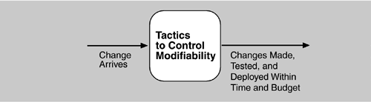
Goal of Modifiability Tactics
Goal of modifiability
controlling the complexity of making changes,
controlling the time and cost to make changes.

Slide 22
Modifiability Tactics

Slide 23
Multiple Choice(single)
Points: 1
If there is a chance that changes will be needed in this module, which design will have smaller modification cost?
Design A the module includes a great deal of capability
A
B
Design B
the module is refined into several smaller modules (each capability is represented in a separate module)

Slide 24
Reduce Size of a Module
Split Module: If the module being modified includes a great deal of capability, the modification costs will likely be high.
Refining the module into several smaller modules should reduce the average cost of future changes.

Slide 25
Increase Cohesion
Increase Semantic Coherence: If the responsibilities A and B in a module do not serve the same purpose, they should be placed in different modules.
This may involve creating a new module or it may involve moving a responsibility to an existing module.

Slide 26
Reducing Coupling
What is coupling?
If two modules’ responsibilities overlap, a single change may affect them both.
Coupling is measured by this overlap, i.e., by the probability that a modification to one module will propagate to the other.
High coupling is an enemy of modifiability.
Encapsulate: Encapsulation introduces an explicit interface to a module. This interface includes an API and its associated responsibilities.
Use an Intermediary: Given a dependency between responsibility A and responsibility B (for example, carrying out A first requires carrying out B), the dependency can be broken by using an intermediary.

Slide 27
Publish/Subscribe System

Slide 28
Introduction: Motivations for Pub/Sub model
Traditional Client/Server communication model
(Employs RPC, message queue etc..)
Synchronous, tightly-coupled request invocations.
Very restrictive for distributed applications, especially for WAN and mobile environments.
When nodes/links fail, system is affected. Fault Tolerance must be built in to support this.
Require a more flexible and de-coupled communication style that offers asynchronous mechanisms.

Slide 29
What is a Publish/Subscribe System?
Pub/Sub System is a communication paradigm that allows freedom in the (distributed) system by the decoupling of communication entities in terms of time, space and synchronization.
An event service system that is asynchronous, anonymous and loosely-coupled.
Ability to quickly adapt in a dynamic environment.

Slide 30
Key components of Pub/Sub System
Publishers : Publishers generate event data and publishes them.
Subscribers : Subscribers submit their subscriptions and process the events received.
P/S service: It’s the mediator/broker that filters and routes events from publishers to interested subscribers.

Slide 31
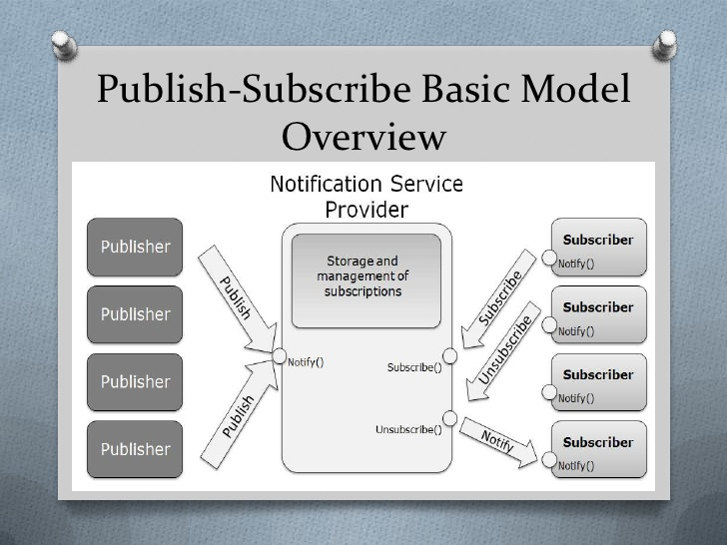
Publish/Subscribe System

Slide 32
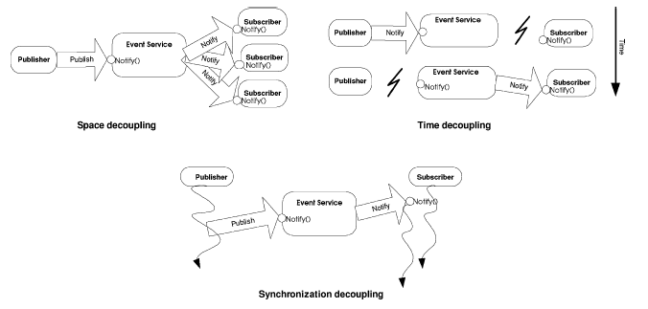
Decoupling in time, space and synchronization
Provides decoupling in time, space and synchronization.

Slide 33
Classification of Pub/Sub Architectures
Centralized Broker model
Consists of multiple publishers and multiple subscribers and centralized broker/brokers (an overlay network of brokers interacting with each other).
Subscribers/Publishers will contact 1 broker, and do not need to have knowledge about others.
E.g. CORBA event services, JMS, JEDI etc…
Peer-to-Peer model
Each node can be publisher, subscriber or broker.
Subscribers subscribe to publishers directly and publishers notify subscribers directly. Therefore they must maintain knowledge of each other.
Complex in nature, mechanisms such as DHT and CHORD are employed to locate nodes in the network.
E.g. Java distributed event service

Slide 34
Key Functions Implemented by P/S Middleware Service
Event filtering (event selection)
The process of selecting the set of subscribers that have shown interest in a given event.
Subscriptions are stored in memory and searched when a publisher publishes a new event.
Event routing (event delivery)
The process of routing the published events to all interested subscribers

Slide 35
Event Filtering (Subscription Model) Topic based VS Content based
Topic based
Generally also known as topic based, group based or channel based event filtering.
Each event is published to one of these channels by its publisher.
Subscribers subscribes to a particular channel and will receive ALL events published to the subscribed channel.

Slide 36
Topic-based subscription
Simple process for matching an event to subscriptions. However, limited expressiveness.
Event filtering is easy, event routing is difficult (Heavy load on the network). The challenge is to multicast event effectively to subscribers.

Slide 37
Event Filtering- Subscription Model Topic based VS Content based
Content based
More flexibility and power to subscribers, by allowing more expression in arbitrary/customized query over the contents of the event.
Event publication by a key/value attribute pair, and subscriptions specify filters using a explicit subscription language.
E.g. Notify me of all stock quotes of IBM from New York stock exchange if the price is greater than 150

Slide 38
Content-based Subscription
Added complexity in matching an event to subscriptions.
However, more precision is provided and event routing is easier

Slide 39
Advantages of Pub/Sub
Highly suited for mobile applications, ubiquitous computing and distributed embedded systems
Robust – Failure of publishers or subscribers does not bring down the entire system
Scalability- Suited to build distributed applications consisting a large number of entities
Adaptability- can be varied to suit different environments (mobile, internet game, embedded systems etc…)

Slide 40
Disadvantages of Pub/Sub
Reliability – no strong guarantee on broker to deliver content to subscriber. After a publisher publishes the event, it assumes that all corresponding subscribers would receive it.
Potential bottleneck in brokers when subscribers and publishers overload them. (Solve by load balancing techniques)

Slide 41
Reduce Coupling
Restrict Dependencies: restricts the modules which a given module interacts with or depends on.
By restricting a module’s visibility and by authorization
For example,
a layer is allowed to see the modules in its bottom layer

Slide 42
Reduce Coupling
Abstract Common Services: where two modules provide not-quite-the-same but similar services, it may be cost-effective to implement the services just once in a more general (abstract) form.

Slide 43
Summary
Modifiability deals with change and the cost in time or money of making a change, including the extent to which this modification affects other functions or quality attributes.
Tactics to reduce the cost of making a change include making modules smaller, increasing cohesion, and reducing coupling.

