Slide 1
COMP3028 Software Architecture

Slide 2
Software Architecture
Quality attributes: Security

Slide 3
Intended Learning Outcomes
By the end of this lesson you will be able to:
apply the design decision categories to security quality attribute

Slide 4
Security

Slide 5

Open Question
Points: 10
What does it mean when we say that the system is secure?
Open Question is only supported on Version 2.0 or newer.
Answer

Slide 6
What is Security?
Security is a measure of the system’s ability to protect data and information from unauthorized access while still providing access to people and systems that are authorized
An action taken against a computer system with the intention of doing harm is called an attack
Attack can be in different forms
unauthorized attempt to access/modify data or service
intended to deny services to legitimate users

Slide 7
What is Security?
Security has three main characteristics, called CIA:
Confidentiality is the property that data or services are protected from unauthorized access.
For example, a hacker cannot access your income tax returns on a government computer.
Integrity is the property that data or services are not subject to unauthorized manipulation.
For example, your grade has not been changed since your instructor assigned it.
Availability is the property that the system will be available for legitimate use.
For example, a denial-of-service attack prevent you from ordering a book from an online bookstore.

Slide 8
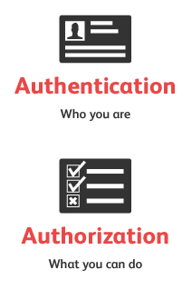
What is Security?
Other characteristics that support CIA are
Authentication verifies the identities of the parties to a transaction and checks if they are truly who they claim to be.
Authorization grants a user the privileges to perform a task.
Nonrepudiation guarantees that the sender/recipient of a message cannot later deny having sent/received the message

Slide 9
Security General Scenario
Portion of Scenario | Possible Values
Source | Human or another system which may have been previously identified (either correctly or incorrectly) or may be currently unknown. A human attacker may be from outside the organization or from inside the organization.
Stimulus | Unauthorized attempt is made to display data, change or delete data, access system services, change the system’s behavior, or reduce availability.
Artifact | System services; data within the system; a component or resources of the system; data produced or consumed by the system
Environment | The system is either online or offline, connected to or disconnected from a network, behind a firewall or open to a network, fully operational, partially operational, or not operational

Slide 10
Security General Scenario
Portion of Scenario | Possible Values
Response | Transactions are carried out in a fashion such that data or services are protected from unauthorized access; data or services are not being manipulated without authorization; parties to a transaction are identified with assurance; the parties to the transaction cannot repudiate their involvements; the data, resources, and system services will be available for legitimate use. The system tracks activities within it by recording access or modification, recording attempts to access data, resources or services, notifying appropriate entities when an apparent attack is occurring.

Slide 11
Security General Scenario
Portion of Scenario | Possible Values
Response Measure | One or more of the following how much of a system is compromised when a particular component or data value is compromised, how much time passed before an attack was detected, how many attacks were resisted, how long does it take to recover from a successful attack, how much data is vulnerable to a particular attack

Slide 12
Sample Concrete Security Scenario
A disgruntled employee from a remote location attempts to modify the pay rate table during normal operations. The system maintains an audit trail and the correct data is restored within a day.
Stimulus: unauthorized attempts to modify the pay rate table
Stimulus source: a disgruntled employee
Artifact: the system with pay rate table
Environment: during normal operation
Response: maintains an audit trail
Response measure: correct data is restored within a day

Slide 13
Security Tactics

Slide 14
Security Tactics

Slide 15
Detect Attacks
Detect Intrusion: compare network traffic or service request patterns within a system to a set of signatures or known patterns of malicious behavior stored in a database.
Detect Service Denial: comparison of the pattern or signature of network traffic coming into a system to historic profiles of known Denial of Service (DoS) attacks.

Slide 16
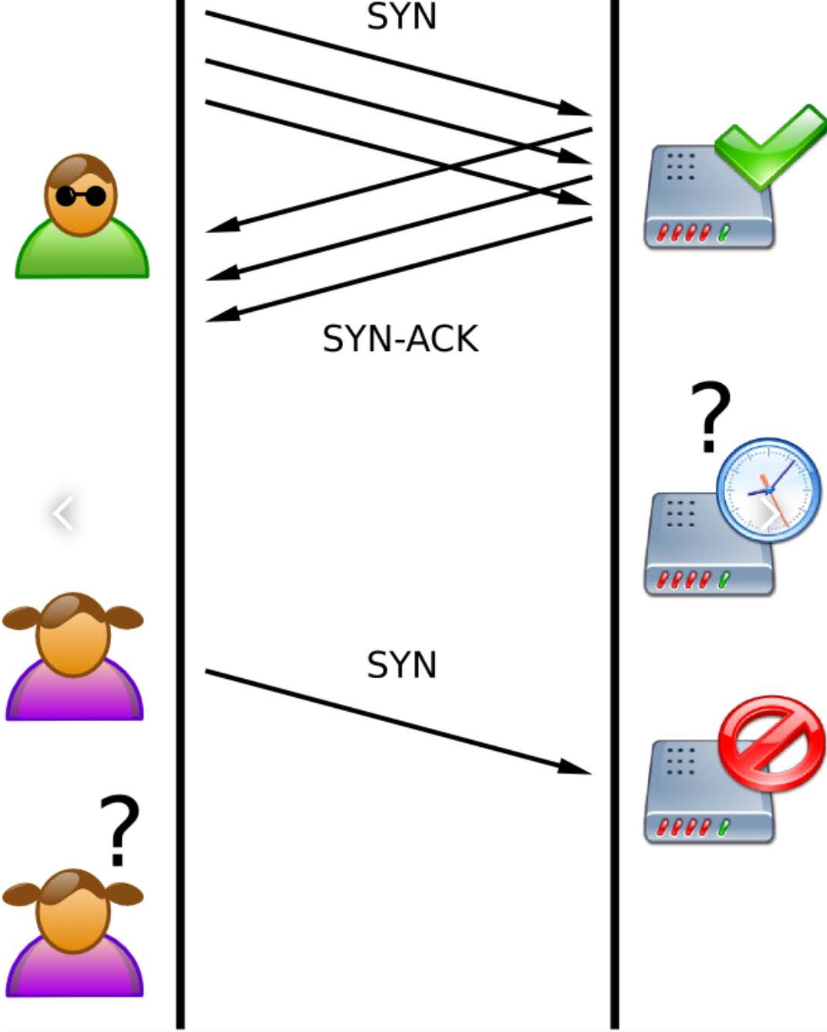
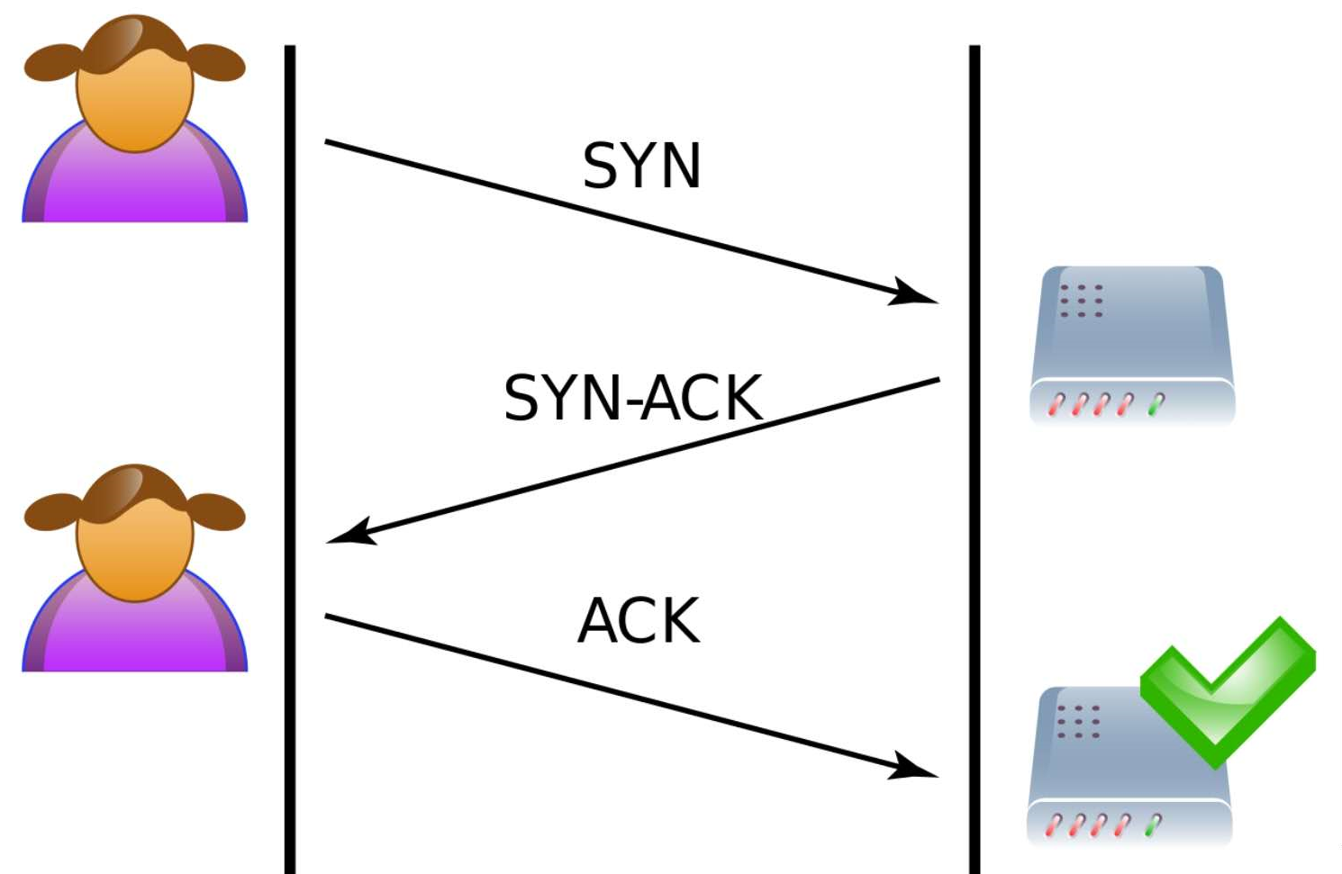
Denial of Service Attack
Ping of Death
UDP Flood
TCP SYN

Slide 17
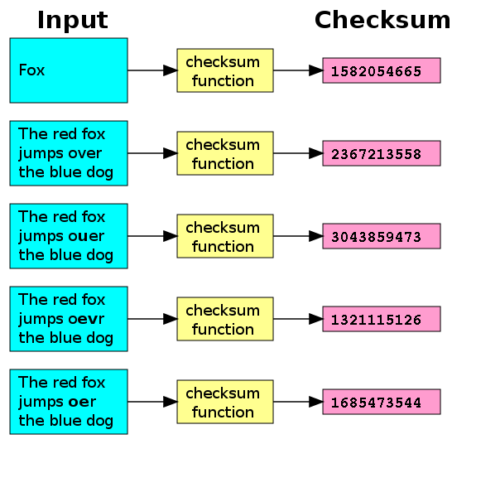
Detect Attacks
Verify Message Integrity: use techniques such as checksums or hash values to verify the integrity of messages, resource files, deployment files, and configuration files.

Slide 18
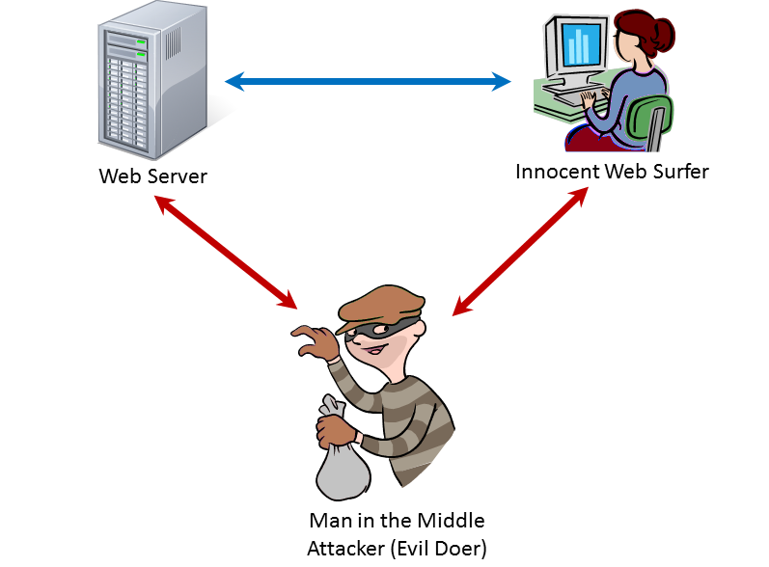
Detect Attacks
Detect Message Delay: checking the time that it takes to deliver a message, it is possible to detect suspicious timing behavior, i.e., man-in-the-middle attack

Slide 19
Security Tactics

Slide 20
Resist Attacks
Identify Actors: identify the source of any external input to the system.
Authenticate Actors: ensure that a user or remote computer is actually who or what it purports to be.
Authorize Actors: ensuring that an authenticated actor has the rights to access and modify either data or services.
Limit Access: limiting access to resources such as memory, network connections, or access points.

Slide 21
Resist Attacks
Limit Exposure: minimize the attack surface of a system by having the fewest possible number of access points.
E.g., firewall is a single point of access to the intranet
E.g., closing a port

Slide 22
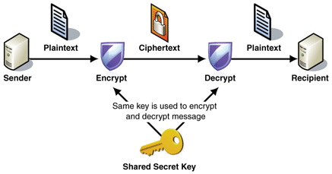
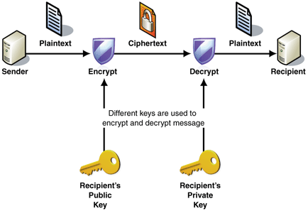
Resist Attacks
Encrypt Data: apply some form of encryption to data and to communication.
Symmetric encryption
asymmetric encryption

Slide 23
Resist Attacks
Separate Entities: can be done through physical separation on different servers, the use of virtual machines
Change Default Settings: Force the user to change settings assigned by default.

Slide 24
Security Tactics

Slide 25
React to Attacks
Revoke Access: limit access to sensitive resources, even for normally legitimate users and uses, if an attack is suspected.
Lock Computer: limit access to a resource if there are repeated failed attempts to access it.
Inform Actors: notify operators, other personnel, or cooperating systems when an attack is suspected or detected.

Slide 26
Security Tactics

Slide 27
Homework
There is no need to submit it, but if you have any questions, we will discuss them in the next class.
Please read the description of the MarkLogic database on the following three pages.
Answer this question
Which security tactics were described in this example?

Slide 28
Example – MarkLogic database
MarkLogic is a multi-model NoSQL database
MarkLogic's Enterprise NoSQL database platform is used in publishing, government, finance and other sectors,
It uses a distributed architecture that can handle hundreds of billions of documents and hundreds of terabytes of data
You can use MarkLogic to create systems that store and retrieve data.
MarkLogic Server includes a powerful and flexible role-based security model to protect your data according to your application security requirements.

Slide 29
Protecting the Execution of XQuery Modules in MarkLogic
One simple way to restrict access to your MarkLogic Server application is to limit the users that have permission to run the application.
If you load your Xquery code into a modules database, you can use an execute permission on the XQuery document itself to control who can run it.
Then, a user must possess execute permissions to run the module.

Slide 30
Steps to allow only selected users to run the application
Using the Admin Interface, specify a modules database in the configuration for the App Server (HTTP or WebDAV) that controls the execution of your XQuery module.
Load the XQuery module into the modules database, using a URI with an .xqy extension, for example my_module.xqy.
Set execute permissions on the XQuery document for a given role. For example, if you want users with the run_application role to be able to execute an XQuery module with the URI http://modules/my_module.xqy, run a query similar to the following:
xdmp:document-set-permissions("http://modules/my_module.xqy",
xdmp:permission("run_application", "execute") )
Create the run_application role.
Assign the run_application role to the users who can run this application.

Slide 31
Summary
Attacks against a system can be characterized as attacks against the confidentiality, integrity, or availability of a system.
Identifying, authenticating, and authorizing actors are tactics intended to determine which users or systems are entitled to what kind of access to a system.
No security tactic is foolproof.
Tactics exist to detect an attack, limit the spread of any attack, and to react and recover from an attack.

