Slide 1
COMP3028 Software Architecture

Slide 2
Software Architecture
Quality attributes: Testability, Usability and others

Slide 3
Intended Learning Outcomes
By the end of this lesson you will be able to:
apply the design decision categories to various quality attributes

Slide 4
Other quality attributes
Availability
Interoperability
Modifiability
Performance
Security
Testability
Usability
Portability
Development Distributability
Scalability
Deployability
Mobility
Monitorability
Safety

Slide 5
Testability
Software testability refers to the ease with which software can be made to demonstrate its faults through (typically execution-based) testing.
Testability refers to the probability that it will fail on its next test execution.
If a fault is present in a system, then we want it to fail during testing as quickly as possible.

Slide 6
Testability v.s. Fault-tolerance
Testability is to make the fault easier to show up
Fault-tolerance attempts to hide the faults, and make it difficult to reveal the faults.
Are the two design goals incompatible?

Slide 7

Poll
1 answer(s) at most
Testability is to make the fault easier to show up.
Fault-tolerance attempts to hide the faults, and make it difficult to reveal the faults.
Are the two design goals incompatible?
A
No, they are compatible. Improving the fault-tolerance of the system will also improve its testability.
B
Yes, they are incompatible. There is a trade-off between testability and fault tolerance.
Submit

Slide 8
Multiple Choice(single)
Points: 1
Testability is to make the fault easier to show up.
Fault-tolerance attempts to hide the faults, and make it difficult to reveal the faults.
Are the two design goals incompatible?
A
No, they are compatible. Improving the fault-tolerance of the system will also improve its testability.
B
Yes, they are incompatible. There is a trade-off between testability and fault tolerance.
Submit

Slide 9
What is Usability?
Usability is concerned with how easy it is for the user to accomplish a desired task and the user support the system provides
Usability is one of the cheapest and easiest ways to improve a system’s quality
Usability comprises the following areas:
Using a system efficiently.
Learning system features.
Minimizing the impact of errors.
Adapting the system to user needs.
Increasing confidence and satisfaction.

Slide 10
Portability
Portability is also a special form of modifiability.
Portability refers to the ease with which software that built to run on one platform can be changed to run on a different platform.

Slide 11
Development Distributability
Development Distributability is the quality of designing the software to support distributed software development.
The system are developed using globally distributed teams.
The purpose is to minimize the coordination among the teams.

Slide 12
Scalability
Horizontal scalability (scaling out) refers to adding more resources to logical units such as adding another server to a cluster.
Vertical scalability (scaling up) refers to adding more resources to a physical unit such as adding more memory to a computer.
Results in a measurable improvement without disruptive operations
Centralized v.s. decentralized?

Slide 13
Deployability
Deployability is concerned with how an executable arrives at a host platform and how it is invoked.
Examples:
Javascripts
Virus
Agent

Slide 14
Mobility
Mobility deals with the problems of movement and affordances of a platform
Issues in mobility include
Battery management
Disconnection and reconnection
Hand-off in cellular network
…

Slide 15
Monitorability
Monitorability deals with the ability of the operations staff to monitor the system while it is executing.
For example
the health of various component
Average transaction processing time
Queue length

Slide 16
Poll
1 answer(s) at most
In your opinion, are safety and security the same thing?
A
Yes
B
No
Submit

Slide 17
Safety
Software safety is about
the software’s ability to avoid entering states that cause or lead to damage, injury, or loss of life,
ability to recover and limit the damage when it does enter into bad states.
The architectural concerns with safety are almost identical with those for availability

Slide 18
There are even more quality attributes….

Slide 19
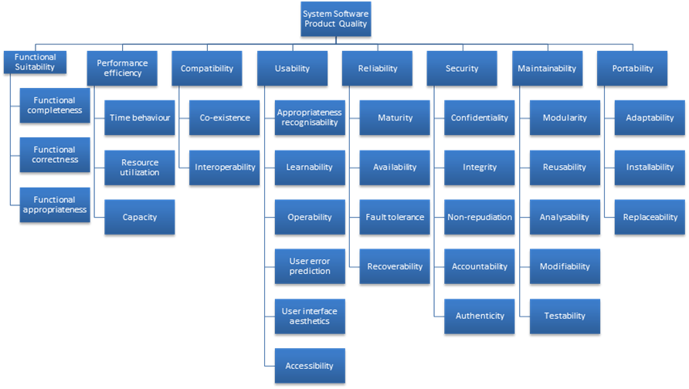
Standard Lists of Quality Attributes
ISO/IEC FCD 25010 Product Quality Standard

Slide 20
Standard Lists of Quality Attributes
Advantages:
Can be helpful checklists to assist requirements gatherers in making sure that no important needs were overlooked.
Can serve as the basis for creating your own checklist that contains the quality attributes of concern in your domain, your industry, your organization, your products, …

Slide 21
Standard Lists of Quality Attributes
Disadvantages:
No list will ever be complete.
Lists often generate more controversy than understanding.
Lists often purport to be taxonomies. But what is a denial-of-service attack?

Slide 22
Summary
There are many other quality attributes than those that we cover in detail.
Taxonomies of attributes may offer some help, but their disadvantages often outweigh their advantages.
You may need to design or analyze a system for a “new” quality attribute. While this may be challenging, it is doable.

