Slide 1
COMP3028 Software Architecture

Slide 2
Software Architecture
Quality Attribute Modelling and Analysis

Slide 3
Intended Learning Outcomes
By the end of this lesson you will be able to:
Model architectures to enable quality attribute analysis
Use quality attribute checklists
Generate and carry out a thought experiment to perform early analysis
Analyse architectures using alternative ways: experiments, simulations and prototypes
Analyse at different stages of the life cycle

Slide 4

Open Question
Points: 10
You designed some algorithm and one of your design goals was to minimize the time the algorithm takes to complete. How can you prove that your algorithm meets this design goal?
Open Question is only supported on Version 2.0 or newer.
Answer

Slide 5
How do we know the quality attributes of a software?
Analytic model
Experiment and measurement
Simulations

Slide 6
Modeling Architectures to Enable Quality Attribute Analysis
Some quality attributes, most notably performance and availability, have well-understood, time-tested analytic models that can be used to assist in an analysis.
By analytic model, we mean one that supports quantitative analysis.
Let us first consider performance.

Slide 7
Performance Models
Parameters: arrival rate of events, chosen queuing discipline, chosen scheduling algorithm, service time for events, network topology, network bandwidth, routing algorithm chosen
Scheduling algorithm
arrivals
results
queue
server
Routing of messages

Slide 8
Allocation Model for MVC

Slide 9


Queuing Model for MVC
Arrivals
View sends requests to Controller
Actions returned to View
Actions returned to model
Model sends actions to View
Users Generate Requests
Model
5
3
4
View
1
2
Controller

Slide 10
Parameters
To solve a queuing model for MVC performance, the following parameters must be known or estimated:
The frequency of arrivals from outside the system
The queuing discipline used at the view queue
The time to process a message within the view
The number and size of messages that the view sends to the controller
The bandwidth of the network that connects the view and the controller
The queuing discipline used by the controller
The time to process a message within the controller
The number and size of messages that the controller sends back to the view
The bandwidth of the network from the controller to the view
The number and size of messages that the controller sends to the model
The queuing discipline used by the model
The time to process a message within the model
The number and size of messages the model sends to the view
The bandwidth of the network connecting the model and the view

Slide 11
Queuing Model for MVC
The frequency of arrivals from outside the system
Arrivals
View sends requests to Controller
Actions returned to View
Actions returned to model
Model sends actions to View
Users Generate Requests
Model
5
3
4
View
1
2
Controller

Slide 12
Parameters
To solve a queuing model for MVC performance, the following parameters must be known or estimated:
The frequency of arrivals from outside the system
The queuing discipline used at the view queue
The time to process a message within the view
The number and size of messages that the view sends to the controller
The bandwidth of the network that connects the view and the controller
The queuing discipline used by the controller
The time to process a message within the controller
The number and size of messages that the controller sends back to the view
The bandwidth of the network from the controller to the view
The number and size of messages that the controller sends to the model
The queuing discipline used by the model
The time to process a message within the model
The number and size of messages the model sends to the view
The bandwidth of the network connecting the model and the view

Slide 13
Queuing Model for MVC
Arrivals
View sends requests to Controller
Actions returned to View
The queuing discipline used by the component
Actions returned to model
Model sends actions to View
Users Generate Requests
Model
5
3
4
View
1
2
Controller

Slide 14
Parameters
To solve a queuing model for MVC performance, the following parameters must be known or estimated:
The frequency of arrivals from outside the system
The queuing discipline used at the view queue
The time to process a message within the view
The number and size of messages that the view sends to the controller
The bandwidth of the network that connects the view and the controller
The queuing discipline used by the controller
The time to process a message within the controller
The number and size of messages that the controller sends back to the view
The bandwidth of the network from the controller to the view
The number and size of messages that the controller sends to the model
The queuing discipline used by the model
The time to process a message within the model
The number and size of messages the model sends to the view
The bandwidth of the network connecting the model and the view

Slide 15
Queuing Model for MVC
The time to process a message in a component
Arrivals
View sends requests to Controller
Actions returned to View
Actions returned to model
Model sends actions to View
Users Generate Requests
Model
5
3
4
View
1
2
Controller

Slide 16
Parameters
To solve a queuing model for MVC performance, the following parameters must be known or estimated:
The frequency of arrivals from outside the system
The queuing discipline used at the view queue
The time to process a message within the view
The number and size of messages that the view sends to the controller
The bandwidth of the network that connects the view and the controller
The queuing discipline used by the controller
The time to process a message within the controller
The number and size of messages that the controller sends back to the view
The bandwidth of the network from the controller to the view
The number and size of messages that the controller sends to the model
The queuing discipline used by the model
The time to process a message within the model
The number and size of messages the model sends to the view
The bandwidth of the network connecting the model and the view

Slide 17
Queuing Model for MVC
The number and size of messages that the component sends to another component
Arrivals
View sends requests to Controller
Actions returned to View
Actions returned to model
Model sends actions to View
Users Generate Requests
Model
5
3
4
View
1
2
Controller

Slide 18
Parameters
To solve a queuing model for MVC performance, the following parameters must be known or estimated:
The frequency of arrivals from outside the system
The queuing discipline used at the view queue
The time to process a message within the view
The number and size of messages that the view sends to the controller
The bandwidth of the network that connects the view and the controller
The queuing discipline used by the controller
The time to process a message within the controller
The number and size of messages that the controller sends back to the view
The bandwidth of the network from the controller to the view
The number and size of messages that the controller sends to the model
The queuing discipline used by the model
The time to process a message within the model
The number and size of messages the model sends to the view
The bandwidth of the network connecting the model and the view

Slide 19
Queuing Model for MVC
The bandwidth of the network that connects the components
Arrivals
View sends requests to Controller
Actions returned to View
Actions returned to model
Model sends actions to View
Users Generate Requests
Model
5
3
4
View
1
2
Controller

Slide 20
Parameters
To solve a queuing model for MVC performance, the following parameters must be known or estimated:
The frequency of arrivals from outside the system
The queuing discipline used at the view queue
The time to process a message within the view
The number and size of messages that the view sends to the controller
The bandwidth of the network that connects the view and the controller
The queuing discipline used by the controller
The time to process a message within the controller
The number and size of messages that the controller sends back to the view
The bandwidth of the network from the controller to the view
The number and size of messages that the controller sends to the model
The queuing discipline used by the model
The time to process a message within the model
The number and size of messages the model sends to the view
The bandwidth of the network connecting the model and the view

Slide 21
Parameters
To solve a queuing model for MVC performance, the following parameters must be known or estimated:
The frequency of arrivals from outside the system
The queuing discipline used at the view queue
The time to process a message within the view
The number and size of messages that the view sends to the controller
The bandwidth of the network that connects the view and the controller
The queuing discipline used by the controller
The time to process a message within the controller
The number and size of messages that the controller sends back to the view
The bandwidth of the network from the controller to the view
The number and size of messages that the controller sends to the model
The queuing discipline used by the model
The time to process a message within the model
The number and size of messages the model sends to the view
The bandwidth of the network connecting the model and the view

Slide 22
Open Question
Points: 10
Remark
Assume we want to estimate the performance of the system we have designed using MVC pattern. Will that be an easy task? What cost do you need to consider?
To estimate the performance of our system, all the parameters we just discussed must be known or estimated. The more accurately the parameters can be estimated, the better the predication of latency. But determining this parameters takes a lot of time and effort. This is our cost. Since the cost is high, are there any benefits?
Open Question is only supported on Version 2.0 or newer.
Answer
Text\Image\Formula are allowed and all the content should be placed in this area

Slide 23
Cost/benefit of Performance Modeling
Cost: determining the parameters previously mentioned
Benefit: estimate of the latency
The more accurately the parameters can be estimated, the better the predication of latency.
This is worthwhile when latency is important and questionable.
This is not worthwhile when it is obvious there is sufficient capacity to satisfy the demand.

Slide 24
Availability Modeling
Another quality attribute with a well-understood analytic framework is availability.
Modeling an architecture for availability—or to put it more carefully, modeling an architecture to determine the availability of a system based on that architecture—is a matter of determining the failure rates and the recovery times of the components.

Slide 25
Example
Just as for performance, to model an architecture for availability, we need an architecture to analyze.
Suppose we want to increase the availability of a system that uses the Broker pattern, by applying redundancy tactics.

Slide 26
Availability Modeling
Three different tactics for increasing the availability of the broker are:
active redundancy (hot spare)
passive redundancy (warm spare)
spare (cold spare).

Slide 27
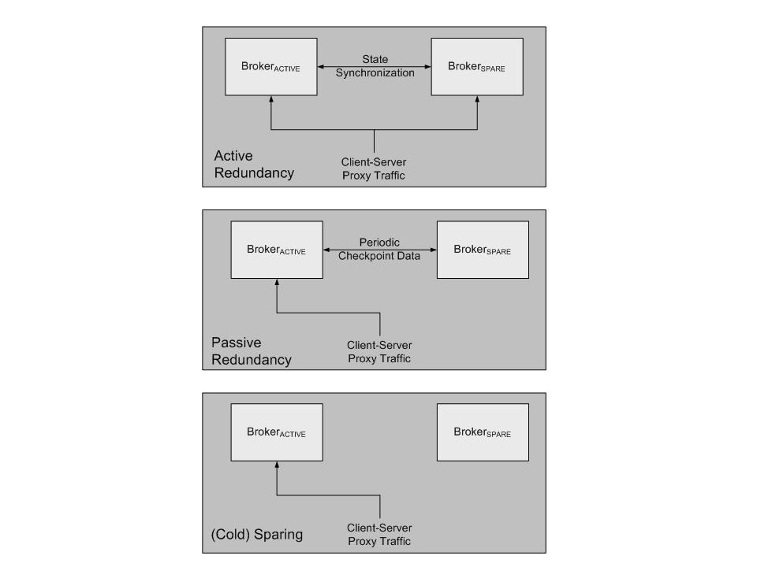
Making Broker More Available
Key:
process:
message:

Slide 28
Applying Probabilities to Tactics
Using probabilities to model different tactics
When two events A and B are independent, the probability that A or B will occur is the sum of the probability of each event: P(A or B) = P(A)+ P(B).
When two events A and B are independent, the probability of both occurring is P(A and B) = P(A) • P(B).
When two events A and B are dependent, the probability of both occurring is P(A and B) = P(A) • P(B|A), where the last term means “the probability of B occurring, given that A occurs.”

Slide 29
Passive Redundancy
Assume
failure of a component (primary or backup) is independent of the failure of its counterpart
assume failure probability of both is the same: P(F)
Then probability that both will fail is: 1 - P(F)²
Can also estimate probability of failure given other tactics.
Then given a cost of implementing appropriate tactic we can do cost/benefit analysis

Slide 30
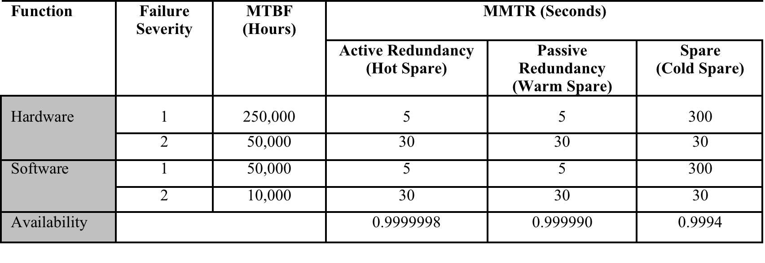
Calculated Availability for an Availability-Enhanced Broker

Slide 31
Maturity of Quality Attribute Models
Quality Attribute | Intellectual Basis | Maturity / Gaps
Availability | Markov models; Statistical models | Moderate maturity in the hardware reliability domain, less mature in the software domain. Requires models that speak to state recovery and for which failure percentages can be attributed to software.
Interoperability | Conceptual framework | Low maturity; models require substantial human interpretation and input.
Modifiability | Coupling and cohesion metrics; Cost models | Substantial research in academia; still requires more empirical support in real-world environments.
Performance | Queuing theory; Real time scheduling theory | High maturity; requires considerable education and training to use properly.
Security | No architectural models
Testability | Component Interaction Metrics | Low maturity; little empirical validation.
Usability | No architectural models

Slide 32
Quality Attribute Checklists
A quality attribute checklist provides a means of:
Checking requirements. Do the requirements capture all of the nuances of a particular quality attribute?
Auditing. Does the design satisfy all of the aspects necessary for a certification process.

Slide 33
Security Checklists
Security checklists are common.
Vendors who accept credit cards should conform to the PCI (Personal Credit Information) standard
Electricity producers have security checklists to prevent attacks on critical infrastructure
Checklists have both:
Product requirements. E.g. the PCI checklist states that the security code on the back of the credit card should never be stored.
Process requirements. E.g. patches should be applied promptly and there should be someone who has the organizational responsibility to ensure that they are.

Slide 34
Thought Experiments
A thought experiment is mentally or verbally working through a particular scenario.
Commonly done by the architect during design to explore alternatives.
Also done during evaluation/documentation to convince third parties of the wisdom of particular design choices

Slide 35
Thought Experiment Steps
Enumerate the steps of a use case
At each step, ask {yourself, the architect}
What mechanism is being implemented to support the achievement of which particular quality requirement?
Does this mechanism hinder the achievement of other quality attribute requirements?
Record problems for later deeper analysis or prototype building

Slide 36
Back-of-the-Envelope Analysis
Analysis does not need to be precise or detailed.
Rough analysis serves for many purposes. E.g. “the volume of traffic generated by this source should be well within the bounds handled by modern infrastructure”
Only do deeper analysis for questionable areas or important requirements.

Slide 37
Experiments, Simulations, and Prototypes
Many tools can help perform experiments to determine behavior of a design
Request generators can create synthetic loads to test scalability
Monitors can perform non-intrusive resource usage detection.
These depend on having a partial or prototype implementation.
Prototype alternatives for the most important decisions
If possible, implement prototype in a fashion so that some of it can be re-used.
Fault injection tools can induce faults to determine response of system under failure conditions.

Slide 38
Simulations
Event based simulators exist that can be used to simulate behavior of system under various loads
Must create the simulation.
Must have a variety of different loads and responses to check for.

Slide 39
Analysis During Requirements and Design
Different types of analysis are done at different stages of the life cycle
Requirements:
Analytic models/back of the envelope analysis can help capacity planning
Checklists can help ensure capture correct set of requirements
Design:
Prototypes can help explore design options
Analytic models or simulation can help understand potential bottlenecks
Checklists can help determine if used a correct mechanism

Slide 40
Analysis During Implementation or Fielding
Experiments and synthetic load tests can be used during the implementation process or after fielding
Monitors can be used after fielding to determine actual behavior and find bottlenecks.

Slide 41
Analysis at Different Stages of the Lifecycle
Life-Cycle Stage | Form of Analysis | Cost | Confidence
Requirements | Experience-based analogy | Low | Low-High
Requirements | Back-of-the-envelope | Low | Low-Medium
Architecture | Thought experiment | Low | Low-Medium
Architecture | Checklist | Low | Medium
Architecture | Analytic Model | Low-Medium | Medium
Architecture | Simulation | Medium | Medium
Architecture | Prototype | Medium | Medium-High
Implementation | Experiment | Medium-High | Medium-High
Fielded System | Instrumentation | Medium-High | High

Slide 42
Summary
Analysis is always a cost/benefit activity
Cost is measure of creating and executing the analysis models and tools
Benefit depends on
Accuracy of analysis
Importance of what is being analyzed
Analysis can be done through
Models for some attributes
Measurement
Simulations
Prototypes
Thought experiments & Back-of-the-envelope analysis

