Slide 1
COMP3028 Software Architecture

Slide 2

Introduction to Software Architecture

Slide 3
Software architecture - main concepts

Slide 4
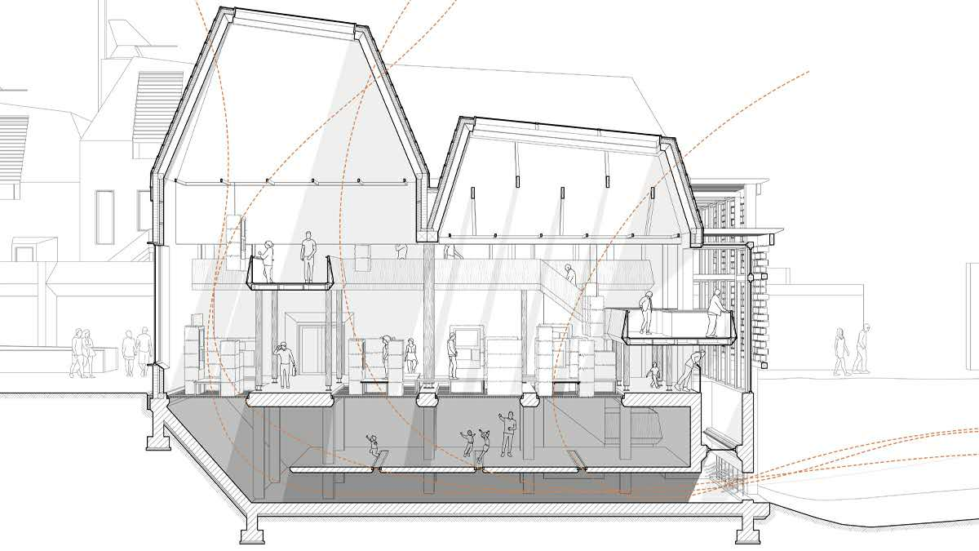
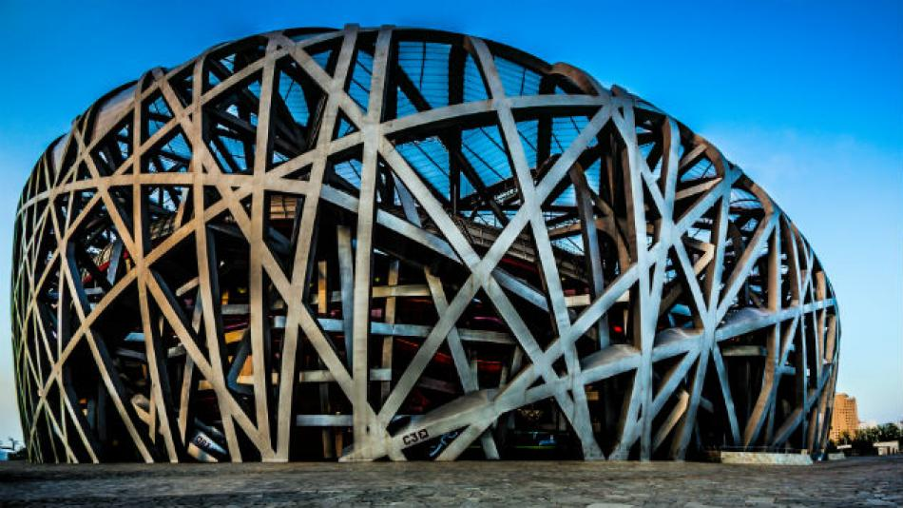
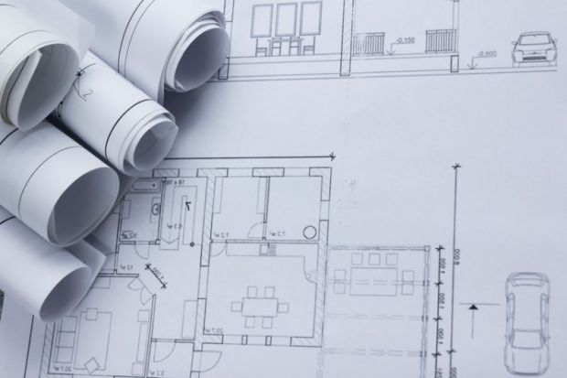
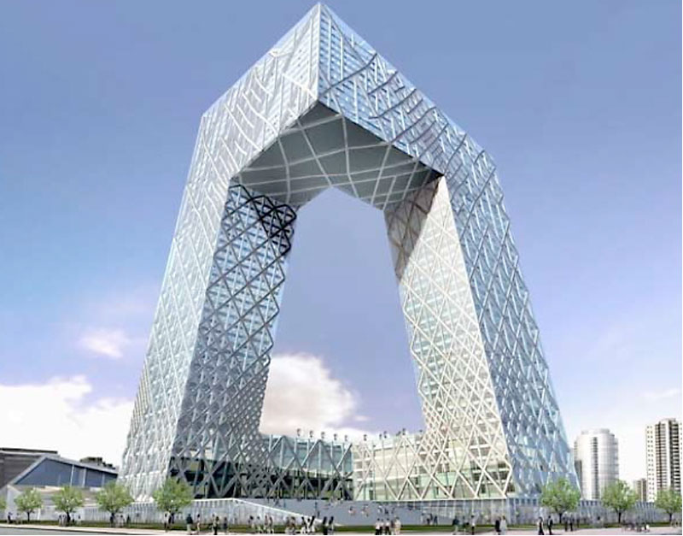
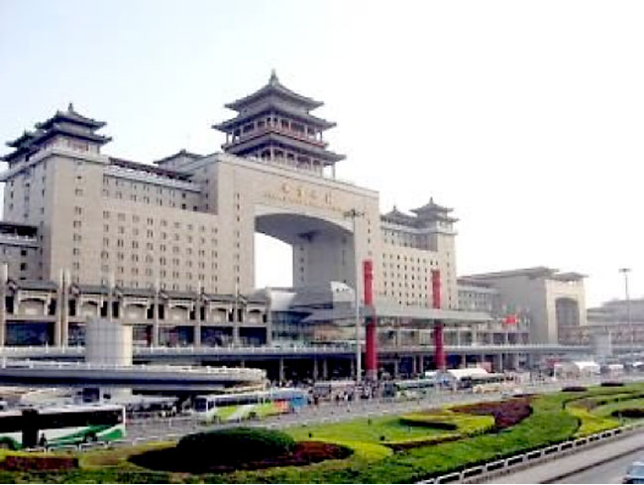
Architecture

Slide 5
Architecture
The process of planning, designing and constructing structures

Slide 6
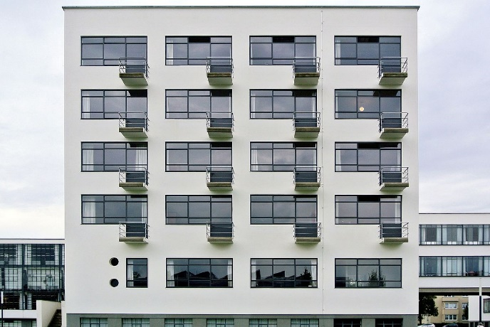
Architecture
The process of planning, designing and constructing structures
Building

Slide 7
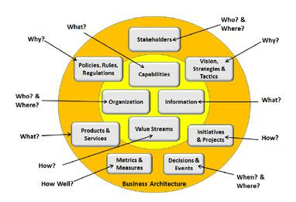
Architecture
The process of planning, designing and constructing structures
Building
Business

Slide 8
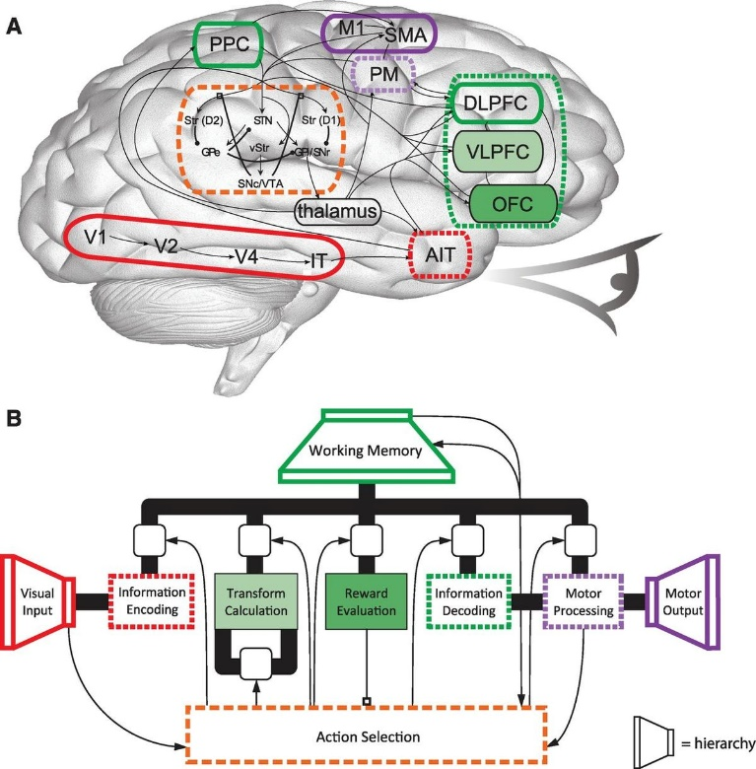
Architecture
The process of planning, designing and constructing structures
Building
Business
Cognitive

Slide 9
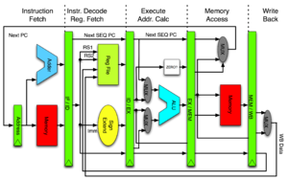
Architecture
The process of planning, designing and constructing structures
Building
Business
Cognitive
Computer

Slide 10
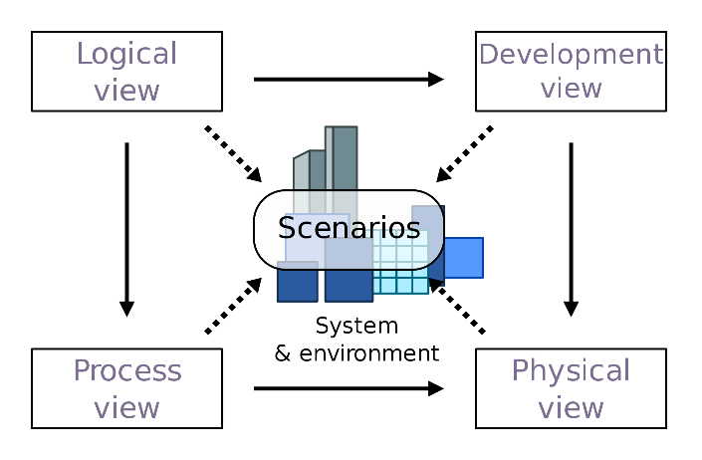
Architecture
The process of planning, designing and constructing structures
Building
Business
Cognitive
Computer
Software
…..

Slide 11
Software Architecture – definition from our textbook
The software architecture of a system is the set of structures needed to reason about the system, which comprise software elements, relations among them, and properties of both.

Slide 12
Let’s understand together what “software architecture”means

Slide 13
Consider this example
You work as a software developer and your client asked you to develop a file sharing application for them
What kind of questions do you need to ask your client before you start your work? What information do you need to know?

Slide 14
1. Perhaps you ask your client what functions the software needs to have

Slide 15
Consider this example – cont.
The client gave you these simple functional requirements
The application should enable sharing files with other users all around the world
Users need to be able to upload the files for sharing
Users need to be able to download the files they are interested in
How will you design this software?

Slide 16
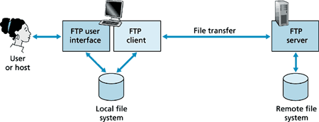
A simple solution
You decide to use a client-server model
There will be 2 main components
Client - clients initiate the transfer
Server – servers satisfy the request
In your design, the server is centralized and there can be many clients requesting the files from the server
In fact, the same model is used in The File Transfer Protocol (FTP) - a standard communication protocol used for the transfer of computer files from a server to a client on a computer network

Slide 17
Example – cont.
You develop the software based on this design, deploy it, and receive a feedback from the client that they are satisfied with the software.

Slide 18
Example – cont.
After a while, another client asks you to develop a software for them. After initial consultation, you find out that the functional requirements are almost the same
The application should enable sharing files with other users all around the world → the same
Users need to be able to upload the files for sharing → the same
Users need to be able to download the files they are interested in →the same
Users need to be able to delete the uploaded files → new function

Slide 19
Example – cont.
Since the functional requirements are the same, and the first client was happy with the software, you decide to use a client-server model for this project as well
You also add additional functions for the users to meet the new functional requirements

Slide 20
Example – cont.
You develop the software based on this design, deploy it, and receive a feedback from the client that they are NOT satisfied with the software.
What went wrong?

Slide 21
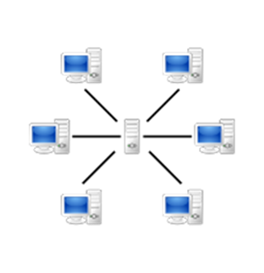
Example – cont.
After discussion with the client, you find out that the server crashes often and none of the users are able to download the file at this time
You investigate further and find out that while the first client had less than a hundred of users of the software, the second client had thousands of users that made requests from the same server at the same time
The server became overloaded and this resulted in crashes or slowing down of the connection

Slide 22
So what went wrong?
Although the two clients had the same functional requirements, but their quality requirements were different
The quality requirements were not discussed at the early stages of software design
The choice of software architecture was not guided by the quality requirements

Slide 23
How to avoid this problem?

Slide 24
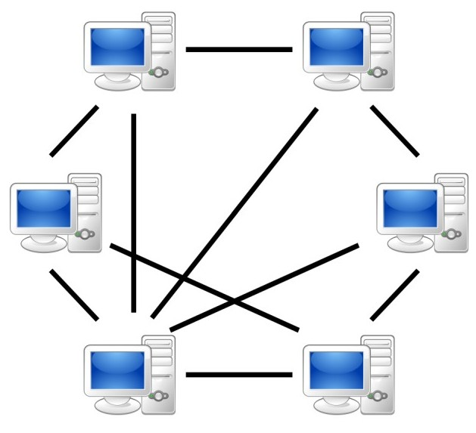
How to avoid this problem?
Select the software architecture that will be more fit for the quality requirements in the second scenario
For example, for the second file sharing system, to avoid the bottleneck caused by the central server in client-server model, you can choose P2P architecture

Slide 25
Example - conclusions
Two systems with the same functionality can have different architectures
Architectural decisions are NOT made based on functional requirements
Architecture is driven by quality requirements

Slide 26
Bonus conclusion
Two systems with different functionality can have the same architectures
Example→ client-server model can be used in
File sharing systems
Online banking
Email
Network printing
Ecommerce
…

Slide 27
Recall our course objectives
Master the basic knowledge and methods of software architecture
have the ability of system analysis, modelling and design oriented to the particular scenario
be able to make the best architectural design decisions according to the actual architectural requirements of large and complex software systems
Master the architecture technology of constructing modern large-scale and complex software system
be able to select the best technology according to the architectural requirements of the actual software project

Slide 28
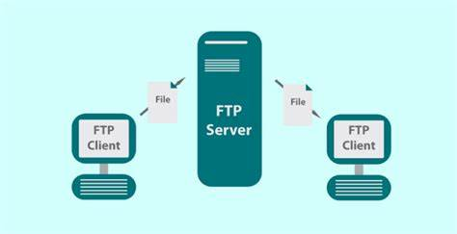
Recall Software Architecture definition
The software architecture of a system is the set of structures needed to reason about the system, which comprise software elements, relations among them, and properties of both.

Slide 29
Software Architecture
Structures of a software system
The discipline of creating such structures and systems

Slide 30
Software Architecture = Structures of a software system
Each structure compromises
Software elements
Relations among the elements
Properties of elements
Properties of relations

Slide 31
Software Architecture = the discipline of creating such structures and systems
Blueprint for the system and the developing project, laying out the task necessary to be executed by the design teams

Slide 32
Software Architecture
The software architecture of a program or computing system is the structure or structures of the system, which comprise software elements, the externally visible properties of those elements, and the relationships among them.
Notes:
软件架构是指在一定的设计原则基础上，从不同角度对组成系统的各部分进行搭配和安排，形成系统的多个结构而组成架构，它包括该系统的各个组件，组件的外部可见属性及组件之间的相互关系。组件的外部可见属性是指其他组件对该组件所做的假设。

Slide 33
Architecture Is a Set of Software Structures
A structure is a set of elements held together by a relation.
Software systems are composed of many structures, and no single structure holds claim to being the architecture.
There are three important categories of architectural structures.
Module
Component and Connector
Allocation
We will learn more about them this semester

Slide 34
Architecture vs Design
The architecture - the selection of architectural elements, their interaction and the restrictions on those elements and their interactions.
The design - modularization and the detailed interfaces of the elements of the system, their algorithms and procedures, and the kinds of data needed to support the architecture and satisfy the requirements.

Slide 35
What is Software Architecture?
The software architecture of a system is the set of structures needed to reason about the system, which comprise software elements, relations among them, and properties of both.

Slide 36
What is Software Architecture?
The software architecture of a system is the set of structures needed to reason about the system, which comprise software elements, relations among them, and properties of both.

Slide 37
Architecture is an Abstraction
An architecture specifically omits certain information about elements that is not useful for reasoning about the system.
The architectural abstraction lets us look at the system in terms of its elements, how they are arranged, how they interact, how they are composed, and so forth.
This abstraction is essential to taming the complexity of an architecture.

Slide 38
Structures and Views
We will learn more about them this semester
A view is a representation of a coherent set of architectural elements, as written by and read by system stakeholders.
A structure is the set of elements itself, as they exist in software or hardware.
In short, a view is a representation of a structure.
For example, a module structure is the set of the system’s modules and their organization.
A module view is the representation of that structure, documented according to a template in a chosen notation, and used by some system stakeholders.
Architects design structures. They document views of those structures.

Slide 39
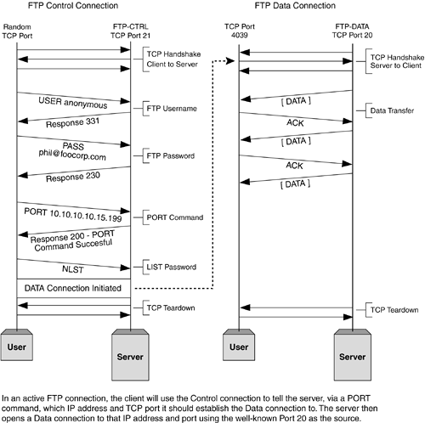
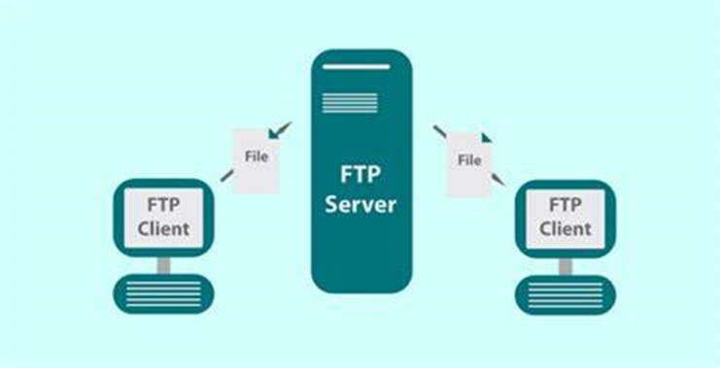
Example of views of a file sharing system

Slide 40
Architectural patterns

Slide 41


Pattern
a model or design used as a guide
an example for others to follow

Slide 42
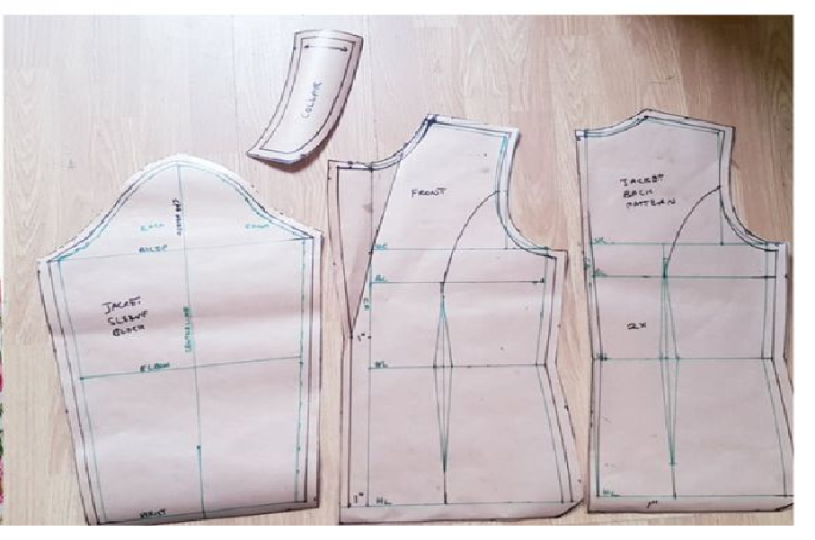
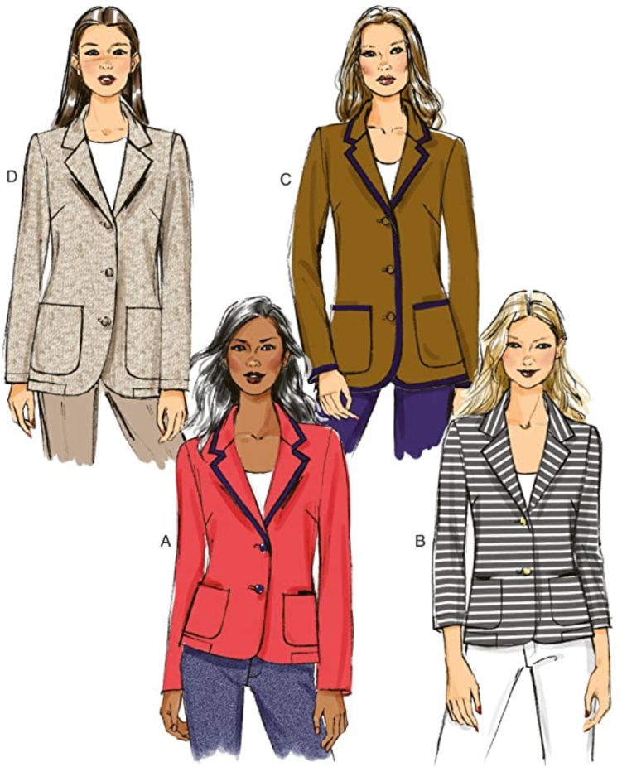
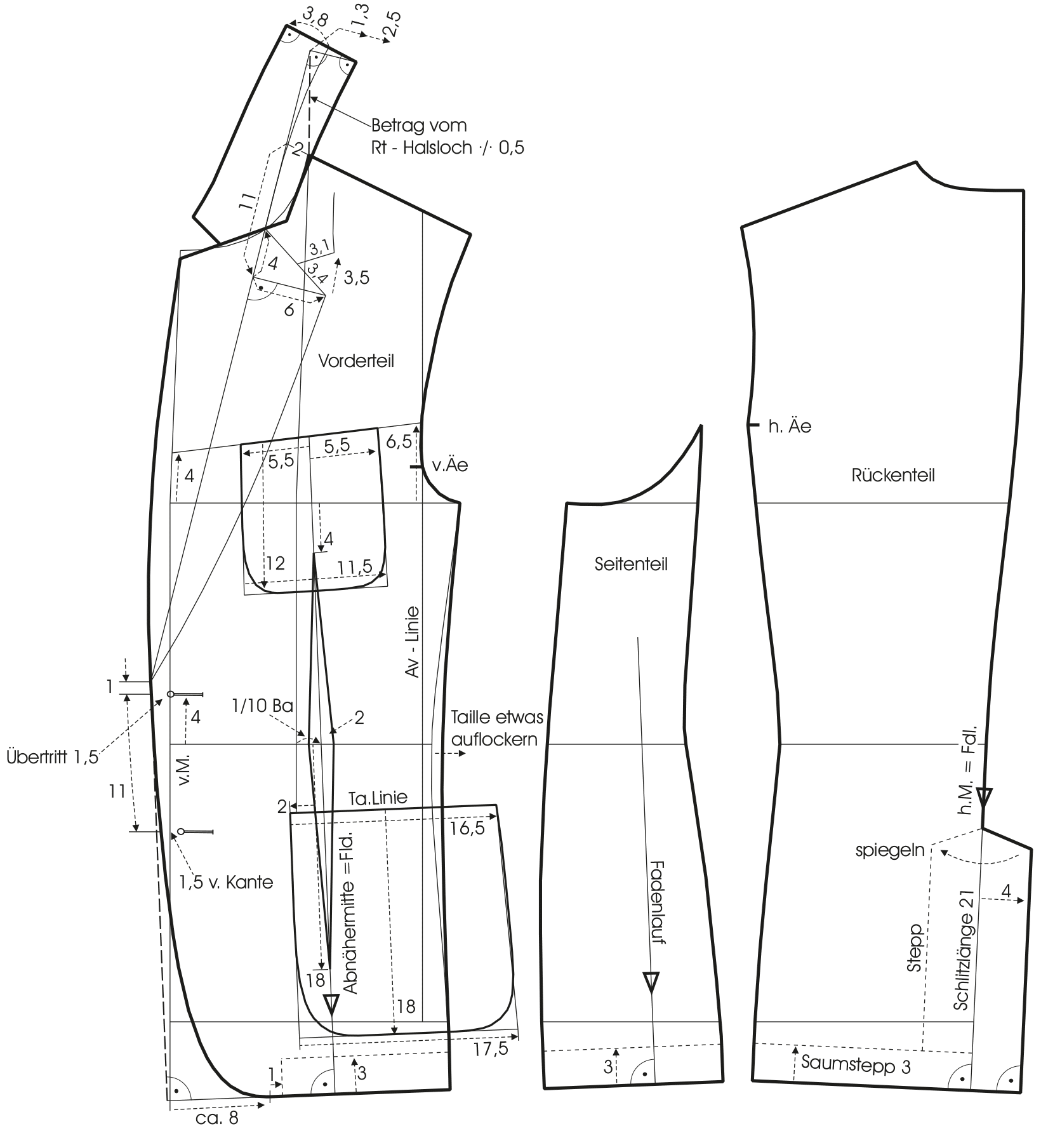
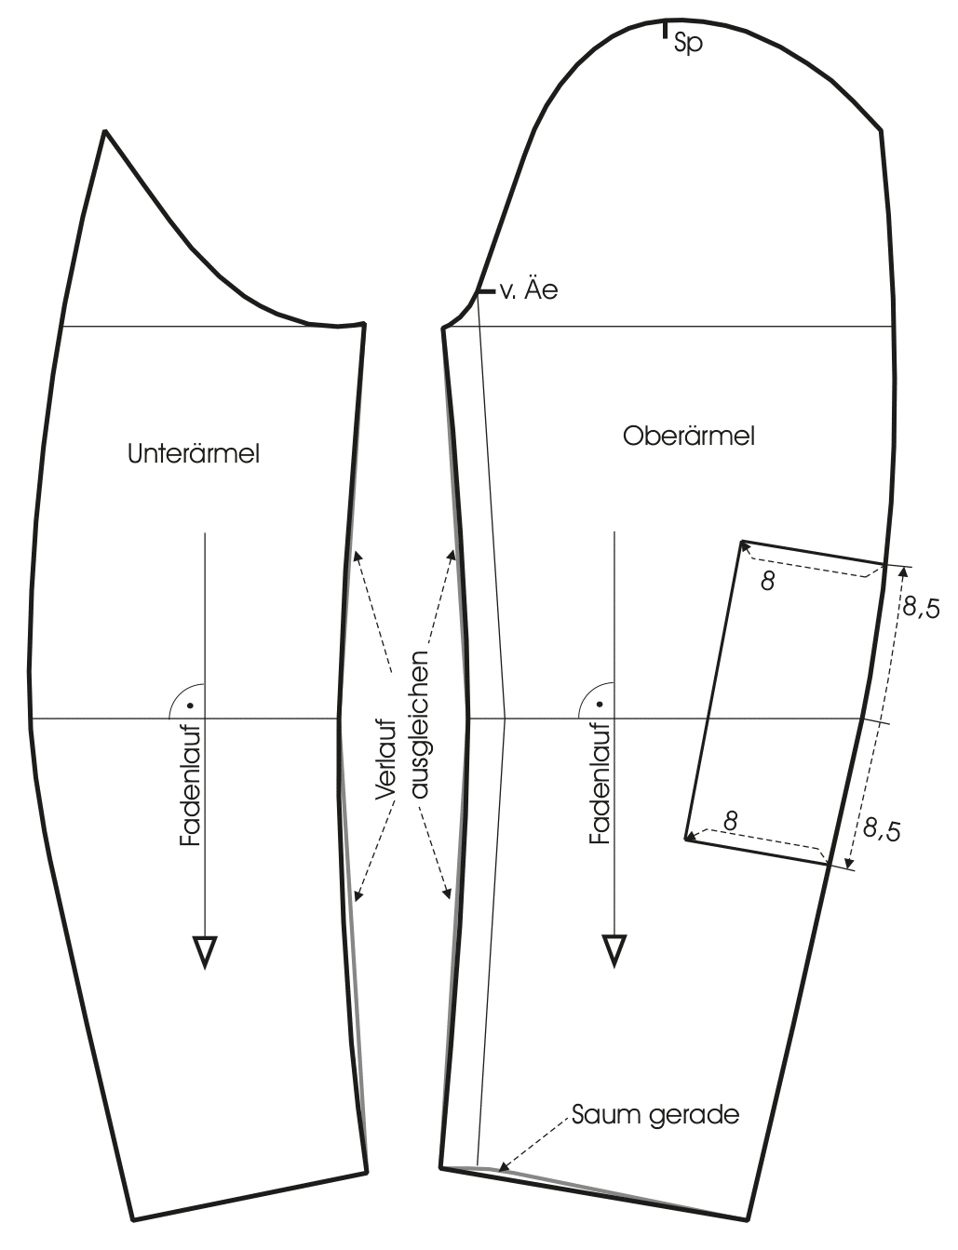
Pattern

Slide 43
Architectural Patterns
We will learn more about them this semester
Architectural elements can be composed in ways that solve particular problems.
The compositions have been found useful over time, and over many different domains
They have been documented and disseminated.
These compositions of architectural elements, called architectural patterns.
Patterns provide packaged strategies for solving some of the problems facing a system.
An architectural pattern delineates the element types and their forms of interaction used in solving the problem.

Slide 44
We will continue this lecture on Wednesday

