Slide 1
COMP3028 Software Architecture

Slide 2

Introduction to Software Architecture

Slide 3
Review – why is architecture is important

Slide 4
Inhibiting or Enabling System’s Quality Attributes
Whether a system will be able to exhibit its desired (or required) quality attributes is substantially determined by its architecture.
Performance
Modifiability
Security
Scalability
Reusability
…

Slide 5
Reasoning About and Managing Change
Architecture determines how easily changes will be accomplished in the system

Slide 6
Predicting System Qualities
When we examine an architecture we can confidently predict that the architecture will exhibit the associated qualities.
The earlier you can find a problem in your design, the cheaper, easier, and less disruptive it will be to fix.

Slide 7
Enhancing Communication Among Stakeholders
The architecture—or at least parts of it—is sufficiently abstract that most nontechnical people can understand it.
Most of the system’s stakeholders can use as a basis for creating mutual understanding, negotiating, forming consensus, and communicating with each other.

Slide 8
Earliest Design Decisions
Software architecture is a manifestation of the earliest design decisions about a system.
These early decisions affect the system’s remaining development, its deployment, and its maintenance life.

Slide 9
Defining Constraints on an Implementation
The design decisions prescribed by the architecture are constraints on the implementer

Slide 10
Influencing the Organizational Structure
Architecture prescribes the structure of the system being developed.
The architecture is typically used as the basis for the work-breakdown structure.
The work-breakdown structure in turn dictates
units of planning, scheduling, and budget
interteam communication channels
configuration and file-system organization
integration and test plans and procedures;
the maintenance activity

Slide 11
Enabling Evolutionary Prototyping
Once an architecture has been defined, it can be prototyped as a skeletal system.
A skeletal system is one in which at least some of the infrastructure is built before much of the system’s functionality has been created.
This approach allows potential performance problems to be identified early in the product’s life cycle.
These benefits reduce the potential risk in the project.

Slide 12
Improving Cost and Schedule Estimates
Architecture is used to help the project manager create cost and schedule estimates early in the project life cycle.

Slide 13
Transferable, Reusable Model
Reuse of architectures provides tremendous benefits for systems with similar requirements.

Slide 14
Using Independently Developed Components
Architecture-based development often focuses on components that are likely to have been developed separately, even independently
The payoff can be
Decreased time to market
Increased reliability
Lower cost
Flexibility (if the component you want to buy is not terribly special purpose, it’s likely to be available from several sources)

Slide 15
Restricting Design Vocabulary
As useful architectural patterns are collected, we see the benefit in restricting ourselves to a relatively small number of choices of elements and their interactions.
We minimize the design complexity of the system we are building.
Enhanced reuse
More regular and simpler designs that are more easily understood and communicated
More capable analysis
Shorter selection time
Greater interoperability.

Slide 16
Basis for Training
The architecture can serve as the first introduction to the system for new project members.
Module views show someone the structure of a project
Who does what, which teams are assigned to which parts of the system, and so forth.
Component-and-connector explains how the system is expected to work and accomplish its job.

Slide 17
End of review

Slide 18
The Many Contexts of Software Architecture

Slide 19
How is Architecture Influenced?

Slide 20
Contexts of Software Architecture
We put software architecture in its place relative to four contexts:
Technical. What technical role does the software architecture play in the system?
Project life cycle. How does a software architecture relate to the other phases of a software development life cycle?
Business. How does the presence of a software architecture affect an organization’s business environment?
Professional. What is the role of a software architect in an organization or a development project?

Slide 21
How is Architecture Influenced?

Slide 22
Technical Context
The most important technical context factor is the set of quality attributes that the architecture can help to achieve.
The architecture’s current technical environment is also an important factor.
Standard industry practices
Software engineering techniques prevalent in the architect’s professional community.

Slide 23
How is Architecture Influenced?

Slide 24
Project Life-cycle Context
Software development processes are standard approaches for developing software systems.
They tell the members of the team what to do next.
There are four dominant software development processes:
Waterfall
Iterative
Agile
Model-driven development

Slide 25
Architecture Activities
Architecture is a special kind of design, so architecture finds a home in each process of software development.
There are activities involved in creating a software architecture, using it to realize a complete design, and then implementing
Understanding the architecturally significant requirements
Creating or selecting the architecture
Documenting and communicating the architecture
Analyzing or evaluating the architecture
Implementing and testing the system based on the architecture
Ensuring that the implementation conforms to the architecture

Slide 26
How is Architecture Influenced?

Slide 27
Business Context
Systems are created to satisfy the business goals of one or more organizations.
Development organizations: e.g., make a profit, or capture market, or help their customers do their jobs better, or keep their staff employed, or make their stockholders happy
Customers have their own goals: e.g. ,make their lives easier or more productive.
Other organizations, such as subcontractors or government regulatory agencies, have their own goals
Architects need to understand the goals.
Many of these goals will influence the architecture.

Slide 28
Architecture and business goals
Notes:
Beat the market competition product -> in performance, or security, or usability
Lower the cost -> modifiability, flexibility
Have long term collaboration with some platform providers -> build the architecture based on the platform
- low the development cost -> move the office to some cheap living place, allow people to work at home

Slide 29
How is Architecture Influenced?

Slide 30
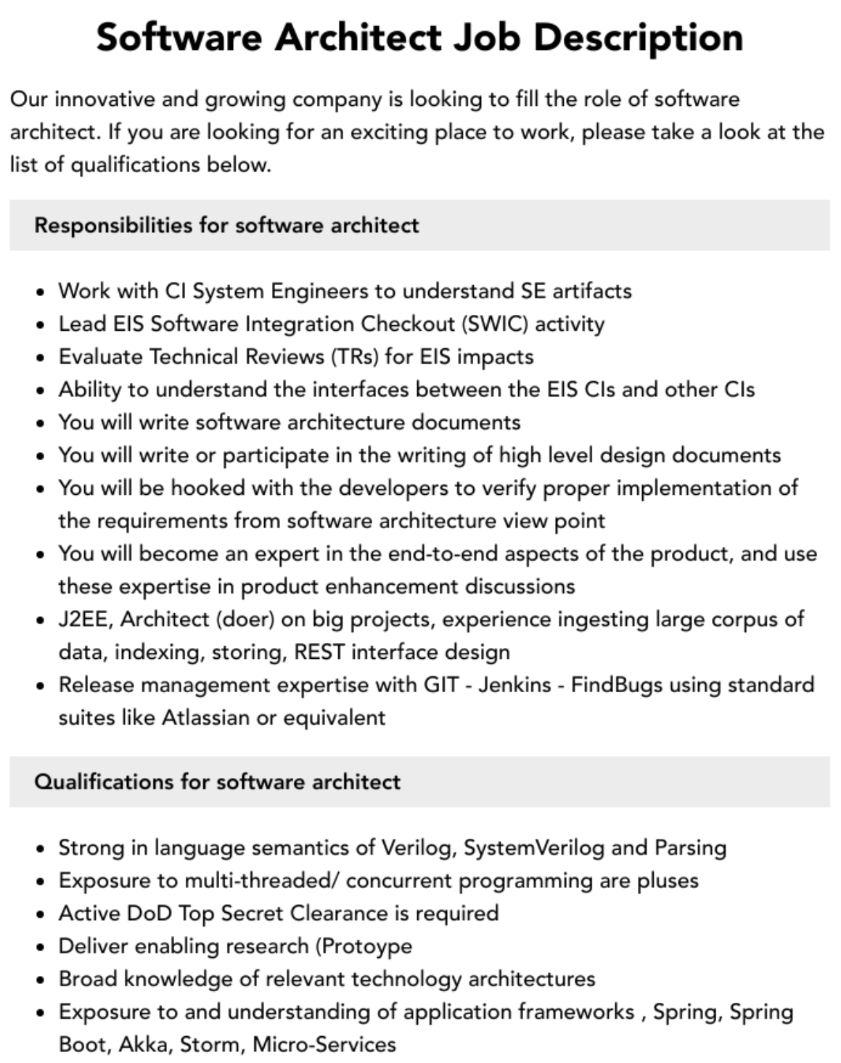
Professional Context
Software architect is a career choice

Slide 31
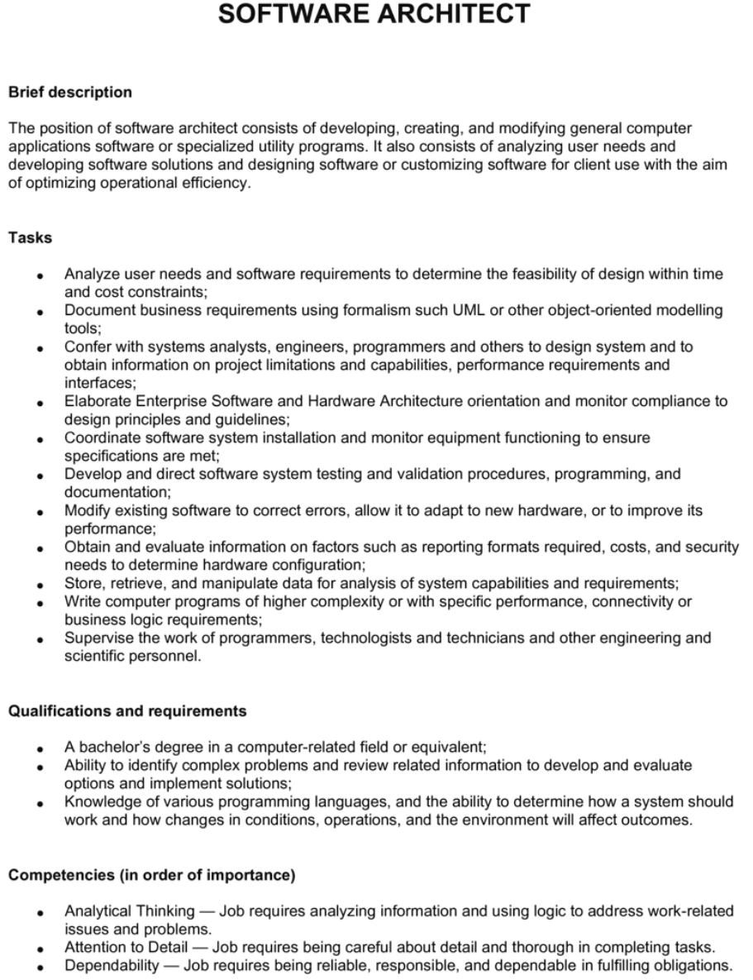
Professional Context
Software architect is a career choice

Slide 32
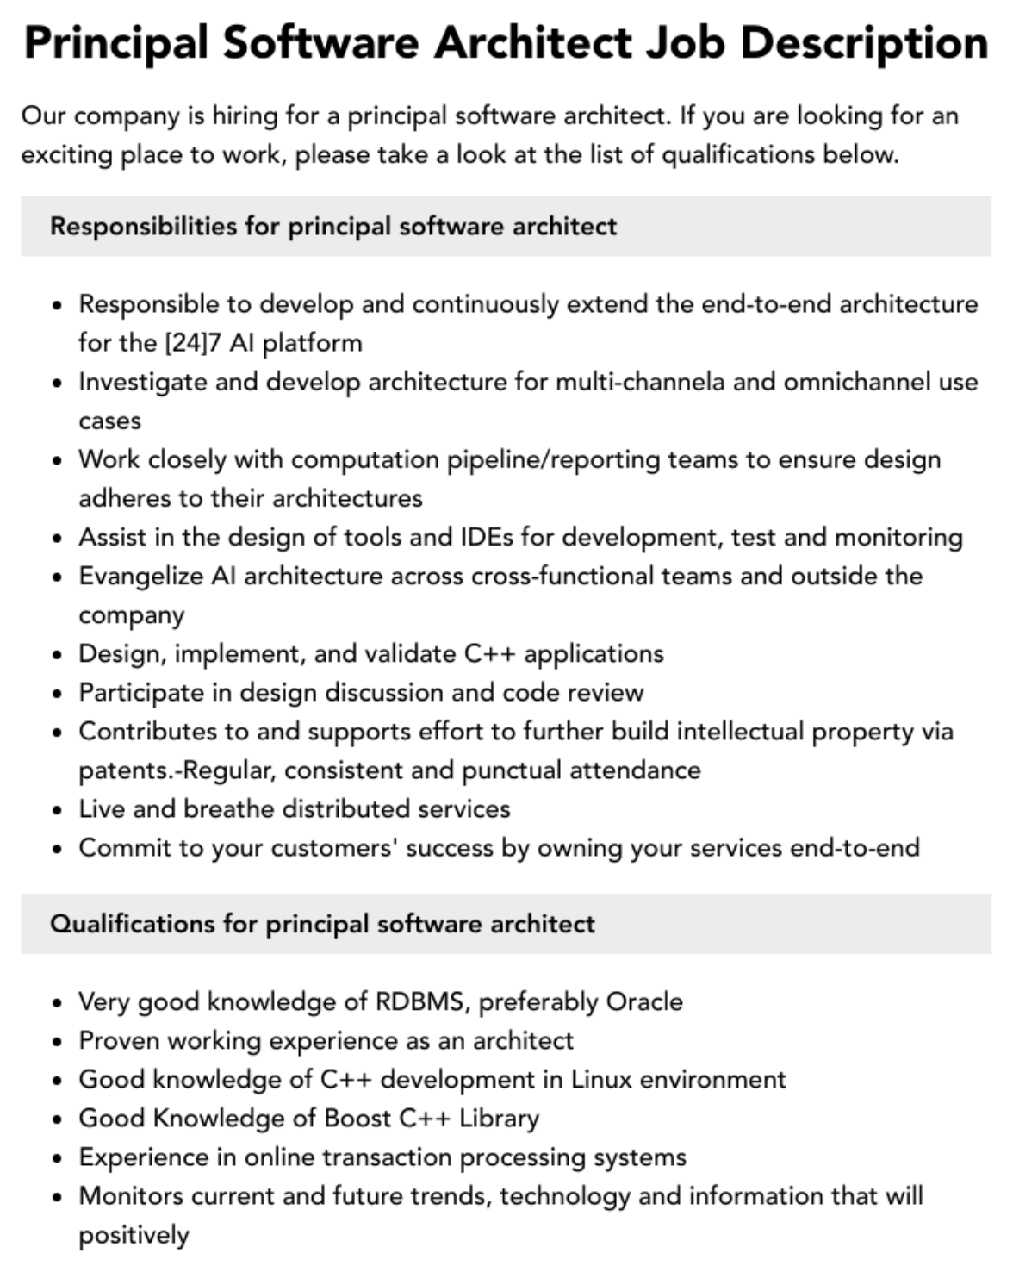
Professional Context
Software architect is a career choice

Slide 33
Professional Context
Architects need more than just technical skills.
Architects need diplomatic, negotiation, and communication skills.
Architects need the ability to communicate ideas clearly
Architects need up-to-date knowledge.
Know about (for example) patterns, or database platforms, or web services standards.
Know about business considerations.
Notes:
Architects need to explain to one stakeholder the chosen, and why particular stakeholders are not having all of their expectations fulfilled.

Slide 34
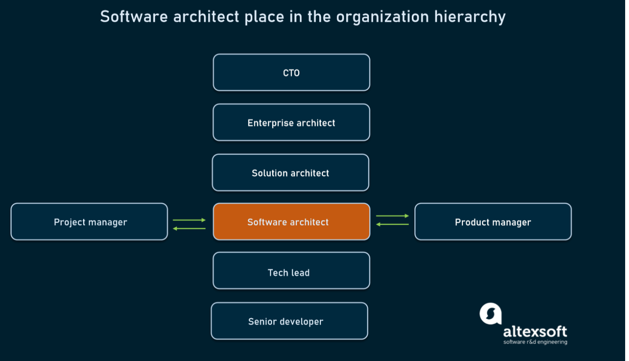
Professional Context

Slide 35
Stakeholders
A stakeholder is anyone who has a stake in the success of the system
Stakeholders typically have different specific concerns on the system
Early engagement of stakeholders to understand the constraints of the task, manage expectations, negotiate priorities, and make tradeoffs.

Slide 36
Stakeholders

Slide 37

Open Question
Points: 10
University Town, has directed its software development subsidiary, Campus Software, to develop a cafeteria system that supports a network of cafeteria Kiosks and POSs (points of sale). Kiosks are distributed in diverse locations of University Town near cafeterias and POSs are located near meal serving stations inside of cafeterias. The users are students, faculty and other employees of University Town. They use Kiosks to make queries, and funds transfers from their bank accounts to their cafeteria accounts. They use POSs to pay for their meals.
Identify as many stakeholders of this system as you can. What are their needs regarding the system?
Open Question is only supported on Version 2.0 or newer.
Answer

Slide 38
How is Architecture Influenced?

Slide 39
What Do Architectures Influence?

Slide 40
Architecture Influence Cycle
Contexts the architecture is influenced by
Business
Technical
Project
Professional
Contexts the architecture influences
Business
Technical
Project
Professional

Slide 41
What Do Architectures Influence?

Slide 42
What Do Architectures Influence?

Slide 43
What Do Architectures Influence?
Technical context
The architecture can affect stakeholder’s requirements for the next system
A customer may relax some of their requirements
Shrinkwrapped software has affected people’s requirements, as it is inexpensive and of high quality

Slide 44
What Do Architectures Influence?

Slide 45
What Do Architectures Influence?
Project context
The architecture affects the structure of the developing organization.
An architecture prescribes the units of software to be implemented and integrated to the system.
These units are the basis for the development project’s structure.
the development, test, and integration activities all revolve around the units.

Slide 46
What Do Architectures Influence?

Slide 47
What Do Architectures Influence?
Business context
The architecture can affect the business goals of the developing organization.
The architecture can provide opportunities for the efficient production and deployment of similar systems, and the organization may adjust its goals to take advantage of its newfound expertise.

Slide 48
What Do Architectures Influence?

Slide 49
What Do Architectures Influence?
Professional context
The process of system building will affect the architect’s experience
A system that was successfully built will make the architect more inclined to build systems using the same approach in the future.
Architectures that fail are less likely to be chosen for future projects.

Slide 50
Architecture Influence Cycle

Slide 51
How can this course benefit you?

Slide 52
Summary
The software architecture of a system is the set of structures needed to reason about the system, which comprise software elements, relations among them, and properties of both
An architecture has an impact on the architect, the organization, and, potentially, the industry

