Slide 1
COMP3028 Software Architecture

Slide 2
Software Architecture
Architecture modelling and representation: Architectural structures and views

Slide 3
Intended Learning Outcomes
By the end of this lesson you will be able to:
differentiate between structures and views
list useful structures and views and understand how they relate to each other
choose the relevant structure and views
combine views
use different notations to express the views

Slide 4
Materials
Textbook
Chapter 1.2
Chapter 18
Philippe Kruchten. 1995. The 4+1 View Model of Architecture. IEEE Softw. 12, 6 (November 1995), 42–50.
4+1 is a view model used for describing the architecture of software-intensive systems, based on the use of multiple, concurrent views
https://www.iso.org/standard/74393.html
the website for ISO/IEC/IEEE 42010:2022, Software, systems and enterprise — Architecture description, the latest edition of the original IEEE Std 1471:2000, Recommended Practice for Architectural Description of Software-intensive Systems.
The standard provides core terms, definitions and relationships for the description of architectures, and specifies desired properties of an Architecture Description.

Slide 5
Review

Slide 6
Software Architecture – definition from our textbook
The software architecture of a system is the set of structures needed to reason about the system, which comprise software elements, relations among them, and properties of both.

Slide 7
Architecture Is a Set of Software Structures
A structure is a set of elements held together by a relation.
Software systems are composed of many structures, and no single structure holds claim to being the architecture.
There are three important categories of architectural structures.
Module
Component and Connector
Allocation

Slide 8
Software Architecture – definition from our textbook
The software architecture of a system is the set of structures needed to reason about the system, which comprise software elements, relations among them, and properties of both.

Slide 9
End of review

Slide 10
In the next section, we will first study
the different categories of architectural structures
and how they help us to reason about the system

Slide 11
Which Structures are Architectural?
A structure is architectural if it supports reasoning about the system and the system’s properties.
The reasoning should be about an attribute of the system that is important to some stakeholder.

Slide 12
Structures and views – stakeholder perspective
To better understand it, let us look at an example of the architecture of the human body

Slide 13
Physiological Structures
Different perspectives
Different VIEWS

Slide 14
Physiological Structures
The neurologist, the orthopedist, the hematologist, and the dermatologist all have different views of the structure of a human body.
Ophthalmologists, cardiologists, and podiatrists concentrate on specific subsystems.
The kinesiologist and psychiatrist are concerned with different aspects of the entire arrangement’s behavior.
Although these views are pictured differently and have different properties, all are inherently related, interconnected.
Together they describe the architecture of the human body.
So it is with software!

Slide 15
Architecture Is a Set of Software Structures
A structure is a set of elements held together by a relation.
Software systems are composed of many structures, and no single structure holds claim to being the architecture.

Slide 16
Which Structures are Architectural?
A structure is architectural if it supports reasoning about the system and the system’s properties.
The reasoning should be about an attribute of the system that is important to some stakeholder.

Slide 17
Stakeholder
Earlier, we already gave some examples of stakeholders,
Today let’s have a look how the ISO/IEC/IEEE 42010:2022 standard defines stakeholders

Slide 18
Definition of a stakeholder in the ISO/IEC/IEEE 42010:2022 standard
To fully understand this definition, we need to read other definitions in this standard

Slide 19
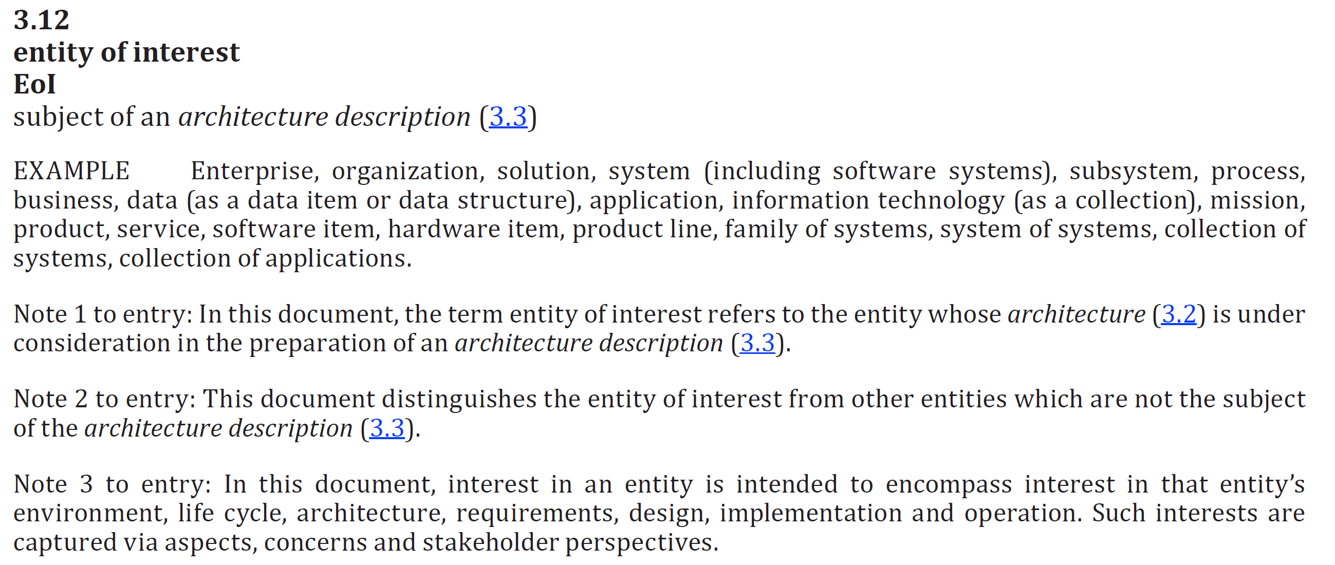

Slide 20
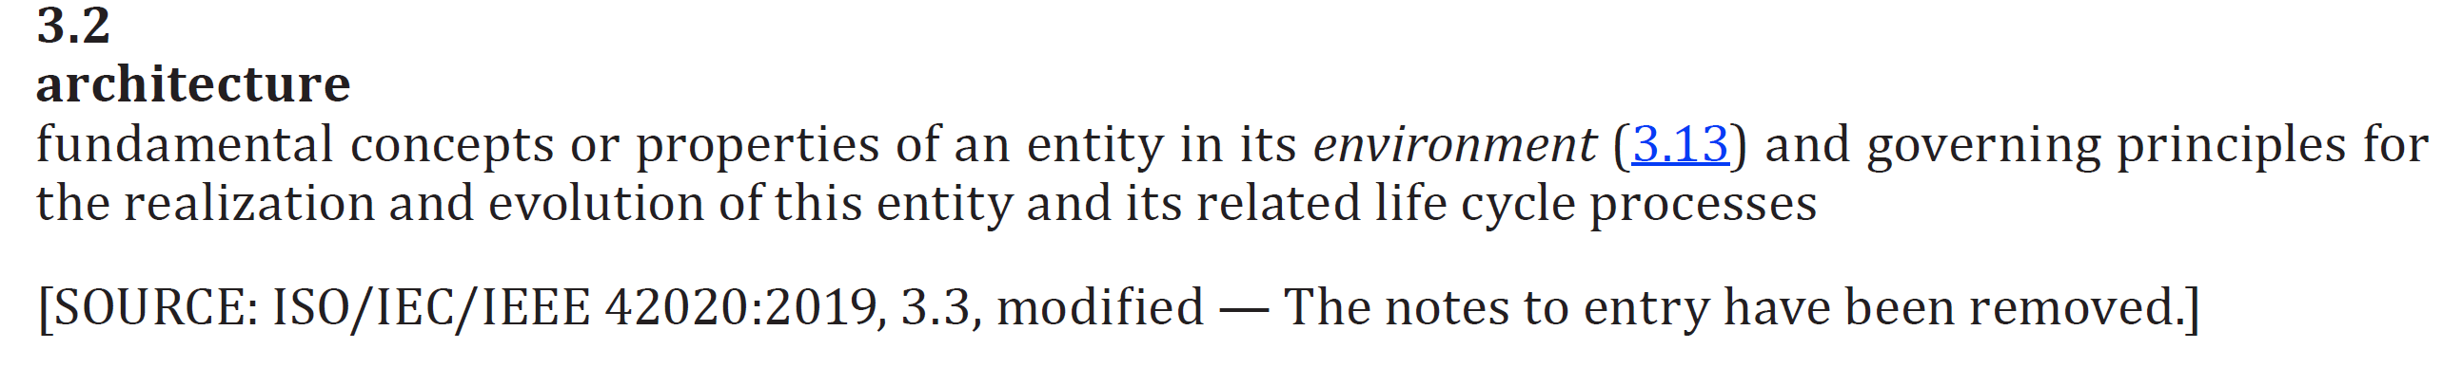

Slide 23
Stakeholder perspectives
Stakeholder perspectives are ways of thinking about the software in a context, especially as they relate to concerns
There are often multiple stakeholder perspectives on any software system
EXAMPLE – a mobile app may have the following perspectives
Development perspective
Deployment perspective
Customization perspective
Each perspective results in one or more concerns

Slide 24
Stakeholder concerns
Concerns are matters of interest or importance to one or more stakeholders
A concern can be shared by one or more stakeholders
A stakeholder can hold more than one concern
During the software life cycle, concerns can arise at any time including (but not limited to) during conceptualization, when design choices are made, from construction or implementation, through deployment, operation, transfer of ownership, retirement and disposal.

Slide 25
Concerns examples
How is the system maintained?
What system behaviours are safety-critical?
What is the cost to operate?
In case of a flight navigation system of a commercial aircraft, what is GPS signal availability, tracking, degree of accuracy, line of sight reception, altitude or elevations?
What is the system’s ability to maintain confidentiality, integrity, and availability for protecting operations?
What is the ability to support a seamless transition from a legacy capability to a modernized operational capability?

Slide 26
Which Structures are Architectural?
The reasoning should be about an attribute of the system that is important to some stakeholder.
These include
functionality achieved by the system
the availability of the system in the face of faults
the difficulty of making specific changes to the system
the responsiveness of the system to user requests,
many others
…

Slide 27
Architecture Is a Set of Software Structures
A structure is a set of elements held together by a relation.
Software systems are composed of many structures, and no single structure holds claim to being the architecture.
There are three important categories of architectural structures.
Module
Component and Connector
Allocation

Slide 28
Module Structures
Some structures partition systems into implementation units, which we call modules.
Modules are assigned specific computational responsibilities, and are the basis of work assignments for programming teams.
In large projects, these elements (modules) are subdivided for assignment to sub-teams.

Slide 29
Component-and-connector Structures
Other structures focus on the way the elements interact with each other at runtime to carry out the system’s functions.
We call runtime structures component-and-connector (C&C) structures.
In our use, a component is always a runtime entity.
In SOA, the system is to be built as a set of services.
These services are made up of (compiled from) the programs in the various implementation units – modules.

Slide 30
Allocation Structures
Allocation structures describe the mapping from software structures to the system’s environments
For example
Modules are assigned to teams to develop, and assigned to places in a file structure for implementation, integration, and testing.
Components are deployed onto hardware in order to execute.

Slide 31

Poll
1 answer(s) at most
Programming team developing our cafeteria system wants to know what units of implementation will be assigned with functional responsibilities. Which structures can help reason about that?
A
Module structures
B
Component and connector structures
C
Allocation structures
Submit

Slide 32
Multiple Choice(single)
Points: 1
Programming team developing our cafeteria system wants to know what units of implementation will be assigned with functional responsibilities. Which structures can help reason about that?
A
Module structures
B
Component and connector structures
C
Allocation structures
Submit

Slide 33
Structures Provide Insight
Each structure provides a perspective for reasoning about some of the relevant quality attributes.
For example:
The module structure, which embodies what modules use what other modules, is strongly tied to the ease with which a system can be extended.
The concurrency structure (belongs to the component-connector category), which embodies parallelism within the system, is strongly tied to the ease with which a system can be made free of deadlock and performance bottlenecks.
The deployment structure (belongs to the allocation category) is strongly tied to the achievement of performance, availability, and security goals.

