Slide 1
COMP3028 Software Architecture

Slide 2
Software Architecture
Architecture modelling and representation: Architectural structures and views

Slide 3
Intended Learning Outcomes
By the end of this lesson you will be able to:
differentiate between structures and views
list useful structures and views and understand how they relate to each other
choose the relevant structure and views
combine views
use different notations to express the views

Slide 4
Materials
Textbook
Chapter 1.2
Chapter 18
Philippe Kruchten. 1995. The 4+1 View Model of Architecture. IEEE Softw. 12, 6 (November 1995), 42–50.
4+1 is a view model used for describing the architecture of software-intensive systems, based on the use of multiple, concurrent views
https://www.iso.org/standard/74393.html
the website for ISO/IEC/IEEE 42010:2022, Software, systems and enterprise — Architecture description, the latest edition of the original IEEE Std 1471:2000, Recommended Practice for Architectural Description of Software-intensive Systems.
The standard provides core terms, definitions and relationships for the description of architectures, and specifies desired properties of an Architecture Description.

Slide 5
Review

Slide 6
Software systems are composed of many structures
The software architecture of a system is the set of structures that supports reasoning about the system and the system’s properties.
The reasoning should be about an attribute of the system that is important to some stakeholder.

Slide 7
Stakeholders

Slide 8
Software systems are composed of many structures
The software architecture of a system is the set of structures that supports reasoning about the system and the system’s properties.
There are often multiple stakeholder perspectives on any software system
The reasoning should be about an attribute of the system that is important to some stakeholder.

Slide 9
Stakeholder perspectives
There are often multiple stakeholder perspectives on any software system
ways of thinking about the software
For example, a mobile app may have the following perspectives
Development
Deployment
Customization

Slide 10
Software systems are composed of many structures
The software architecture of a system is the set of structures that supports reasoning about the system and the system’s properties.
There are often multiple stakeholder perspectives on any software system
Each perspective results in one or more concerns
The reasoning should be about an attribute of the system that is important to some stakeholder.

Slide 11
Stakeholder concerns
Concerns are matters of interest or importance to one or more stakeholders
A concern can be shared by one or more stakeholders
A stakeholder can hold more than one concern
How is the system maintained?
What system behaviours are safety-critical?
What is the cost to operate?

Slide 12
Software systems are composed of many structures
The software architecture of a system is the set of structures that supports reasoning about the system and the system’s properties.
There are often multiple stakeholder perspectives on any software system
Each perspective results in one or more concerns
The reasoning should be about an attribute of the system that is important to some stakeholder.

Slide 13
Which Structures are Architectural?
The reasoning should be about an attribute of the system that is important to some stakeholder.
These include
functionality achieved by the system
the availability of the system in the face of faults
the difficulty of making specific changes to the system
the responsiveness of the system to user requests,
many others
…

Slide 14
Architecture Is a Set of Software Structures
A structure is a set of elements held together by a relation.
Software systems are composed of many structures, and no single structure holds claim to being the architecture.
There are three important categories of architectural structures.
Module
Component and Connector
Allocation

Slide 15
Module Structures
Some structures partition systems into implementation units, which we call modules.
Modules are assigned specific computational responsibilities, and are the basis of work assignments for programming teams.
In large projects, these elements (modules) are subdivided for assignment to sub-teams.

Slide 16
Component-and-connector Structures
Other structures focus on the way the elements interact with each other at runtime to carry out the system’s functions.
We call runtime structures component-and-connector (C&C) structures.
In our use, a component is always a runtime entity.
In SOA, the system is to be built as a set of services.
These services are made up of (compiled from) the programs in the various implementation units – modules.

Slide 17
Allocation Structures
Allocation structures describe the mapping from software structures to the system’s environments
For example
Modules are assigned to teams to develop, and assigned to places in a file structure for implementation, integration, and testing.
Components are deployed onto hardware in order to execute.

Slide 18
Structures Provide Insight
Each structure provides a perspective for reasoning about some of the relevant quality attributes.
For example:
The module structure, which embodies what modules use what other modules, is strongly tied to the ease with which a system can be extended.
The concurrency structure (belongs to the component-connector category), which embodies parallelism within the system, is strongly tied to the ease with which a system can be made free of deadlock and performance bottlenecks.
The deployment structure (belongs to the allocation category) is strongly tied to the achievement of performance, availability, and security goals.

Slide 19
Software systems are composed of many structures
The software architecture of a system is the set of structures that supports reasoning about the system and the system’s properties.
There are often multiple stakeholder perspectives on any software system
Each perspective results in one or more concerns
The reasoning should be about an attribute of the system that is important to some stakeholder.

Slide 20
End of review

Slide 21
We know understand that the structures can in fact help us to reason about different attributes of the system that has not been developed yet
In the next section, we will see more examples:
the different categories of architectural structures
and how they help us to reason about the system

Slide 22
We introduced these 3 categories of structures
Module
Component-connector
Allocation
Let’s first have a quick look to see what kind of questions about the system can structures from each category help us answer

Slide 23
Module Structures
Module structures embody decisions as to how the system is to be structured as a set of code or data units
In any module structure, the elements are modules of some kind (perhaps classes, or layers, or merely divisions of functionality, all of which are units of implementation).
Modules are assigned areas of functional responsibility.

Slide 24
Component-and-connector Structures
Component-and-connector structures embody decisions as to how the system is to be structured as a set of elements that have runtime behavior (components) and interactions (connectors).
Elements are runtime components such as services, peers, clients, servers, or many other types of runtime element)
Connectors are the communication vehicles among components, such as call-return, process synchronization operators, pipes, or others.

Slide 25
Component-and-connector Structures
Component-and-connector views help us answer questions such as these:
What are the major executing components and how do they interact at runtime?
What are the major shared data stores?
Which parts of the system are replicated?
How does data progress through the system?
What parts of the system can run in parallel?

Slide 26
Allocation structures
Allocation structures show the relationship between the software elements and elements in one or more external environments in which the software is created and executed.
Allocation views help us answer questions such as these:
What processor does each software element execute on?
In what directories or files is each element stored during development, testing, and system building?
What is the assignment of each software element to development teams?

Slide 27
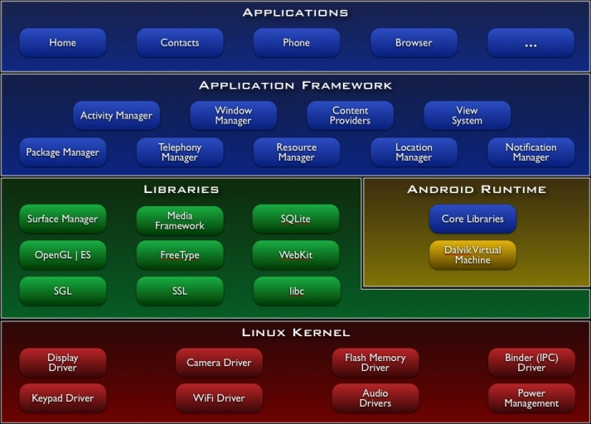
Which kind of structure is represented in this figure?

Slide 28

Poll
2 answer(s) at most
Which kind of structure is represented in this figure?
A
Module structure
B
Component and connector structure
C
Allocation structure
Submit

Slide 29
Multiple Choice(multiple)
Points: 1
Which kind of structure is represented in this figure?
A
Module structure
B
Component and connector structure
C
Allocation structure
Submit

Slide 30
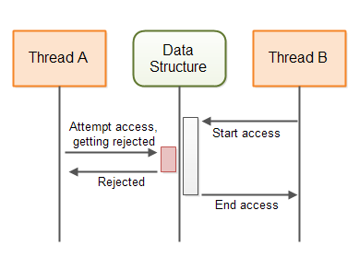
How about this structure?

Slide 31
Poll
2 answer(s) at most
Which kind of structure is represented in this figure?
A
Module structure
B
Component and connector structure
C
Allocation structure
Submit

Slide 32
Multiple Choice(multiple)
Points: 1
Which kind of structure is represented in this figure?
A
Module structure
B
Component and connector structure
C
Allocation structure
Submit

Slide 33
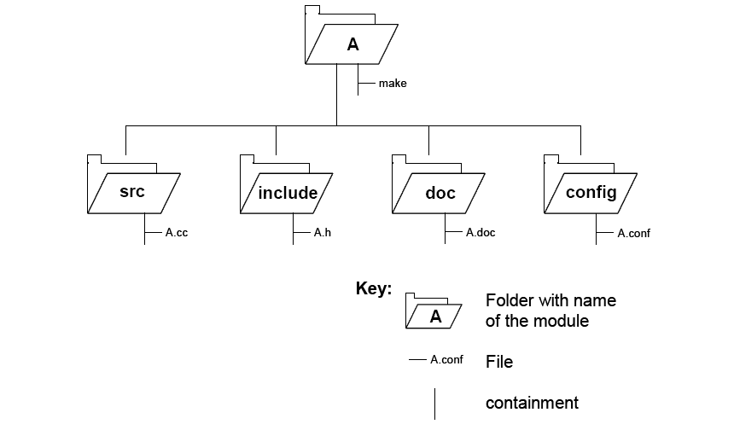
What about this one?

Slide 34
Poll
2 answer(s) at most
Which kind of structure is represented in this figure?
A
Module structure
B
Component and connector structure
C
Allocation structure
Submit

Slide 35
Multiple Choice(multiple)
Points: 1
Which kind of structure is represented in this figure?
A
Module structure
B
Component and connector structure
C
Allocation structure
Submit

Slide 36
We have seen some examples of structures
We will now look at more useful structures from each category
Each of them can provide us with different insights about the system – can help us reason about different aspects of the system

Slide 37
Some Useful Module Structures

Slide 38
Some Useful Module Structures
Decomposition structure
The units are modules that are related to each other by the is-a-submodule-of relation.
It shows how modules are decomposed into smaller modules recursively until the modules are small enough to be easily understood.
Modules often have products (such as interface specifications, code, test plans, etc.) associated with them.
What does this structure help us to reason about?

Slide 39
Decomposition structure: an example

Slide 40
Some Useful Module Structures
Decomposition structure
The units are modules that are related to each other by the is-a-submodule-of relation.
It shows how modules are decomposed into smaller modules recursively until the modules are small enough to be easily understood.
Modules often have products (such as interface specifications, code, test plans, etc.) associated with them.
The decomposition structure determines, to a large degree, the system’s modifiability, by assuring that likely changes are localized.

Slide 41
Some Useful Module Structures
Uses structure.
The units here are also modules, perhaps classes.
The units are related by the uses relation, a specialized form of dependency.
A unit of software uses another if the correctness of the first requires the presence of a correctly functioning version (as opposed to a stub) of the second.
What does this structure help us to reason about?

Slide 42
Uses structure: an example

Slide 43
Some Useful Module Structures
Uses structure.
The units here are also modules, perhaps classes.
The units are related by the uses relation, a specialized form of dependency.
A unit of software uses another if the correctness of the first requires the presence of a correctly functioning version (as opposed to a stub) of the second.
The ability to easily create a subset of a system allows for incremental development.

Slide 44
Some Useful Module Structures
Layer structure
The modules in this structure are called layers.
A layer is an abstract “virtual machine” that provides a cohesive set of services through a managed interface.
Layers are allowed to use other layers in a strictly managed fashion.
In strictly layered systems, a layer is only allowed to use a single other layer.
What does this structure help us to reason about?

Slide 46
Some Useful Module Structures
Layer structure
The modules in this structure are called layers.
A layer is an abstract “virtual machine” that provides a cohesive set of services through a managed interface.
Layers are allowed to use other layers in a strictly managed fashion.
In strictly layered systems, a layer is only allowed to use a single other layer.
This structure imbues a system with portability, the ability to change the underlying computing platform.

Slide 47
Some Useful Module Structures
Class (or generalization) structure
The module units in this structure are called classes.
The relation is inherits from or is an instance of.
Inheritance is a mechanism for code reuse and to allow independent extensions of the original software
What does this structure help us to reason about?

Slide 48
Some Useful Module Structures
Class (or generalization) structure
The module units in this structure are called classes.
The relation is inherits from or is an instance of.
Inheritance is a mechanism for code reuse and to allow independent extensions of the original software
The class structure allows one to reason about reuse and the incremental addition of functionality.

Slide 49
Some Useful Module Structures
There are more useful module structures described in your book

Slide 50
Some Useful C&C Structures
Service structure
The units are services that interoperate with each other by service coordination mechanisms such as SOAP
The service structure helps to engineer a system composed of components that may have been developed anonymously and independently of each other.
Notes:
Example of web service: soap, xml and json

Slide 51
Some Useful C&C Structures
Concurrency structure
This structure helps determine opportunities for parallelism and the locations where resource contention may occur.
The units are components
The connectors are their communication mechanisms.
The components are arranged into logical threads.

Slide 53
Some Useful Allocation Structures
Deployment structure
The deployment structure shows how software is assigned to hardware processing and communication elements.
The elements are software elements (usually a process from a C&C view), hardware entities (processors), and communication pathways.
Relations are allocated-to, showing on which physical units the software elements reside, and migrates-to if the allocation is dynamic.
This structure can be used to reason about performance, data integrity, security, and availability.
It is of particular interest in distributed and parallel systems.

Slide 54
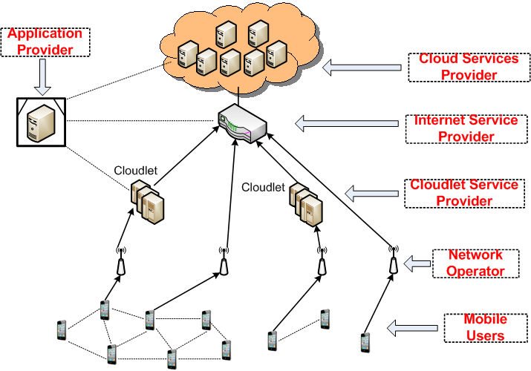
Task allocation in mobile cloud

Slide 55
Some Useful Allocation Structures
Implementation structure
This structure shows how software elements (usually modules) are mapped to the file structure(s) in the system’s development, integration, or configuration control environments.

Slide 56
Implementation structure

Slide 57
Some Useful Allocation Structures
Work assignment structure
This structure assigns responsibility for implementing and integrating the modules to the teams who will carry it out.

Slide 58
Some Useful Structures
There are more useful structures described in your book

Slide 59
What can be reasoned from structures

Slide 60
Relating Structures to Each Other
Elements of one structure will be related to elements of other structures, and we need to reason about these relations.
A module in a decomposition structure may be manifested as one, part of one, or several components in one of the component-and-connector structures.
In general, mappings between structures are many to many.

Slide 61
Example: Modules vs. Components

Slide 62
Open Question
Points: 10
Why do we need both views of this system?
Open Question is only supported on Version 2.0 or newer.
Answer

Slide 63
Open Question
Points: 10
Why do we need both views of this system?
Tip: what different things can we reason from each of the views?
Open Question is only supported on Version 2.0 or newer.
Answer

Slide 64
Documenting views

Slide 65
Architecture Documentation
Even the best architecture will be useless if the people who need it
do not know what it is;
cannot understand it well enough to use, build, or modify it;
misunderstand it and apply it incorrectly.
All of the effort, analysis, hard work, and insightful design on the part of the architecture team will have been wasted.

Slide 66
Three Uses for Architecture Documentation
1. Education - Introducing people to the system
2. Primary vehicle for communication among stakeholders
3. Basis for system analysis and construction

Slide 67
Three Uses for Architecture Documentation
Education
Introducing people to the system
New members of the team
External analysts or evaluators
New architect

Slide 68
Three Uses for Architecture Documentation
Primary vehicle for communication among stakeholders
Especially architect to developers
Especially architect to future architect!

Slide 69
Three Uses for Architecture Documentation
Basis for system analysis and construction
Architecture tells implementers what to implement.
Each module has interfaces that must be provided and uses interfaces from other modules.
Documentation can serve as a receptacle for registering and communicating unresolved issues.
Architecture documentation serves as the basis for architecture evaluation.

Slide 70
Structures and Views
A structure is the set of elements itself, as they exist in software or hardware
A view is a representation of a coherent set of architectural elements, as written by and read by system stakeholders

Slide 71
Structures and Views
In short, a view is a representation of a structure.
For example, a module structure is the set of the system’s modules and their organization.
A module view is the representation of that structure, documented according to a template in a chosen notation, and used by some system stakeholders.

Slide 72
Structures and Views
Architects
design structures
document views of those structures

Slide 73
Notations
What forms of expressions do we use in architecture descriptions?

Slide 74
Notations
What forms of expressions do we use in architecture descriptions?
Informal notations

Slide 75
Informal notations
Views are depicted (often graphically) using general-purpose diagramming and editing tools
Box-and-line informal drawings annotated with such things as
the nature of the component
Properties
semantics of connections
overall system behavior
The semantics of the description are characterized in natural language

Slide 76
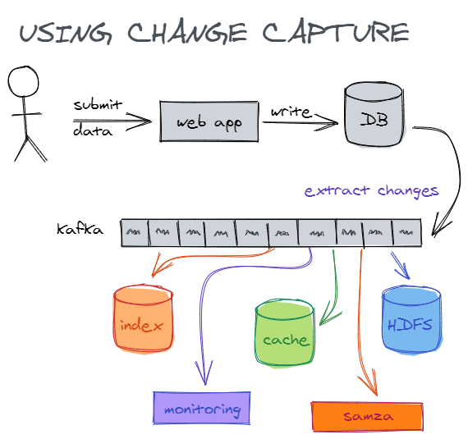
Informal notation example

Slide 77
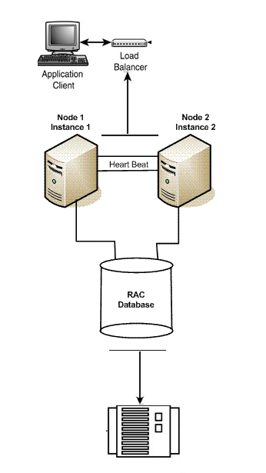
Informal notation example

Slide 78
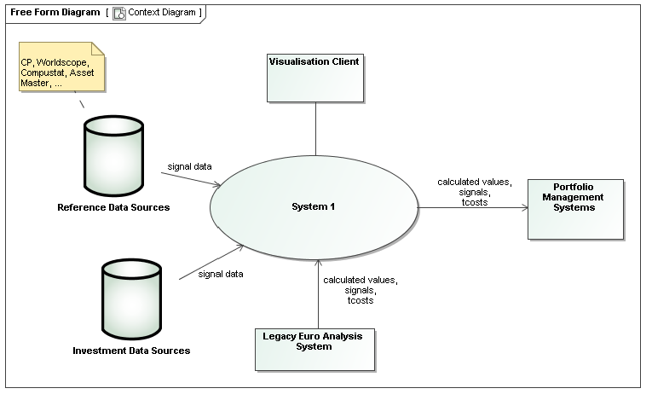
Informal notation example

Slide 79
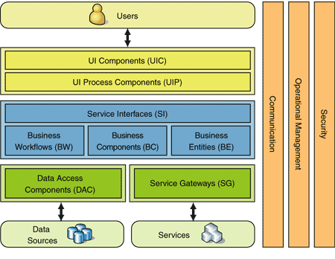
Informal notation example

Slide 80
Informal notations benefits
For a long time have been the most predominant means for describing software architectures

Slide 81
Are infromal notations good enough?

Slide 82
Informal notations drawbacks
The meaning is imprecise - their usefulness is limited
They cannot be formally analyzed
it may be impossible to analyze an architecture for consistency or determine non-trivial properties of it
there is no way to check that a system implementation is faithful to its architectural design
A more rigorous way for describing software architectures is required

Slide 83
Notations
What forms of expressions do we use in architecture descriptions?
Informal notations
Formal notations

Slide 84
Formal notations
Views are described in a notation that has a precise (usually mathematically based) semantics
Many formal architecture description languages (ADLs) have been proposed by research
Different conceptual architectural elements
Different syntax or semantics
Focusing on a specific operational domain
Only suitable for a specific analysis techniques

Slide 85
Formal notations benefits
Formal analysis of both syntax and semantics is possible
Support automation through associated tools
A standard notation for representing architectures helps promote
mutual communication
the embodiment of early design decisions
the creation of a transferable abstraction of a system

Slide 86
Formal notations drawbacks
Formal ADLs have been rarely integrated in the software life-cycle
They are seldom supported by mature tools
Focusing on very specific needs
Lack of industry adoption

Slide 87
Notations
What forms of expressions do we use in architecture descriptions?
Informal notations
Formal notations
Semiformal notations

Slide 88
Semiformal notations
A way to overcome some of the limitations of informal and formal approaches
Standardized notation that prescribes graphical elements and rules of construction
Lacks a complete semantic treatment of the meaning of those elements
Rudimentary analysis can be applied

Slide 89
UML example
UML is a semiformal notation in this sense
The Unified Modeling Language (UML) - a general-purpose, developmental modeling language in the field of software engineering that is intended to provide a standard way to visualize the design of a system
Has been embraced by the industry

Slide 90
UML example

Slide 91
UML example

Slide 92
UML example

Slide 93
UML example

Slide 94
UML example

Slide 95
Choosing a Notation
Tradeoffs
Typically, more formal notations take more time and effort to create and understand, but offer reduced ambiguity and more opportunities for analysis.
Conversely, more informal notations are easier to create, but they provide fewer guarantees.
Different notations are better (or worse) for expressing different kinds of information.
UML class diagram will not help you reason about schedulability, nor will a sequence chart tell you very much about the system’s likelihood of being delivered on time.
Choose your notations and representation languages knowing the important issues you need to capture and reason about.

Slide 96
Views
Principle of architecture documentation:
Documenting an architecture is a matter of documenting the relevant views and then adding documentation that applies to more than one view.

Slide 97
Overview of Module Views
Elements
Modules, which are implementation units of software that provide a coherent set of responsibilities.
Relations
Is part of, which defines a part/whole relationship between the submodule—the part—and the aggregate module—the whole.
Depends on, which defines a dependency relationship between two modules. Specific module views elaborate what dependency is meant.
Is a, which defines a generalization/specialization relationship between a more specific module—the child—and a more general module—the parent.

Slide 98
Overview of Module Views
Constraints
Different module views may impose specific topological constraints, such as limitations on the visibility between modules.
Usage
Blueprint for construction of the code
Change-impact analysis
Planning incremental development
Requirements traceability analysis
Communicating the functionality of a system and the structure of its code base
Supporting the definition of work assignments, implementation schedules, and budget information
Showing the structure of information that the system needs to manage

Slide 99
Module Views
It is unlikely that the documentation of any software architecture can be complete without at least one module view.

Slide 100
Module views notations
Informal:
box-and-line drawings (Nesting can represent “is part of” relations)
tables or lists (indenting can represent “is part of”)
Semi-formal:
UML class diagrams and package diagrams

Slide 101
Overview of C&C Views
Elements
Components. Principal processing units and data stores. A component has a set of ports through which it interacts with other components (via connectors).
Connectors. Pathways of interaction between components. Connectors have a set of roles (interfaces) that indicate how components may use a connector in interactions.
Relations
Attachments. Component ports are associated with connector roles to yield a graph of components and connectors.
Interface delegation. In some situations component ports are associated with one or more ports in an “internal” subarchitecture. The case is similar for the roles of a connector

Slide 102
Overview of C&C Views
Constraints
Components can only be attached to connectors, not directly to other components.
Connectors can only be attached to components, not directly to other connectors.
Attachments can only be made between compatible ports and roles.
Interface delegation can only be defined between two compatible ports (or two compatible roles).
Connectors cannot appear in isolation; a connector must be attached to a component.
Usage
Show how the system works.
Guide development by specifying structure and behavior of runtime elements.
Help reason about runtime system quality attributes, such as performance and availability.

Slide 103
Notations for C&C Views
UML components are good match for C&C components.

Slide 104
Notations for C&C Views
UML connectors are not rich enough to represent many C&C connectors.
UML connectors cannot have substructure, attributes, or behavioral descriptions.
Represent a “simple” C&C connector using a UML connector—a line.
Many commonly used C&C connectors have well-known, application-independent semantics and implementations, such as function calls or data read operations.
You can use a stereotype to denote the type of connector.
Connector roles cannot be explicitly represented with a UML connector.
The UML connector element does not allow the inclusion of interfaces.
Label the connector ends and use these labels to identify role descriptions that must be documented elsewhere.
Represent a “rich” C&C connector using a UML component, or by annotating a line UML connector with a tag that explains the meaning of the complex connector.

Slide 105
Overview of Allocation Views
Elements
Software element and environmental element.
A software element has properties that are required of the environment.
An environmental element has properties that are provided to the software.
Relations
Allocated to. A software element is mapped (allocated to) an environmental element. Properties are dependent on the particular view.

Slide 106
Overview of Allocation Views
Constraints
Varies by view
Usage
Reasoning about performance, availability, security, and safety.
Reasoning about distributed development and allocation of work to teams.
Reasoning about concurrent access to software versions.
Reasoning about the form and mechanisms of system installation.

Slide 107
Quality Views
A quality view can be tailored for specific stakeholders or to address specific concerns.
A quality view is formed by extracting the relevant pieces of structural views and packaging them together.

Slide 108
Quality Views: Examples
Security view
Show the components that have some security role or responsibility, how those components communicate, any data repositories for security information, and repositories that are of security interest.
The view’s context information would show other security measures (such as physical security) in the system’s environment.
The behavior part of a security view
Show how the operation of security protocols and where and how humans interact with the security elements.
Capture how the system would respond to specific threats and vulnerabilities.

Slide 109
Quality Views: Examples
Communications view
Especially helpful for systems that are globally dispersed and heterogeneous.
Show all of the component-to-component channels, the various network channels, quality-of-service parameter values, and areas of concurrency.
Used to analyze certain kinds of performance and reliability (such as deadlock or race condition detection).
The behavior part of this view could show (for example) how network bandwidth is dynamically allocated.

