Slide 1
ENVIRONMENTAL MANAGEMENT
Scientific, Technological, Economic, and Legal Foundations
Tran Thanh Thuong
Notes:
Hello class. In today’s lesson, we will explore the foundations of environmental management, focusing on four key dimensions: science, technology, economics, and law. These foundations help us understand not only what environmental problems are, but also why they happen and how they can be managed in a practical and integrated way.

Slide 2

Scientific and Philosophical-Social Foundations of EM
Understanding the intersection of human activity and natural systems.
Notes:
Let us begin with the first foundation: the scientific and philosophical-social foundation of environmental management. Before we can manage any environmental issue, we must first understand the relationship between humans, society, and nature. Environmental management is not only about trees, rivers, or air quality. It is also about the way people live, produce, consume, and organize society. So in this first part, we will start from the basic question: how are human beings connected to nature?

Slide 3

Warm-up Question
Why can't environmental problems be solved by technology alone?
Example: Air pollution isn't just about filters; it involves consumer behavior, transport policy, urban planning, and enforcement.
Notes:
In this section, we focus on four learning objectives: understanding the human–society–nature relationship, explaining the systems perspective, identifying the scientific basis of environmental management, and linking science with real decisions. The warm-up question asks why technology alone cannot solve environmental problems. This question prepares us to see that environmental issues are not only technical; they are also social, behavioral, and institutional.

Slide 4
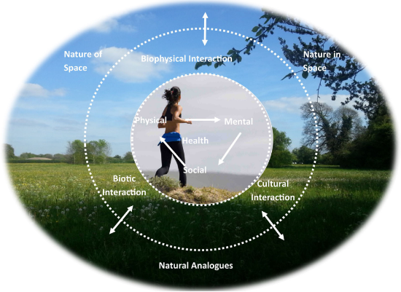


Philosophical-Social Foundation
Human – Society – Nature Interdependence
Material unity of the world: Nature and society are intrinsically connected.
Social dependency: The human–nature relationship depends entirely on stages of social development.
Conscious regulation: Humans must consciously regulate their interaction with nature to ensure sustainability.
Why this matters:
Environmental problems are not just "natural"; they are created by production, consumption, institutions, and lifestyles. EM must address both environment and society.
Notes:
In this part, we have four main learning objectives. First, we need to understand the relationship between humans, society, and nature. Second, we need to understand why environmental management requires a systems perspective. Third, we need to identify the scientific basis of environmental management. And fourth, we need to connect science with practical environmental decisions. Now think about the warm-up question: why can environmental problems not be solved by technology alone? For example, air pollution is not only a technical issue. Even if we have filters and better engines, we still need better transport policy, better urban planning, stronger enforcement, and also changes in human behavior. So from the beginning, we can already see that environmental management is broader than technology alone.

Slide 5



Systems Perspective in EM
The Environment as a System
Real Example: Rice Straw Burning
Cause: Open burning habit after harvest + lack of reuse market.
Human activities affect multiple components simultaneously.
One action can create widespread chain effects across ecosystems.
Impacts: Smoke, air pollution, traffic risk, GHG emissions.
Solutions must be integrated, not isolated.
Key Message: EM begins with understanding relationships, not isolated problems.
Lesson: This is not only a "farmer problem," but also a market, policy, and behavioral issue.
Notes:
From this relationship, we move to the systems perspective. In environmental management, we should never look at one problem in isolation. The environment is a system, and when one part changes, other parts are also affected. Let us take the example of rice straw burning. Some people may think this is only a simple farming practice after harvest. But if we look carefully, we see many connected impacts: smoke affects air quality, reduced visibility increases traffic risk, burning releases greenhouse gases, and the loss of biomass also means lost opportunities for reuse. So this is not only a farmer’s issue. It is also a market issue, a policy issue, and a behavioral issue. This is exactly why systems thinking is so important in environmental management.

Slide 6





The Scientific Basis of EM
Environmental problems are complex and interdisciplinary. EM uses natural science + social science + management science.
Ecosystems & Impacts
Indicators & Thresholds
Evidence for Decisions
Providing deep understanding of ecosystem mechanics and assessing direct/indirect impacts.
Establishing environmental indicators, evaluating resources, and defining safety standards and thresholds.
Scientific knowledge supports accurate prediction, continuous monitoring, and effective control.
Notes:
Once we understand that environmental issues are interconnected, the next question is this: what role does science play? Science provides the knowledge base for environmental management. It helps us understand how ecosystems work, how impacts spread, what indicators we should monitor, and what thresholds should not be exceeded. Science also gives us evidence for decision-making. Instead of making assumptions, we use data, observation, analysis, and prediction. For example, if we want to manage river pollution, we need scientific knowledge about water quality, pollution sources, ecosystem response, and possible risks to human health. So science is the foundation that makes environmental management more accurate, rational, and effective.

Slide 7

Application Activities
Activity: Match the Problem
Mini Case Discussion
Match the problem with the type of scientific knowledge needed:
Case: A river near a town becomes polluted.
River pollution: Water quality analysis
Questions to discuss:
Urban air pollution: Monitoring + emission data
What data do we need first?
Biodiversity loss: Ecosystem assessment
Who should collect it?
What conclusions cannot be made without solid scientific evidence?
Plastic waste on campus: Waste audit + behavior survey
Notes:
Now we apply what we have just learned. Firstly, you match the problem with the type of scientific knowledge needed. Different environmental problems require different kinds of scientific knowledge, such as water analysis, air monitoring, ecosystem assessment, or behavior surveys. If we are studying river pollution, we may need water quality analysis. If we are dealing with urban air pollution, we need monitoring data and emission data. If biodiversity is declining, we need ecosystem assessment. If there is plastic waste on campus, we may need both a waste audit and a behavior survey. Let us think about the mini case here: a river near a town becomes polluted. What should we do first? We should not jump immediately to conclusions. First, we need evidence. We need to know what pollutants are present, where they may come from, how serious the contamination is, and who has the expertise to collect and analyze the data. This reminds us that environmental decisions must begin with solid scientific understanding.

Slide 8
Technological Foundations of Environmental Management
Monitoring, treatment, GIS, modeling, and technology choice in practice.
Notes:
Now that we have discussed the scientific foundation, let us move to the technological foundation. If science helps us understand environmental problems, technology helps us act on them in practice. Technology gives us tools to measure environmental conditions, monitor changes, treat waste, control pollution, and support planning. So in this second part, we shift from understanding the problem to managing it more directly.

Slide 9

Warm-up Question: Is "better technology" always enough to solve environmental problems?
Technology in EM: Two Main Roles
Understanding the environment: Measurement, modeling, and observation.
Controlling environmental impacts: Treatment, mitigation, and prevention.
Notes:
In this section, we will identify the main technological foundations of environmental management. We will distinguish between monitoring technology and treatment technology, and we will also look at tools such as GIS, modeling, environmental impact assessment, and auditing. Here, technology has two major roles. The first role is understanding the environment through measurement, observation, and modeling. The second role is controlling environmental impacts through treatment, mitigation, and prevention. But again, think about the warm-up question: is better technology always enough? The answer is often no. Technology is very important, but without management, policy, maintenance, and public cooperation, even good technology may not work effectively.

Slide 10
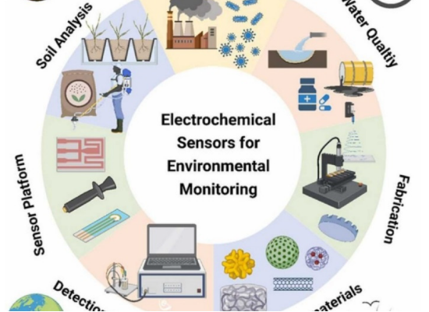
Monitoring and Control Technologies
Monitoring & Measurement
Environmental monitoring instruments
Sampling and analysis
Data collection systems & Information management
Key message: We cannot manage what we do not measure.
Notes:
Let us first look at monitoring and measurement technologies. These include environmental monitoring instruments, sampling and analysis methods, and data collection systems. These tools help us understand the current state of the environment and detect changes over time..

Slide 11
Monitoring and Control Technologies
Pollution Control Technologies
Solid waste treatment
Wastewater treatment
Air pollution control
Hazardous waste handling
Notes:
Then we have pollution control technologies. These include solid waste treatment, wastewater treatment, air pollution control, and hazardous waste handling. These are the technologies used to reduce or remove harmful impacts before they spread further. The key message here is very clear: we cannot manage what we do not measure. If we do not know the condition of the environment, the sources of pollution, or the scale of the problem, then management becomes weak and uncertain.

Slide 12


Modern Tools Highlighted in EM
GIS & Mapping
Environmental Modeling
EIA & Auditing
Spatial data, hotspot identification, land-use conflict analysis, planning and zoning support.
EIA: Before project implementation. Auditing: Check compliance and performance during operation.
Predict future impacts, compare scenarios, support early warning, and reduce uncertainty in planning.
Ex: Mapping illegal dumping sites.
Notes:
In modern environmental management, technology goes beyond treatment systems. We also use GIS and mapping to analyze spatial data, identify hotspots, and support land-use planning. For example, GIS can help us map illegal dumping sites or identify areas at high environmental risk. We also use environmental modeling to predict impacts, compare different scenarios, and reduce uncertainty in planning. In addition, EIA and environmental auditing are important management tools. EIA is used before a project begins, while auditing is used during operation to check compliance and performance. These tools help environmental management become more proactive, systematic, and evidence-based.

Slide 13

Real Example & Group Activity
Case: Factory Expansion
Choose the Right Technology
A food-processing factory wants to expand. Technology questions to ask:
Choose 1 case: Campus plastic waste, livestock waste, craft village wastewater, or construction dust/noise.
How much more wastewater will be generated?
Is the treatment system enough?
Answer:
What monitoring should be upgraded?
What tech is needed for monitoring?
What indicators should be reported?
What tech is needed for control/treatment?
What is the limitation of technology alone?
Notes:
Now let us look at a real example. Imagine that a food-processing factory wants to expand its production. At first, expansion may sound like a positive economic decision. But from an environmental management perspective, we need to ask several important questions. If production increases, how much more wastewater will be generated? Can the current treatment system handle that extra load? Does the monitoring system need to be upgraded? And what indicators should be reported to ensure proper environmental control? These are practical questions that environmental managers must ask before expansion is approved. Now in the group activity, each group chooses one case, such as campus plastic waste, livestock waste, craft village wastewater, or construction dust and noise. For your case, think about two things. First, what technology is needed for monitoring? Second, what technology is needed for control or treatment? And finally, remember to ask one more important question: what is the limitation of technology alone? This is important because environmental management is never only about installing a device or building a treatment system.

Slide 14



Real Example & Group Activity
Possible Matching Outcomes
Limits of Technology
•
Campus plastic waste: waste audit + sorting bins + recycling link
•
High capital and operational cost
•
Unequal access to modern solutions
•
Livestock waste: biogas + wastewater treatment + odor control
•
Weak maintenance infrastructure
•
Poor enforcement protocols
•
Craft village wastewater: pre-treatment + shared system + sampling
Crucial: Technology without behavior change may ultimately fail.
•
Construction dust/noise: dust/noise barriers + monitoring devices
Notes:
Now let us look at some possible answers. For campus plastic waste, a suitable combination could include a waste audit, sorting bins, and a recycling link. For livestock waste, we may think of biogas systems, wastewater treatment, and odor control. For craft village wastewater, pre-treatment, a shared treatment system, and regular sampling may be appropriate. For construction dust and noise, barriers and monitoring devices can help. However, we must also understand the limits of technology. Technology may require high capital cost and operating cost. Access to modern solutions may not be equal. Some places lack maintenance capacity. In other cases, enforcement is weak. Most importantly, if human behavior does not change, technology may fail in the long term. So technology is necessary, but it is not sufficient by itself.

Slide 15
Economic and Legal Foundations of Environmental Management
Market failures, economic instruments, legal frameworks, and integrated choices.
Notes:
In this last part of the lesson, we focus on the economic and legal foundations of environmental management. Environmental problems continue not only because of scientific uncertainty or technological limits, but also because people and organizations respond to incentives and rules. So now we shift our attention from knowledge and tools to governance, responsibility, and regulation.

Slide 16
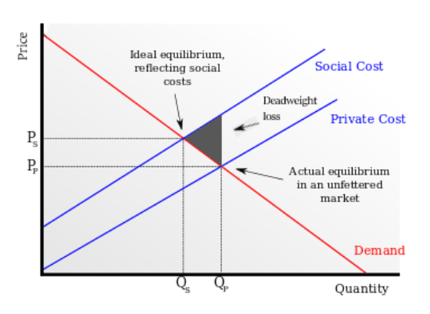
The Economic Foundation
Warm-up: Why do firms often pollute more if there are no rules or fees?
Economic Basics
Market economy affects environmental behavior.
•
Producers naturally respond to costs and incentives.
•
Government uses economic tools to actively guide behavior.
•
Understanding Externalities
•
A factory gains profit, but nearby residents bear health costs.
•
Society pays for cleanup, healthcare, and lost productivity.
•
Result: Pollution cost is not fully reflected in market price.
Notes:
Let us start with economics. Why do firms often pollute more when there are no rules or fees? The reason is that producers usually respond to costs and incentives. If polluting is cheap, and cleaner production is expensive, many firms will choose the cheaper option. This leads us to the concept of externalities. A factory may gain profit, but nearby residents may bear the health cost. Society may pay for environmental cleanup, healthcare, and lost productivity. In that situation, pollution cost is not fully reflected in the market price. This is why the market alone may fail to protect the environment, and why government intervention becomes necessary.

Slide 17
Main Economic Instruments
Why they matter: Internalize externalities, influence production/consumption, reward cleaner behavior, and discourage pollution.
Instrument Type | Simple Example / Application
Pollution Taxes | Carbon tax, fuel tax.
Fees and Charges | Wastewater discharge fee.
Subsidies | Financial support for adopting cleaner production methods.
Deposit–Refund Systems | Bottle return system to encourage recycling.
Liability Systems | The polluter must pay compensation for environmental damage.
Environmental Funds | Dedicated financial support for environmental projects.
Notes:
To address this problem, governments use economic instruments. These include pollution taxes, fees and charges, subsidies for cleaner production, deposit–refund systems, liability systems, and environmental funds. Why are these instruments important? Because they help internalize externalities. In simple words, they make polluters face more of the real environmental cost of their actions. At the same time, they can reward cleaner behavior and encourage more sustainable production and consumption patterns. So economics gives environmental management a way to influence behavior through incentives, not only through commands.

Slide 18

Class Activity: Choose the Best Instrument
Case Options
Group Discussion
Plastic bottles on campus
For your selected case, answer the following:
•
Wastewater from a factory
Which economic instrument is most suitable?
•
Rice straw burning
Why? Provide justification based on incentives.
•
Illegal dumping in a tourist area
•
What are its possible weaknesses? Consider enforcement, cost, or loopholes.
Notes:
Now let us apply this to real cases. Each group can choose one case: plastic bottles on campus, wastewater from a factory, rice straw burning, or illegal dumping in a tourist area. For your case, think about three questions. Which economic instrument is most suitable? Why is it suitable from the perspective of incentives? And what weaknesses might it have, such as problems of enforcement, cost, or loopholes? This activity is useful because it shows that economic tools are not one-size-fits-all. The best instrument depends on the nature of the problem, the actors involved, and the management context.

Slide 19

The Legal Foundation of EM
Legal Framework & Scope
•
Regulates relationships between all environmental actors.
•
•
Provides standards, rights, duties, and sanctions.
Both International and Domestic laws matter.
Notes:
Now let us turn to law. Legal tools are essential because they create binding rules. They define what is allowed and what is prohibited. They set standards, assign duties, and establish sanctions when violations occur. This slide also reminds us that both international law and domestic law matter.

Slide 20
The Legal Foundation of EM
International Law
Treaties and conventions
Customary law & Judicial decisions
Soft law instruments
Law on Environmental Protection 2020
Notes:
At the international level, treaties, conventions, and other legal instruments help address shared environmental issues.

Slide 21
The Legal Foundation of EM
Vietnam's Legal Framework
Law on Environmental Protection 2020
Decree No. 08/2022/ND-CP
Sectoral laws: water, biodiversity, forestry, minerals, marine environment
Notes:
At the national level, Vietnam has an important legal framework, including the Law on Environmental Protection 2020, Decree No. 08/2022/ND-CP, and other sectoral laws related to water, biodiversity, forestry, minerals, and the marine environment. So law gives environmental management a formal and enforceable framework.

Slide 22
Comparing Management Tools
Why legal tools are essential: They make rules mandatory, define acceptable standards, assign responsibilities, create sanctions, and support prevention and accountability.
Tool Type | Strength | Limitation
Legal Tools | Mandatory, clear boundaries, enforceable by state power. | Rigid, sometimes slow to adapt, costly to enforce continuously.
Economic Tools | Flexible, incentive-based, encourages continuous improvement. | Hard to design precisely, may face political/corporate resistance.
Notes:
At this point, we can compare legal tools and economic tools. Legal tools are strong because they are mandatory. They set clear boundaries and can be enforced by state authority. But they may also be rigid, slow to adapt, and costly to enforce continuously. Economic tools, on the other hand, are more flexible. They work through incentives and can encourage continuous improvement. But they can also be difficult to design accurately, and sometimes they face resistance from political or business interests. So which is better? In practice, neither is enough alone. The real strength of environmental management comes from combining them appropriately.

Slide 23


Integrated Tool Choice & Challenge
The Ultimate Strategy
Final Group Challenge
The best environmental management usually combines:
Scenario-based exercise. For a given scenario, choose:
•
One main problem
•
Legal tools
•
One legal tool
•
Economic tools
•
One economic tool
•
Technical tools
•
One technological support tool
Supportive tools
•
Notes:
This slide brings us to the most practical conclusion of the lesson: the best environmental management strategy usually combines multiple tools. Legal tools provide rules and standards. Economic tools shape incentives. Technical tools support monitoring and control. Supportive tools strengthen implementation. In the final group challenge, you are asked to choose one main environmental problem and then identify one legal tool, one economic tool, and one technological support tool. This reflects real environmental management practice, because in reality, we rarely solve environmental problems with only one type of tool.

Slide 24
Integrated Solutions
Scenario | Legal Tool | Economic Tool | Technological Tool
Factory wastewater | Permit + strict standards | Discharge fee / heavy fine | Treatment system + monitoring
Rice straw burning | Local no-burn regulation | Support/subsidy for straw reuse | Composting / biochar options
Campus plastic waste | Campus ban / regulation | Deposit-return / vendor fee | Sorting stations + tracking
Notes:
Here we have some examples of integrated solutions. For factory wastewater, legal tools such as permits and strict standards can be combined with discharge fees or fines, and supported by treatment systems and monitoring. For rice straw burning, local no-burn regulations can be combined with subsidies for straw reuse and supported by composting or biochar solutions. For campus plastic waste, campus regulations can work together with deposit-return systems and sorting stations. These examples show that effective environmental management is about integration. Each foundation supports the others, and together they create a more complete solution.

Slide 25








Summary
Science
Technology
Economics
Law
Gives evidence, thresholds, and deep ecosystem understanding.
Helps measure, monitor, and directly control environmental impacts.
Changes incentives and internalizes environmental externalities.
Creates binding obligations, clear standards, and strict accountability.
Effective Environmental Management requires all four foundations.
Notes:
Now let us summarize the whole lesson. Science gives us evidence, thresholds, and understanding of ecosystem processes. Technology helps us measure, monitor, and directly control environmental impacts. Economics changes incentives and helps internalize environmental costs. Law creates binding obligations, standards, and accountability. The most important message of today’s lecture is that effective environmental management requires all four foundations. If we rely on only one, our response will be incomplete.

Slide 26

QUIZ

Slide 27
Assessment & Wrap-up
Final Short Assessment
Why can environmental management not rely on only one type of foundation?
(Please answer in 3–4 lines on your exit slip)
Notes:
To finish, let me return to the final question: why can environmental management not rely on only one type of foundation? The answer is because environmental problems are complex. They involve natural systems, human behavior, social institutions, economic incentives, and legal responsibility. So if we want environmental management to be effective, we must combine scientific understanding, technological capacity, economic instruments, and legal frameworks. Only then can we move toward more sustainable and practical solutions. Thank you, everyone.

