Slide 1

RF Technologies for Indoor Localization
Xuanjiao Zhu

Slide 2
Table of content
Part 1: Introduction
Part 2: Hardware
Part 3: Experiments
Part 4: Result
Part 5: Future work
Notes:
My presentation contains 4 parts

Slide 3
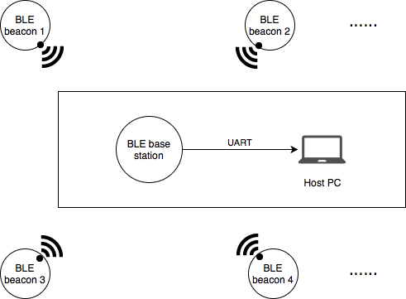
Introduction
We compare ANT and BLE protocols when used for indoor localization
Both are ultra low power consumption protocol
BLE:
Widely used
Peer-to-Peer, star
Notes:
We compare ANT and BLE when used for indoor localization.
They are both ultra low power consumption protocol
they support low-duty-cycle transmission and extremely low-power sleep modes
BLE is widely used. Most smart phone can scan ble device, without install ble service
but ble support peer to peer and star topology. in one

Slide 4
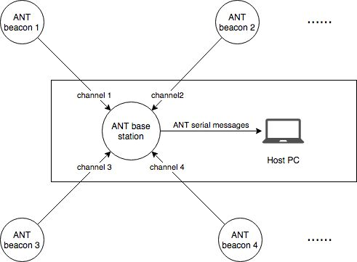
Introduction
ANT
Support all Types of topologies
Small payload
Channel based communication
Channel factors
Notes:
ANT is not as popular as BLE but it is commonly used in fitness domain. An increasing number of smartphone support ANT service. It includes all phones from Samsung XiaoMi and Oneplus.. There is a device support list in official website.
standard ANT message's payload 8 byte. extend msg payload : max.22 bytes
ANT topologies: Mesh, tree, star,
ANT communication depends on channel factors, like share or independent biddirection/one direction
In this picture, 4 ANT beacons, which is 4 master establish 4 independent channel.
The base station is slave. I‘ll expand it in next slide. We set all channel parameter to 0, so it can listen through all channels.
If we base station's channel parameter
same as beacon1, it will listen to beacon 1 and ignor all messages form beacon 2, 3 and 4.
( Why we don’t use only one share channel?
In one share channel one master is allowed.
And the master will listen to nodes 1 in on first channel peroid, node 2 on the second period….)

Slide 5
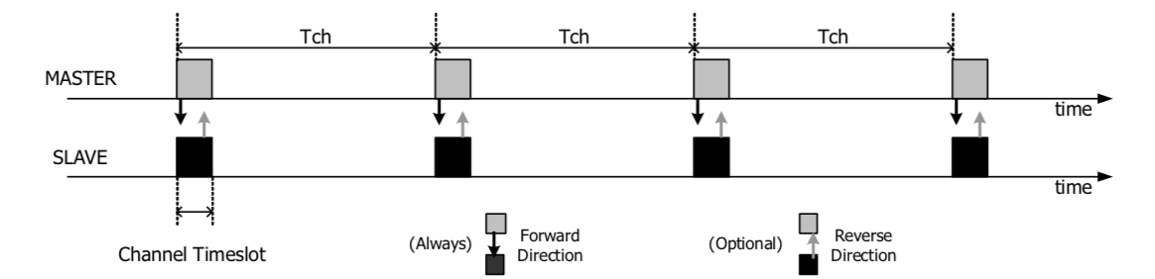
Introduction
ANT
Independent bidirectional channel
Beacons
Base station
Notes:
Master make search window to ensure the transmission not interfere with another device
a master device will always transmit a message on each channel timeslot
When using bidirectional channels, the master device it transmitted a message . keeps its radio receiver on for a short time after
if another master turn on, it will start transmit in other time (point out)
Bcz Master initialize make search window and master mainly send message, so we set beacons to Master and base station to slave

Slide 6
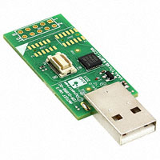
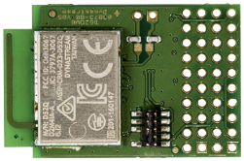
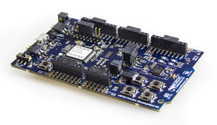
Hardware
Dynastream D52QM6 SoC modules
Based on Nordic nRF 52832 SoC
ARM Cortex M4 Microcontroller
Roles:
ANT /BLE beacons
ANT base station
nRF 52 DK
Development kit for the Nordic nRF52832 SoC
Segger J-Link Program/Debug supported
Role:
BLE base station
Notes:
In this pic we use two hardware:
The D52 SoC module and nRF52 Development kit. They are both base on Nordic nRF 52 SoC and ARM Cortex M4 Microcontroller.
This two hardware plays different roles.
When it used as beacons, it is connected to a battery board
when it used as base station, it is connected to PC through USB adpter
The nRF DK is BLE base station because the ble base station requires UART that USB adapter don‘t support
It is also used as a J-Link Programmer to flash the binary file to Soc

Slide 7
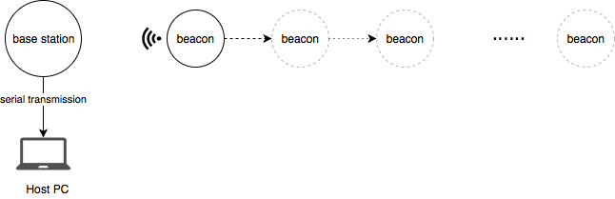
Experiments
Set up BLE network
Beacons – slave
Base station – master
Notes:
In this project, we set base station to observer and beacons are broadcaster, They never establish a connection.
Simple to implement
In locolization sys, beacon should be visible to different base station. It should allow many users to use this sys.
we make antennas pointed to each other, and place the beacon 20cm, measure 5min, and move it to 40cm, measure 5 min and so on. The max distance is 5m
The base station will measure the RSSI of RF signal and transfer it to PC through UART
Received signal strength indication

Slide 8
Experiments
Set up ANT network
Beacon – master
Base station - slave
Notes:
As we mentioned before,
Master initialize make search window to reduce interfering, and master mainly send message,
so we set beacons to Master and base station to slave
Move beacons to next pos. every 5 min

Slide 9
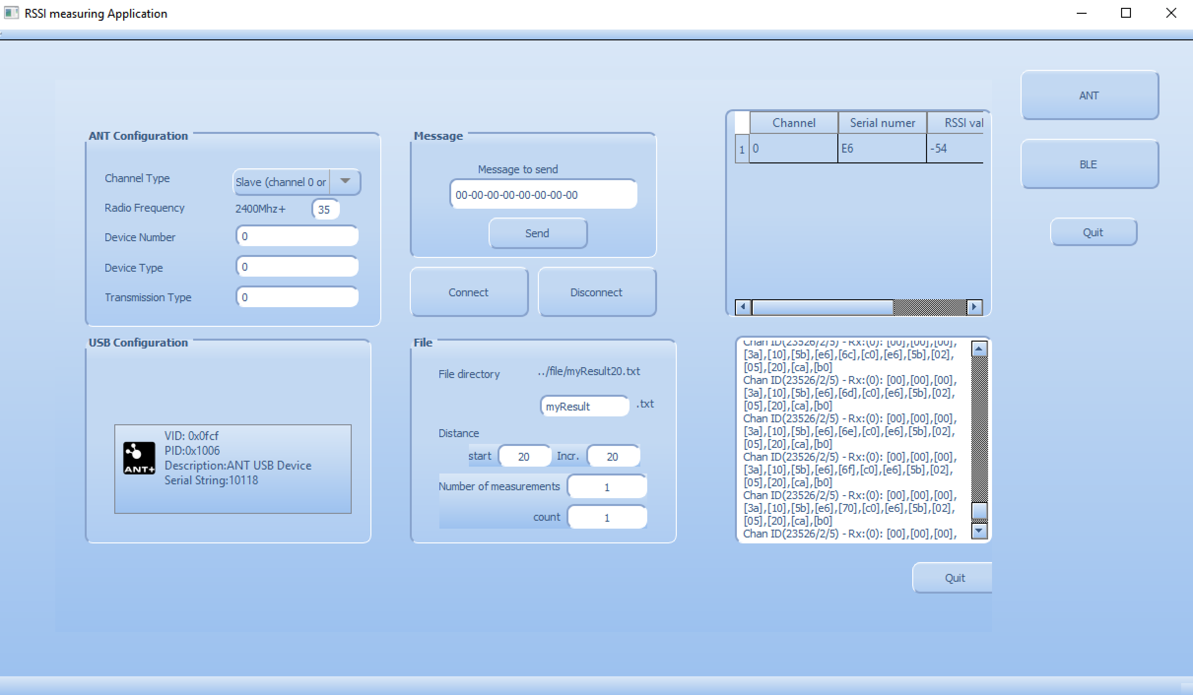
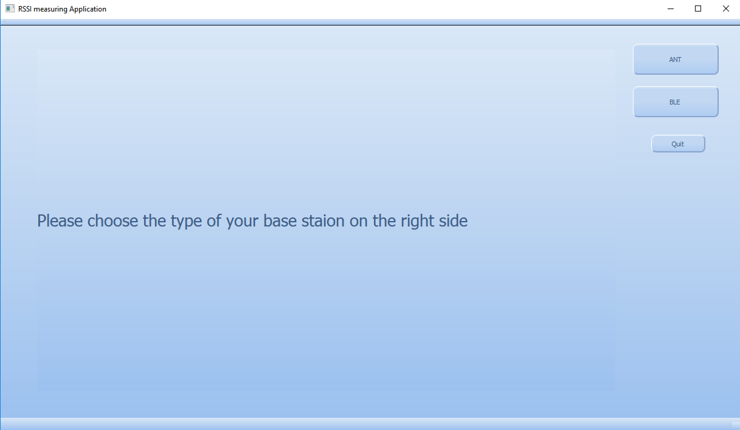
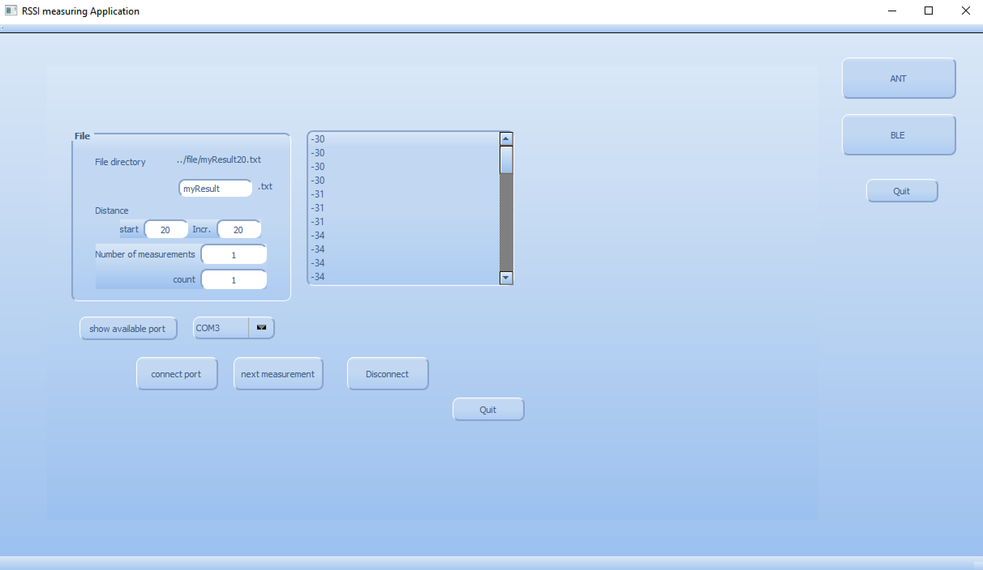
Experiments
Channel configuration
Receive RSSI value in Host PC
ANT
storage location
Received massage
BLE
Serial port configuration
Notes:
- channel config
- single/multi
- 4 channel factors
- File storage
- connect button
- textview print payload

Slide 10
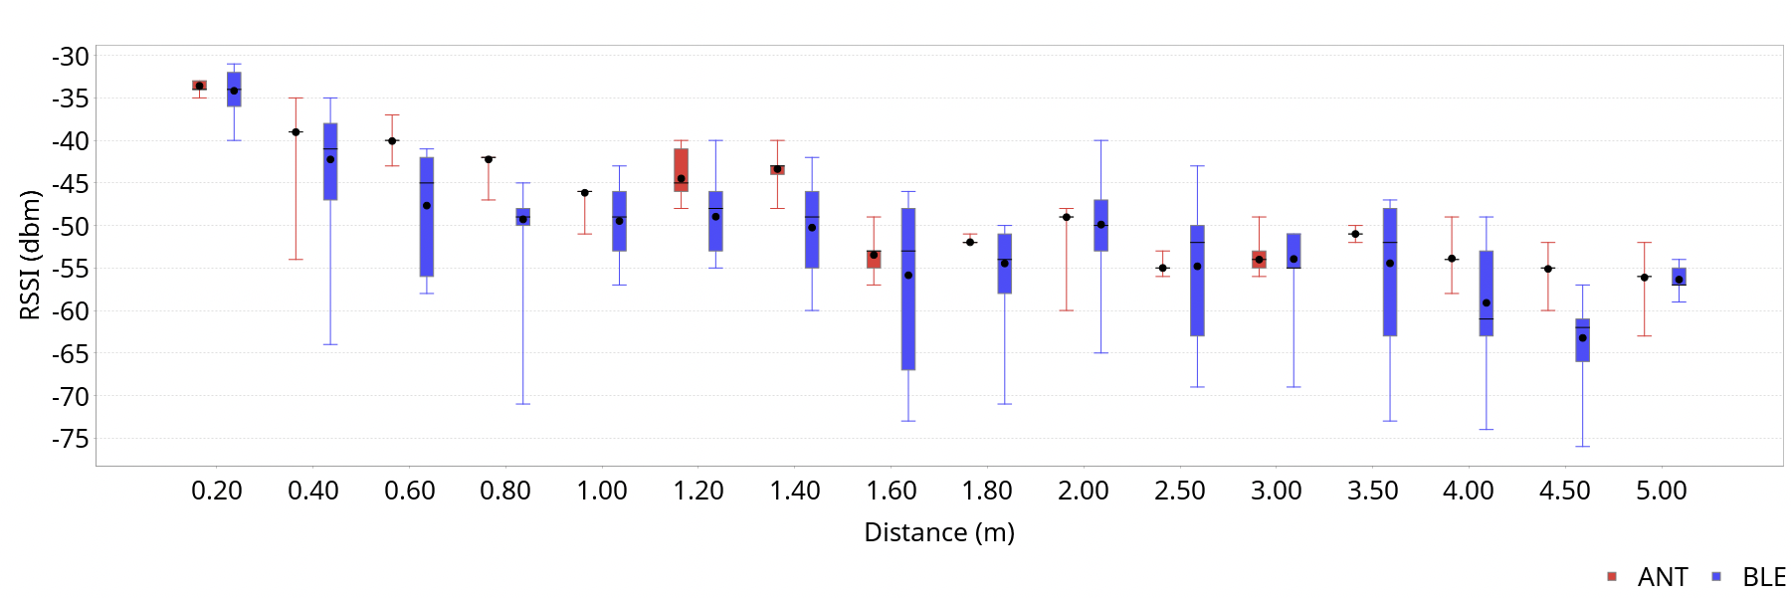
Result
RSSI distribution at Different distance
Notes:
- The boxes show the 25th and 75th percentile of the values.
The error bar shows the minimal and maximal value.
ANT measurement result is more concentrate.
- The black dot and the bar show the average and median values.
The RSSI value logarithmic drops, but it is clearly not perfect, because multi-pathpropagation of RF signals affect the result
ANT vs BLE
the RSSI values of ANT are more stable than BLE.

Slide 11
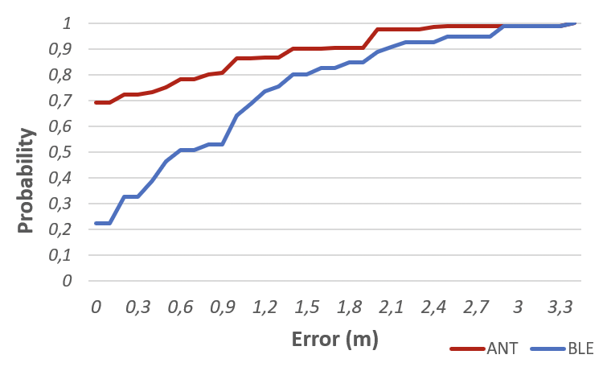
Result
ANT-based localization can clearly outperform BLE when using fingerprinting localization principle.
Notes:
We used a simple fingerprint argrisum based on RADAR [7].
We made 1000 measurements for each distance. the first 500 values are training set , last 500 is localization attempts. The resulting error distributionis depicted in Figure

Slide 12
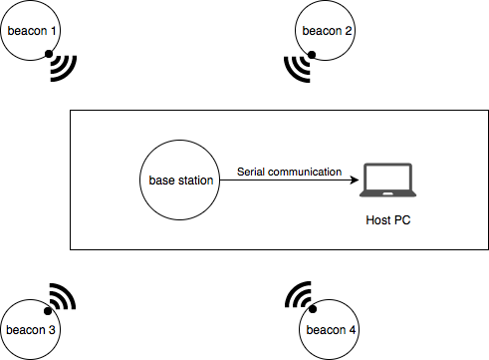
Future work
Experiment with different transmission power
Experiment with different device height
Experiment with different antenna orientation
Build localization system based on fingerprint principle

Slide 13
Thank you
Notes:
Thanks for Prof. Rasit‘s supervising and Dr. Marcus ‘s support on analysing data

